Slide 1
Adding functionality to a growth model; A tutorial on queries in GroImp
Basic plant.gsz
Adding function using queries

Slide 2
What is a query
A query specifies a pattern and at run-time it finds all instances of that pattern
m:Meristem ==> Internode [Leaf] m;
m:Meristem, (m.rank>Flowering) ==> Flower;
m:Meristem,(*p:Plantbase*),(p.flower) ==> Flower;
Plantbase is marked as context, meaning it is not altered by the code but must be present for the rule to match.

Slide 3
Basic plant.gsz
Simple growth model
Plantbase, Meristem, Leaf, Internode
Light model
Direct and Diffuse
Light interception by the plant
PAR, red, farred

Slide 4
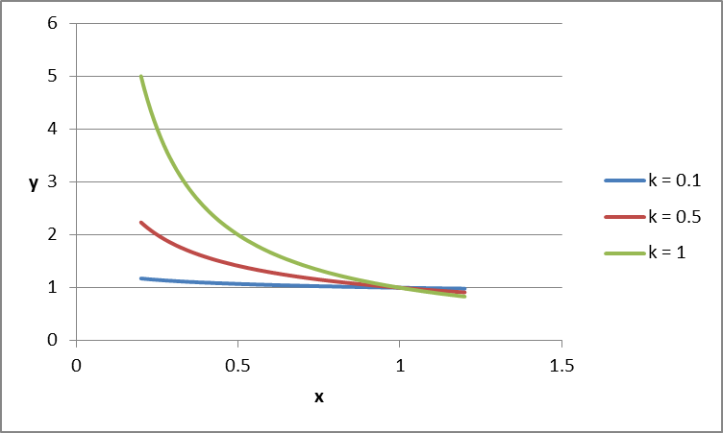
Leaf plasticity – Modules.rgg
Petiole length dependent on red/farred ratio (rfr)
$$y=a∗x^{−k}$$
module Leaf extends Organ {
void Plasticity() {
double a = 0.2;
double x = Math.max(0.1,rfr);
double k = 0.4;
fPet = Math.max(fPet, a*x**-k);
}

Slide 5
Leaf plasticity
Length/width ratio dependent on red/farred ratio (rfr)
$$y=a∗x^{−k}$$
void Plasticity() {
...
LW = lwRatio*x**-0.4;
}

Slide 6
Leaf plasticity
Implement the Plasticity() method
void update() {
Plasticity();
...
}
void update() {
//Plasticity();
...
}
To turn off leaf plasticity, simply add // to skip running the Plasticity() method

Slide 7
Testing the result of Leaf Plasticity
module Plantbase {
int ID
double sumabs;
void output() {
double L = sum((*l:Leaf, (l.ID==ID)*)[abs]);
sumabs += L;
}
Iteration target
Iteration expression
Query - Finds all instances of Leaf whose value of ID matches the ID of Plantbase
value

Slide 8
Aggregate methods - values
A query is a generator expression, an aggregate method is a consumer expression that takes a sequence of values as input and returns a single value.
sum() sum of listed values
prod() product of listed values
mean() mean of listed values
count() counts the number of listed values
max() returns the highest listed value
min() return the lowest listed value

Slide 9
Testing the result of Leaf Plasticity
module Plantbase {
...
void output() {
...
double pet = mean((*l:Leaf, (l.ID==ID)*)[PetLength]);
double lw = sum((*l:Leaf, (l.ID==ID)*)[length])/
sum((*l:Leaf, (l.ID==ID)*)[width]);
}

Slide 10
Testing the result of Leaf Plasticity
module Plantbase {
...
void output() {
...
println(“cumulative abs = “ + sumabs);
println(“mean pet length = “ + pet);
println(“mean lw ratio = “ + lw);
}

Slide 11
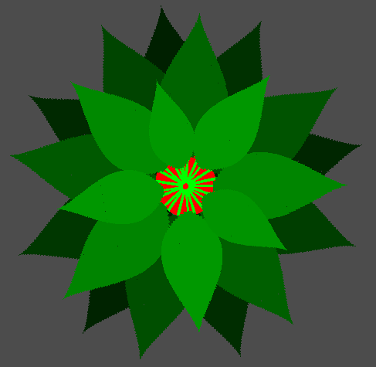
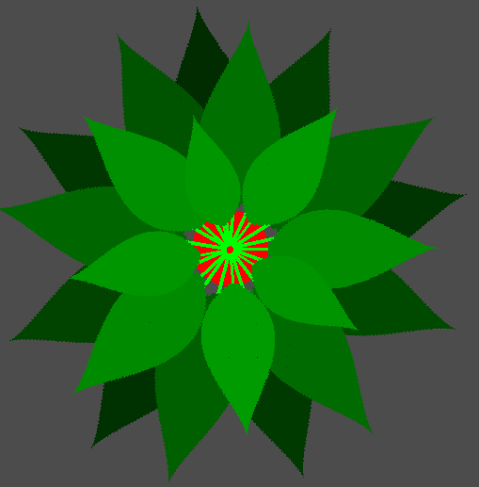
Testing the result of Leaf Plasticity
Run two 60 day simulations, one with and one without plasticity, and compare the output.
cumulative abs = 15204 cumulative abs = 16156
mean pet length = 0.089 mean pet length = 0.109
l/w ratio = 2.024 l/w ratio = 2.22

Slide 12
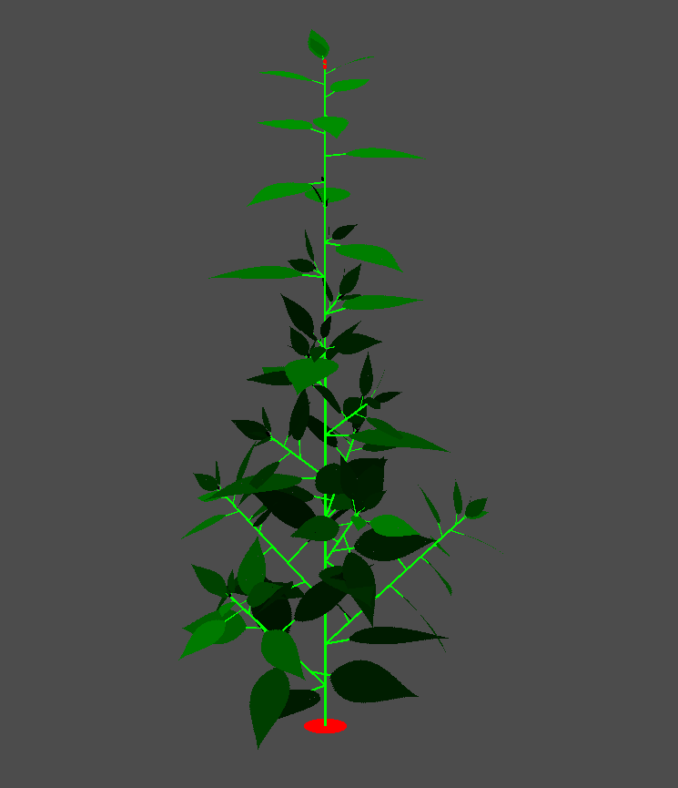
Branching plant
Parameters.rgg
...
const int MaxOrder = 1;
...
static double wmax_I = 0.2;
...

Slide 13
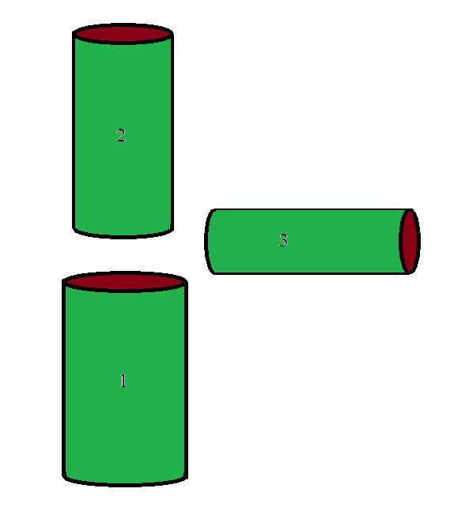
Pipe model
$$Area_{1}=Area_{2}+Area_{3}$$

Slide 14
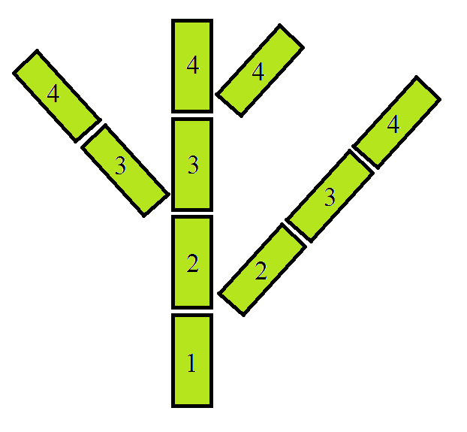
Pipe model
Each internode needs information from other internodes upwards in the plant architecture.
Internode rank

Slide 15
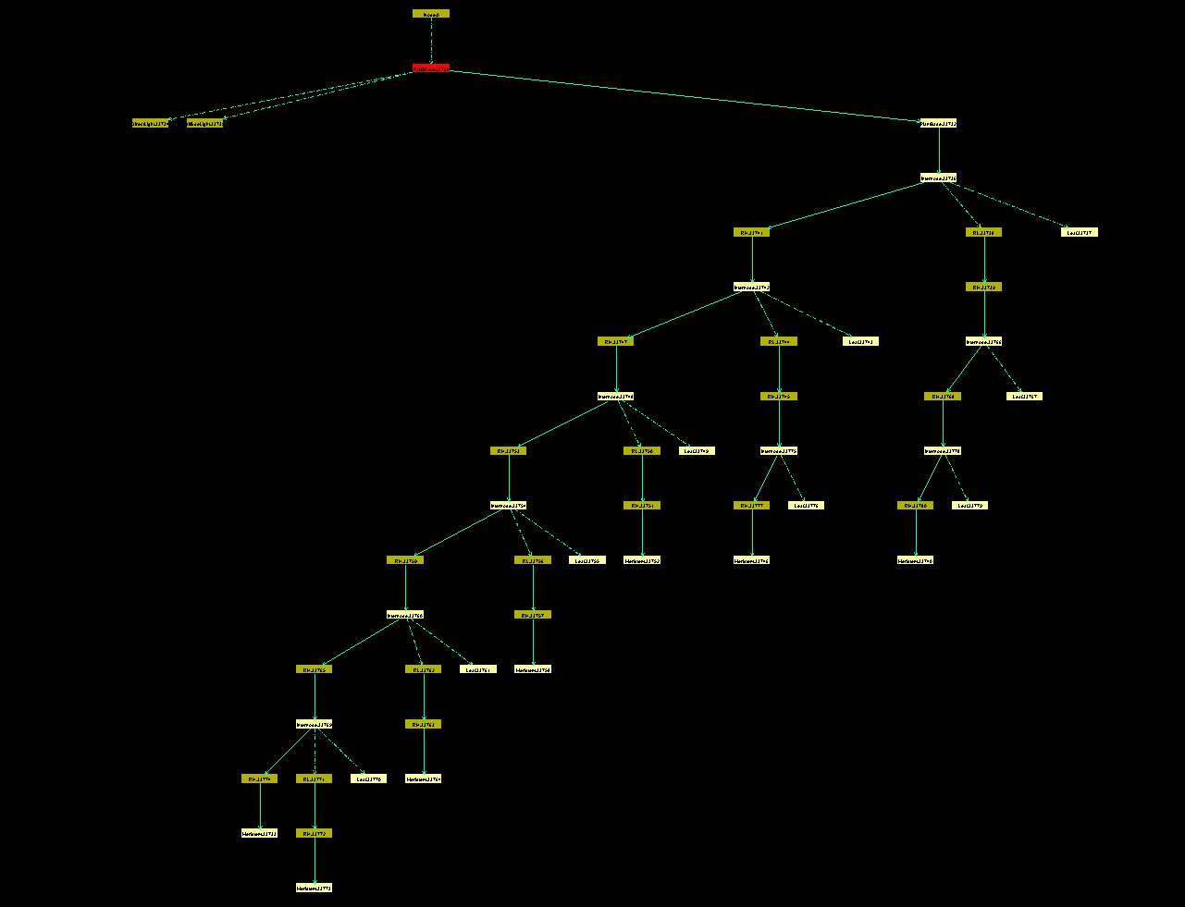
Graph
Panels -> 2D -> Graph
Nodes
Edges

Slide 16
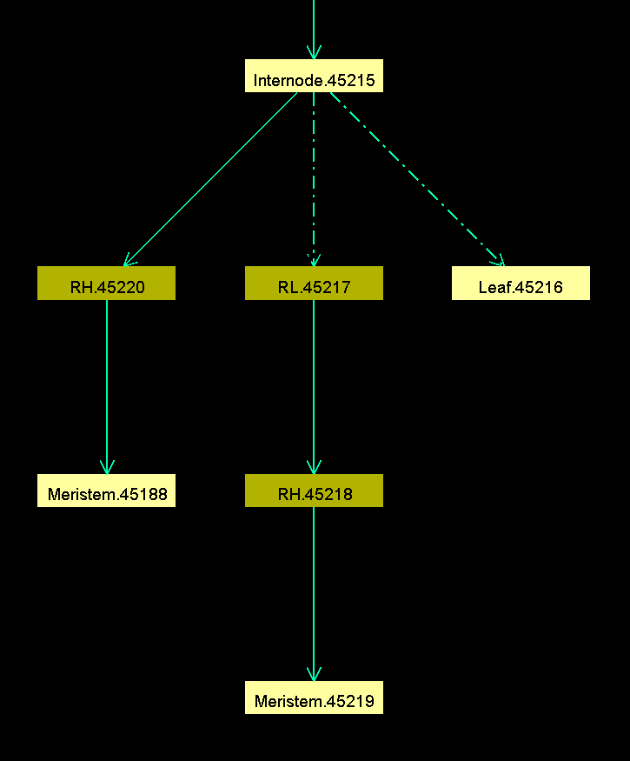
Graph – Develop.rgg
m:Meristem, (m.newPhytomerAllowed()) ==>
i:Internode.(length=0)
[ l:Leaf ]
if(m.order+1<=MaxOrder) (
[ RL() RH() am:Meristem ]
)
RH(137.5)
m.(rank++)
;

Slide 17
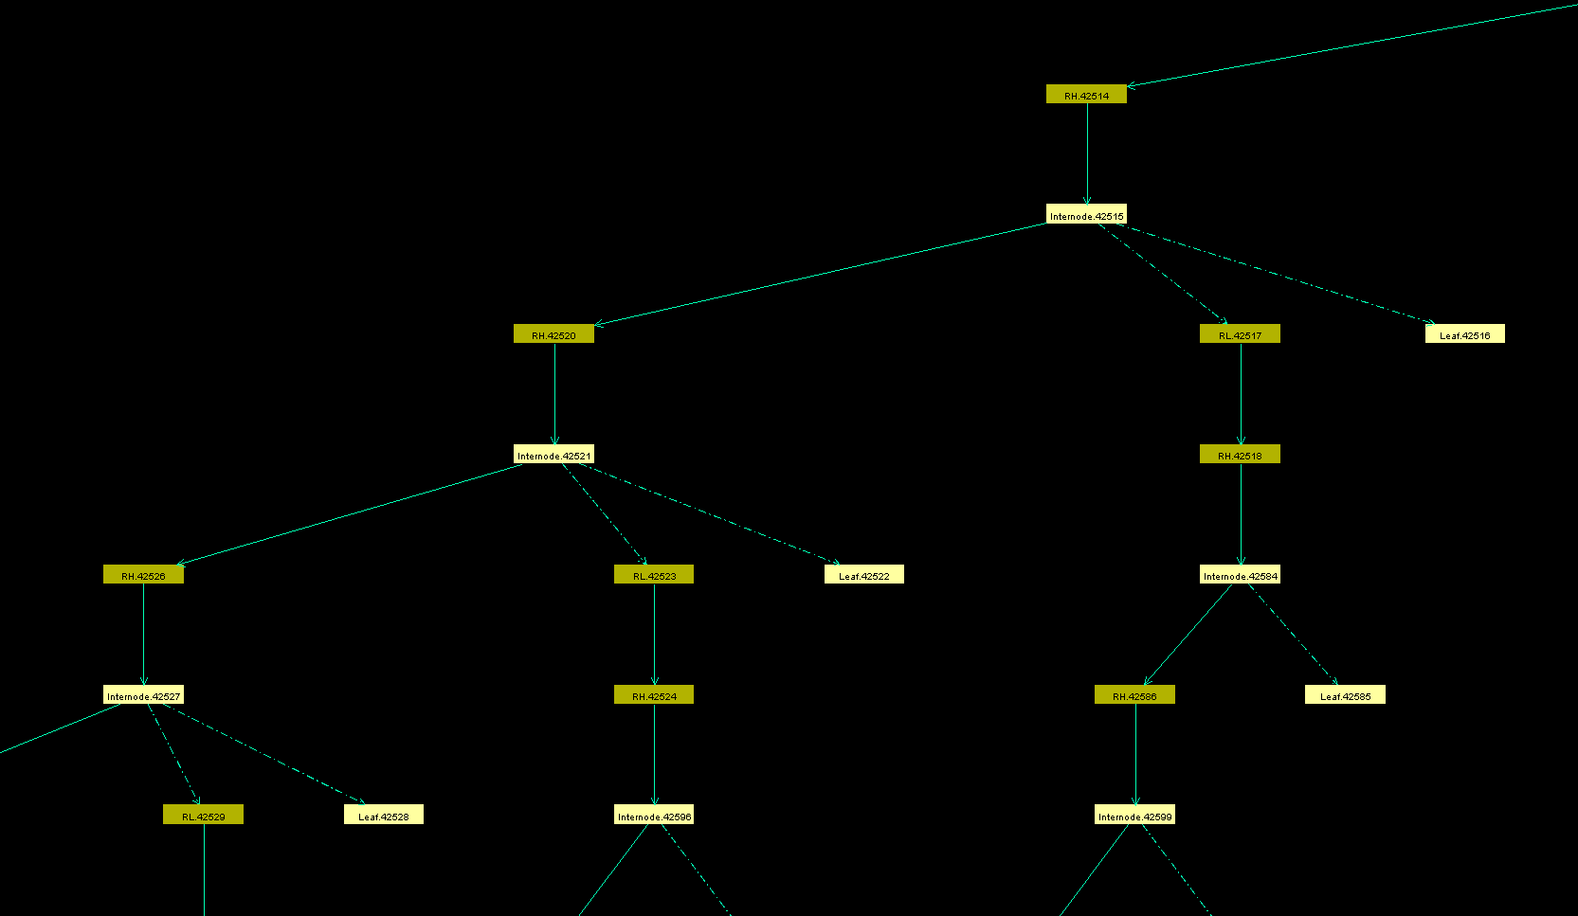
Graph

Slide 18
Edge notations
Edge type: Number of Edges:
--> Any Edge ()+ 1-n
> Successor Edge ()* 0-n
+> Branch Edge ()? 0-1
(){a} a
Direction: (){a,b} a-b
-- Any direction (){a,} a-n
<--> Both directions
--> Deeper into the graph (Away from the RGGRoot)
<-- Back up the graph (Towards the RGGRoot)

Slide 19
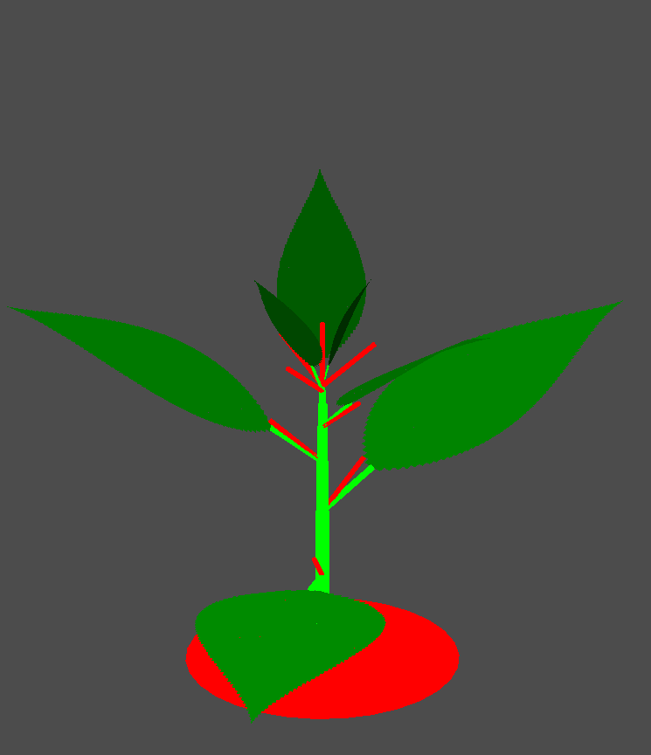
Constructing queries
Model.rgg
public void findMeristems() [
l:Leaf, m:Meristem, (isSelected(l)) ::> {
Shader S = RED;
m.length = 0.05;
m.S = S;
}
]
Remember: A query returns all instances of the specified pattern

Slide 20
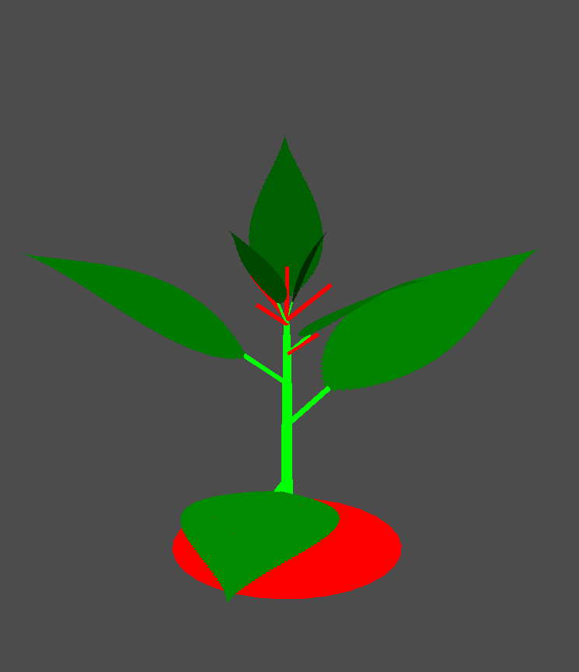
Constructing queries
Find all Meristems above the selected leaf, including its own axillary meristem
Find all meristems above the selected leaf, excluding its own axillary meristem
Find only the axillary meristem of the next leaf
Find only the apical meristem

Slide 21
Constructing queries
Find all Meristems above the selected leaf, including its own axillary meristem l:Leaf <+ (-->)+ m:Meristem, (isSelected(l)) ::>
Find all meristems above the selected leaf, excluding its own axillary meristem l:Leaf <+ > (-->)+ m:Meristem, (isSelected(l)) ::>

Slide 22
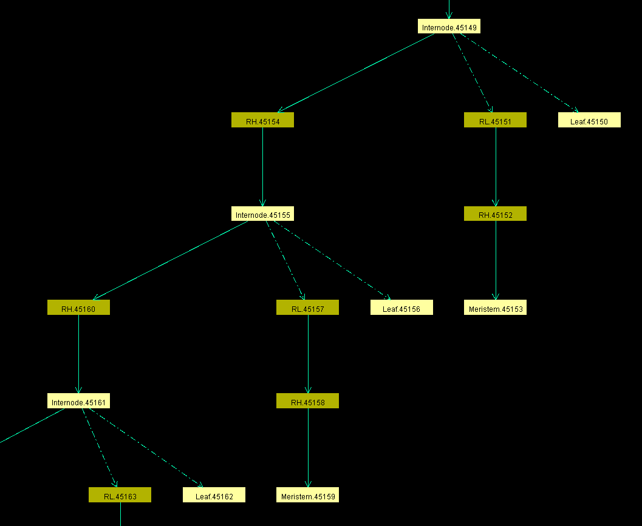
Constructing queries
Find only the axillary meristem of the next leaf l:Leaf <+ (>){2} +> (>)+ m:Meristem, (isSelected(l)) ::>

Slide 23
Constructing queries
Find only the apical meristem
Selected leaf is of order 0; l:Leaf <+ (>)+ m:Meristem, (isSelected(l))
Selected leaf is of order 1;
l:Leaf <+ (<)* <+ (>)+ m:Meristem, (isSelected(l))
l:Leaf, m:Meristem, (isSelected(l)&&l.ID==m.ID&&m.order==0)

Slide 24
Pipe model
module internode extends Organ {
...
double crossArea;
void PipeModel() {
double NrB = count((*this ...... Internode*)) +1;
crossArea = NrB * Math.PI * InitRadius**2;
radius = Math.sqrt(crossArea/Math.PI);
}
Make an edge pattern that finds all branches upwards in the architecture.
Apical Meristem
Edge pattern

Slide 25
Graph

Slide 26
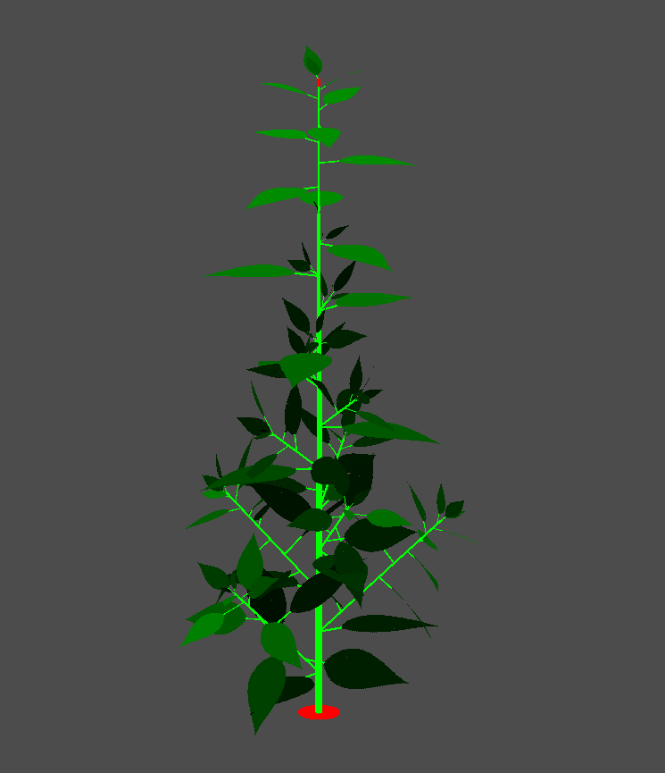
Branching plant
count((*this (-->)* +> (>){2} Internode*))

Slide 28
implementing queries in Modules.rgg
Modules.rgg
module Leaf extends Organ {
void findMeristem [
this <+ (>)+ m:Meristem ::> {
Shader S = RED;
m.length = 0.05;
m.S = S;
}
]

Slide 29
Aggregate methods - Object
Some aggregate methods take a sequence of objects (nodes) as input and return a single object.
first() the first object in the sequence
last() the last object in the sequence
empty() returns true if the sequence is empty
selectWhere()
selectWhereMin()
selectWhereMax()
selectRandomly()

Slide 30
Aggregate methods - Object
selectWhere((*...*),Logical_Statement)
selectWhere((*a:A*),a.rank==1)
selectWhereMax ((*...*),value), selectWhereMin()
selectWhereMax((*a:A*),a.rank)
selectRandomly((*...*),probability)
selectRandomly ((*a:A*),1)
selectRandomly ((*a:A*),a.rank)
selectRandomly ((*a:A, (a.order>0)*),a.rank)

Slide 31
implementing queries in Modules.rgg
Modules.rgg
Module Leaf extends Organ {
void findMeristem {
Meristem m = last((* this <+ (<--)* (>)+ M:Meristem, (M.ID==ID)*));
Shader S = RED;
m.length = 0.05;
m.S = S;
}
Note the [ bracket is now a {

