Slide 1


Functional-Structural Plant Models
Summer semester 2026 -
Winfried Kurth and Tim Oberländer
University of Göttingen
Chair of Computer Graphics and Ecoinformatics
6th Lecture: 4 June, 2026

Slide 2
From our last lecture:
Using imperative code in XL programs
Loops and arrays in branch constructions
Textures

Slide 3
Today:
Projects in GroIMP (.gsz files)
stochastic L-systems
context sensitive L-systems
a new rule type: interpretation rules

Slide 4
Projects in GroIMP
Saving an entire project (XL code and texture files):
File → Save, give name of the Project (does not have to match the name of the RGG program). Photo data will be saved.
Project data will have a name ending with .gsz (readable with a data compression program, e.g., WinZIP)
Example:
sm09_e10.gsz Use of a leaf texture

Slide 5
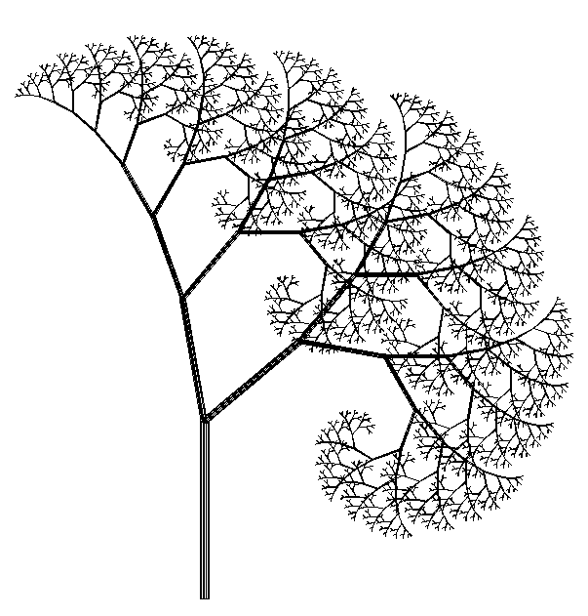
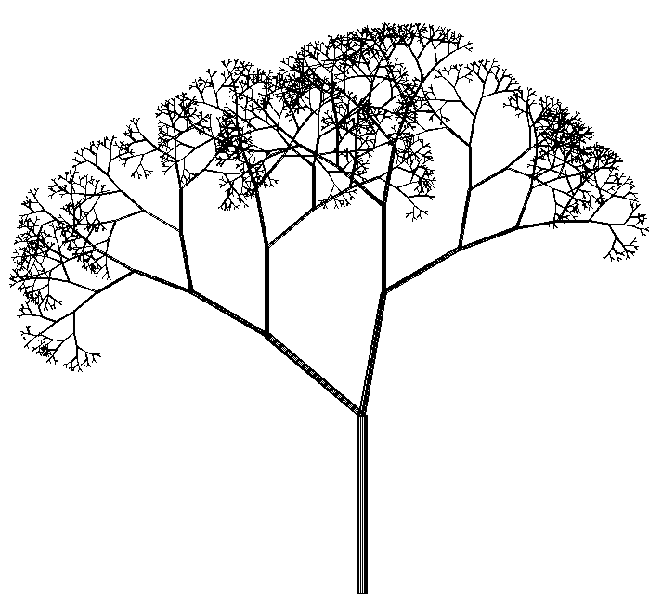
Stochastic L-Systems
Use of pseudo-random numbers
Example:
deterministic stochastic
Axiom ==> L(100) D(5) A;
A ==> F0 LMul(0.7) DMul(0.7)
[ RU(50) A ] [ RU(-10) A ];
Axiom ==> L(100) D(5) A;
A ==> F0 LMul(0.7) DMul(0.7)
if (probability(0.5))
( [ RU(50) A ] [ RU(-10) A ] )
else
( [ RU(-50) A ] [ RU(10) A ] );

Slide 6
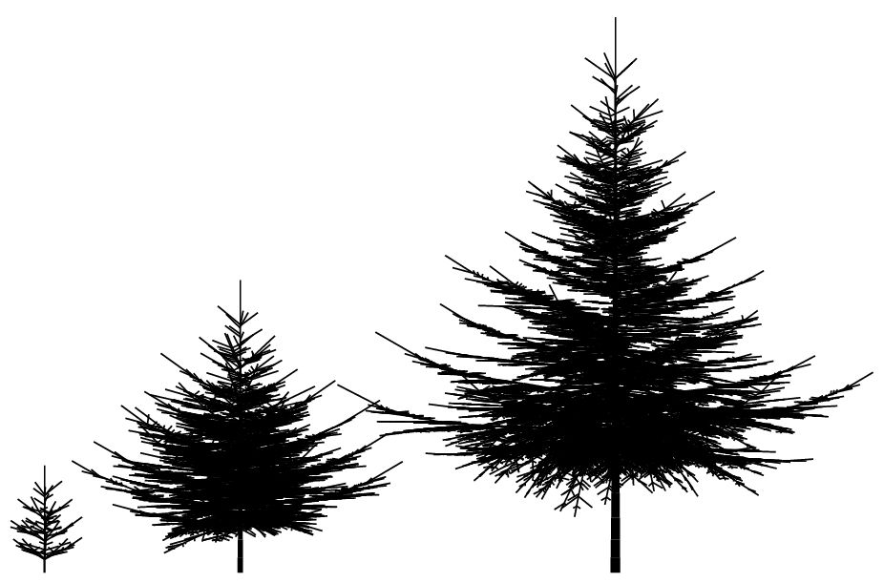
Example:
Spruce model in 3D
generated with L-system

Slide 7
XL functions for pseudo-random numbers
probability (x)
returns 1 with probability x, 0 with probability 1-x
random (a, b)
generates evenly distributed floating point random numbers between a and b
irandom (a, b)
generates evenly distributed integer random numbers between a and b
normal (m, s)
generates normally distributed floating-point random numbers with mean m and standard deviation s
setSeed (n)
sets a starting value for the random number generator (to generate identical sequences of pseudo-random numbers)
Math.random ()
Generates evenly distributed floating-point random numbers between 0 and 1
distribution (v) with vector v
returns whole integer random numbers with probability v[0] for 0, v[1] for 1, ...

Slide 8
Try the example
sm09_e19.rgg
Stochastic L-System
(different variants of the use of random variables)

Slide 9
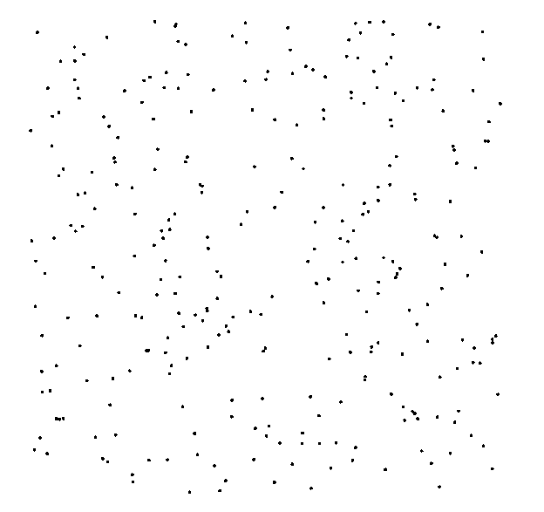
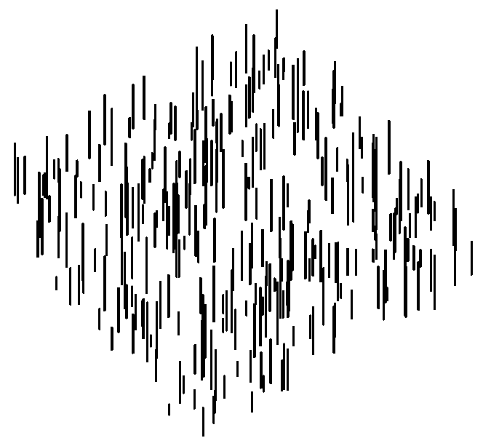
Generation of a random distribution in a plane
Axiom ==> D(0.5) for ((1:300))
( [ Translate(random(0, 100), random(0, 100), 0)
F(random(5, 30)) ] );
View from above Diagonally from the side

Slide 10
Try the examples
sm09_e23.rgg Dispersal model (1 species)
sm09_e24.rgg Dispersal model (2 species)
In these examples the competition is not yet taken into account
It is also shown how population densities can be plotted during the simulation runtime, in charts

Slide 11
Context-sensitive L-systems
Query a context that must exist for a rule to be applicable
in XL: context specification in (* .... *)

Slide 12
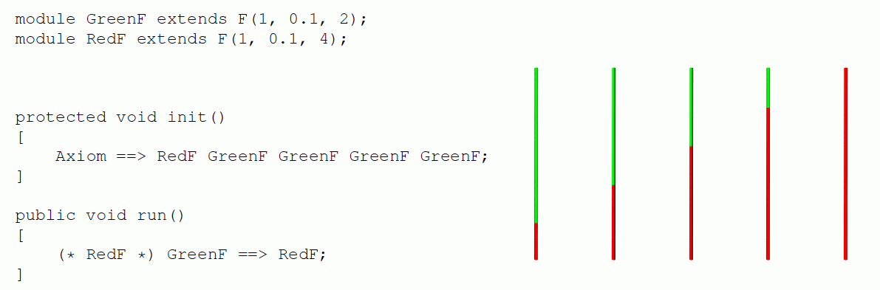
Context-sensitive L-systems
Example of using left-sided context:
another example of left context:
sm09_e14.rgg

Slide 13
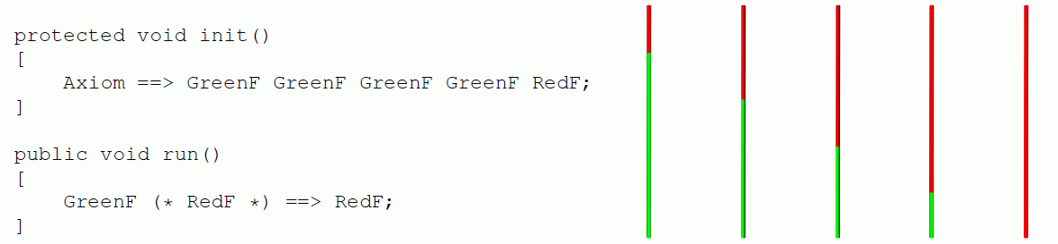
Context-sensitive L-systems
Example of using right-sided context:
another example of right context:
sm09_e15.rgg

Slide 14
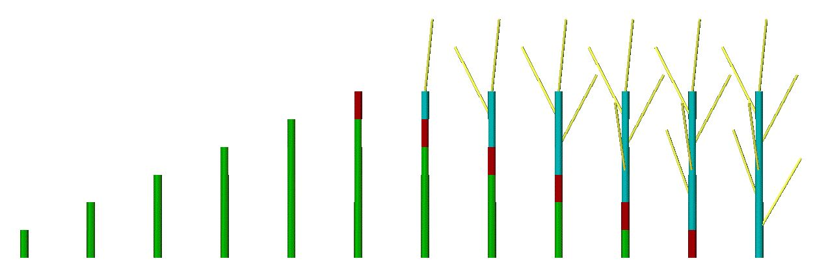
Right context
installation in a model for signal-controlled triggering of lateral shoot formation
module A(int age);
module B(super.length, super.color) extends F(length, 3, color);
Axiom ==> A(0);
A(t), (t < 5) ==> B(10, 2) A(t+1); // 2 = green
A(t), (t == 5) ==> B(10, 4); // 4 = red
B(s, 2) (* B(r, 4) *) ==> B(s, 4);
B(s, 4) ==> B(s, 3) [ RH(random(0, 360)) RU(30) F(30, 1, 14) ]; // 3 = blue

Slide 15
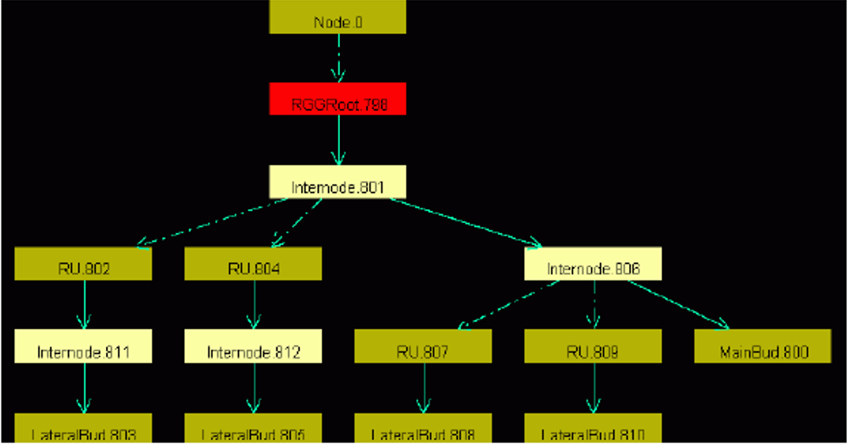
Insertion:
Graph View
GroIMP always carries a graph with it, which contains all the current structure information.
this is transformed by applying the rules
the graph can be displayed completely in the 2D graph view
GroIMP: Panels > 2D > Graph
(the 2D graph view can be anchored with
the mouse in the GroIMP user interface)
Graph > Layout
Graph > View > Redraw

Slide 16
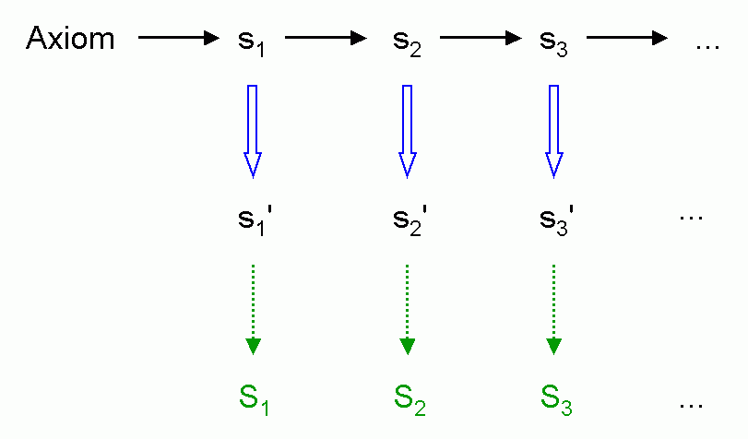
Interpretation rules
Installation of a further rule application immediately before graphic interpretation (without effect on the next generation)
Interpretation rule application
Interpretation by turtle

Slide 17
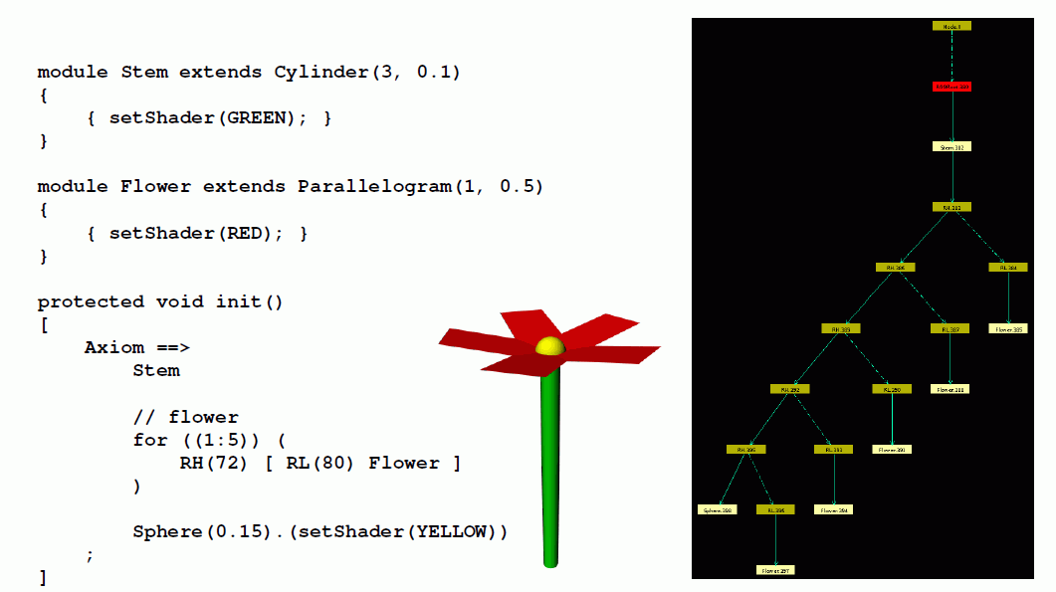
Ordinary geometric interpretation (without interpretation rules)

Slide 18
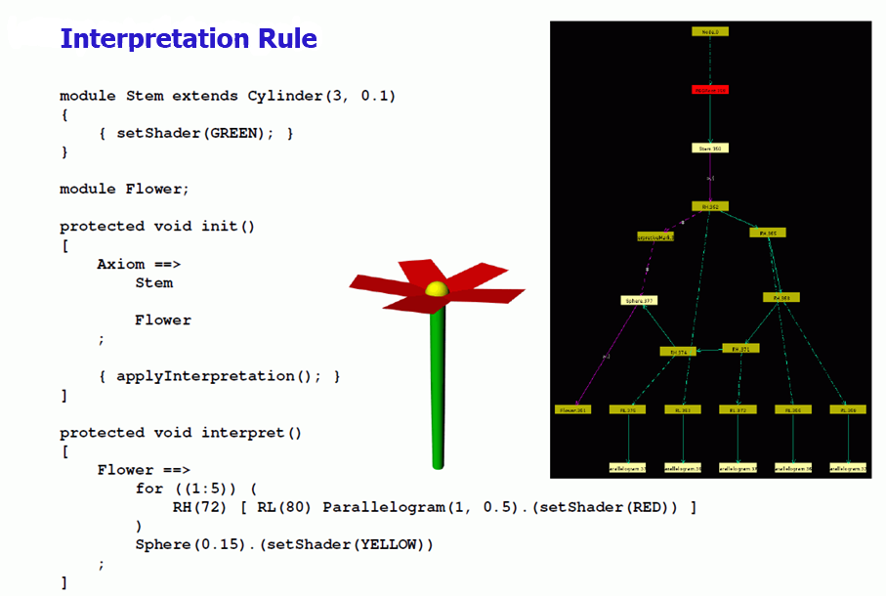
With the use of interpretation rules

Slide 19
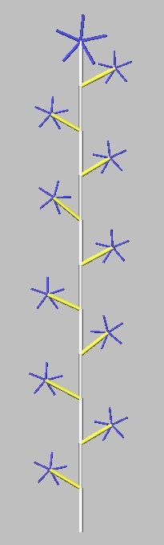
Another example
module MainBud(int x) extends Sphere(3) {{setShader(GREEN);}};
module LBud extends Sphere(2) {{setShader(RED);}};
module LMeris;
module AMeris;
module Flower;
const float d = 30;
const float crit_dist = 21;
protected void init()
[ Axiom ==> MainBud(10); ]
public void run()
{ [
MainBud(x) ==> F(20, 2, 15) if (x > 0)
( RH(180) [ LMeris ] MainBud(x-1) )
else
( AMeris );
LMeris ==> RU(random(50, 70)) F(random(15, 18), 2, 14) LBud;
LBud ==> RL(90) [ Flower ];
AMeris ==> Scale(1.5) RL(90) Flower; /* Flower: here only a symbol */
]
applyInterpretation(); /* Call for the execution of interpretation rules
(in imperative section { ... } !) */
}
protected void interpret() /* Block with interpretation rules */
[
Flower ==> RH(30) for ((1:5))
( RH(72) [ RL(80) F(8, 1, 9) ] );
]

Slide 20
Yet another example
public void run()
{
[
Axiom ==> A;
A ==> Scale(0.3333) for (int i:(-1:1))
for (int j:(-1:1))
if ((i+1)*(j+1) != 1)
( [ Translate(i, j, 0) A ] );
]
applyInterpretation();
}
public void interpret()
[
A ==> Box;
]
creates the so-called "Menger Sponge" (a fractal)

Slide 21
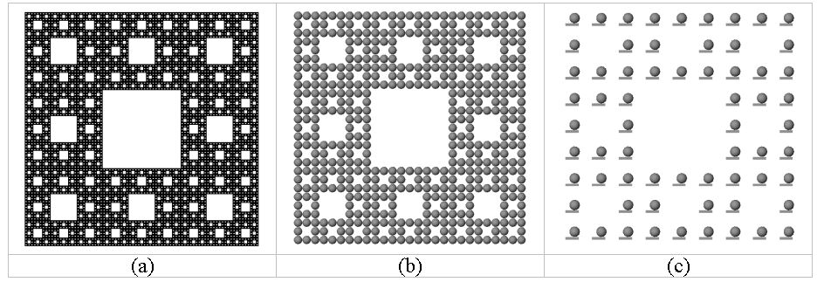
public void run()
{ [
Axiom ==> A;
A ==> Scale(0.3333) for (int i:(-1:1))
for (int j:(-1:1))
if ((i+1)*(j+1) != 1)
( [ Translate(i, j, 0) A ] );
]
applyInterpretation();
}
public void interpret()
[
A ==> Box;
]
(a)
(b)
(c)
A ==> Box(0.1, 0.5, 0.1)
Translate(0.1, 0.25, 0) Sphere(0.2);
A ==> Sphere(0.5);

Slide 22
What does this example create?
public void run()
{
[
Axiom ==> [ A(0, 0.5) D(0.7) F(60) ] A(0, 6) F(100);
A(t, speed) ==> A(t+1, speed);
]
applyInterpretation();
}
public void interpret()
[
A(t, speed) ==> RU(speed*t);
]

