Slide 1


Functional-Structural Plant Models
Summer semester 2026 -
Winfried Kurth and Tim Oberländer
University of Göttingen
Chair of Computer Graphics and Ecoinformatics
About the measurements on 18+22 May, 2026

Slide 2
Morphological measurements, 18 and 22 May, 2026 (10:00 a.m. s.t., Büsgenweg 4, room CIP-III)
Please bring the following:
Smartphone or camera
Coloured pencils
Ruler, protractor (if available)
Small adhesive labels (if available), alternatively “Tesafilm”
Notebook / Tablet to enter data in dtd format
2 or 3 groups will work simultaneously
manual morphology / FASTRAK digitizer

Slide 3
Objects of investigation:
Young plants of spruce (provided by us)
Before the detailed measurements:
Give the tree an ID name (name tag!)
check for special features
define reference direction (in pot)
photograph the tree from several sides (with reference direction and name tag)
record measured variables related to the entire tree

Slide 4
Measurement quantities related to the entire tree:
Height
Diameter at the base
Number of lateral branches of 1st order
Date of measurement
Units of measurement:
for lengths and diameters: mm
for angles: degrees

Slide 5
Preparation of the topological and geometrical detail survey of the tree:
Finding the annual shoot limits (shoot base scars), as far as possible!
Numbering of annual shoots.
For side branches: number further within each side branch
Topological sketch of the entire tree with all annual shoots on a large drawing sheet (use several sheets if necessary - provide enough space for length and angle information!)

Slide 6
Geometric detail measurements:
Lengths of annual shoots: accurate to mm
Diameter of shoots: accurate to 1/10 mm; measured in the middle.
Angle: accurate to 5° (azimuth angle: 10°); measurement between continued direction of the mother shoot and direction of the measured shoot

Slide 7
To analyze the measured data
dtd-Data:
upload in GroIMP - check for visual plausibility
First analyses: Creation of tables with GroIMP (elementary analysis; lengths and angles); also possible with queries from the GroIMP console
Statistical evaluation of tables (R or Excel) (see description on Grogra-CD, to be adapted)
Targets: Progression of morphological quantities along the axes and during branching; correlation and regression analysis of the quantities among each other; mean values and standard deviations

Slide 8
How to upload dtd-Data in GroIMP
File / Open > choose dtd-Data > Open
Branching structure appears in the 3D view
Change camera settings if necessary
Modify the file and save
  modification becomes visible on the display

Slide 9
Checking for consistency of the dtd file:
Optical control
- pay special attention to the base shoot, are there
more (too many) shoots at the base?
- Checking the age count:
- Grogra analysis option F
- 5th column of the generated table: is age 0 too rare?

Slide 10
Simple analyses
some features were taken from the predecessor software GROGRA
Panels > RGG Panels > GROGRA functions > Analysis
There you can find:
- list of all shoots (generates complete list)
- elementary analysis
- basic tree parameters
- topological analysis (more on this later)

Slide 11
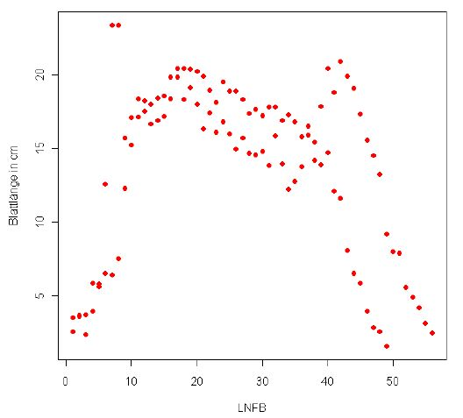
Example for statistical analysis
Trend for leaf length along the main tree trunk for Poplar
(assignment results from René Degenhard, 2008)

Slide 12
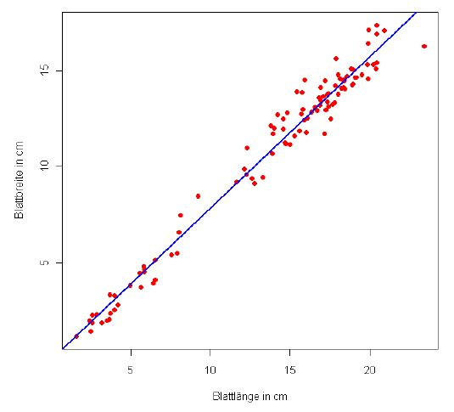
Correlation between leaf length and width for Poplar
(assignment results from René Degenhard, 2008)
The analysis of the data will be part of the assignment and will not be elaborated here any further.

