Slide 1
Functional-Structural Plant Models
Summer semester 2024 -
Winfried Kurth
University of Göttingen
Chair of Computer Graphics and Ecoinformatics
12th Lecture: 11 July, 2024

Slide 2
From our last lecture:
Simple functional-structural plant model
(first steps)
GroIMP’s integrated light model
task of the term paper, evaluation criteria

Slide 3
On our next slides:
Simple functional-structural plant model
(further, more refined versions)
modelling leaf growth
measurement and visualization of shadow
on the ground
photosynthesis model
modelling of transport processes

Slide 4
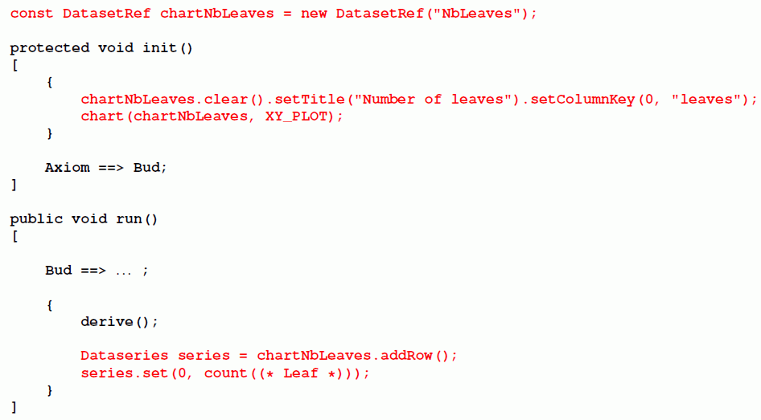
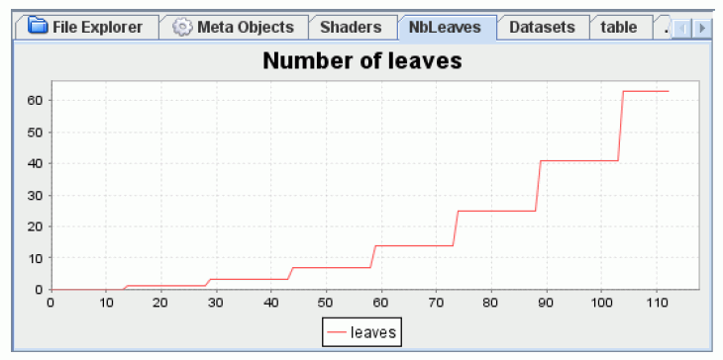
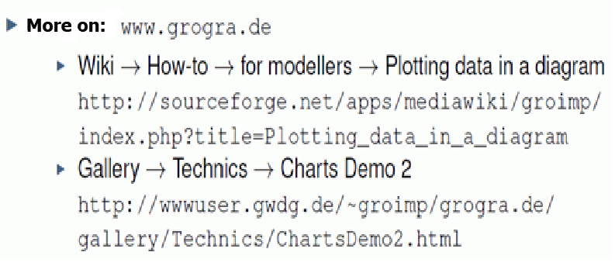
Plotting charts
(repetition, compare dispersal models – examples 23 und 24)

Slide 5
Leaf growth using logistic function

Slide 6
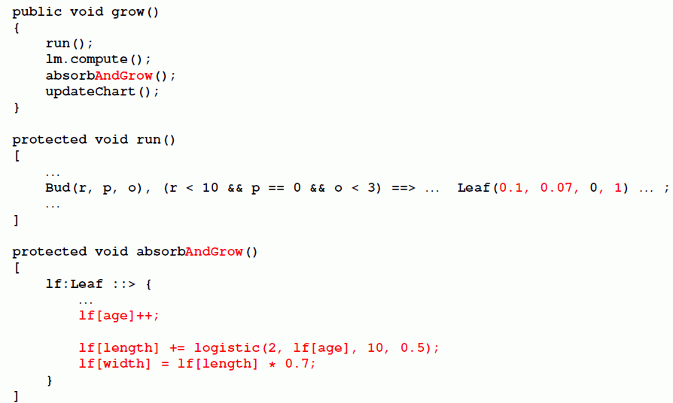
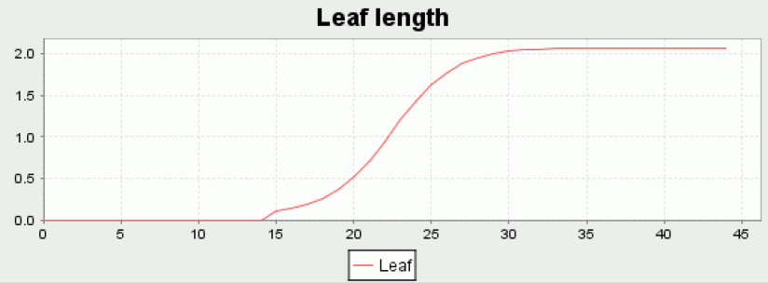
Leaf growth using logistic function (application)

Slide 7
Leaf growth using logistic function
Plotting of absorbed light (only new parts of the model) sfspm06.gsz
/* the leaf is modelled as a 3-d box now and gets new parameters: */
module Leaf(super.length, super.width, float al, int age)
extends Box(length, width, 0.01)
{{ setShader(new AlgorithmSwitchShader(new RGBAShader(0, 1, 0), GREEN)); }};
// ............
/* Introducing leaf growth: */
/* derivative of logistic function */
public float logistic(float maxdim, int time, float phylloM, float slope)
{
return (slope * maxdim * Math.exp(-slope*(time-phylloM))) /
((Math.exp(-slope*(time-phylloM))+1)**2);
}
/* Table for absorbed light values: */
const DatasetRef lightdata = new DatasetRef("Light intercepted by canopy");
protected void init()
[
{
lightdata.clear(); /* the chart is initialized */
chart(lightdata, XY_PLOT);
}
Axiom ==> Bud(1, phyllo, 0);
==> ^ M(50) RU(180) MyLight; /* Light source is placed above the scene */
]

Slide 8
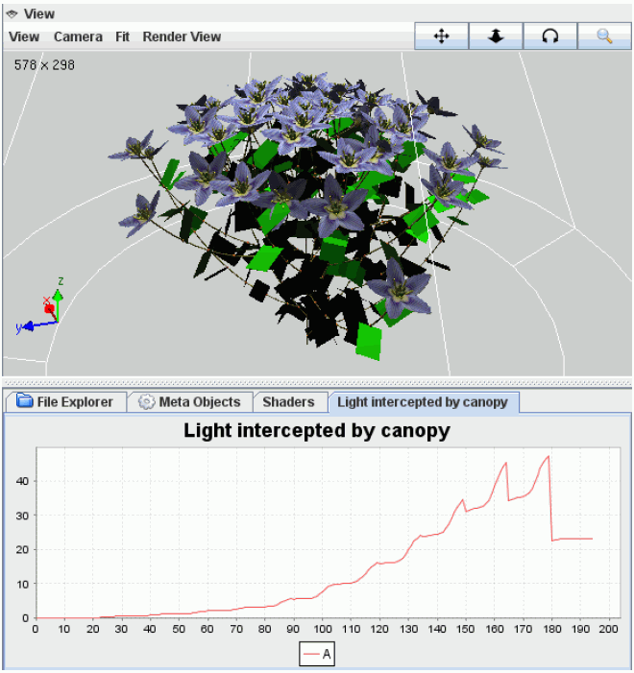
Leaf growth using logistic function
Plotting of absorbed light (only new parts of the model, continued)
sfspm06.gsz:
public void grow()
{
run();
lm.compute();
absorb_and_growleaf();
lightdata.addRow().set(0, sum((* Leaf *)[al]));
}
protected void run()
[
Bud(r, p, o), (p>0) ==> ...........
// further rules....
]
protected void absorb_and_growleaf()
[
lf:Leaf ::>
{
lf[al] = lm.getAbsorbedPower3d(lf).integrate();
lf.(setShader(new AlgorithmSwitchShader(
new RGBAShader((float) lf[al]/5.0, (float) lf[al]*2, (float) lf[al]/100.0),
GREEN)));
println(lf[al]);
lf[age]++; /* the leaf is ageing */
lf[length] += logistic(2, lf[age], 10, 0.5); /* logistic growth */
lf[width] = lf[length]*0.7;
}
]

Slide 9
protected void absorb_and_growleaf()
[
lf:Leaf ::>
{
lf[al] = lm.getAbsorbedPower3d(lf).integrate();
/* without factor 2.25;
this factor would convert from global radiation [W/m2]
into photosynthetically active radiation [umol phot./m2] */
lf.(setShader(new AlgorithmSwitchShader(
new RGBAShader((float) lf[al]/5.0, (float) lf[al]*2,
(float) lf[al]/100.0), GREEN)));
println(lf[al]);
lf[age]++; /* the leaf is ageing */
lf[length] += logistic(2, lf[age], 10, 0.5);
/* logistic growth */
lf[width] = lf[length]*0.7;
}
]

Slide 10
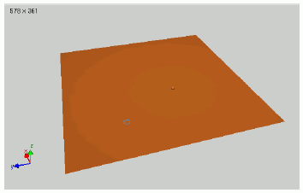
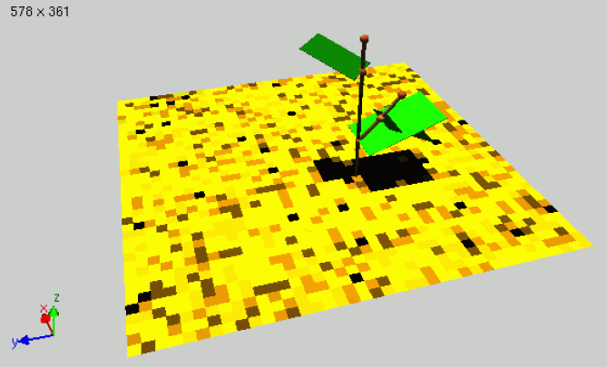
Determination of the light arriving at the soil
sfspm07.gsz: (only new parts of the model)
// .....
/* a single tile (will be positioned on the ground): */
module Tile(float len, float wid) extends Parallelogram(len, wid)
{ float al; };
// .....
protected void init()
[
{
lightdata.clear(); /* the chart is initialized */
chart(lightdata, XY_PLOT);
}
Axiom ==> [ RL(90) M(4) RU(90) M(-4) for ((1:40)) /* paving the ground */
( for ((1:40))
( Tile(0.25, 0.25).(setShader(new RGBAShader(0.6, 0.3, 0.1))) )
M(-10) RU(90) M(0.25) RU(-90)
) ]
Bud(1, phyllo, 0);
==> ^ M(50) RU(180) MyLight; /* Light source is placed above the scene */
]
// .....
protected void absorb_and_grow()
[
lf:Leaf ::> ......
p:Tile ::>
{
p[al] = lm.getAbsorbedPower3d(p).integrate();
println(p[al]);
p.(setShader(new AlgorithmSwitchShader(new RGBAShader(
p[al]*300, p[al]*200, p[al]), new RGBAShader(0.6, 0.3, 0.1))));
}
]

Slide 11
Most simple model of photosynthesis
Assumption of a linear relationship between the absorbed light and the amount of assimilates produced in the leaf
- conversion factor CONV_FACTOR
- Leaf gets new property “as” (produced amount of assimilates)
sfspm08.gsz: use of the linear photosynthesis model
(only new parts of the model)
// .....
const float CONV_FACTOR = 0.2; /* conversion factor light->assimilates */
// .....
protected void absorb_and_grow()
[
lf:Leaf ::>
{
lf[al] = lm.getAbsorbedPower3d(lf).integrate();
// ...................
lf[as] = lf[al] * CONV_FACTOR; /* amount of assimilates */
float lfas = sum((* Leaf *)[as]); /* ... of all leaves */
if (lfas > 0) /* dependency of growth on availability of assimilates */
{
lf[length] += logistic(2, lf[age], 10, 0.5); /* logistic growth */
}
lf[width] = lf[length]*0.7;
}
itn:Internode ::> // ......
]

Slide 12
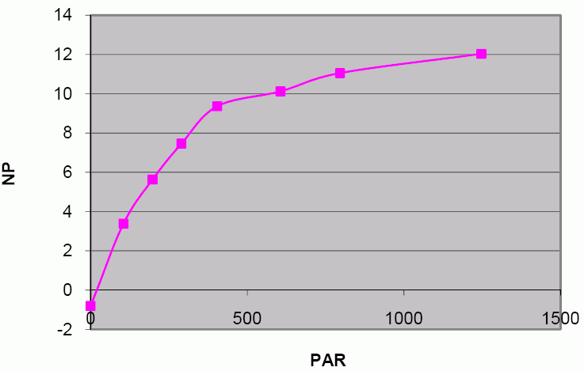
Inclusion of a more realistic (non-linear) model of photosynthesis
(see short script on photosynthesis modelling: photosyn_modell.pdf )
CO₂-exchange rate (carbon dioxide exchange rate, CER) - saturation curve in dependence of photon flux density (ppfd) according to:
mit RD = dark respiration
PE = photosynthetic efficiency
F_{max} = maximal photosynthesis
Units:
CER, ppfd, RD, Fmax : μmol ⋅ m⁻²⋅ s⁻¹ ; PE : dimensionsless
sfspm09.gsz: Photosynthesis in the leaves with improved model (calculation of photosynthesis only)
/* function calculateCER gives the instantaneous CO2 fixation rate
(micromol CO2 m-2 s-1) depending on light intensity (ppfd).
Dependency on temperature is not included. */
float calculateCER(float ppfd)
{
return (float) ( (FMAX+DARK_RESPIRATION_RATE) * PHOTO_EFFICIENCY * ppfd) /
(PHOTO_EFFICIENCY*ppfd + FMAX + DARK_RESPIRATION_RATE) - DARK_RESPIRATION_RATE;
}
CER
ppfd

Slide 13
Conversion of the amount of assimilates in kg for a leaf of certain area and during a given time span
/* function calculatePS gives the assimilate production (in kg) of a leaf,
depending on leaf area a (in m**2), ppfd (in umol/(m**2 s)) and duration
d (in seconds) of light interception.
Dependency on temperature is not included. */
float calculatePS(float a, float ppfd, float d)
{
return
calculateCER(ppfd) * a * d
* 44.01e-6 /* mass of 1 umol CO2 in g */
* (180.162/264.06) /* conversion CO2 -> Glucose */
/ 1000.0; /* conversion g -> kg */
}
Conversion of photon flux from W (power) in μmol ⋅ s⁻¹
const float PPFD_FACTOR = 0.575; /* conversion factor from absorbed
power (W) to photon flux (umol/s);
unit: umol/J; after Kniemeyer 2008 */
// .............
lf:Leaf ::>
{
lf[al] = lm.getAbsorbedPower3d(lf).integrate();
// ................
float area = LEAF_FF * lf[length] * lf[width] / 10000.0;
/* converted from cm**2 to m**2 */
/* calculation of photosynthetic production of the leaf: */
lf[as] += calculatePS(area, PPFD_FACTOR * lf[al] / area, DURATION);
// ................
}

Slide 14
Required for the distribution of the assimilates
Modelling of transport processes
Model assumption: substrate flows from elements with high concentration to elements with low concentration (principle of diffusion)
Example:
sm09_e41.rgg (concentration of a substrate is visualized
by the diameter here)

Slide 15
module Internode(super.diameter) extends F(100, diameter);
protected void init()
[
Axiom ==> P(14) Internode(1) P(2) Internode(1)
P(4) Internode(1) P(15) Internode(60);
]
public void transport()
[
i_top:Internode < < i_bottom:Internode ::>
{
float r = 0.1 * (i_bottom[diameter] - i_top[diameter]);
i_bottom[diameter] :-= r;
i_top[diameter] :+= r;
}
]
(2 reverse successor edges after the other)

Slide 16
Modelling of transport in sfspm09.gsz
const float DIFF_CONST = 0.01; /* diffusion constant for transport
of assimilates */
// ..........
public void grow()
{
run();
lm.setSeed(irandom(1,100000));
lm.compute();
absorb_and_grow();
for (apply(5)) transport(); /* 5 iterations of transport per step */
// ..........
}
protected void transport()
[
/* transport of assimilates from a leaf to the supporting internode: */
lf:Leaf <-minDescendants- itn:Internode ::>
{
float r = DIFF_CONST * (lf[as] - itn[as]);
lf[as] :-= r;
itn[as] :+= r;
}
/* exchange between successive internodes: */
i_top:Internode <-minDescendants- i_bottom:Internode ::>
{
float r = DIFF_CONST * (i_bottom[as] - i_top[as]);
i_bottom[as] :-= r;
i_top[as] :+= r;
}
]

Slide 17
Questions:
- is this transport mechanism realistic?
- how are the conditions in the very beginning?
- what about buds which do not yet produce assimilates but need some for extension growth?
- for growth and photosynthesis, nitrogen (N) is also needed. This is delivered by the roots. How would a transport model for N differ from that of C?

Slide 18
Further addition
Time counting and integration of phenology (leaf shedding) in sfspm10.gsz
int time; /* global time counter */ /* initialized to 1 in init() */
const int STEPS_OF_YEAR = 100; /* number of time steps of veget. period */
/****************/
public void grow()
{
run();
lm.setSeed(irandom(1,100000));
lm.compute();
absorb_and_grow();
for (apply(5)) transport(); /* 5 iterations of transport per step */
lightdata.addRow().set(0, sum((* Leaf *)[al]));
if (time == STEPS_OF_YEAR) time = 0;
time++;
}
protected void run()
[
Bud(r, p, o), (p>0) ==> Bud(r, p-1, o);
Bud(r, p, o), (r==10 && probability(0.5)) ==>
RV(-0.1) Internode(0.05, 1) Internode(0.05, 1)
NiceFlower(1, irandom(10, 15));
Bud(r, p, o), (p==0 && o<=2) ==> RV(-0.1) Internode(0.1, 1) NiceNode
[ RL(50) Bud(r, PHYLLO, o+1) ] [ RL(70) Leaf(0.1, 0.07, 0, 1, 0) ]
RH(G_ANGLE) RV(-0.1) Internode(1, 1) Bud(r+1, PHYLLO, o);
NiceFlower(t, m), (t < m) ==> NiceFlower(t+1, m); /* ageing of flower */
NiceFlower(t, m), (t >= m) ==> ;
Leaf, (time == STEPS_OF_YEAR) ==>> ;
NiceFlower, (time == STEPS_OF_YEAR) ==>> ;
]

Slide 19
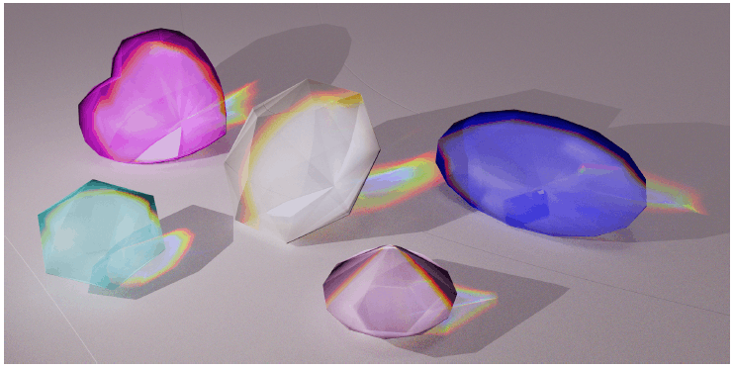
Thank you for your attention!

