Slide 1
Functional-Structural Plant Models
Summer semester 2024 -
Winfried Kurth
University of Göttingen
Chair of Computer Graphics and Ecoinformatics
11th Lecture: 4 July, 2024

Slide 2
From our last lecture:
Sequential and parallel derivation mode
Modelling diameter growth
Instantiation rules

Slide 3
On our next slides:
Simple functional-structural plant model
(first steps: 1-5)
GroIMP’s integrated radiation model
task of the term paper, evaluation criteria

Slide 4
Simple functional-structural plant model (FSPM) in 10 steps
no real plant species, rather a general basic shape and development
(cf. Goethe: “Urpflanze")
mimics an annual plant
modification / adaptation of the model will be part of the assignment
functional part will be: light interception, photosynthesis, transport of assimilates in the plant
in the first versions, purely structural model of a plant

Slide 5
First version (sfspm01.rgg):
/* Steps towards a simple FSPM. sfspm01.rgg:
A simple plant with leaves and branching
is generated.
Original version by G. Buck-Sorlin; modified. */
module Bud extends Sphere(0.1)
{{ setShader(RED); }};
module Node extends Sphere(0.07)
{{ setShader(GREEN); }};
module Internode extends F;
/* leaves are rectangles: */
module Leaf extends Parallelogram(2, 1);
const float G_ANGLE = 137.5; /* golden angle */

Slide 6
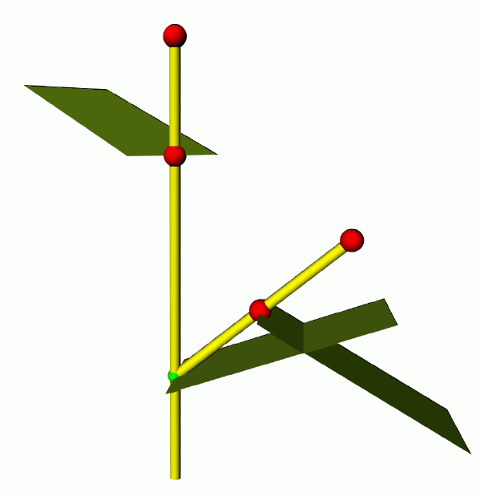
/* simple plant, with leaves and branches: */
protected void init()
[
Axiom ==> Bud;
]
public void run()
[
Bud ==> Internode Node [ RL(50) Bud ] [ RL(70) Leaf ]
RH(G_ANGLE) Internode Bud;
]
(an “Internode” is here basically half of an internode)

Slide 7
Second version (sfspm02.rgg)
Restriction of the branching order
module Bud(int order) extends Sphere(0.0001)
{{ setShader(RED); setRadius(0.2); }};
module Node extends Sphere(0.07)
{{ setShader(GREEN); }};
module Internode extends F;
module Leaf extends Parallelogram(2, 1);
const float G_ANGLE = 137.5; /* golden angle */
/* simple plant, with leaves and branches: */
protected void init()
[
Axiom ==> Bud(0);
]
public void run()
[
Bud(o), (o < 3) ==> Internode Node [ RL(50) Bud(o+1) ]
[ RL(70) Leaf] RH(G_ANGLE) Internode Bud(o);
]

Slide 8
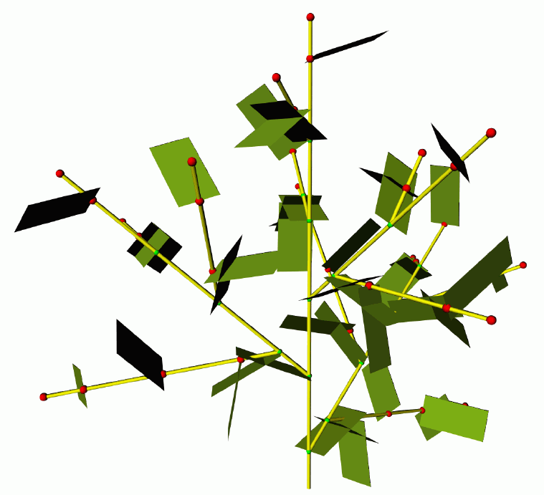
restricted branching order

Slide 9
Third version:
- more precise timing for appearance of new metamers (internode, node, leaf)
- Phyllochron = time span between the appearances of new metamers in apical position at the same shoot axis
- (often used as synonym: plastochron, but this means in its proper sense the time span between two initiations of new metamers)
- (Phyllochron: notion does not depend on growth being preformed or neoformed)
Time count in the model in discrete steps
(1 step = 1 parallel application of rules)
finer time steps!

Slide 10
sfspm03.rgg
module Bud (int ph, int order) extends Sphere(0.1)
{{ setShader(RED); }};
module Node extends Sphere(0.07)
{{ setShader(GREEN); }};
module Internode extends F;
module Leaf extends Parallelogram(2, 1);
const float G_ANGLE = 137.5; /* golden angle */
/* introducing a phyllochron */
const int PHYLLO = 25;
protected void init()
[
Axiom ==> Bud(PHYLLO, 0);
]
public void run()
[
Bud(p, o), (p > 0) ==> Bud(p-1, o); /* first parameter
counted down until...*/
Bud(p, o), (p == 0 && o <= 1) ==> Internode Node
[ RL(50) Bud(PHYLLO, o+1) ] [RL(70) Leaf]
RH(G_ANGLE) Internode Bud(PHYLLO, o);
/* (order restricted to 1 ... for efficiency) */
]

Slide 11
sfspm04.gsz: with flowers and textured organs
const ShaderRef leafmat = new ShaderRef("Leafmat");
const ShaderRef petalmat = new ShaderRef("Petalmat");
const ShaderRef internodemat = new ShaderRef("Internodemat");
const ShaderRef nodemat = new ShaderRef("Nodemat");
module Bud(int time, int ph, int order) extends Sphere(0.1)
{{ setShader(nodemat); }};
module Node extends Sphere(0.07)
{{ setShader(GREEN); }};
module NiceNode extends Sphere(0.07)
{{ setShader(nodemat); }};
module Internode extends F(1, 0.1, 7);
module NiceInternode extends Cylinder(1, 0.08)
{{ setShader(internodemat); }};
module Leaf extends Parallelogram(2, 1)
{{ setColor(0x82B417); }};
module NiceLeaf extends Parallelogram(2,2)
{{ setShader(leafmat); }};
module Flower ==> /* Instanzierungsregel */
RU(180) Cone(0.3, 0.3).(setColor(0x82B417)) M(-0.25) RL(90)
[ for (int i=1; i<=5; i++) ( [ RU(i*360/5) RL(20)
Parallelogram(2, 1).(setColor(0xFF00FF)) ] ) ] RU(45)
[ for (int i=1; i<=5; i++) ( [ RU(i*360/5) RL(40) F(0.3, 0.1, 14) RV(-0.3)
F(0.3, 0.1, 14) RV(-0.3) F(0.3, 0.1, 14) ] ) ] RU(-45)
[ for (int i=1; i<=5; i++) ( [ RU(i*360/5) RL(70)
Frustum(0.7, 0.2, 0.05).(setColor(0x8DAF58)) ] )
module NiceFlower ==>
RU(180) Cone(0.3, 0.3).(setShader(internodemat)) M(-0.25) RL(90)
[ for (int i=1; i<=5; i++) ( [ RU(i*360/5) RL(20)
Parallelogram(2, 1).(setShader(petalmat)) ] ) ] RU(45)
[ for (int i=1; i<=2; i++) ( [ RU(i*360/3) RL(40) F(0.3, 0.1, 14) RV(-0.3)
F(0.3, 0.1, 14) RV(-0.3) F(0.3, 0.1, 14) ] ) ] RU(-45)
[ for (int i=1; i<=5; i++) ( [ RU(i*360/5) RL(70)
Frustum(0.7, 0.2, 0.05).(setColor(0x8DAF58)) ] ) ];

Slide 12
// sfspm04.gsz, continuation
const float G_ANGLE = 137.5; /* golden angle */
const int PHYLLO = 25;
protected void init()
[
Axiom ==> Bud(1, PHYLLO, 0);
]
public void run()
[
Bud(r, p, o), (p > 0) ==> Bud(r, p-1, o);
Bud(r, p, o), (r<10 && p==0 && o<=2) ==> RV(-0.1) NiceInternode NiceNode
[ RL(50) Bud(r, PHYLLO, o+1) ] [ RL(70) NiceLeaf ] RH(G_ANGLE) RV(-0.1)
NiceInternode Bud(r+1, PHYLLO, o);
Bud(r, p, o), (r == 10) ==> RV(-0.1) NiceInternode RV(-0.1)
NiceInternode NiceFlower;
]
Additionally there are image files for the used textures, which are connected manually in GroIMP with the shader names "Leafmat", "Petalmat" etc. (see Lecture on textures)

Slide 13
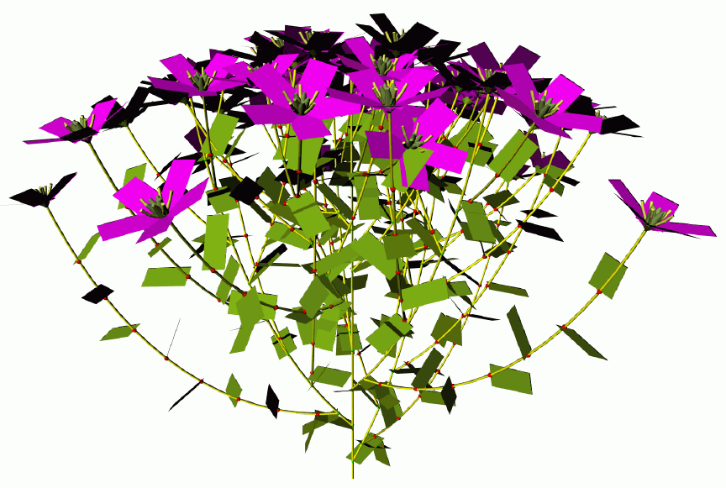
A variant with simpler “Flower” instead of the texturized “NiceFlower”

Slide 14
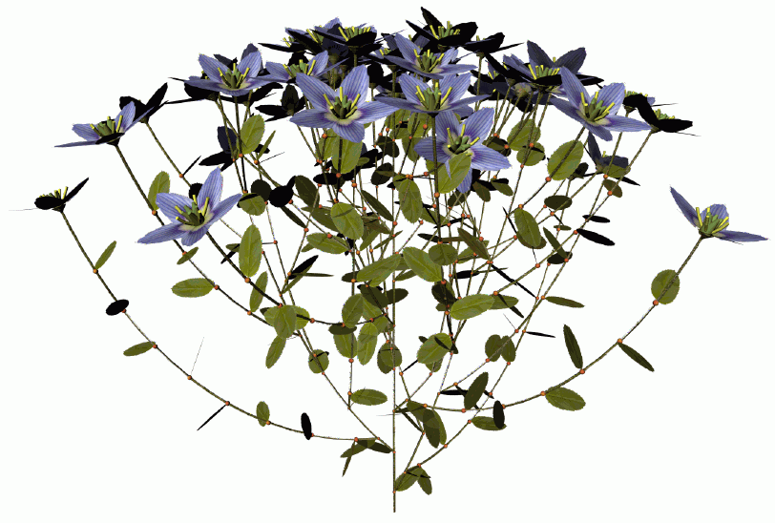
A variant with “NiceFlower” and “NiceLeaf”

Slide 15
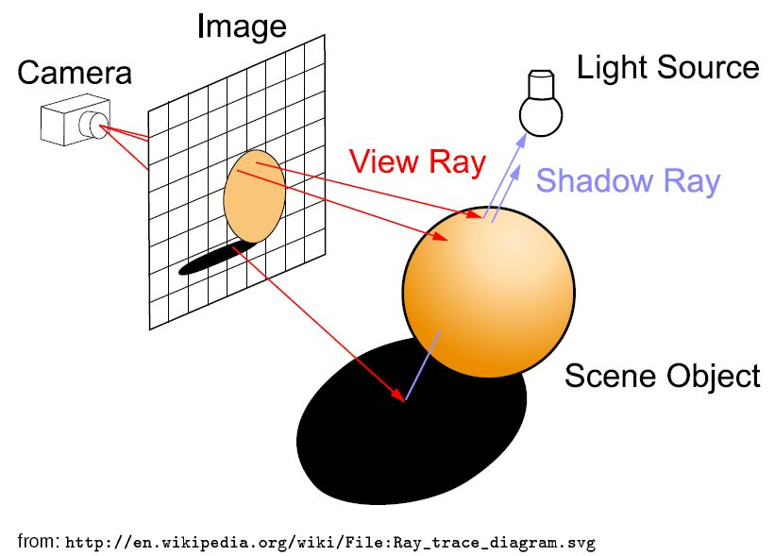
Model approach for light calculation
(physically more accurate than the "shadow cone" approach from last time)
Raytracing - a method from computer graphics
Basic principle:
Additionally the ray can be traced along one or several reflections

Slide 16
we don't want to generate an image, but calculate for all leaves of the virtual plant the amount of intercepted light
→ reversal of the direction of the rays:
the rays run from the light sources to the objects ("photontracing"). An extra shadow test is not necessary.
a large number of rays with random directions is generated: "Monte-Carlo-Raytracing".
accumulation of the intercepted power of radiation (in the unit W = Watt) is possible for each object
Requirement: there has to be a light source in the scene
DirectionalLight, PointLight, SpotLight, Sky

Slide 17
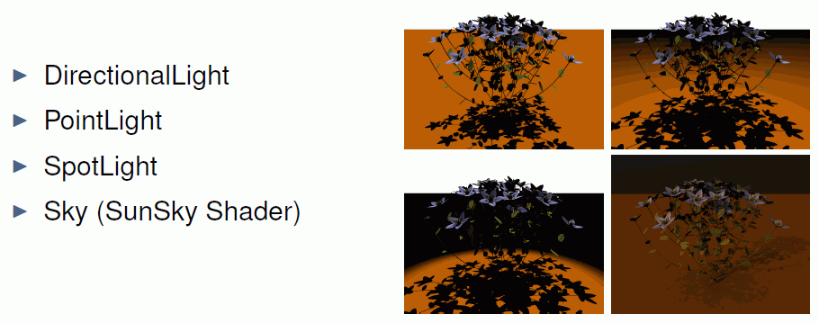
Types of light sources in the scene

Slide 18
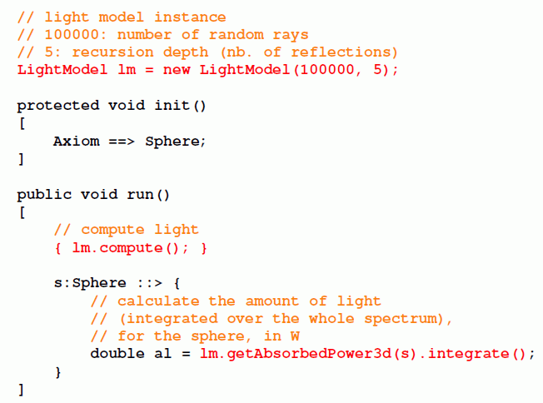
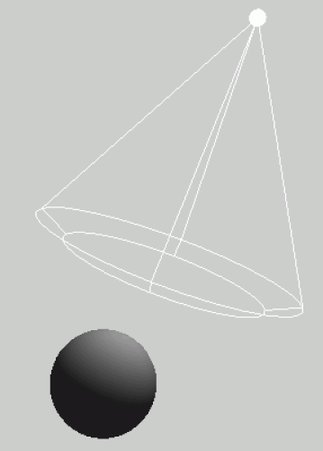
The radiation model of GroIMP

Slide 19
sfspm05.gsz (only new parts of the model are displayed)
Light source inserted into the scene; special feature: AlgorithmSwitchShader
// ..... module definitions .....
/* the leaf collects light and gets a new shader for the radiation model: */
module Leaf(float al) extends Parallelogram(2, 1)
{{ setShader(new AlgorithmSwitchShader(new RGBAShader(0, 1, 0), GREEN)); }};
// ..... further module definitions .....
/* the light source: */
module MyLamp extends SpotLight
{{
setPower(200.0); /* power in W */
setAttenuationDistance(50.0); /* in m */
setAttenuationExponent(0.0);
setInnerAngle(22.5*Math.PI/180.0);
setOuterAngle(30.0*Math.PI/180.0);
}};
module MyLight extends LightNode(1.0, 1.0, 1.0) /* R, G, B */
{{ setLight(new MyLamp()); }};
/* the radiation model is defined */
LightModel lm = new LightModel(100000, 5);
/* 100000: number of random rays, 5: recursion depth (nb. of reflections) */
GUI-Shader Radiation-Shader

Slide 20
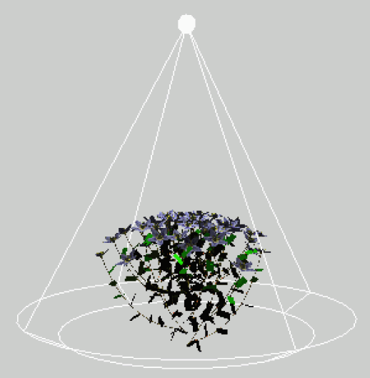
sfspm05.gsz (only new parts of the model are displayed)
protected void init()
[
Axiom ==> Bud(1, PHYLLO, 0);
==> ^ M(50) RU(180) MyLight; /* Light source is placed above the scene */
]
public void grow()
{
run();
lm.compute();
absorb();
}
protected void run()
[
Bud(r, p, o), (p>0) ==> ..........
// further rules....
]
protected void absorb()
[
lf:Leaf ::>
{
lf[al] = lm.getAbsorbedPower3d(lf).integrate();
lf.(setShader(new AlgorithmSwitchShader(
new RGBAShader((float) lf[al]/5.0, (float) lf[al]*2, (float) lf[al]/100.0),
GREEN)));
println(lf[al]);
}
]

Slide 21
sfspm05.gsz (only new parts of the model are displayed)
// ..... module definitions .....
/* the leaf collects light and gets a new shader for the radiation model: */
module Leaf(float al) extends Parallelogram(2, 1)
{{ setShader(new AlgorithmSwitchShader(new RGBAShader(0, 1, 0), GREEN)); }};
// ..... further module definitions .....
/* the light source: */
module MyLamp extends SpotLight
{{
setPower(200.0); /* power in W */
setAttenuationDistance(50.0); /* in m */
setAttenuationExponent(0.0);
setInnerAngle(22.5*Math.PI/180.0);
setOuterAngle(30.0*Math.PI/180.0);
}};
module MyLight extends LightNode(1.0, 1.0, 1.0) /* R, G, B */
{{ setLight(new MyLamp()); }};
/* the radiation model is defined */
LightModel lm = new LightModel(100000, 5);
/* 100000: number of random rays, 5: recursion depth (nb. of reflections) */

Slide 22
sfspm05.gsz (continuation)
protected void init()
[
Axiom ==> Bud(1, PHYLLO, 0);
==> ^ M(50) RU(180) MyLight; /* Light source is placed above the scene */
]
public void grow()
{
run();
lm.compute();
absorb();
}
protected void run()
[
Bud(r, p, o), (p>0) ==> ..........
// further rules....
]
protected void absorb()
[
lf:Leaf ::>
{
lf[al] = lm.getAbsorbedPower3d(lf).integrate();
lf.(setShader(new AlgorithmSwitchShader(
new RGBAShader((float) lf[al]/5.0, (float) lf[al]*2, (float) lf[al]/100.0),
GREEN)));
println(lf[al]);
}
]

Slide 23
For conifer shoots:
work with annual shoots (growth units) instead of internodes
for each shoot, use a second (thicker) green cylinder around the woody shoot for light interception
[ NeedleHull ] GrowthUnit

Slide 24
Tasks for the assignment
Functional-structural plant model 2024
(I) Thorough critical analysis of the present model sfspm10.gsz
- please analyze the underlying concept and model structure
- include a description of the modelling of light interception and
photosynthesis
proposals for further conceptual development of an improvement of the model:
- to this end - evaluation of your measured data, statistical analysis, and adaptation of the model
- also, formulate theoretical considerations for improving the modelling, especially for the growth
- you do not need a detailed presentation of the methods for statistical data analysis of the measured data; a presentation of the results is all that is required

Slide 25
Improvement and extension of the model. The following list shows possible subject areas, where you can start. You can also create and develop your own topics (please contact W. Kurth)
Mandatory for all is a parameterization of the model with
measured data (including photosynthesis data, even if the latter has
been determined on other plants)
You can set priorities for further improvements.
(IV) Sensitivity analysis of your model version: How strongly do changes
in parameters / rules, affect the result?
Are the results biologically plausible?
What could be improved further?

Slide 26
Please note:
The model “SFSPM" in its present form is not a complete, fully tested and calibrated version
It may still contain errors!
So far it is designed for plants with terminal flowers. The adaptation of morphology and phenology (e.g. incorporation of dormancy, phases of growth) to woody species would be useful
Work with annual shoots instead of internodes in the case of conifers
Finding possible deficiencies and errors is part of this assignment

Slide 27
Possible improvements to the model
Further model adaptation to the measured data: photosynthetic parameters, (maximum) organ sizes, angles, growth rates, growth rules
Adaptation of the leaves (flowers/fruits) to the species you have investigated
Equilibrating the mass balance of the plant including assimilate sinks, especially the assimilate requirement for organ growth
Managing growth - light dependence; dependence on existing amount of assimilate; possible density sensitivity...
Control of the formation of new metamers / shoots, analogous to the control of growth

Slide 28
Possible improvements to the model (continued)
(6) Consideration of plant dormancy
(7) Inclusion of sylleptic shoot formation / free growth
(8) Branching control (according to assimilate quantity or light)
Improvement of the modeling of growth thickness (e.g. using the pipe model; see also the example "Tree based on pipe model of branch width" in GroIMP)
Improvement of the assimilate allocation model
e.g., change in transport rates for young leaves; inclusion
of a central C stock (starch pool) and a reserve from the
seed at the beginning; inclusion of the root

Slide 29
Evaluation criteria for the assignment
points (giving 7 in total)
Outline, introduction and theory 1
Contents 3
Analysis of the model 0,6
Data analysis, incorporation of the data 0,6
Conceptual improvement (ideas) 0,6
Concrete improvement of the model 0,6
Sensitivity analysis 0,6
Literature 0,5
Accuracy 1
Language 0,5
Originality 1

Slide 30
Deadline for submission of assignment
13 September, 2024, at 24:00
(the date of the digital delivery is noted; please also submit a printed copy)
Note:
Please use the consultation opportunities provided by W. Kurth, T. Oberländer, G. Heidsieck and T. Hay, in particular when re-programming the model!

