Slide 1
Functional-Structural Plant Models
Summer semester 2024
Winfried Kurth
University of Göttingen
Chair of Computer Graphics and Ecoinformatics
8th Lecture: 13 June, 2024

Slide 2
From our last lecture:
context sensitive L-Systems
interpretation rules
spruce model
graphs
About the measurements

Slide 3
Agenda for today:
Spruce model (answers to the questions)
Graph replacement rules
How relational growth grammars work
Two rule types: L system rules and SPO rules
Notation of graphs in XL
The current global graph in GroIMP

Slide 4
A Spruce Model in XL
/* Spruce model sm09_fichte.rgg */
module T; /* Terminal buds */
module M1; /* Side-branch bud 1st order, medial position */
module S1; /* Side-branch bud 1st order, subapical position */
module M2; /* Side-branch bud 2nd order, medial position */
module S2;
module M3;
module S3;
module GU(float incd, int age) extends F0; /* growth unit */
module BA(int age, super.angle) extends RL(angle);
module GA(int age, super.angle) extends RL(angle);
module HA(int age, super.angle) extends RL(angle);
const int ang = 45;
const int x3 = 50;
const int[] a = { 0, 15, 25, 32, 37, 40 };
const int[] gg = { 0, 0, 4 };
const int[] hh = { 0, 0, 2, 4, 8 };
int n, k;
const float[] prob_n = {0.1, 0.4, 0.3, 0.2};
const int[] n_subap = {5, 6, 7, 8};

Slide 5
protected void init()
[
Axiom ==> P(2) D(1) L(100) T;
]
public void grow()
[
x:T ==> Nl(80*TurtleState.length(x)) GU(2.2, 0)
RH(random(0, 360)) { k = 0; }
for ((1:3)) /* 3 medial side branches of 1st order */
( [ MRel(random(0.2, 0.85)) RH(k*120+normal(0, 5.5))
{ k++; } RL(x3+normal(0, 2.2)) BA(0, 0) LMul(0.4) M1 ] )
RH(random(0, 360)) { n = n_subap[distribution(prob_n)]; k = 0; }
for ((1:n)) /* n subapical side branches of 1st order */
( [ MRel(random(0.85, 1)) RH(k*360/n+normal(0, 3.1))
{ k++; } RL(x3+normal(0, 2.2)) BA(0, 0) LMul(0.65) S1 ] )
T;
x:S1 ==> Nl(80*TurtleState.length(x)) GU(1.3, 0)
[ MRel(random(0.85, 1)) RH(15)
RU(ang+normal(0, 2.2)) AdjustLU LMul(0.7) S2 ]
[ MRel(random(0.85, 1)) RH(-15)
RU(-ang+normal(0, 2.2)) AdjustLU LMul(0.7) S2 ] GA(0, 0) S1;
x:M1 ==> Nl(80*TurtleState.length(x)) GU(0.8, 0)
[ MRel(random(0.85, 1)) RH(15)
RU(ang+normal(0, 2.2)) AdjustLU LMul(0.7) M2 ]
[ MRel(random(0.85, 1)) RH(-15)
RU(-ang+normal(0, 2.2)) AdjustLU LMul(0.7) M2 ] HA(0, 0) M1;

Slide 6
x:S2 ==> Nl(80*TurtleState.length(x)) GU(1.3, 0)
[ MRel(random(0.85, 1)) RH(10)
RU(ang) AdjustLU LMul(0.7) S3 ]
[ MRel(random(0.85, 1)) RH(-10)
RU(-ang) AdjustLU LMul(0.7) S3 ] S2;
x:M2 ==> Nl(80*TurtleState.length(x)) GU(0.8, 0)
[ MRel(random(0.85, 1)) RH(10)
RU(ang) AdjustLU LMul(0.7) M3 ]
[ MRel(random(0.85, 1)) RH(-10)
RU(-ang) AdjustLU LMul(0.7) M3 ] M2;
x:S3 ==> Nl(80*TurtleState.length(x)) GU(1.3, 0);
x:M3 ==> Nl(80*TurtleState.length(x)) GU(0.8, 0);
GU(incd, t) ==> DlAdd(incd*(t+1)) GU(incd, t+1);
DlAdd(arg) ==> ;
BA(age, angle) ==> BA(age+1, a[age<5 ? age+1 : 5]);
GA(age, angle) ==> GA(age+1, gg[age<2 ? age+1 : 2]);
HA(age, angle) ==> HA(age+1, hh[age<4 ? age+1 : 4]);
]

Slide 7
Assignment from last lecture
Analyze the XL code of the model sm09_fichte.rgg.
Test the Model with GroIMP, and analyze again the code for the second time.
Take note of everything that might be unclear to you.
Try to answer the following questions:
how to increase the thickness growth
- for all growth units (GU)?
- for the trunk only?
how can a slimmer crown shape be achieved (e.g., by changing the length growth)?
- how can the number of main side branches be reduced?

Slide 8
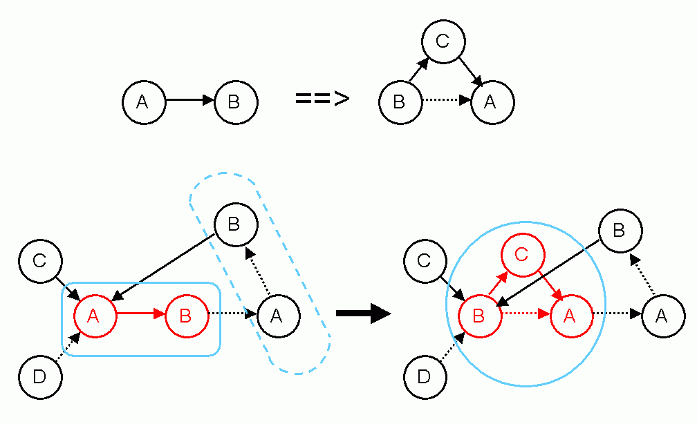
Graph-grammar (example)
Rule:
Application:
not applicable here! (wrong edge type)

Slide 9
A Relational Growth Grammar (RGG)
is a special type of graph grammar
Contains:
an alphabet
- the definition of all allowed
▪ node types
▪ edge types (types of relations)
the axiom
- an initial graph composed of elements of the
alphabet
a set of graph replacement rules

Slide 10
A Relational Growth Grammar contains:
an alphabet
- the definition of all allowed
▪ node types
▪ types of relations
the axiom
- an initial graph composed of elements of the
alphabet
a set of graph replacement rules
Root
Shoot
Bud
Successor Branching
Root
Shoot
Bud

Slide 11
What are these graph replacement rules (RGG rules)?
And how do we apply them?

Slide 12
Graph replacement rules are rules for the transformation of a graph (subgraph) into another graph A rule consists essentially of:
left-hand side of rule ==> right-hand side of rule

Slide 13
How an RGG rule is applied
each left-hand side of a rule describes a subgraph (a pattern of nodes and edges which is searched for in the whole graph), which is replaced when the rule is applied
each right-hand side of a rule defines a new subgraph, which is inserted as substitute for the removed subgraph

Slide 14
Simple example with strings
Every occurrence of the subgraph defined in the left-hand side of the rule is replaced!
A
B
C
A
C
A
is replaced by
D
D
B
C
D
C
2 rule applications in the same time step

Slide 15
A complete RGG rule can contain 5 parts
(* context *), left-hand side, ( condition )
==>
right-hand side { imperative XL code }

Slide 16
Context example
(* context *), left-hand side, ( condition )
==>
right-hand side { imperative XL code }
Example:
A
B
C
A
C
A
(*
B
*)
is replaced by
D
D
B
C
A
C

Slide 17
Condition example
(* context *), left-hand side, ( condition )
==>
right-hand side { imperative XL code }
Example:
A
B
C
A
C
a:A
B
( a[length] > 10 )
is replaced by
D
D
C
A
C
2 possible results, depending on the current length parameter of the A node
A
B
C
A
C

Slide 18
RELATIONAL GROWTH GRAMMARS
RGG: Relational Growth Grammars, parallel graph grammars
Summary: Structure of a rule of a RGG
(* C *), L,(E) ==> R { P };
Context
(Set of graphs)
Left-hand side of rule
(Set of graphs
to be replaced by R)
Condition
(Set of logical expressions, contains parameters related to node labels from L and C)
Right-hand side of rule
(Set of graphs)
Imperative Code
(List of commands)
Graphs: directed with edge-labels and node-labels

Slide 19
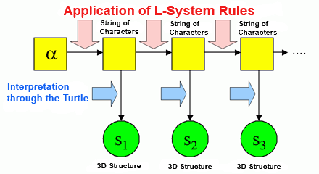
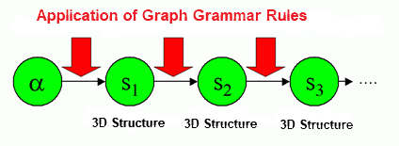
The grammar directly modifies the graph
The workaround via string code is omitted (or is only used for rule input)

Slide 20
RGG as generalizations of L-systems
Character strings correspond to special graphs
In text form we write in general (user-defined) edges as
-edgetype->
Edges of the special type "successor" are usually written as a blank
(instead of -successor->)
Also possible: >

Slide 21
For general graphs:
Problem of embedding the right-hand side of the rule
Rule:
Application:

Slide 22
2 types of rules for graph replacement in XL
● L-System-Rule, symbol: ==>
embeds the right-hand side into the graph (i.e. incoming and outgoing edges are retained)
● SPO-Rule, symbol: ==>>
incoming and outgoing edges are deleted (unless their retention is explicitly specified in the rule)
“SPO” means “single pushout” - a notion from universal algebra

Slide 23
Example
a:A ==>> a C (SPO-rule)
B ==> D E (L-System rules)
C ==> A
Start graph:
A
B
C

Slide 24
Example
a:A ==>> a C (SPO-rule)
B ==> D E (L-System rules)
C ==> A
A
B
C
D
E
A

Slide 25
Example
a:A ==>> a C (SPO-rule)
B ==> D E (L-System rules)
C ==> A
A
B
C
a:
D
E
A

Slide 26
Example
a:A ==>> a C (SPO-rule)
B ==> D E (L-System rules)
C ==> A
A
D
E
A
a:
= final result
C

Slide 27
Test the example sm09_e27.rgg
module A extends Sphere(3);
protected void init()
[ Axiom ==> F(20, 4) A; ]
public void runL()
[
A ==> RU(20) F(20, 4) A;
]
public void runSPO()
[
A ==>> ^ RU(20) F(20, 4, 5) A;
]
( ^ denotes the root node in the current graph)
Also view the result in the (2D) graph panel!

Slide 28
Another type of rule
Update rules
Sometimes you don't want to change anything in the graph structure, but only change attributes of a single node (e.g. to calculate the photosynthesis for a leaf). There is a separate rule type for this:
A ::> { imperative Code };
Test the following examples:
sm09_e25.rgg
sm09_e16.rgg
sm09_e18.rgg

Slide 29
Display of graphs in the XL programming
language
● node types must be declared with "module”
● nodes can be all Java objects. In user-made module declarations, methods (functions) and additional variables can be introduced, as in Java
● Notation for nodes in a graph:
Node type, optionally preceded by: label:
Examples: A, Meristem(t), b:Bud
● Notation for edges in a graph:
-edgetype->
<-edgetype-
● Special edge types:
successor edge: -successor->, > or (blank)
branch edge: -branch->, +> or [
refinement or decomposition edge: />

Slide 30
Representation of graphs
Notation for edges in a graph:
-r-> forward
<-r- backward
-r- forward or backward
<-r-> forward and backward
r (edge identifier) = successor, branch, ancestor,
minDescendants, descendants, ... (more later)

Slide 31
User-defined edge types
const int xxx = EDGE_0; // or EDGE_1, ..., EDGE_14
Usage in the graph: -xxx->, <-xxx-, -xxx-

Slide 32
Notations for special edge types (overview)
forward backward forward or backward forward and backward
successor
branch
refinement
arbitrary

Slide 33
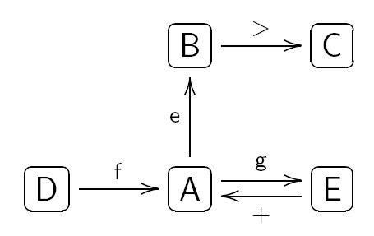
Notation of graphs in XL
Example:
is represented in program code as
(the representation is not unique!)
( >: successor edge, +: branch edge)

Slide 34
How can the following graph be described in XL code?
Bud
>
0
1
X
+
Leaf

Slide 35
The current graph
GroIMP maintains always a graph which contains the complete current structural information. This graph is transformed by application of the rules.
Attention: Not all nodes are visible objects in the 3-D view of the structure!
F0, F(x), Box, Sphere: Yes
RU(30), A, B: normally not (if not derived by “extends“
from visible objects)
The graph can be completely visualized in the 2-D graph view (in GroIMP: Panels - 2D - Graph).

Slide 36
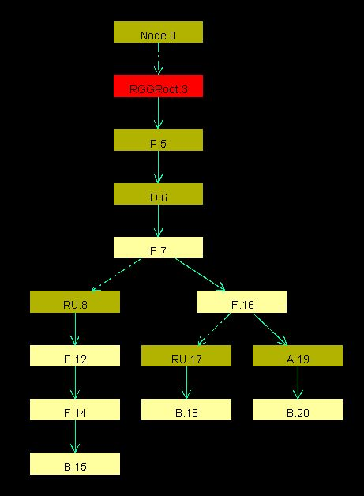
Load an example RGG file in GroIMP
and execute some steps (do not work with a too complex structure).
Open the 2-D graph view, fix the window with the mouse in the GroIMP user interface and test different layouts (Layout - Edit):
Tree
Sugiyama
Square
Circle
Random
SimpleEdgeBased
Fruchterman
Keep track of the changes of the
graph when you apply the rules
(click on “redraw”)

Slide 37
Which parts of the current graph of GroIMP are visible (in the 3-D view)?
all geometry nodes which can be accessed from the root (denoted ^) of the graph by exactly one path which consists only of "successor" and "branch" edges
How to enforce that an object is visible in any case:
==>> ^ Object

Slide 38
Assignments
1. Work through lessons 13 - 16 and 20 - 22 in the ILIAS learning module "Introduction to GroIMP" (available via StudIP).
2. Read Chapter 1, Section 1.8 of the book "The Algorithmic Beauty of Plants" by P. Prusinkiewicz and A. Lindenmayer (pp. 30-35)
(Note the different notation for context-sensitive rules)

