Slide 1
Functional-Structural Plant Models
Summer semester 2024
Winfried Kurth
University of Göttingen
Chair of Computer Graphics and Ecoinformatics
7th Lecture: 6 June, 2024

Slide 2
From our last lecture:
Adding textures to plant models
stochastic L-systems

Slide 3
Today:
context sensitive L-systems
a new rule type: interpretation rules
a spruce model
graph grammars
Informations about the measurements on 7 and 14 June (09:30 a.m., Büsgenweg 2)

Slide 4
Context-sensitive L-systems
Query a context that must exist for a rule to be applicable
in XL: context specification in (* .... *)

Slide 5
Context-sensitive L-systems
Example of using left-sided context:
another example of left context:
sm09_e14.rgg

Slide 6
Context-sensitive L-systems
Example of using right-sided context:
another example of right context:
sm09_e15.rgg

Slide 7
Right context
installation in a model for signal-controlled triggering of lateral shoot formation
module A(int age);
module B(super.length, super.color) extends F(length, 3, color);
Axiom ==> A(0);
A(t), (t < 5) ==> B(10, 2) A(t+1); // 2 = green
A(t), (t == 5) ==> B(10, 4); // 4 = red
B(s, 2) (* B(r, 4) *) ==> B(s, 4);
B(s, 4) ==> B(s, 3) [ RH(random(0, 360)) RU(30) F(30, 1, 14) ]; // 3 = blue

Slide 8
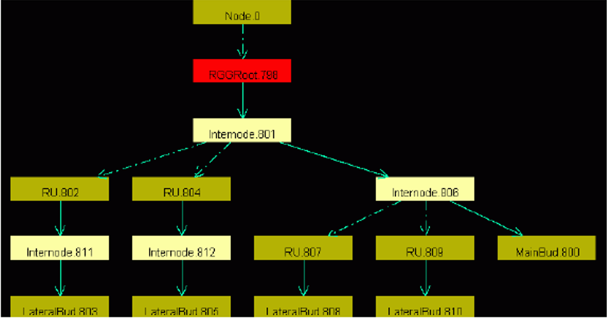
Insertion:
Graph View
GroIMP always carries a graph with it, which contains all the current structure information.
this is transformed by applying the rules
the graph can be displayed completely in the 2D graph view
GroIMP: Panels > 2D > Graph
(the 2D graph view can be anchored with
the mouse in the GroIMP user interface)
Graph > Layout
Graph > View > Redraw

Slide 9
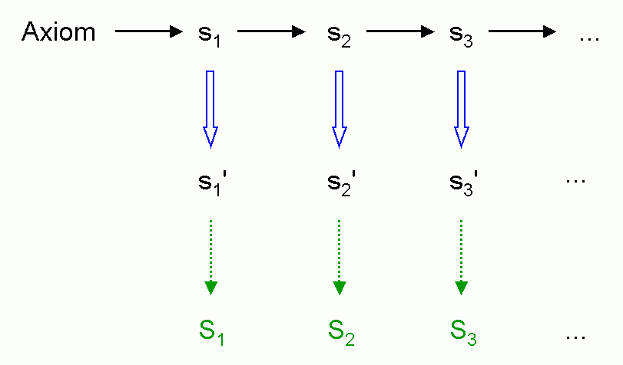
Interpretation rules
Installation of a further rule application immediately before graphic interpretation (without effect on the next generation)
Interpretation rule application
Interpretation by turtle

Slide 10
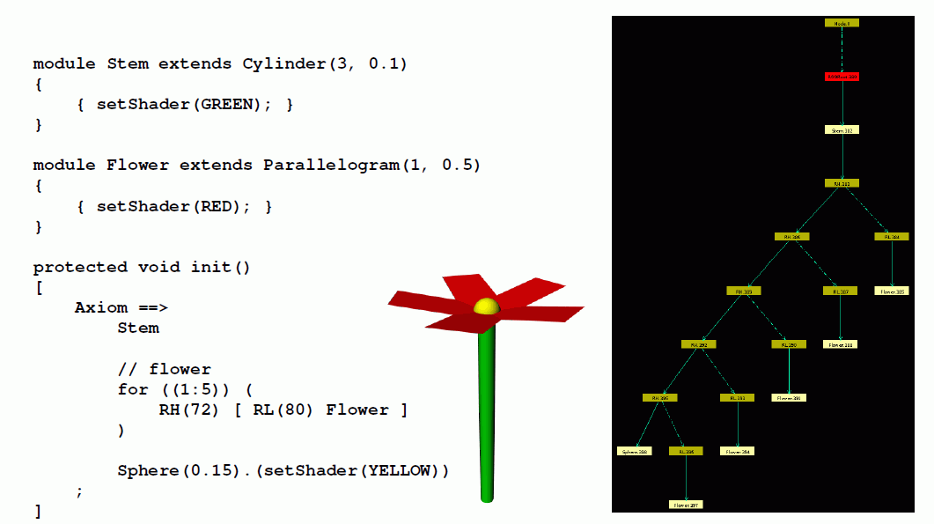
Ordinary geometric interpretation (without interpretation rules)

Slide 11
With the use of interpretation rules

Slide 12
Another example
module MainBud(int x) extends Sphere(3) {{setShader(GREEN);}};
module LBud extends Sphere(2) {{setShader(RED);}};
module LMeris;
module AMeris;
module Flower;
const float d = 30;
const float crit_dist = 21;
protected void init()
[ Axiom ==> MainBud(10); ]
public void run()
{ [
MainBud(x) ==> F(20, 2, 15) if (x > 0)
( RH(180) [ LMeris ] MainBud(x-1) )
else
( AMeris );
LMeris ==> RU(random(50, 70)) F(random(15, 18), 2, 14) LBud;
LBud ==> RL(90) [ Flower ];
AMeris ==> Scale(1.5) RL(90) Flower; /* Flower: here only a symbol */
]
applyInterpretation(); /* Call for the execution of interpretation rules
(in imperative section { ... } !) */
}
protected void interpret() /* Block with interpretation rules */
[
Flower ==> RH(30) for ((1:5))
( RH(72) [ RL(80) F(8, 1, 9) ] );
]

Slide 13
Yet another example
public void run()
{
[
Axiom ==> A;
A ==> Scale(0.3333) for (int i:(-1:1))
for (int j:(-1:1))
if ((i+1)*(j+1) != 1)
( [ Translate(i, j, 0) A ] );
]
applyInterpretation();
}
public void interpret()
[
A ==> Box;
]
creates the so-called "Menger Sponge" (a fractal)

Slide 14
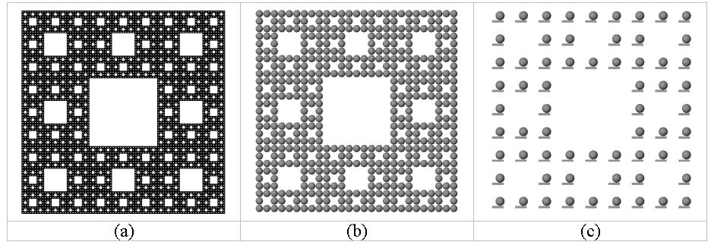
public void run()
{ [
Axiom ==> A;
A ==> Scale(0.3333) for (int i:(-1:1))
for (int j:(-1:1))
if ((i+1)*(j+1) != 1)
( [ Translate(i, j, 0) A ] );
]
applyInterpretation();
}
public void interpret()
[
A ==> Box;
]
(a)
(b)
(c)
A ==> Box(0.1, 0.5, 0.1)
Translate(0.1, 0.25, 0) Sphere(0.2);
A ==> Sphere(0.5);

Slide 15
What does this example create?
public void run()
{
[
Axiom ==> [ A(0, 0.5) D(0.7) F(60) ] A(0, 6) F(100);
A(t, speed) ==> A(t+1, speed);
]
applyInterpretation();
}
public void interpret()
[
A(t, speed) ==> RU(speed*t);
]

Slide 16
A Spruce Model in XL
/* Spruce model sm09_fichte.rgg */
module T; /* Terminal buds */
module M1; /* Side-branch bud 1st order, middle position */
module S1; /* Side-branch bud 1st order, subapical position */
module M2; /* Side-branch bud 2nd order, middle position */
module S2;
module M3;
module S3;
module GU(float incd, int age) extends F0; /* growth unit */
module BA(int age, super.angle) extends RL(angle);
module GA(int age, super.angle) extends RL(angle);
module HA(int age, super.angle) extends RL(angle);
const int ang = 45;
const int x3 = 50;
const int[] a = { 0, 15, 25, 32, 37, 40 };
const int[] gg = { 0, 0, 4 };
const int[] hh = { 0, 0, 2, 4, 8 };
int n, k;
const float[] prob_n = {0.1, 0.4, 0.3, 0.2};
const int[] n_subap = {5, 6, 7, 8};

Slide 17
protected void init()
[
Axiom ==> P(2) D(1) L(100) T;
]
public void grow()
[
x:T ==> Nl(80*TurtleState.length(x)) GU(2.2, 0)
RH(random(0, 360)) { k = 0; }
for ((1:3)) /* 3 median side branches 1st order */
( [ MRel(random(0.2, 0.85)) RH(k*120+normal(0, 5.5))
{ k++; } RL(x3+normal(0, 2.2)) BA(0, 0) LMul(0.4) M1 ] )
RH(random(0, 360)) { n = n_subap[distribution(prob_n)]; k = 0; }
for ((1:n)) /* n subapical side branches of 1st order */
( [ MRel(random(0.85, 1)) RH(k*360/n+normal(0, 3.1))
{ k++; } RL(x3+normal(0, 2.2)) BA(0, 0) LMul(0.65) S1 ] )
T;
x:S1 ==> Nl(80*TurtleState.length(x)) GU(1.3, 0)
[ MRel(random(0.85, 1)) RH(15)
RU(ang+normal(0, 2.2)) AdjustLU LMul(0.7) S2 ]
[ MRel(random(0.85, 1)) RH(-15)
RU(-ang+normal(0, 2.2)) AdjustLU LMul(0.7) S2 ] GA(0, 0) S1;
x:M1 ==> Nl(80*TurtleState.length(x)) GU(0.8, 0)
[ MRel(random(0.85, 1)) RH(15)
RU(ang+normal(0, 2.2)) AdjustLU LMul(0.7) M2 ]
[ MRel(random(0.85, 1)) RH(-15)
RU(-ang+normal(0, 2.2)) AdjustLU LMul(0.7) M2 ] HA(0, 0) M1;

Slide 18
x:S2 ==> Nl(80*TurtleState.length(x)) GU(1.3, 0)
[ MRel(random(0.85, 1)) RH(10)
RU(ang) AdjustLU LMul(0.7) S3 ]
[ MRel(random(0.85, 1)) RH(-10)
RU(-ang) AdjustLU LMul(0.7) S3 ] S2;
x:M2 ==> Nl(80*TurtleState.length(x)) GU(0.8, 0)
[ MRel(random(0.85, 1)) RH(10)
RU(ang) AdjustLU LMul(0.7) M3 ]
[ MRel(random(0.85, 1)) RH(-10)
RU(-ang) AdjustLU LMul(0.7) M3 ] M2;
x:S3 ==> Nl(80*TurtleState.length(x)) GU(1.3, 0);
x:M3 ==> Nl(80*TurtleState.length(x)) GU(0.8, 0);
GU(incd, t) ==> DlAdd(incd*(t+1)) GU(incd, t+1);
DlAdd(arg) ==> ;
BA(age, angle) ==> BA(age+1, a[age<5 ? age+1 : 5]);
GA(age, angle) ==> GA(age+1, gg[age<2 ? age+1 : 2]);
HA(age, angle) ==> HA(age+1, hh[age<4 ? age+1 : 4]);
]
New node types and new commands occurring herein:
see the following slides

Slide 19
Function TurtleState.length(x) (for one node x):
returns the step length of the turtle at node x
Turtle command (Node) AdjustLU :
rotates the turtle around the H axis so that the U vector points upwards
Turtle-Command (Node) N :
controls leaf mass (analogous to L und D)

Slide 20
Operator with 3 arguments for case distinctions:
Condition ? Expression 1 : Expression 2
- Returns the value of Expression1 if the condition is met, otherwise the value of Expression2.
x = Condition ? Expression1 : Expression2 is equivalent to
if (Condition)
x = Expression1;
else
x = Expression2;
(this operator is also available in C, C++ and Java)

Slide 21
Assignment
Analyze the XL code of the model sm09_fichte.rgg.
Test the Model with GroIMP, and analyze again the code for the second time.
Take note of everything that might be unclear to you.
Try to answer the following questions:
how to increase the thickness growth
- for all growth units (GU)?
- for the trunk only?
how can a slimmer crown shape be achieved (e.g., by changing the length growth)?
- how can the number of main side branches be reduced?

Slide 22
The step to graph grammars
Disadvantage of L-Systems:
• In L-Systems with branches (using Turtle commands) only 2 possible relations between objects:
- "direct successor" and "branch"
Extensions:
Allow further relation types (arbitrarily selected)
Allow cycles
→ Graph-Grammar

Slide 23
A graph: a way to organize data Definition: a set of nodes (partially) connected by (directed) edges (relations)
S
S
S
I
I
I
Edge types (relational):
- Successor relationship
- Decomposition relationship
Nodes
S
I
(S = Shoot, I = Internode)

Slide 24
A sequence of characters (string): - a very simple graph
- A string of characters can be interpreted as a 1-dimensional graph with only one type of edge - Successor edges (successor relation)
A
B
A
C
A
A
B
A
C

Slide 25
Do you find such a structure anywhere in real life?
R
S
S
S
B
S
S
B
B
S
S
B
B
B
B
B
S
B
B
S
B
B
S
B
B
B
B
B
S
B
B
S
B
B
S
B
B
B
B
B
B

Slide 26
How about now?
Bud
Bud
Shoot
Bud
Bud
Bud
Shoot
Bud
Shoot
Shoot
Bud
Bud
Bud
Bud
Bud
Shoot
Bud
Shoot
Bud
Bud
Bud
Bud
Bud
Shoot
Shoot
Bud
Shoot
Shoot
Shoot
Bud
Bud
Bud
Bud
Bud
Shoot
Bud
Root
Shoot
Bud
Bud
Bud

Slide 27
It is a tree - trees are special graphs
4
3 Node types
Root compartment
annual shoots
Buds
3
2
2 Edge types
Successor relation (same axis)
Branching relation (new axis)
1

Slide 28
Topology - underlying field of mathematics
mathematical field, where positional relationships are investigated by omitting metrics (lengths, angles)
Typical topological terms:
Neighborhood
Boundary (of a set)
Connectedness
Two geometric structures are topologically equivalent (isomorphic) if they can be transformed into each other by plastic deformation (without cutting or gluing parts together)

Slide 29
Graph Theory
This has emerged as an independent field from topology and combinatorics
A graph consists of a set of vertices (nodes) and a set of (directional or non-directional) edges (links) each connecting two vertices
Two isomorphic graphs:

Slide 30
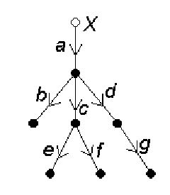
Directed graphs
all edges are provided with a direction (orientation)
A tree is a graph without circles (closed chains of consecutive edges).
A rooted tree is a tree with a specially designed vertex, the base vertex or root.
each rooted tree can be given a "natural orientation" of the edges by orienting all edges "away from the base vertex".

Slide 31
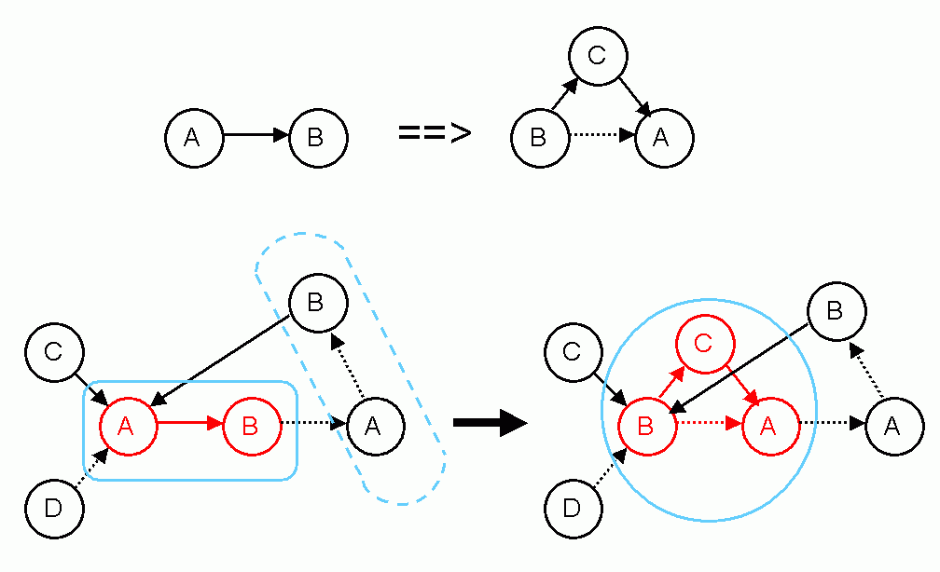
Now we let the graphs change over time!
Graph-grammars (example)
Example rule:

Slide 32
Graph-grammar (example)
Rule:
Application:
not applicable here! (wrong edge type)

Slide 33
Morphological measurements, 7 and 14 June, 2024 (09:30 a.m., Büsgenweg 4)
Please bring the following:
Smartphone or camera
Coloured pencils
Ruler, protractor (if available)
Small adhesive labels (if available), alternatively “Tesafilm”
Notebook / Tablet to enter data in dtd format
2 or 3 groups will work simultaneously
gas exchange / manual morphology / FASTRAK digitizer

Slide 34
Objects of investigation:
Young plants of poplar and spruce, the same as for the photosynthesis measurements
Before the detailed measurements:
Give the tree an ID name (name tag!)
check for special features
define reference direction (in pot)
photograph the tree from several sides (with reference direction and name tag)
record measured variables related to the entire tree

Slide 35
Measurement quantities related to the entire tree:
Height
Diameter at the base
Number of leaves
Number of side branches 1st order
Date of measurement
Units of measurement:
for lengths and diameters: mm
for angle: degrees
for masses: g (but in GroIMP, as a rule, SI unit: kg)

Slide 36
Preparation of the topological and geometrical detail survey of the tree:
Finding the annual shoot limits (shoot base scars), as far as possible!
(for poplar:) Numbering of the internodes of the main axis (trunk) from bottom to top (with consideration of the annual shoot arrangement); correspondingly also for the side branches; numbering of leaves. (For spruce:) Numbering of annual shoots.
For side branches: number further within each side branch
Topological sketch of the entire tree with all leaves on a large drawing sheet (use several sheets if necessary - provide enough space for length and angle information!)

Slide 37
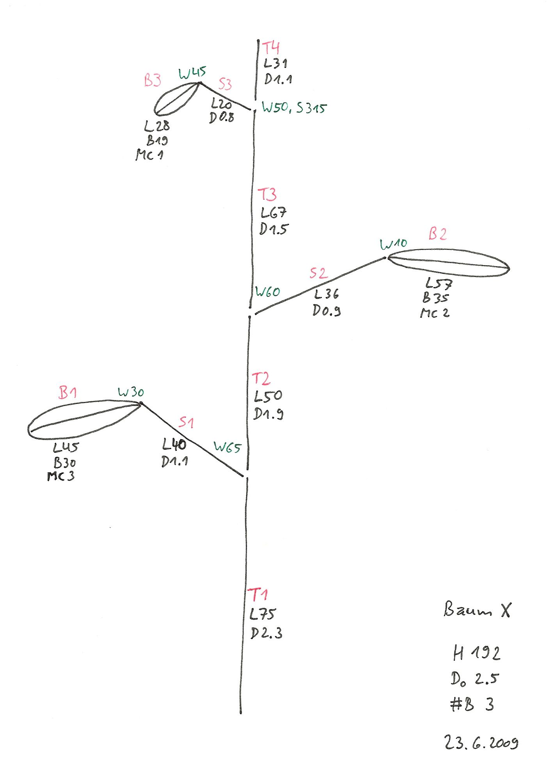
Red: Names of internodes, petioles and leaf blades
Black: Length (L), Diameter (D), Width (of leaf blade; B)
Green: Angle specifications. Angle of divergence (deviation from the growth direction of the main axis): W (in degrees), azimuth angle (relative to the reference direction on the ground): S (in degrees); note: no negative angles possible.
optional: angle between two consecutive internodes (W-indicator)

Slide 38
Corresponding dtd file:
T1 L75 ## O0 D2.3
T2 L50 #T1 V D1.9
T3 L67 #T2 V D1.5
T4 L31 #T3 V D1.1
S1 L40 #T1 - W65 D1.1
S2 L36 #T2 + W60 D0.9
S3 L20 #T3 S315 W50 D0.8
B1 L45 #S1 V R5 W30 C4 < B30 >
B2 L57 #S2 V R5 W10 C4 < B35 >
B3 L28 #S3 V R5 W45 C4 < B19 >
# Name of the parent segment
V stands for "extension" (of the axis)
+ for S90 (growth direction right)
– for S270 (growth direction left)
R5 for downward direction (= S180)
C4 for red colour marking (arbitrary)
The B-specifications for the leaf blades are written in comment brackets (currently no automatic processing by GroIMP)

Slide 39
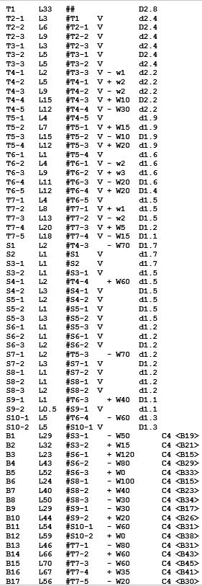
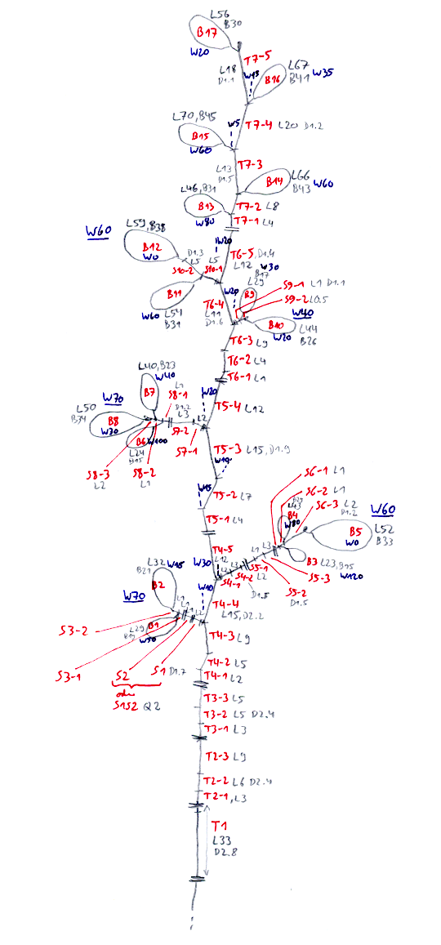
Example for small Beech
dtd-Data

Slide 40
Geometric detail measurements:
Length of internodes and petioles (for poplar): accurate to mm
Diameter of internodes (annual growth at least 1 time per year) : accurate to 1/10 mm; measured in the middle. Same for shoots in case of spruce.
For poplar tree:
Length of a leaf: measured from the beginning of the leaf stalk to the blade tip, accurate to mm
Width of leaf: measured at the widest point
Leaf area (only by destructive measurement): possible with a special leaf measuring instrument after the dismemberment of the tree
Angle: accurate to 5° (azimuth angle: 10°); measurement between internode and midrib of leaf blade
Mass:
Internodes and leaves: dry mass for entire tree

Slide 41
To analyze the measured data
dtd-Data:
upload in GroIMP - check for visual plausibility
Representation of leaves with width and area currently not possible (transfer leaf data to extra table)
First analyses: Creation of tables with GroIMP (elementary analysis; lengths and angles); also possible with queries from the GroIMP console
Statistical evaluation of tables (R or Statistica) (see description on Grogra-CD, to be adapted)
Targets: Progression of morphological quantities along the axes and during branching; correlation and regression analysis of the quantities among each other; mean values and standard deviations; non-linear adaptation of a light response curve to the photosynthesis data

Slide 42
How to upload dtd-Data in GroIMP
File / Open > choose dtd-Data > Open
Branching structure appears in the 3D view
Change camera settings if necessary
Modify the file and save
modification becomes visible on the display

Slide 43
Checking for consistency of the dtd file:
Optical control
- pay special attention to the base shoot, are there
more (too many) shoots at the base?
- Checking the age count:
- Grogra analysis option F
- 5th column of the generated table: is age 0 too rare?

Slide 44
Simple analyses
some features were taken from the predecessor software GROGRA
Panels > RGG Panels > GROGRA functions > Analysis
There you can find:
- list of all shoots (generates complete list)
- elementary analysis
- basic tree parameters
- topological analysis (more on this later)

Slide 45
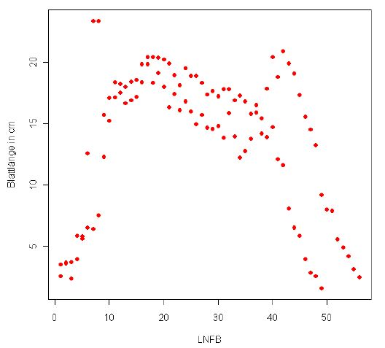
Example for statistical analysis
Trend for leaf length along the main tree trunk for Poplar
(assignment results from René Degenhard, 2008)

Slide 46
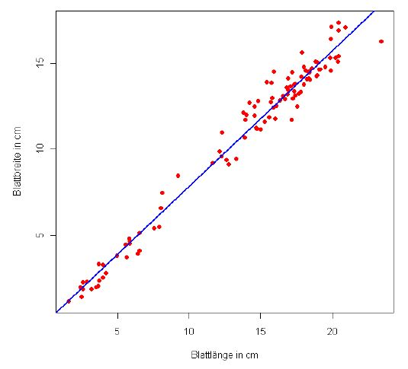
Correlation between leaf length and width for Poplar
(assignment results from René Degenhard, 2008)
The analysis of the data will be part of the assignment and will not be elaborated here any further.

