Slide 1


Functional-Structural Plant Models
Summer semester 2024
Winfried Kurth
University of Göttingen
Chair of Computer Graphics and Ecoinformatics
4th Lecture: 2 May, 2024

Slide 2
From our last lecture:
generating branches with turtle geometry
simple L-systems (string substitution systems)
their execution with GroIMP
simple branching patterns modeled with L-systems

Slide 3
On our next slides:
branches in turtle geometry (further examples)
parametric L-systems, further L-system examples
imperative code in XL (introduction)

Slide 4
Example code sm09_e02.rgg
How to modify a simple model of a triangle to extend it to a Koch curve
protected void init ()
[ Axiom ==> RU(50) F(10) RU(120) F(10) RU(120) F(10); ]
// pubic method for the interactive use in GroIMP
// (via button):
public void application ()
// rules must be put in square brackets [ ] and must be finished with semicolon
[
// each F() is replaced by 4 smaller F()
// the length of the F on the left-hand side of the rule
// is taken over to the right-hand side and divided by 3
F(x) ==> F(x/3) RU(-60) F(x/3) RU(120) F(x/3) RU(-60) F(x/3);
]

Slide 5
Example code sm09_e03.rgg
/* You learn at this example:
- how to create a simple plant model (according to the architectural model Schoute)
- how to specify branches (subgraphs) by [ ]
*/
// Example of a simple tree architecture (Schoute architecture)
//----------- Extensions to the standard alphabet ----------
// Shoot() is an extension of the turtle-command F() and stands for an annual shoot
module Shoot(float len) extends F(len);
// Bud is an extension of a sphere object and stands for a terminal bud
// its strength controls the length of the produced shoot in the next timestep
module Bud(float strength) extends Sphere(0.2)
{{ setShader(RED); setTransform(0, 0, 0.3); }};
//-----------------------------------------------------------
protected void init ()
[ // Initial state (one bud)
Axiom ==> Bud(5);
]
public void run ()
[
// A square bracket [] will indicate a branch (daughter relation)
// Rotation around upward axis (RU) and head axis (RH)
// Decrease of strength of the Bud (each step by 20%)
Bud(x) ==> Shoot(x) [ RU(30) Bud(0.8*x) ] [ RU(-30) Bud(0.8*x) ];

Slide 6
Alternate branching and shortening:
module A;
Axiom ==> L(10) F0 A;
A ==> LMul(0.5) [ RU(90) F0 ] F0 RH(180) A;

Slide 7

Alternate branching and shortening:
module A;
Axiom ==> L(10) F0 A;
A ==> LMul(0.5) [ RU(90) F0 ] F0 RH(180) A;

Slide 8
What kind of structure would the following code produce?
Axiom ==> F(10) A ;
A ==> [ RU(-60) F(6) RH(180) A Sphere(3) ]
[ RU(40) F(10) RH(180) A Sphere(3) ];
Sphere ==> Z;
F(n) returns a line of the given length (n)
Sphere(n) returns a sphere with radius (n)

Slide 9
Extension of the symbol concept
Allow numerical parameters not only for turtle commands such as "RU(45)" and "F(3)", but for all characters as well (cf. examples e02, e03 above)
parameterized L-Systems
Any long, finite parameter lists are allowed!
Parameters are assigned values during rule matching
Example:
Rule A(x, y) ==> F(7*x+10) B(y/2)
present character, example: A(2, 6)
After rule application: F(24) B(3)
Conditions for the parameters can be checked (in logical conditions with Java syntax):
A(x, y) (x >= 17 && y != 0) ==> ....

Slide 10
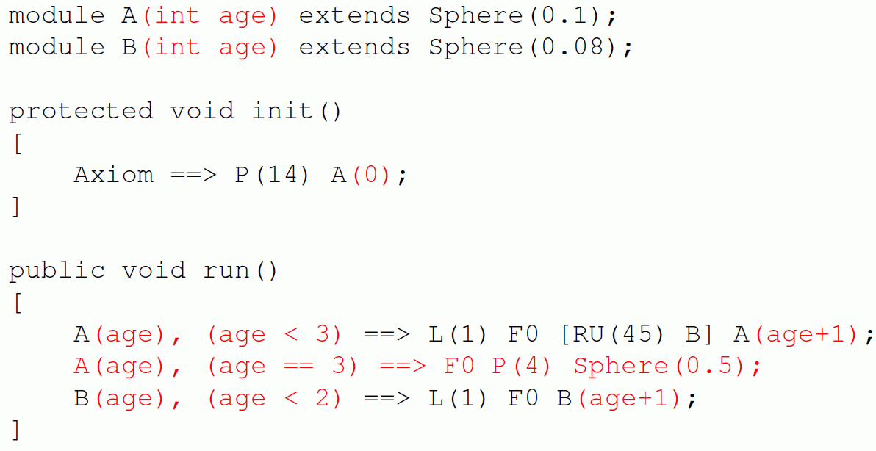
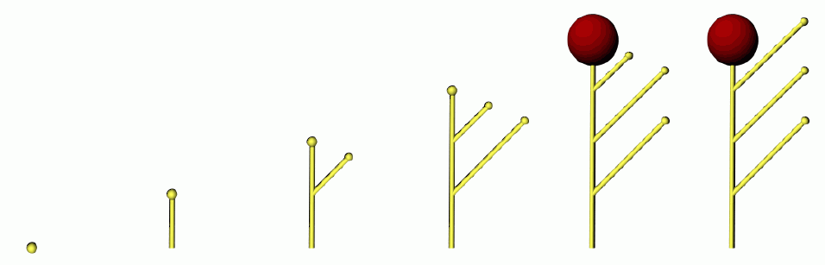
Example:

Slide 11
What structure is generated by the following L-System?
Axiom ==> [ RU(90) M(1) RU(90) A(1) ] A(1);
A(n) ==> F(n) RU(90) A(n+1);

Slide 12
What structure is generated by the following L-System?
Axiom ==> [ RU(90) M(1) RU(90) A(1) ] A(1);
A(n) ==> F(n) RU(90) A(n+1);
Alternative:
in the second rule replace "RU(90)" for instance,
by "RU(92)"

Slide 13
Examples:
sm09_e04.rgg - two rule blocks
sm09_e05.rgg - alternating positioning of lateral
branches
sm09_e06.rgg - shoot growth with opposite
branching (in 3d)
sm09_e07.rgg - insert simple imperative XL code
directly into a rule
sm09_e08.rgg - define your own modules in order
to simplify the code
sm09_e21.rgg - 3 variants how to position lateral
branches at another place than at
the end of an object

Slide 14
Using Imperative Code in XL Programs
Commands such as assignments of values to variables, additions, function statements, output (print commands), etc., are specified with the same notation as in the Java programming language and are enclosed in curly brackets { ... }
Examples:
int i; // Declaration of an integer variable with the name i
float a = 0.0; // Declaration and initialization
// of a floating point variable
int[] x = new int[20]; // Declaration of an array (data field) with
// length 20; with access: x[0], ..., x[19]
float[] y = { 0.1, 0.2, 0.7, -1.4 }; // Declaration and
// initialization of an array
i = 25; // assignment

Slide 15
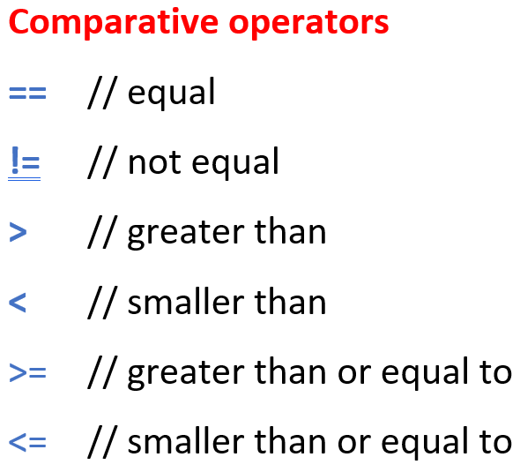
Use of imperative code (continued)
i++; // i will be increased by 1
i--; // i will be decreased by 1
i += 5; // i will be increased by 5
i -= 5; // i will be decreased by 5
i *= 2; // i will be doubled
i /= 3; // i will be divided by 3
n = m % a; // n becomes the remainder of m after integer
// division by a
x = Math.sqrt(2); // x is the square root of 2 by assignment
if (x != 0) { y = 1/x; } // conditional assignment of 1/x to y
while (i <= 10) { i++; } // Loop: as long as i ≤ 10,
// i is increased by 1
for (i = 0; i < 100; i++) { x[i] = 2*i; } // imperative
// for-loop
if (i == 0) { ... } // test for equality ( “=“ would be assignment!)

Slide 16
Simple Data Types:
int - integers
float - floating point numbers
double - floating point numbers, double precision
char - characters
void - empty type (for functions that return nothing)

Slide 17
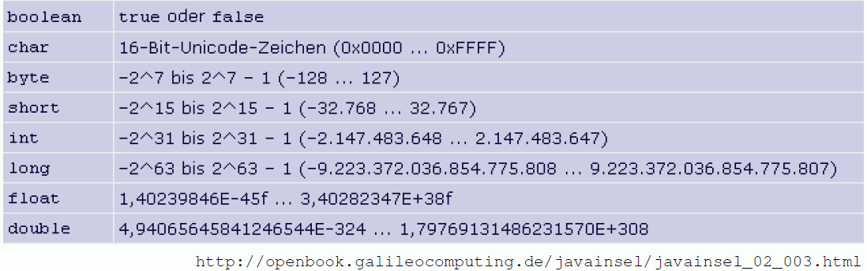
Simple Data Types:
int - integers
float - floating point numbers
double - floating point numbers, double precision
char - characters
void - empty type (for functions that return nothing)
Exact definition:
or
characters
till
till
till
till

Slide 18
Mathematical constants:
Math.PI π
Math.E e
Logical operators:
&& AND
|| OR
! NOT

Slide 19
Mathematical Functions:
Math.abs absolute value Math.sqrt square root
Math.acos arccosine Math.tan tangent
Math.asin arcsine Math.toDegrees
Math.atan arctangent Math.toRadians
Math.cos cosine
Math.exp exponential function e^{x}
Math.log natural logarithm
Math.max maximum of two numbers
Math.min minimum of two numbers
Math.round rounding function
Math.sin sine
Conversion –
degree ↔ radian measurement

Slide 20
sm_progbsp01.rgg
A simple imperative program:
the numbers from 1 to 10 are output to the GroIMP console
protected void init()
{
int i;
for (i=1; i<= 10; i++)
println(i);
println("End.");
}

Slide 21
Assignment for our next lecture:
(1) Work in the ILIAS learning module “GroIMP – Module XL“ (available through StudIP):
- Lessons 1 - 5
(2) Read Chapter 1, Sections 1.6 – 1.7 and 1.10 / 1.10.1 in the book “The Algorithmic Beauty of Plants“ by P. Prusinkiewicz and A. Lindenmayer (available online, see literature site for the course). (= pp. 21-30 and 40-43).

