Slide 1
Functional-Structural Plant Models
Summer semester 2023 -
Winfried Kurth
University of Göttingen
Chair of Computer Graphics and Ecoinformatics
11th Lecture: 6 July, 2023

Slide 2
From our last lecture:
Sequential and parallel derivation mode
Modelling diameter growth
Instantiation rules

Slide 3
On our next slides:
Simple functional-structural plant model
(first steps: 1-5)
GroIMP’s integrated radiation model

Slide 4
Simple functional-structural plant model (FSPM) in 10 steps
no real plant species, rather a general basic shape and development
(cf. Goethe: “Urpflanze")
mimics an annual plant
modification / adaptation of the model will be part of the assignment
functional part will be: light interception, photosynthesis, transport of assimilates in the plant
in the first versions, purely structural model of a plant

Slide 5
First version (sfspm01.rgg):
/* Steps towards a simple FSPM. sfspm01.rgg:
A simple plant with leaves and branching
is generated.
Original version by G. Buck-Sorlin; modified. */
module Bud extends Sphere(0.1)
{{ setShader(RED); }};
module Node extends Sphere(0.07)
{{ setShader(GREEN); }};
module Internode extends F;
/* leaves are rectangles: */
module Leaf extends Parallelogram(2, 1);
const float G_ANGLE = 137.5; /* golden angle */

Slide 6
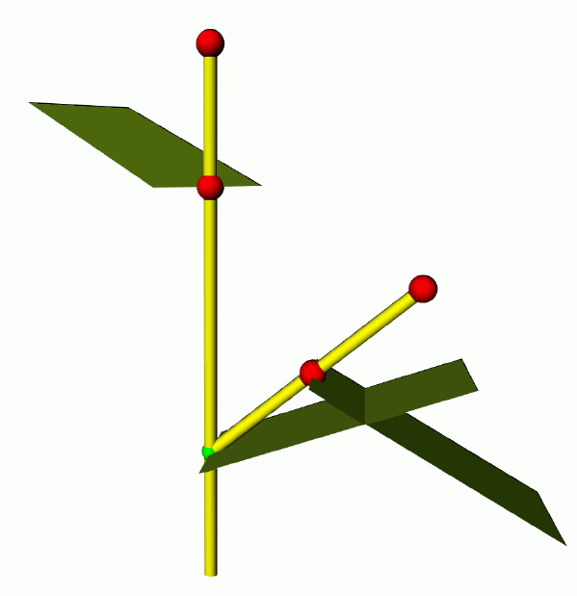
/* simple plant, with leaves and branches: */
protected void init()
[
Axiom ==> Bud;
]
public void run()
[
Bud ==> Internode Node [ RL(50) Bud ] [ RL(70) Leaf ]
RH(G_ANGLE) Internode Bud;
]
(an “Internode” is here basically half of an internode)

Slide 7
Second version (sfspm02.rgg)
Restriction of the branching order
module Bud(int order) extends Sphere(0.0001)
{{ setShader(RED); setRadius(0.2); }};
module Node extends Sphere(0.07)
{{ setShader(GREEN); }};
module Internode extends F;
module Leaf extends Parallelogram(2, 1);
const float G_ANGLE = 137.5; /* golden angle */
/* simple plant, with leaves and branches: */
protected void init()
[
Axiom ==> Bud(0);
]
public void run()
[
Bud(o), (o < 3) ==> Internode Node [ RL(50) Bud(o+1) ]
[ RL(70) Leaf] RH(G_ANGLE) Internode Bud(o);
]

Slide 8
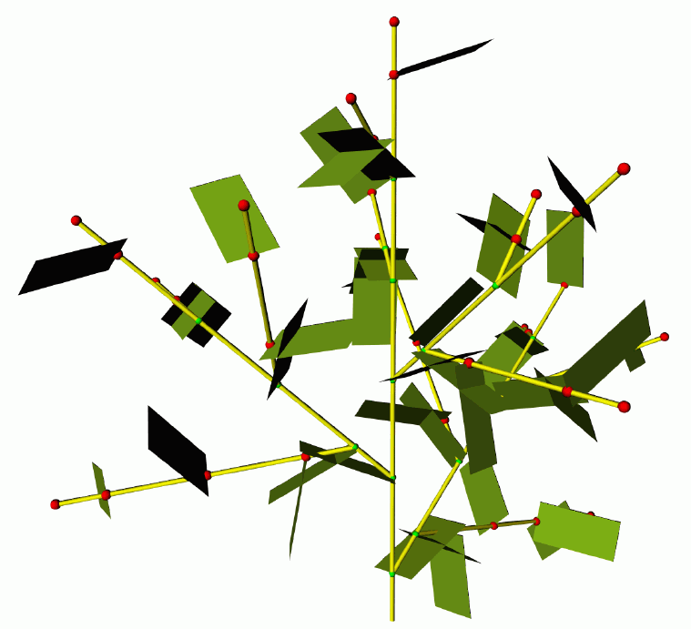
restricted branching order

Slide 9
Third version:
- more precise timing for appearance of new metamers (internode, node, leaf)
- Phyllochron = time span between the appearances of new metamers in apical position at the same shoot axis
- (often used as synonym: plastochron, but this means in its proper sense the time span between two initiations of new metamers)
- (Phyllochron: notion does not depend on growth being preformed or neoformed)
Time count in the model in discrete steps
(1 step = 1 parallel application of rules)
finer time steps!

Slide 10
sfspm03.rgg
module Bud (int ph, int order) extends Sphere(0.1)
{{ setShader(RED); }};
module Node extends Sphere(0.07)
{{ setShader(GREEN); }};
module Internode extends F;
module Leaf extends Parallelogram(2, 1);
const float G_ANGLE = 137.5; /* golden angle */
/* introducing a phyllochron */
const int PHYLLO = 25;
protected void init()
[
Axiom ==> Bud(PHYLLO, 0);
]
public void run()
[
Bud(p, o), (p > 0) ==> Bud(p-1, o); /* first parameter
counted down until...*/
Bud(p, o), (p == 0 && o <= 1) ==> Internode Node
[ RL(50) Bud(PHYLLO, o+1) ] [RL(70) Leaf]
RH(G_ANGLE) Internode Bud(PHYLLO, o);
/* (order restricted to 1 ... for efficiency) */
]

Slide 11
sfspm04.gsz: with flowers and textured organs
const ShaderRef leafmat = new ShaderRef("Leafmat");
const ShaderRef petalmat = new ShaderRef("Petalmat");
const ShaderRef internodemat = new ShaderRef("Internodemat");
const ShaderRef nodemat = new ShaderRef("Nodemat");
module Bud(int time, int ph, int order) extends Sphere(0.1)
{{ setShader(nodemat); }};
module Node extends Sphere(0.07)
{{ setShader(GREEN); }};
module NiceNode extends Sphere(0.07)
{{ setShader(nodemat); }};
module Internode extends F(1, 0.1, 7);
module NiceInternode extends Cylinder(1, 0.08)
{{ setShader(internodemat); }};
module Leaf extends Parallelogram(2, 1)
{{ setColor(0x82B417); }};
module NiceLeaf extends Parallelogram(2,2)
{{ setShader(leafmat); }};
module Flower ==> /* Instanzierungsregel */
RU(180) Cone(0.3, 0.3).(setColor(0x82B417)) M(-0.25) RL(90)
[ for (int i=1; i<=5; i++) ( [ RU(i*360/5) RL(20)
Parallelogram(2, 1).(setColor(0xFF00FF)) ] ) ] RU(45)
[ for (int i=1; i<=5; i++) ( [ RU(i*360/5) RL(40) F(0.3, 0.1, 14) RV(-0.3)
F(0.3, 0.1, 14) RV(-0.3) F(0.3, 0.1, 14) ] ) ] RU(-45)
[ for (int i=1; i<=5; i++) ( [ RU(i*360/5) RL(70)
Frustum(0.7, 0.2, 0.05).(setColor(0x8DAF58)) ] )
module NiceFlower ==>
RU(180) Cone(0.3, 0.3).(setShader(internodemat)) M(-0.25) RL(90)
[ for (int i=1; i<=5; i++) ( [ RU(i*360/5) RL(20)
Parallelogram(2, 1).(setShader(petalmat)) ] ) ] RU(45)
[ for (int i=1; i<=2; i++) ( [ RU(i*360/3) RL(40) F(0.3, 0.1, 14) RV(-0.3)
F(0.3, 0.1, 14) RV(-0.3) F(0.3, 0.1, 14) ] ) ] RU(-45)
[ for (int i=1; i<=5; i++) ( [ RU(i*360/5) RL(70)
Frustum(0.7, 0.2, 0.05).(setColor(0x8DAF58)) ] ) ];

Slide 12
// sfspm04.gsz, continuation
const float G_ANGLE = 137.5; /* golden angle */
const int PHYLLO = 25;
protected void init()
[
Axiom ==> Bud(1, PHYLLO, 0);
]
public void run()
[
Bud(r, p, o), (p > 0) ==> Bud(r, p-1, o);
Bud(r, p, o), (r<10 && p==0 && o<=2) ==> RV(-0.1) NiceInternode NiceNode
[ RL(50) Bud(r, PHYLLO, o+1) ] [ RL(70) NiceLeaf ] RH(G_ANGLE) RV(-0.1)
NiceInternode Bud(r+1, PHYLLO, o);
Bud(r, p, o), (r == 10) ==> RV(-0.1) NiceInternode RV(-0.1)
NiceInternode NiceFlower;
]
Additionally there are image files for the used textures, which are connected manually in GroIMP with the shader names "Leafmat", "Petalmat" etc. (see Lecture on textures)

Slide 13
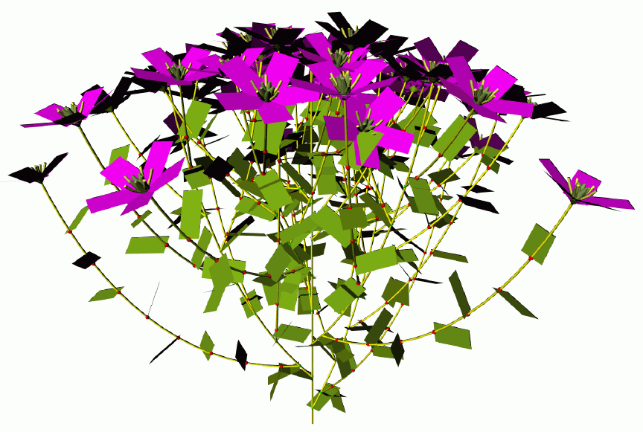
A variant with simpler “Flower” instead of the texturized “NiceFlower”

Slide 14
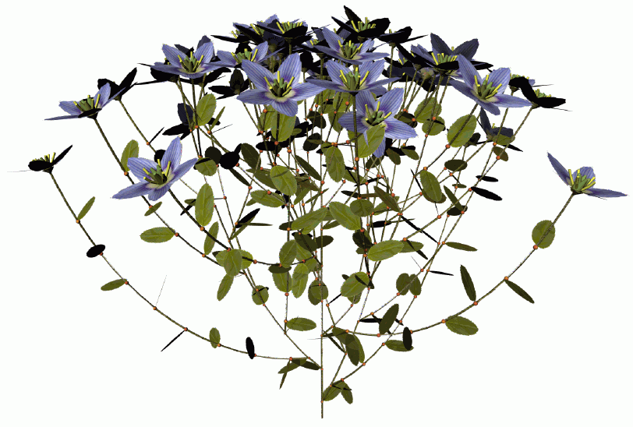
A variant with “NiceFlower” and “NiceLeaf”

Slide 15
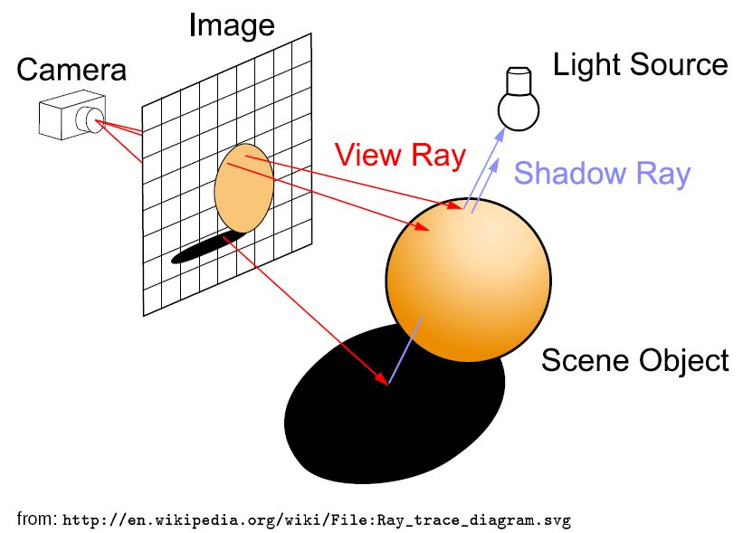
Model approach for light calculation
(physically more accurate than the "shadow cone" approach from last time)
Raytracing - a method from computer graphics
Basic principle:
Additionally the ray can be traced along one or several reflections

Slide 16
we don't want to generate an image, but calculate for all leaves of the virtual plant the amount of intercepted light
→ reversal of the direction of the rays:
the rays run from the light sources to the objects ("photontracing"). An extra shadow test is not necessary.
a large number of rays with random directions is generated: "Monte-Carlo-Raytracing".
accumulation of the intercepted power of radiation (in the unit W = Watt) is possible for each object
Requirement: there has to be a light source in the scene
DirectionalLight, PointLight, SpotLight, Sky

Slide 17
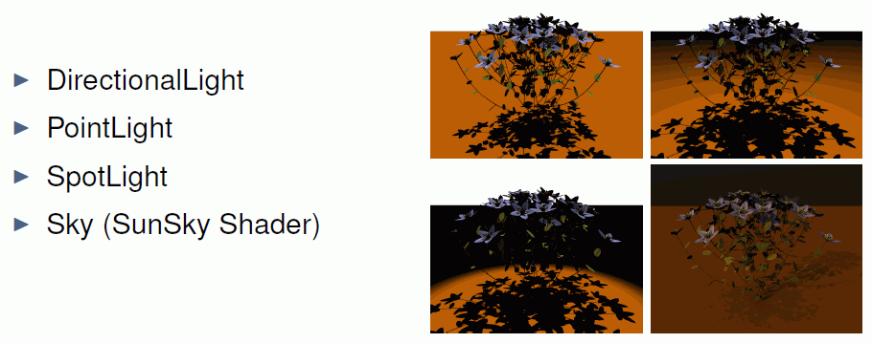
Types of light sources in the scene

Slide 18
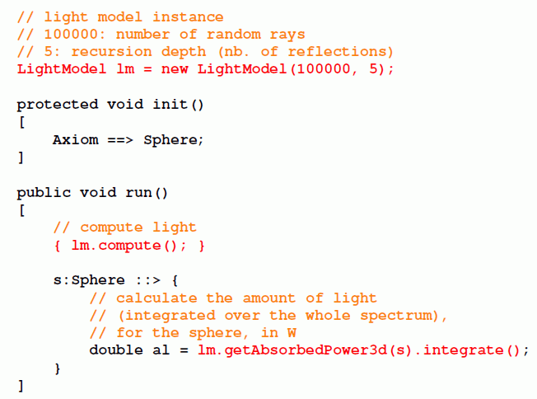
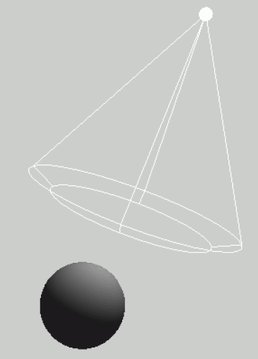
The radiation model of GroIMP

Slide 19
sfspm05.gsz (only new parts of the model are displayed)
Light source inserted into the scene; special feature: AlgorithmSwitchShader
// ..... module definitions .....
/* the leaf collects light and gets a new shader for the radiation model: */
module Leaf(float al) extends Parallelogram(2, 1)
{{ setShader(new AlgorithmSwitchShader(new RGBAShader(0, 1, 0), GREEN)); }};
// ..... further module definitions .....
/* the light source: */
module MyLamp extends SpotLight
{{
setPower(200.0); /* power in W */
setAttenuationDistance(50.0); /* in m */
setAttenuationExponent(0.0);
setInnerAngle(22.5*Math.PI/180.0);
setOuterAngle(30.0*Math.PI/180.0);
}};
module MyLight extends LightNode(1.0, 1.0, 1.0) /* R, G, B */
{{ setLight(new MyLamp()); }};
/* the radiation model is defined */
LightModel lm = new LightModel(100000, 5);
/* 100000: number of random rays, 5: recursion depth (nb. of reflections) */
GUI-Shader Radiation-Shader

Slide 20
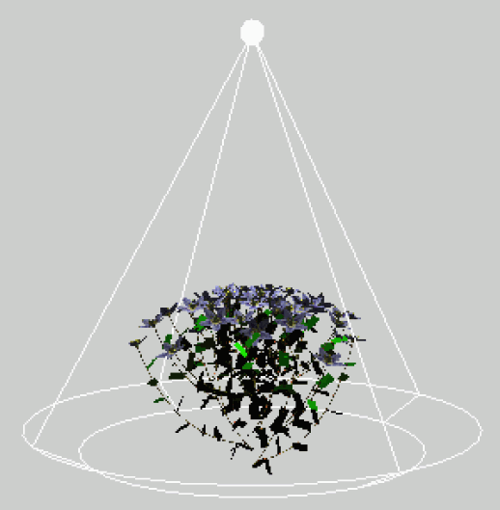
sfspm05.gsz (only new parts of the model are displayed)
protected void init()
[
Axiom ==> Bud(1, PHYLLO, 0);
==> ^ M(50) RU(180) MyLight; /* Light source is placed above the scene */
]
public void grow()
{
run();
lm.compute();
absorb();
}
protected void run()
[
Bud(r, p, o), (p>0) ==> ..........
// further rules....
]
protected void absorb()
[
lf:Leaf ::>
{
lf[al] = lm.getAbsorbedPower3d(lf).integrate();
lf.(setShader(new AlgorithmSwitchShader(
new RGBAShader((float) lf[al]/5.0, (float) lf[al]*2, (float) lf[al]/100.0),
GREEN)));
println(lf[al]);
}
]

Slide 21
sfspm05.gsz (only new parts of the model are displayed)
// ..... module definitions .....
/* the leaf collects light and gets a new shader for the radiation model: */
module Leaf(float al) extends Parallelogram(2, 1)
{{ setShader(new AlgorithmSwitchShader(new RGBAShader(0, 1, 0), GREEN)); }};
// ..... further module definitions .....
/* the light source: */
module MyLamp extends SpotLight
{{
setPower(200.0); /* power in W */
setAttenuationDistance(50.0); /* in m */
setAttenuationExponent(0.0);
setInnerAngle(22.5*Math.PI/180.0);
setOuterAngle(30.0*Math.PI/180.0);
}};
module MyLight extends LightNode(1.0, 1.0, 1.0) /* R, G, B */
{{ setLight(new MyLamp()); }};
/* the radiation model is defined */
LightModel lm = new LightModel(100000, 5);
/* 100000: number of random rays, 5: recursion depth (nb. of reflections) */

Slide 22
sfspm05.gsz (continuation)
protected void init()
[
Axiom ==> Bud(1, PHYLLO, 0);
==> ^ M(50) RU(180) MyLight; /* Light source is placed above the scene */
]
public void grow()
{
run();
lm.compute();
absorb();
}
protected void run()
[
Bud(r, p, o), (p>0) ==> ..........
// further rules....
]
protected void absorb()
[
lf:Leaf ::>
{
lf[al] = lm.getAbsorbedPower3d(lf).integrate();
lf.(setShader(new AlgorithmSwitchShader(
new RGBAShader((float) lf[al]/5.0, (float) lf[al]*2, (float) lf[al]/100.0),
GREEN)));
println(lf[al]);
}
]

