Slide 1
Functional-Structural Plant Models
Summer semester 2023
Winfried Kurth
University of Göttingen
Chair of Computer Graphics and Ecoinformatics
10th Lecture: 29 June, 2023

Slide 2
From our last lecture:
Notations for derived relations in graphs
Overview of XL and GroIMP
Graph queries in XL
Cone-based shadow model

Slide 3
On the following slides:
Cone-based shadow model (revisited)
Sequential and parallel derivation modes
A model for diameter growth
Instantiation rules and their application

Slide 4
Cone-based shadow model
sm09_e42.rgg
module Segment(int t, int ord) extends F0;
module TBud(int t) extends F(1, 1, 1);
module LBud extends F(0.5, 0.5, 1);
Vector3d z = new Vector3d(0, 0, 1);
protected void init()
[
Axiom ==> P(2) D(5) V(-0.15) [ TBud(-4) ] RU(90) M(600) RU(-90)
[ TBud(0) ] RU(-90) M(1200) RU(90)
[ TBud(-8) ];
]
public void run()
[
TBud(t), (t < 0) ==> TBud(t+1);
x:TBud(t), (t >= 0 && empty( (* s:Segment, (s in cone(x, z, 45)) *) ) ) ==>
L(random(80, 120)) Segment(0, 0)
[ MRel(random(0.5, 0.9)) RU(60) LBud ]
[ MRel(random(0.5, 0.9)) RU(-60) LBud ] TBud(t+1);
y:LBud,
(empty( (* s:Segment, (s in cone(y, z, 45)) *) ) ) ==>
L(random(60, 90) Segment(0, 1) RV0 LBud;
Segment(t, o), (t < 8) ==> Segment(t+1, o);
Segment(t, o), (t >= 8 && o == 1) ==>> ; /* Deletion of branches */
]

Slide 5
Derivation modes in XL
- Default: parallel application of rules (like in L-systems)
- To switch into sequential mode (then in each step at most one rule is applied to one match):
setDerivationMode(SEQUENTIAL_MODE)
- To switch back to parallel mode use:
setDerivationMode(PARALLEL_MODE)
Test the following example:
sm09_e32.rgg

Slide 6
Modelling diameter growth in plants
Frequently used approaches:
Regression diameter ~ length for new growth units
- Diameter increment dependent from age, branch order, etc.
e.g., use rule with fixed annual growth
Shoot(l, d) ==> Shoot(l, d+delta_d);
Interpretive rule for shoot: Shoot(l, d) ==> F(l, d);
or: “pipe-model” assumption

Slide 7
“pipe model”
(Shinozaki et al. 1964)
Parallel “unit pipes”
Cross section area
~ leaf mass
~ fine root mass

Slide 8
Conclusion
“Leonardo rule” (da Vinci, about 1500)
d_{i}
In each branching node we have
d² = Σ d_{i}²
(invariance of cross section area)
↔
↔
d

Slide 9
Realization in an XL Model:
see examples sm09_e33.rgg, sm09_e34.rgg
In those examples, first the structural and length growth is simulated, then in separate steps the diameter growth, calculated top-down
(also, a more realistic combination is possible)
A₁
A = A₁ + A₂
d ² = d₁² + d₂²
A
A₂

Slide 10
Yet another rule type in XL
Instantiation rules
Purpose: replacement of individual modules with more complicated structures, for display only (as with interpretive rules)
But, less is saved (saving storage space)
unlike interpretive rules, no turtle commands are used with effect on other nodes
Further possibility: "replicator node" for copying and repositioning of entire structures

Slide 11
Instantiation rules - syntax
no new rule arrow
specifying the instantiation rule directly in the module declaration
module A ==> B C D;
replaces (instantiates) everywhere A by B C D
Example:
sm09_e43.rgg

Slide 12
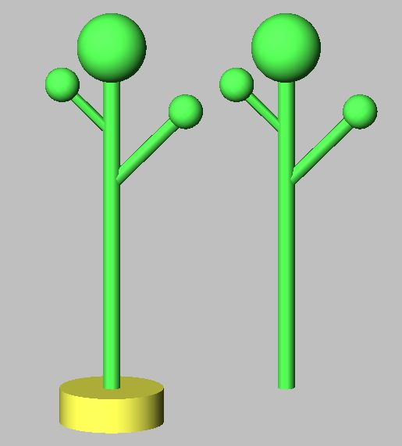
const int multiply = EDGE_0; /* self-defined edge type */
module Tree ==> F(20, 1)
[ M(-8) RU(45) F(6, 0.8) Sphere(1) ]
[ M(-5) RU(-45) F(4, 0.6) Sphere(1) ] Sphere(2);
module Replicator ==> [ getFirst(multiply) ] Translate(10, 0, 0)
[ getFirst(multiply) ];
public void run1()
[
Axiom ==> F(2, 6) P(10) Tree;
]
public void run2()
[
Axiom ==> F(2, 6) P(10) Replicator -multiply-> Tree;
]
Tree is instantiated with the red structure
it will be inserted what is hanging at the "multiply" edge

Slide 13
Another example of an application of a multiplier node with instantiation rule
(Henke 2006)

