Slide 1


Functional-Structural Plant Models
Summer semester 2023
Winfried Kurth
University of Göttingen
Chair of Computer Graphics and Ecoinformatics
8. Lecture: 15th June, 2023

Slide 2
From our last lecture:
Graph as mathematical basic structure
Graph replacement rules
Two rule types: L-system and SPO rules
Simple spruce model

Slide 3
On our next slides:
Notation of graphs in XL
The current graph in GroIMP
Preparation for morphological measurements (June 22/29,
9:00 a.m., Forest Botany and Tree Physiology department)

Slide 4
Repetition: RELATIONAL GROWTH GRAMMARS
RGG: Relational Growth Grammars, parallel graph grammars
Summary: Structure of a rule of a RGG
(* C *), L,(E) ==> R { P };
Context
(Set of graphs)
Left-hand side of rule
(Set of graphs
to be replaced by R)
Condition
(Set of logical expressions, contains parameters related to node labels from L and C)
Right-hand side of rule
(Set of graphs)
Imperative Code
(List of commands)
Graphs: directed with edge-labels and node-labels

Slide 5
Another type of rule
Update rules
Sometimes you don't want to change anything in the graph structure, but only change attributes of a single node (e.g. to calculate the photosynthesis for a leaf). There is a separate rule type for this:
A ::> { imperative Code };
Test the following examples:
sm09_e25.rgg
sm09_e16.rgg
sm09_e18.rgg

Slide 6
Display of graphs in the XL programming
language
● node types must be declared with "module”
● nodes can be all Java objects. In user-made module declarations, methods (functions) and additional variables can be introduced, as in Java
● Notation for nodes in a graph:
Node type, optionally preceded by: label:
Examples: A, Meristem(t), b:Bud
● Notation for edges in a graph:
-edgetype->
<-edgetype-
● Special edge types:
successor edge: -successor->, > or (blank)
branch edge: -branch->, +> or [
refinement or decomposition edge: />

Slide 7
Representation of graphs
Notation for edges in a graph:
-r-> forward
<-r- backward
-r- forward or backward
<-r-> forward and backward
r (edge identifier) = successor, branch, ancestor,
minDescendants, descendants, ... (more later)

Slide 8
User-defined edge types
const int xxx = EDGE_0; // or EDGE_1, ..., EDGE_14
Usage in the graph: -xxx->, <-xxx-, -xxx-

Slide 9
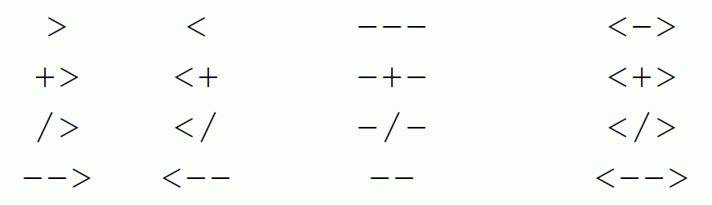
Notations for special edge types (overview)
forward backward forward or backward forward and backward
successor
branch
refinement
arbitrary

Slide 10
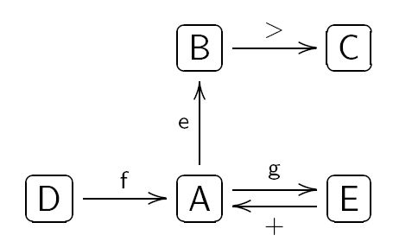
Notation of graphs in XL
Example:
is represented in program code as
(the representation is not unique!)
( >: successor edge, +: branch edge)

Slide 11
How can the following graph be described in XL code?
Bud
>
0
1
X
+
Leaf

Slide 12
The current graph
GroIMP maintains always a graph which contains the complete current structural information. This graph is transformed by application of the rules.
Attention: Not all nodes are visible objects in the 3-D view of the structure!
F0, F(x), Box, Sphere: Yes
RU(30), A, B: normally not (if not derived by “extends“
from visible objects)
The graph can be completely visualized in the 2-D graph view (in GroIMP: Panels - 2D - Graph).

Slide 13
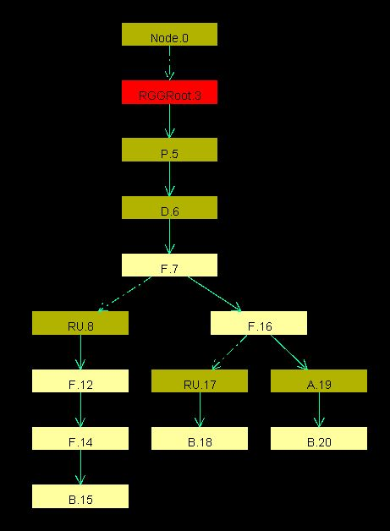
Load an example RGG file in GroIMP
and execute some steps (do not work with a too complex structure).
Open the 2-D graph view, fix the window with the mouse in the GroIMP user interface and test different layouts (Layout - Edit):
Tree
Sugiyama
Square
Circle
Random
SimpleEdgeBased
Fruchterman
Keep track of the changes of the
graph when you apply the rules
(click on “redraw”)

Slide 14
Which parts of the current graph of GroIMP are visible (in the 3-D view)?
all geometry nodes which can be accessed from the root (denoted ^) of the graph by exactly one path which consists only of "successor" and "branch" edges
How to enforce that an object is visible in any case:
==>> ^ Object

Slide 15
Morphological measurements, 22 and 29 June, 2023
Please bring the following:
Smartphone or camera
Coloured pencils
Ruler, protractor (if available)
Small adhesive labels (if available), alternatively “Tesafilm”
Notebook / Tablet to enter data in dtd format
3 Groups will work simultaneously
gas exchange / manual morphology / FASTRAK digitizer

Slide 16
Objects of investigation:
Young plants Hornbeam / Maple / Sweet Cherry / Beech, the same as for the photosynthesis measurements
Before the detailed measurements:
Give the tree a ID name (name tag!)
Check for special features
Define reference direction (in pot)
Photograph the tree from several sides (with reference direction and name tag)
record measured variables related to the entire tree

Slide 17
Measurement quantities related to the entire tree:
Height
Diameter at the base
Number of leaves
Number of side branches 1st order
Date of measurement
Units of measurement:
for lengths and diameters: mm
for angle: degrees
for masses: g (but in GroIMP, as a rule, SI unit: kg)

Slide 18
Preparation of the topological and geometrical detail survey of the tree:
Finding the annual shoot limits (shoot base scars), as far as possible!
Numbering of the internodes of the main axis (trunk) from bottom to top (with consideration of the annual shoot arrangement); correspondingly also for the side branches; if necessary short shoots and leaves.
For side branches: number further within each side branch
Topological sketch of the entire tree with all leaves on a large drawing sheet (use several sheets if necessary - provide enough space for length and angle information!)

Slide 19
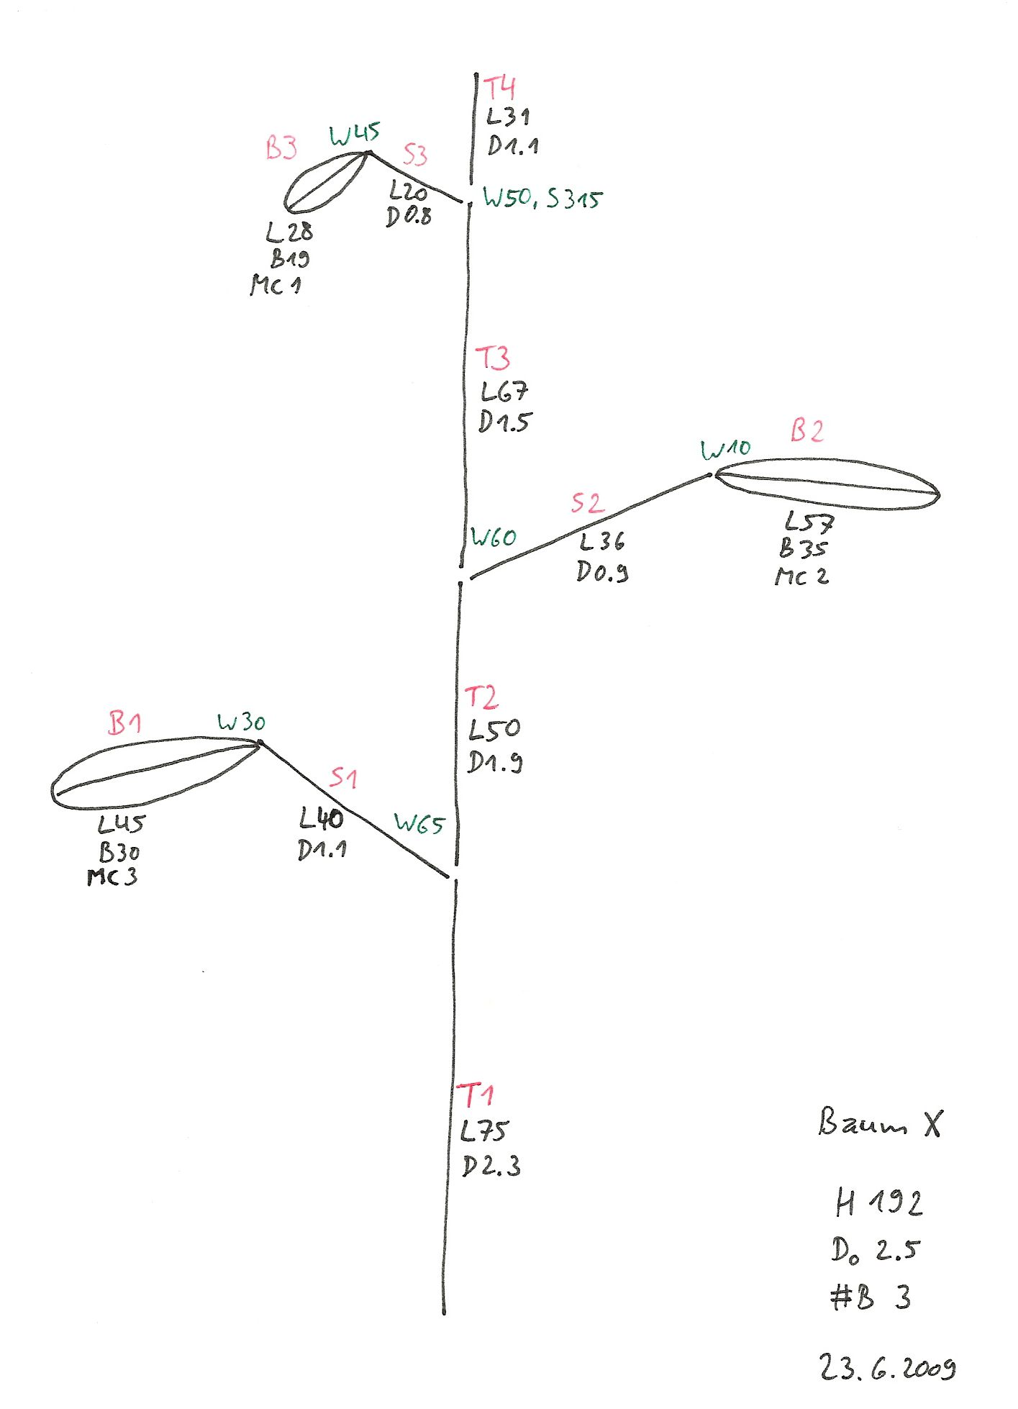
Red: Names of internodes, petioles and leaf blades
Black: Length (L), Diameter (D), Width (of leaf blade; B)
Green: Angle specifications. Angle of divergence (deviation from the growth direction of the main axis): W (in degrees), azimuth angle (relative to the reference direction on the ground): S (in degrees); note: no negative angles possible.
optional: angle between two consecutive internodes (W-indicator)

Slide 20
Corresponding dtd file:
T1 L75 ## O0 D2.3
T2 L50 #T1 V D1.9
T3 L67 #T2 V D1.5
T4 L31 #T3 V D1.1
S1 L40 #T1 - W65 D1.1
S2 L36 #T2 + W60 D0.9
S3 L20 #T3 S315 W50 D0.8
B1 L45 #S1 V R5 W30 C4 < B30 >
B2 L57 #S2 V R5 W10 C4 < B35 >
B3 L28 #S3 V R5 W45 C4 < B19 >
# Name of the parent segment
V stands for "extension" (of the axis)
+ for S90 (growth direction right)
– for S270 (growth direction left)
R5 for downward direction (= S180)
C4 for red colour marking (arbitrary)
The B-specifications for the leaf blades are written in comment brackets (currently no automatic processing by GroIMP)

Slide 21
Short shoot chains:
summary information possible through Qn instead of the length Lx
stands for short shoot chain consisting of n short shoots (no length specification provided)

Slide 22
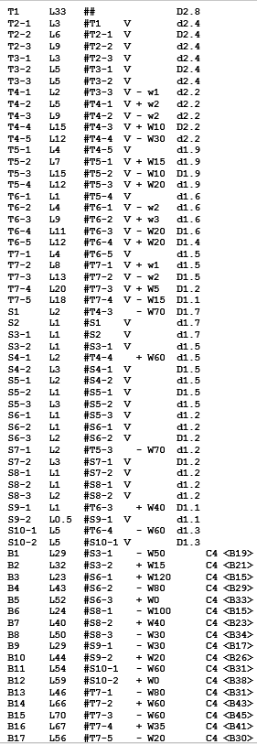
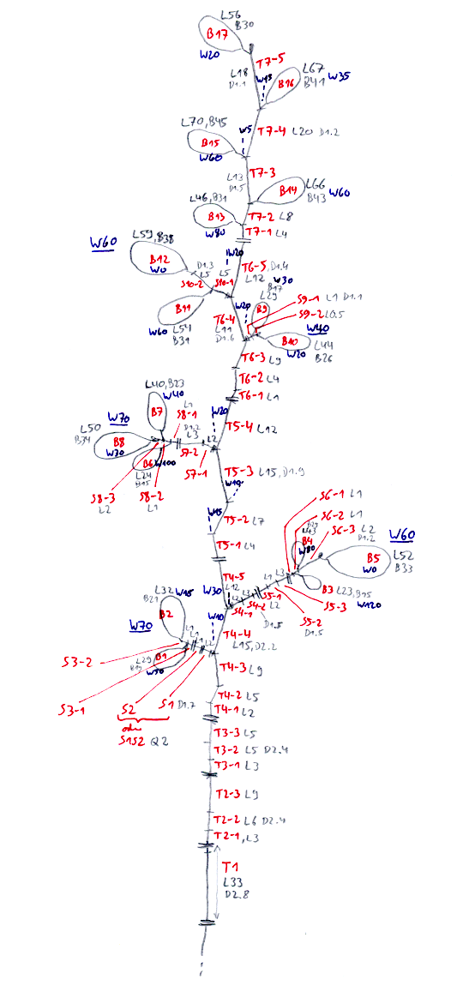
Example for small Beech
dtd-Data

Slide 23
Geometric detail measurements:
Length of internodes and petioles: accurate to mm
Diameter of internodes (annual growth at least 1 time per year) : accurate to 1/10 mm; measured in the middle
Length of a leaf: measured from the beginning of the leaf stalk to the blade tip, accurate to mm
Width of leaf: measured at the widest point
Leaf area (only by destructive measurement): possible with a special leaf measuring instrument after the dismemberment of the tree
Angle: accurate to 5° (azimuth angle: 10°); measurement between internode and midrib of leaf blade
Mass:
Internodes and Leaves: dry mass for entire tree

Slide 24
To analyze the measured data
dtd-Data:
upload in GroIMP - check for visual plausibility
Representation of leaves with width and area currently not possible (transfer leaf data to extra table)
First analyses: Creation of tables with GroIMP (elementary analysis; lengths and angles); also possible with queries from the GroIMP console
Statistical evaluation of tables (R or Statistica) (see description on Grogra-CD, to be adapted)
Targets: Progression of morphological quantities along the axes and during branching; correlation and regression analysis of the quantities among each other; mean values and standard deviations; non-linear adaptation of a light response curve to the photosynthesis data

Slide 25
How to upload dtd-Data in GroIMP
File / Open > choose dtd-Data > Open
Branching structure appears in the 3D view
Change camera settings if necessary
Modify the file and save
  modification becomes visible on the display

Slide 26
Checking for consistency of the dtd file:
Optical control
- pay special attention to the base shoot, are there
more (too many) shoots at the base?
- Checking the age count:
- Grogra analysis option F
- 5th column of the generated table: is age 0 too rare?

Slide 27
Simple analyses
some features were taken from the predecessor software GROGRA
Panels > RGG Panels > GROGRA functions > Analysis
There you can find:
- list of all shoots (generates complete list)
- elementary analysis
- basic tree parameters
- topological analysis (more on this later)

Slide 28
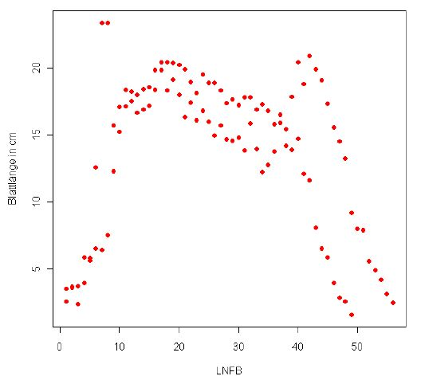
Example for statistical analysis
Trend for leaf length along the main tree trunk for Poplar
(assignment results from René Degenhard, 2008)

Slide 29
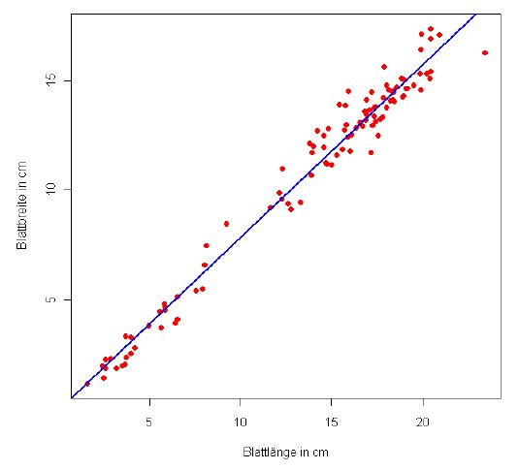
Correlation between leaf length and width for Poplar
(assignment results from René Degenhard, 2008)
The analysis of the data will be part of the assignment and will not be elaborated here any further.

