Slide 1
Functional-Structural Plant Models
Summer semester 2023 -
Winfried Kurth
University of Göttingen
Chair of Computer Graphics and Ecoinformatics
5th Lecture: 11 May, 2023

Slide 2
From our last lecture:
simple branching patterns modelled with L-systems
more L-system examples

Slide 3
Today:
two additional examples
using imperative code in XL programs
use of loops and arrays for branch constructions
conditional rule application (examples)
incorporation of textures into plant models
creating a project in GroIMP

Slide 4
Examples:
sm09_e08.rgg - define your own modules in order
to simplify the code
sm09_e21.rgg - 3 variants how to position lateral
branches at another place than at
the end of an object

Slide 5
Using Imperative Code in XL Programs
Commands such as assignments of values to variables, additions, function statements, output (print commands), etc., are specified with the same notation as in the Java programming language and are enclosed in curly brackets { ... }
Examples:
int i; // Declaration of an integer variable with the name i
float a = 0.0; // Declaration and initialization
// of a floating point variable
int[] x = new int[20]; // Declaration of an array (data field) with
// length 20; with access: x[0], ..., x[19]
float[] y = { 0.1, 0.2, 0.7, -1.4 }; // Declaration and
// initialization of an array
i = 25; // assignment

Slide 6
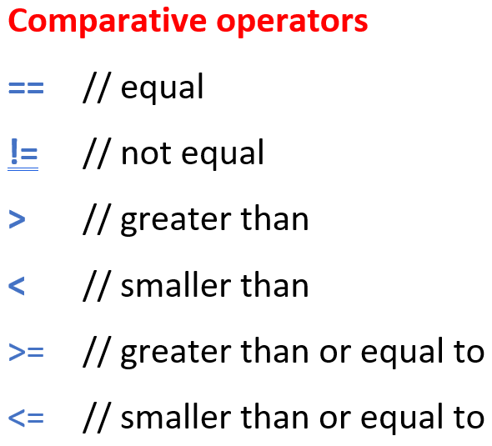
Use of imperative code (continued)
i++; // i will be increased by 1
i--; // i will be decreased by 1
i += 5; // i will be increased by 5
i -= 5; // i will be decreased by 5
i *= 2; // i will be doubled
i /= 3; // i will be divided by 3
n = m % a; // n becomes the remainder of m after integer
// division by a
x = Math.sqrt(2); // x is the square root of 2 by assignment
if (x != 0) { y = 1/x; } // conditional assignment of 1/x to y
while (i <= 10) { i++; } // Loop: as long as i ≤ 10,
// i is increased by 1
for (i = 0; i < 100; i++) { x[i] = 2*i; } // imperative
// for-loop
if (i == 0) { ... } // test for equality ( “=“ would be assignment!)

Slide 7
Simple data types in Java and XL:
int - integers
float - floating point numbers
double - floating point numbers, double precision
char - characters
void - empty type (for functions that return nothing)

Slide 8
Simple data types in Java and XL:
int - integers
float - floating point numbers
double - floating point numbers, double precision
char - characters
void - empty type (for functions that return nothing)
Exact definition:
or
characters
till
till
till
till

Slide 9
Mathematical constants:
Math.PI π
Math.E e
Logical operators:
&& AND
|| OR
! NOT

Slide 10
Mathematical Functions:
Math.abs absolute value Math.sqrt square root
Math.acos arccosine Math.tan tangent
Math.asin arcsine Math.toDegrees
Math.atan arctangent Math.toRadians
Math.cos cosine
Math.exp exponential function e^{x}
Math.log natural logarithm
Math.max maximum of two numbers
Math.min minimum of two numbers
Math.round rounding function
Math.sin sine
Conversion
degree ↔ radian measurement

Slide 11
sm_progbsp01.rgg
A simple imperative program:
the numbers from 1 to 10 are output to the GroIMP console
protected void init()
{
int i;
for (i=1; i<= 10; i++)
println(i);
println("End.");
}

Slide 12
sm_progbsp02.rgg
a simple imperative program:
the odd square numbers from 1 to 81 are output to the GroIMP console
protected void init()
{
int a, b;
for (a = 1; a <= 10; a++)
{
b = a*a;
if (b % 2 != 0) println(b);
}
println("end.");
}

Slide 13
sm_progbsp03.rgg
a simple imperative program
the first 20 Fibonacci numbers are written into an array
and then output to the GroIMP console
protected void init()
{
int i;
int[] fibo = new int[20]; /* Array declaration
and initialization */
fibo[0] = fibo[1] = 1;
for (i=2; i <= 19; i++)
fibo[i] = fibo[i-1] + fibo[i-2];
for (i=0; i <= 19; i++)
println(fibo[i]);
println("end.");
}

Slide 14
sm_progbsp04.rgg: using a function
/* a simple imperative program:
A self-written function calculates x² + 1;
this is evaluated for x from 0 to 1 in 0.1 steps.
Pay attention to rounding errors and to the correct upper limit for x. */
public float function(float x)
{
return x*x + 1;
}
protected void init()
{
float a = 0.0; /* floating-point number */
while (a <= 1.00001)
{
println(function(a)); /* evaluate function, and print */
a += 0.1; /* increment a */
}
println("end.");
}

Slide 15
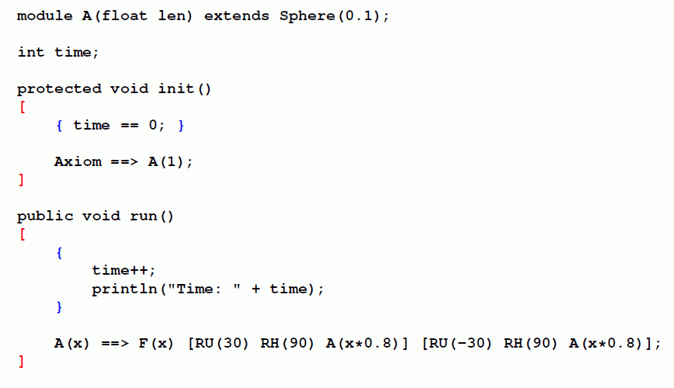
Nesting of rule-based and imperative code in XL
Rule-oriented block: [ … ]
Imperative block (similar to Java): { … }
=

Slide 16
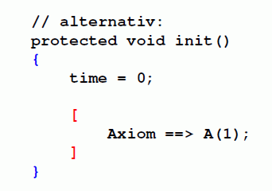
Nesting of rule-based and imperative code in XL
Rule-oriented block: [ … ]
Imperative block (similar to Java): { … }
alternatively:
=

Slide 17
Note the different syntax of control structures in the imperative and rule-based parts of XL:
imperative:
{
// ...
for (int i = 1; i <= 42; i++)
{
x[i] = 3*i + 1;
}
}
rule-based:
[
A(x) ==> for (int i = 1; i <= 7; i++)
(
RU(15) F(x)
);
]
(also with if ( ... ) )

Slide 18
Example of a for-loop:
the automatic generation of several lateral branches
sm09_e22.rgg
protected void init()
[ Axiom ==> F(10); ]
public void sideBranch()
[
F(x) ==> F(x) L(x)
for (int i=1; i<=5; i++)
(
[ MRel(0.1*i+0.2) RU((-1**i)*30) F(x*0.2) ]
);
]

Slide 19
Example of using arrays
difference between functions and arrays
sm09_e20.rgg
const float[] length = { 1, 1, 0.5, 0.2};
const float[] angle = {40, 50, 80 , 100 };
public void run1()
[
a:A, (a[order] < 4) ==> F(length[a[order]])
[ RU( angle[a[order]]) RH(90) A(a[order]+1) ]
[ RU(-angle[a[order]]) RH(90) A(a[order]+1) ];
]

Slide 20
Conditional L-system rule in XL
left side of rule, (condition) ==> right side of rule
Examples:
sm09_e11.rgg - how to make the application of a rule depend on a condition
sm09_e12.rgg - how to keep the branching order as a parameter and how to get access to its value in a condition
sm09_e13.rgg - how to connect two conditions logically

Slide 21
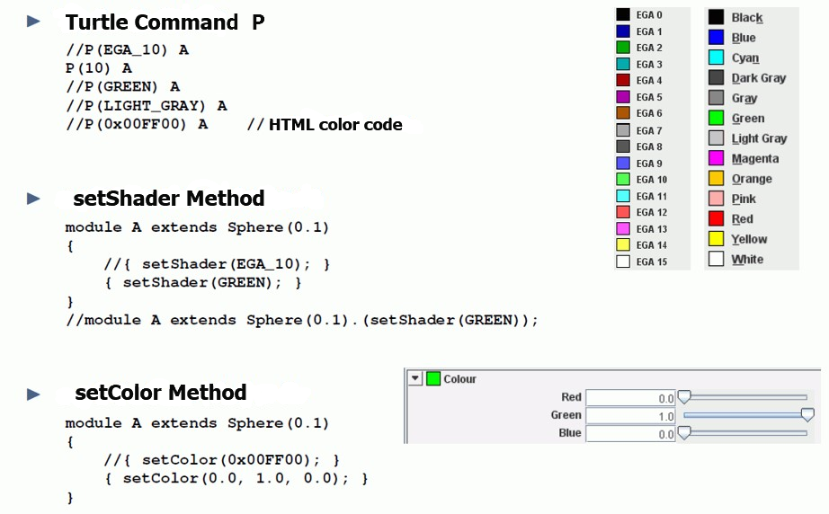
Setting colors in XL (summary)

Slide 22
Texture
Textures are 2-dimensional patterns that are applied to surfaces instead of colors to give a more realistic impression of the appearance of object surfaces.
Sources for textures: photos, scans of objects, image databases on the Internet, artificially generated patterns...

Slide 23
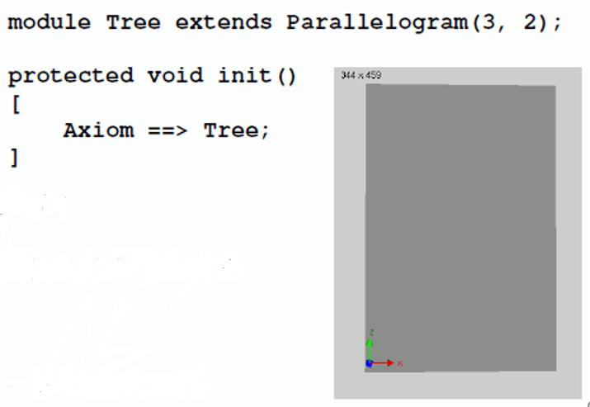
GroIMP project with textures
Our default program: see the box
Panels > Explorers > 3D > Shaders
The shader window to be anchored in the user interface
In the shader window: Object > New > Lambert
Name “Lambert” click twice (with pause) or tip F2 and rename (e.g., tree)
Double click on the Sphere icon > the Attribute Editor should open
In Attribute Editor: Diffuse color > Surface Maps > Image
Then click on: Image > From File
Choose your photo data and add to the project by using “Add File”

Slide 24
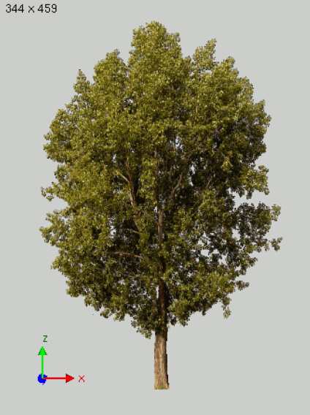
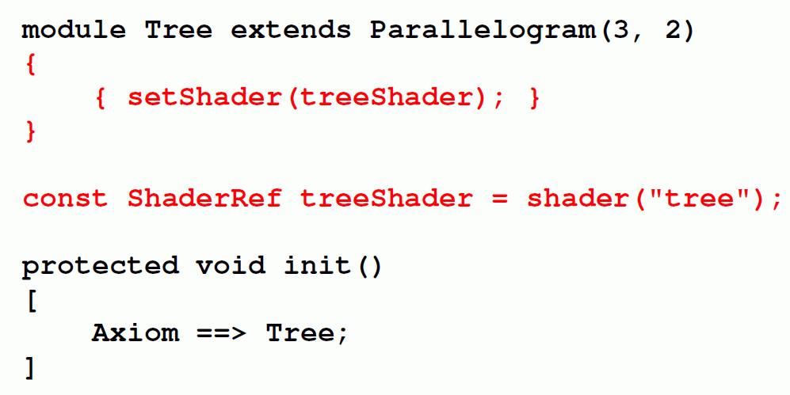
Example with tree photo as texture for the rectangle:

Slide 25
To be taken into account when creating the project:
after selecting the image file, the editor content needs to be saved / compiled once again
- textured objects are now displayed with texture
Saving the entire project :
File → Save, give name of the Project (does not have to match the name of the RGG program). Photo data will be saved.
Project data will have a name ending with .gsz (readable with a data compression program, e.g., WinZIP)
Example:
sm09_e10.gsz Use of a leaf texture

Slide 26
Assignment for our next lecture:
Work in the ILIAS learning module “GroIMP – Module XL“ (available through StudIP):
- Lessons 6 - 10

