Slide 1
Functional-structural plant models
- Summer Semester 2023 -
Winfried Kurth
University of Göttingen
Chair of Computer Graphics and Ecoinformatics
3rd Lecture: 27 April, 2023

Slide 2
From our last lecture:
Paradigms of programing (imperative, object-oriented, rule-based)
Turtle geometry
its execution with GroIMP

Slide 3
On our next slides
Branches in turtle geometry
simple L-systems (string replacement systems)
their execution with GroIMP
simple branching patterns modeled with L-systems

Slide 4
Branches:
Realization with memory commands
[ save current state to memory
("Tray", stack)
] take uppermost state from the stack and make this the current state
(so: the branch ends)

Slide 5
Branches:
Realization with memory commands
[ save current state to memory
("Tray", stack)
] take uppermost state from the stack and make this the current state
(so: the branch ends)
F0 [ RU(-40) F0 ] RU(20) DMul(2) F0

Slide 6
Branches:
Realization with memory commands
[ save current state to memory
("Tray", stack)
] take uppermost state from the stack and make this the current state
(so: the branch ends)
F0 [ RU(-40) F0 ] RU(20) DMul(2) F0

Slide 7
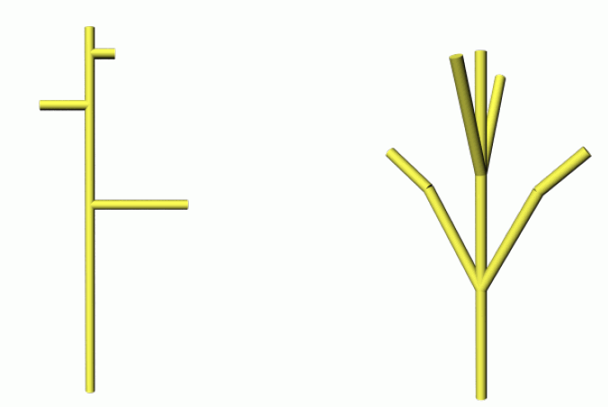
Which Turtle command sequences are used to create the following structures?

Slide 8
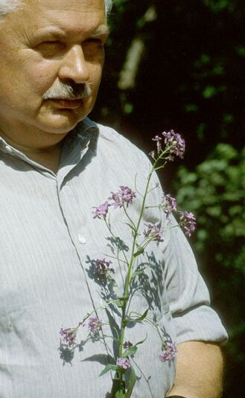
Dynamic structural description
L-Systems (Lindenmayer System)
Character string replacement control systems
In each derivation step, all characters to which a rule applies are replaced in parallel
introduced by A. Lindenmayer (botanist) in 1968 to model the growth of filamentous algae
Aristid Lindenmayer (1925-1989)

Slide 9
L-systems mathematically:
An L-system is a triple (Σ, α, R); therein is:
Σ a set of characters, the alphabet,
α a string with characters from Σ, the start word (also "Axiom"),
R a set of rules of the form
character → character string;
where the character on the left-hand side of the rule and the characters of the string are taken from Σ.

Slide 10
For comparison: Grammar for natural language
Sentence → S P O
S → Max
S → Tina
P → learns
O → English
O → French
Possible outcomes:
Sentence Sentence
S P O S P O
Max learns French Tina learns English

Slide 11
A derivation step (rewriting) of a character string consists of replacing all of its characters that occur on the left-hand side of a rule by the corresponding right-hand side of the rule.
One agrees that:
Characters to which no rules can be applied are transferred without change

Slide 12
A derivation step (rewriting) of a character string consists of replacing all of its characters that occur on the left-hand side of a rule by the corresponding right-hand side of the rule.
One agrees that:
Characters to which no rules can be applied are transferred without change.
Result:
Derivation chain of character strings that result from repeated application of the replacement process to the start word
α → σ₁ → σ₂ → σ₃ → ....

Slide 13
Example:
Alphabet {A, B}, start word A
Rule set:
A → B
B → AB

Slide 14
Example:
Alphabet {A, B}, start word A
Rule set:
A → B
B → AB
A

Slide 15
Example:
Alphabet {A, B}, start word A
Rule set:
A → B
B → AB
B

Slide 16
Example:
Alphabet {A, B}, start word A
Rule set:
A → B
B → AB
AB
parallel replacement

Slide 17
Example:
Alphabet {A, B}, start word A
Rule set:
A → B
B → AB
BAB

Slide 18
Example:
Alphabet {A, B}, start word A
Rule set:
A → B
B → AB
BAB

Slide 19
Example:
Alphabet {A, B}, start word A
Rule set:
A → B
B → AB
ABBAB

Slide 20
Example:
Alphabet {A, B}, start word A
Rule set:
A → B
B → AB
Derived chain:
A → B → AB → BAB → ABBAB → BABABBAB
→ ABBABBABABBAB → BABABBABABBABBABABBAB
→ ...

Slide 21
Example:
Alphabet {A, B}, start word A
Rule set:
A → B
B → AB
Derived chain:
A → B → AB → BAB → ABBAB → BABABBAB
→ ABBABBABABBAB → BABABBABABBABBABABBAB
→ ...
How long is the n^{th} string in this derivation?

Slide 22
Example:
Alphabet {A, B}, start word A
Rule set:
A → B
B → AB
Derived chain for better visualization:

Slide 23
What is still missing for the modelling of graphical and biological structures?
a geometric interpretation

Slide 24
What is still missing for the modelling of graphical and biological structures?
a geometric interpretation
So add:
A mapping that assigns to each string a subset of the 3-dimensional space
Then we have an "interpreted" L-System processing:
α → σ₁ → σ₂ → σ₃ → ....
↓ ↓ ↓
S₁ S₂ S₃ ....
S₁, S₂, S₃, ... can be interpreted as development levels of an object, a scene or an organism

Slide 25
For the interpretation of strings:
Turtle geometry
The turtle command set becomes a subset of the L-system character set
Symbols that are not turtle commands are ignored by the turtle

Slide 26
For the interpretation of strings:
Turtle geometry
The turtle command set becomes a subset of the L-system character set
Symbols that are not turtle commands are ignored by the turtle
→ connection with the imperative paradigm

Slide 27
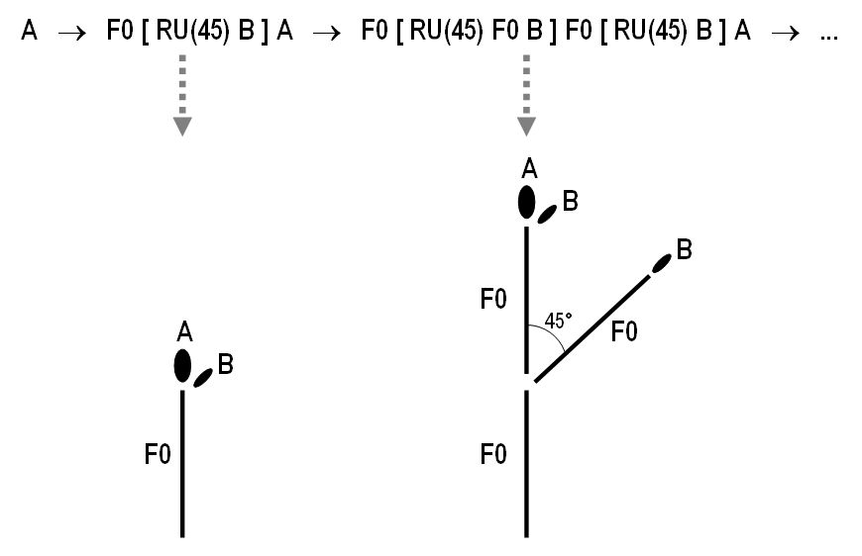
Example:
Rules
A ==> F0 [ RU(45) B ] A ;
B ==> F0 B ;
Start word A
(A and B would normally not be geometrically interpreted)
Interpretation
through
turtle geometry

Slide 28
What kind of structure does the following L-system provide
A ==> [ LMul(0.25) RU(-45) F0 ] F0 B;
B ==> [ LMul(0.25) RU(45) F0 ] F0 A;
with start word L(10) A ?

Slide 29
What kind of structure does the following L-system provide
A ==> [ LMul(0.25) RU(-45) F0 ] F0 B;
B ==> [ LMul(0.25) RU(45) F0 ] F0 A;
with start word L(10) A ?
Equivalent Rule:
A ==> [ LMul(0.25) RU(-45) F0 ] F0 RH(180) A;

Slide 30
Another Example:
Area-filling curve:
Axiom ==> L(10) RU(-45) X RU(-45) F(1) RU(-45) X;
X ==> X F0 X RU(-45) F(1) RU(-45) X F0 X

Slide 31
Area-filling curve:
Axiom ==> L(10) RU(-45) X RU(-45) F(1) RU(-45) X;
X ==> X F0 X RU(-45) F(1) RU(-45) X F0 X

Slide 32
Area-filling curve:
Axiom ==> L(10) RU(-45) X RU(-45) F(1) RU(-45) X;
X ==> X F0 X RU(-45) F(1) RU(-45) X F0 X
Indian Kolam pattern
"Anklets of Krishna"

Slide 33
Example code for a fractal:
Koch's Curve
Axiom ==> RU(90) F(10);
F(x) ==> F(x/3) RU(-60) F(x/3) RU(120) F(x/3) RU(-60) F(x/3)

Slide 34
Axiom ==> RU(90) F(10);
F(x) ==> F(x/3) RU(-60) F(x/3) RU(120) F(x/3) RU(-60) F(x/3)

Slide 35
Axiom ==> RU(90) F(10);
F(x) ==> F(x/3) RU(-60) F(x/3) RU(120) F(x/3) RU(-60) F(x/3)

Slide 36
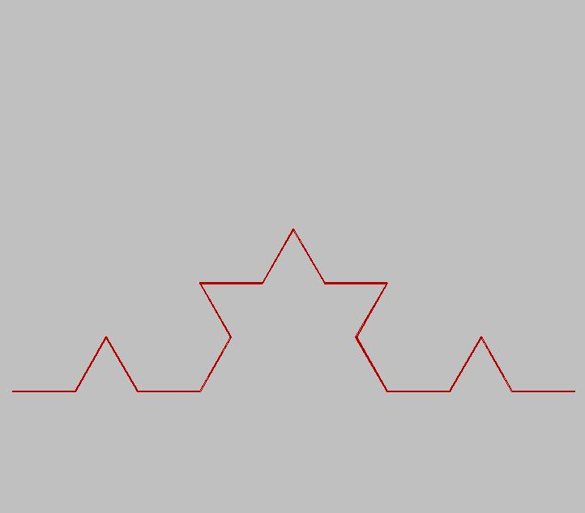
Axiom ==> RU(90) F(10);
F(x) ==> F(x/3) RU(-60) F(x/3) RU(120) F(x/3) RU(-60) F(x/3)

Slide 37
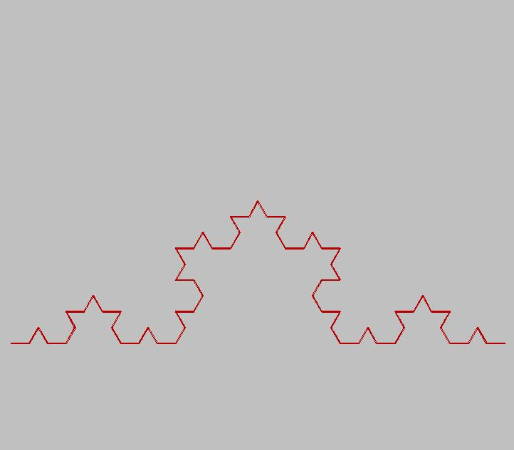
Axiom ==> RU(90) F(10);
F(x) ==> F(x/3) RU(-60) F(x/3) RU(120) F(x/3) RU(-60) F(x/3)

Slide 38
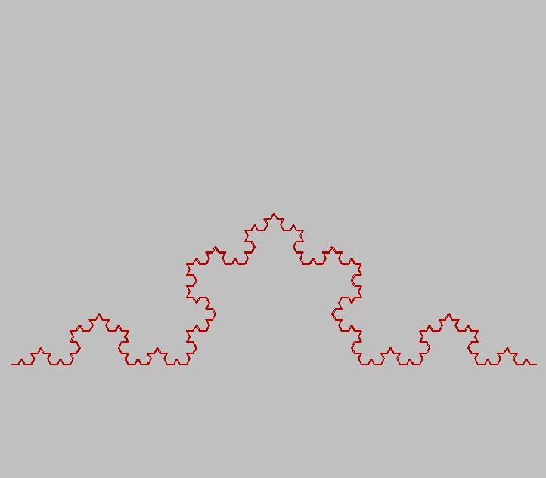
Axiom ==> RU(90) F(10);
F(x) ==> F(x/3) RU(-60) F(x/3) RU(120) F(x/3) RU(-60) F(x/3)

Slide 39
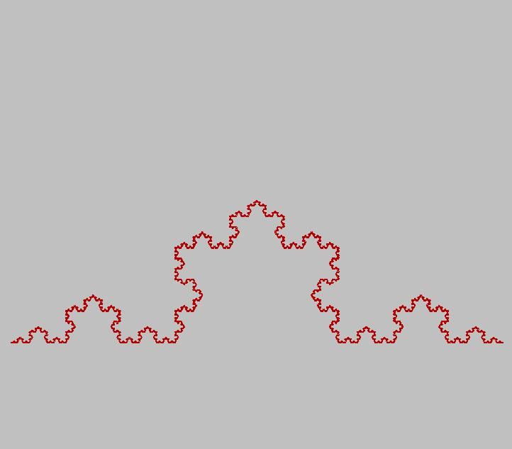
Axiom ==> RU(90) F(10);
F(x) ==> F(x/3) RU(-60) F(x/3) RU(120) F(x/3) RU(-60) F(x/3)
.

Slide 40
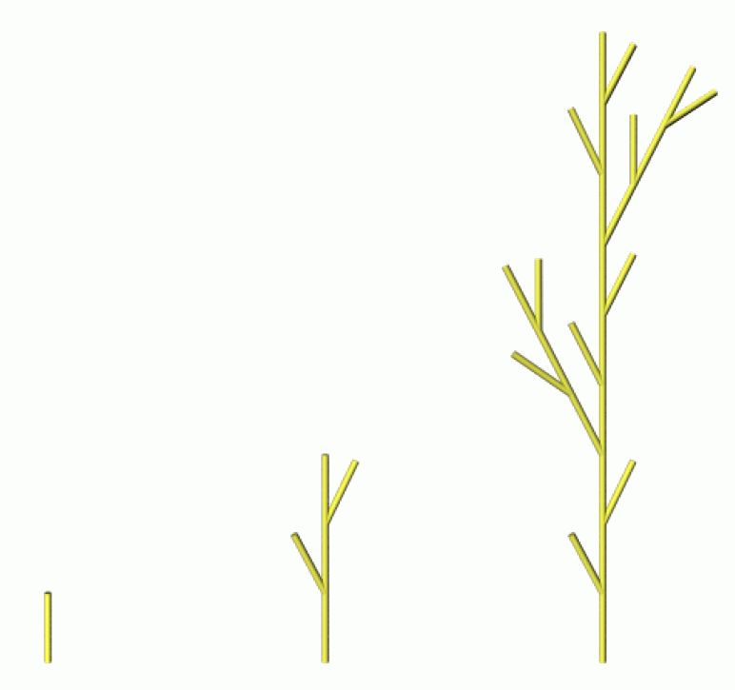
L-systems with GroIMP
Notation after Prusinkiewicz & Lindenmayer:
= 27.5
F
F → F [ + F ] F [ - F ] F
in the language XL:
protected void init()
[ Axiom ==> L(1) F0; ]
public void run()
[
F0 ==> F0 [ RU(-27.5) F0 ] F0
[ RU(27.5) F0 ] F0;
]

Slide 41
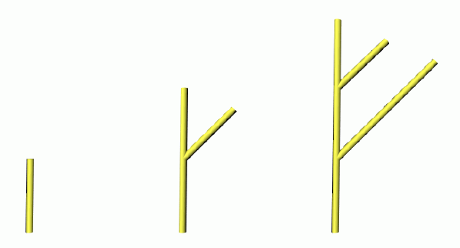
L-systems with GroIMP
Declaration of new, own symbols (modules):
module A;
module B;
protected void init()
[ Axiom ==> A; ]
public void run()
[
A ==> L(1) F0 [ RU(45) B ] A;
B ==> L(1) F0 B;
]
» A and B in this case will not
be geometrically interpreted

Slide 42
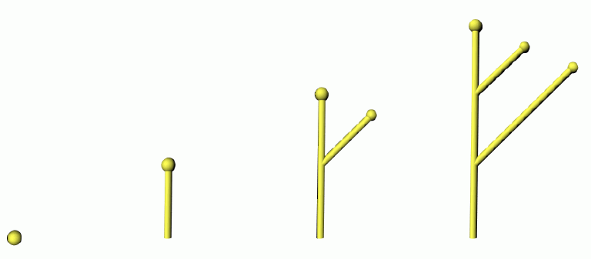
L-systems with GroIMP
Declaration of own symbols with geometric interpretation:
module A extends Sphere(0.1);
module B extends Sphere(0.08);
protected void init()
[ Axiom ==> P(14) A; ]
public void run()
[
A ==> L(1) F0 [ RU(45) B ] A;
B ==> L(1) F0 B;
]

