Slide 1


Functional-Structural Plant Models
- Summer Semester 2023 -
Winfried Kurth
University of Göttingen
Chair of Computer Graphics and Ecoinformatics
2nd Lecture: 20 April, 2023

Slide 2
From our last lecture
Model triangle for plant models
Pure structural models, motivation
3 levels of structure description
2 types of static description
  tabular (dtd format)
  imperative (Turtle geometry - not yet discussed)
meristem-based modelling approach

Slide 3
On our next slides
- a workflow for structural tree modelling
GroIMP (a first glance)
Programming paradigms
Turtle geometry
Execution of Turtle geometry command sequences using GroIMP

Slide 4
our workflow for structural tree modelling
Morphological Measurements
Branch mapping
Encoding
static
GroIMP
Statistical Data Analysis
Growth grammar with parameters
dynamic
GroIMP
Time series of three-dimensional structures
Statistical data analysis
Graphics
Other simulation programmes

Slide 5
The GroIMP Software
"Growth-grammar related Interactive Modelling Platform“
Written in Java
Download from Sourceforge (free & open source)
rgg files, projects (gsz files)
Editor, development environment
3D window
2D (graph) window (hidden!)
Attribute view for each object
Camera position
Navigation
Interactive modeling
Compiler for the programming language XL

Slide 6
Paradigms of programming
The term "programming paradigm”
Paradigm:
fundamental way of thinking, concept guided by examples

Slide 7
Paradigm:
"Describes a lot of theories, standards and methods, which jointly represent a way to organize knowledge”
Thomas Kuhn 1970: The Structure of Scientific Revolutions

Slide 8
Paradigm:
"Describes a lot of theories, standards and methods, which jointly represent a way to organize knowledge”
Thomas Kuhn 1970: The Structure of Scientific Revolutions
Paradigm shift: difficult.
A revolution in the way of thinking!

Slide 9
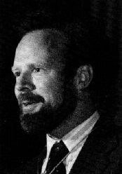
This was picked up by Robert Floyd in 1978:
Turing Award Lecture
- "The Paradigms of Programming”
Robert W. Floyd (1936-2001)

Slide 10
Which paradigms are suggested through problems such as......
… the simulation of natural objects?
… computer graphics representation?

Slide 11
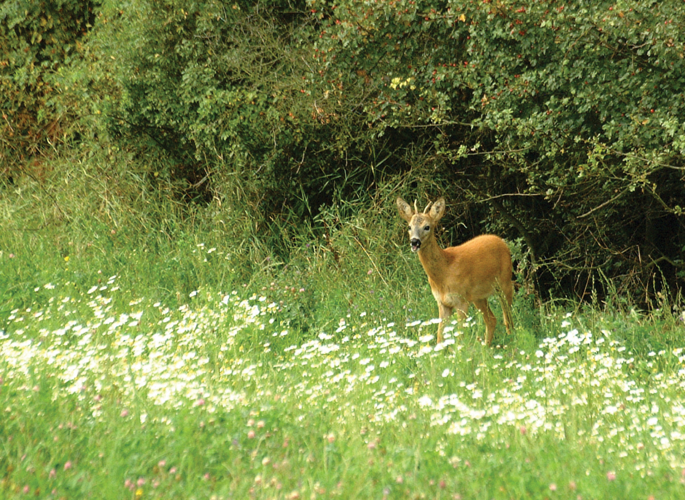
Ecology

Slide 12
Ecology
Organisms

Slide 13
Ecology
Organisms
Describing the structure

Slide 14
Ecology
Behavior (under certain conditions)
Organisms
Describing the structure

Slide 15
Ecology
Behavior (under certain conditions)
Organisms
Describing the structure
General principles
(rules) determine

Slide 16
Ecology
Behavior (under certain conditions)
Organisms
Describing the structure
Processes
General principles
(rules) determine

Slide 17
Ecology
Behavior (under certain conditions)
Organisms
Describing the structure
Processes
General principles
(rules) determine
Calculated dynamics

Slide 18
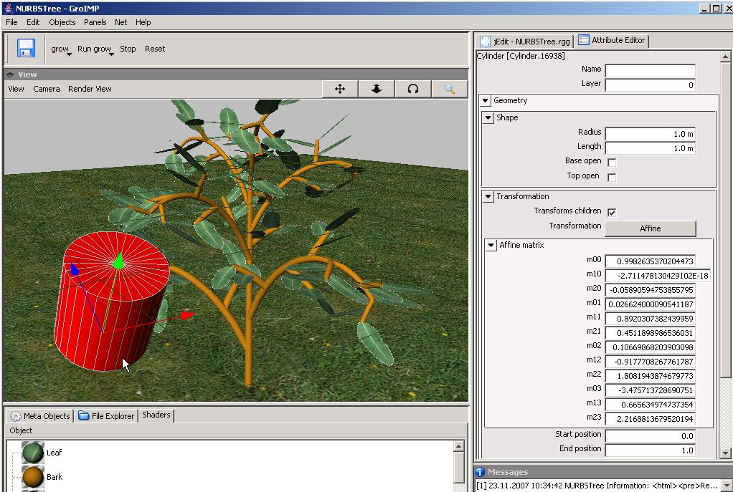
Graphical system

Slide 19
Graphical system
Object

Slide 20
Graphical system
Object
(with attributes)

Slide 21
Graphical system
Object
(with attributes)
Regular
structures

Slide 22
Graphical system
Object
(with attributes)
Regular
structures
Processes

Slide 23
Programming paradigms
for numerical simulation of processes:
  imperative paradigm

Slide 24
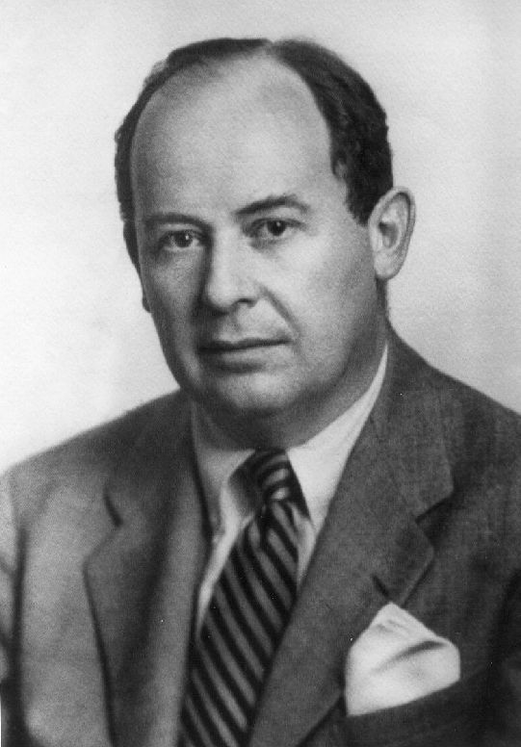
Programming paradigms
for numerical simulation of processes:
  imperative paradigm
  (also: Von-Neumann paradigm,
  control-flow paradigm)
John von Neumann (1903-1957)

Slide 25
Imperative:
„Programming by commands“
  Computer = ?

Slide 26
Imperative programming
Computer = machine for changing values
of variables

Slide 27
Imperative programming
Computer = machine for changing values
of variables
(these changes can have side effects)

Slide 28
Imperative programming
Computer = machine for changing values
of variables
(these changes can have side effects)
- Programme = ?

Slide 29
Imperative programming
Computer = machine for changing values
of variables
(these changes can have side effects)
Programme = plan for the calculation process
with indication of the commands
and the control flow (e.g., loops)

Slide 30
Imperative programming
Computer = machine for changing values
of variables
(these changes can have side effects)
Programme = plan for the calculation process
with indication of the commands
and the control flow (e.g., loops)
- Programme development: ?

Slide 31
Imperative programming
Computer = machine for changing values
of variables
(these changes can have side effects)
Programme = plan for the calculation process
with indication of the commands
and the control flow (e.g., loops)
Programme development: find elementary
single steps and put them in a suitable,
flexible order

Slide 32
Imperative programming
Computer = machine for changing values of variables (these changes can have side effects)
Programme = plan for the calculation process with indication of the commands and the control flow (e.g., loops)
Programme development: find elementary single steps and put them in a suitable, flexible order
Programming languages that support this
paradigm:
- Fortran, Pascal, C, ..., parts of Java, ...

Slide 33
Example
x = 0;
while (x < 100)
x = x + 1;
Content of the variable x is changed
Loop defines control flow

Slide 34
Example
x = 0;
while (x < 100)
x = x + 1;
Content of the variable x is changed
Loop defines control flow
Note: "=" does not stand for the common math equality, but for assignment (a process)!

Slide 35
Disadvantage of the imperative paradigm
simultaneous, parallel assignment is not supported

Slide 36
Disadvantage of the imperative paradigm
simultaneous, parallel assignment is not supported
Example (Floyd 1978):
Predator-Prey-System, described by two equations:
R_{neu} = f(R, B),
B_{neu} = g(R, B)
Beginner's programming error:
for (i = ... ) {
R = f(R, B);
B = g(R, B);
}

Slide 37
Disadvantage of the imperative paradigm
simultaneous, parallel assignment is not supported
Example (Floyd 1978):
Predator-Prey-System, described by two equations:
R_{neu} = f(R, B),
B_{neu} = g(R, B)
Beginner's programming error:
for (i = ... ) {
R = f(R, B);
B = g(R, B);
}

Slide 38
Programming languages that support this paradigm
- Fortran, Pascal, C, ..., parts of Java, ...
Command language of Turtle geometry

Slide 39
Turtle
A drawing turtle, which listens to commands

Slide 40
Turtle
A drawing turtle, which listens to commands

Slide 41
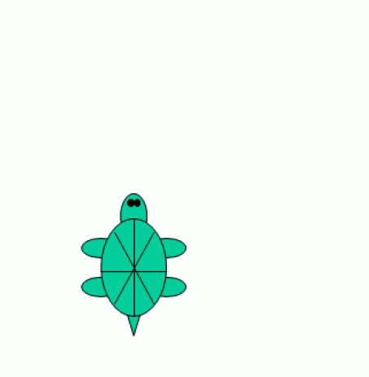
F0

Slide 42
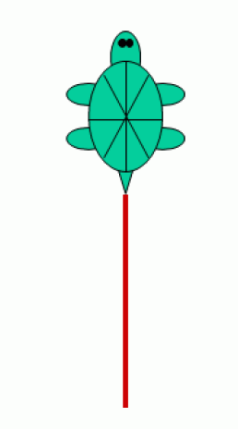
F0

Slide 43
F0 RU(90)

Slide 44
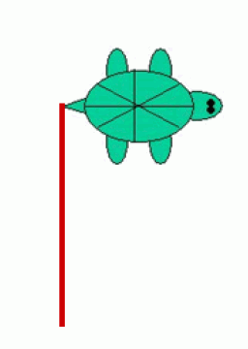
F0 RU(90)

Slide 45
F0 RU(90) F0

Slide 46
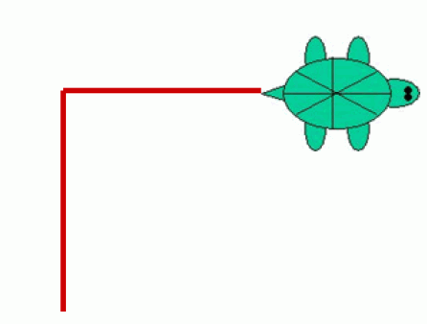
F0 RU(90) F0

Slide 47
F0 RU(90) F0 RU(90) LMul(0.5) F0

Slide 48
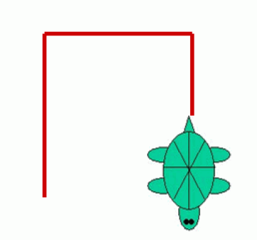
F0 RU(90) F0 RU(90) LMul(0.5) F0
(more for later)

Slide 49
Back to previous example
Object
(with attributes)

Slide 50
Object-oriented paradigm
Computer = environment for virtual objects
Programme = List of (object) classes, i.e. general specifications of objects that can be created and destroyed (several times) at runtime and communicate with each other.
Programme development: Specification of the classes (data and methods) that define the object structure and behavior.
Programming languages: Smalltalk, Simula, C++, Java, ...

Slide 51
Example
public class Car extends Vehicle
{
public String brand;
public int places;
public void show()
{
System.out.println("The Car is a " + brand);
System.out.println("It has " + places + "Seats.");
}
}
Typical:
Classes (Car) with data (brand, places) and methods (show)

Slide 52
Inheritance of attributes and methods from superclass to subclass
Example
public class Car extends Vehicle
{
public String brand;
public int places;
public void show()
{
System.out.println("The Car is a " + brand);
System.out.println("It has " + places + "Seats.");
}
}
Typical:
Classes (Car) with data (brand, places) and methods (show)

Slide 53
Object hierarchies also make sense in biology
Example:
Organ
Leaf
Flower
Internode
Root Segment
Deciduous leaf
Needle
Coarse-RS
Fine-RS

Slide 54
Regular
Structures

Slide 55
Rule-based paradigm
Computer = transformational machine for structures
There is a current structure that is transformed as long as it is possible

Slide 56
Rule-based paradigm
Computer = transformational machine for structures
There is a current structure that is transformed as long as it is possible
Work process: search and application process
matching: search for a suitable rule
rewriting: application of the rule to rewrite the structure.

Slide 57
Rule-based paradigm
Computer = transformational machine for structures
There is a current structure that is transformed as long as it is possible
Work process: search and application process.
matching: search for a suitable rule
rewriting: application of the rule to rewrite the structure.
Programme = set of transformation rules

Slide 58
Rule-based paradigm
Computer = transformational machine for structures
There is a current structure that is transformed as long as it is possible
Work process: search and application process.
matching: search for a suitable rule
rewriting: application of the rule to rewrite the structure.
Programme = set of transformation rules
Programme development: specification of rules

Slide 59
Rule-based paradigm
Computer = transformational machine for structures
There is a current structure that is transformed as long as it is possible
Work process: search and application process.
matching: search for a suitable rule
rewriting: application of the rule to rewrite the structure.
Programme = set of transformation rules
Programme development: specification of rules
Programming languages: L-System languages, AI languages, Prolog, ...

Slide 60
Example
L-Systems (Lindenmayer Systems)
Control systems for the replacement of character strings
(more coming soon)

Slide 61
Similar rule-based mechanism:
Graph grammars

Slide 62
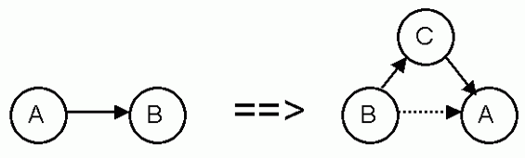
Similar rule-based mechanism:
Graph grammars
Rule:

Slide 63
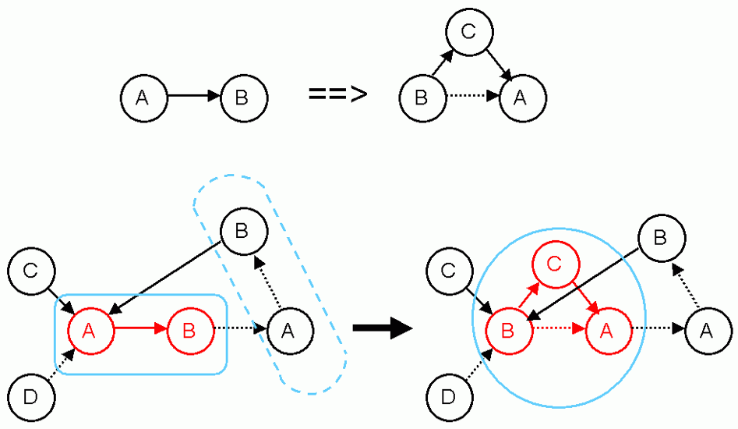
Similar rule-based mechanism:
Graph grammars
Rule:
Application:

Slide 64
Conclusion:
Programming paradigms

Slide 65
Conclusion:
Programming paradigms
Imperative

Slide 66
Conclusion:
Programming paradigms
Imperative
  Change in variables
  Turtle geometry as an example

Slide 67
Conclusion:
Programming paradigms
Imperative
  Change in variables
  Turtle geometry as an example
Object-oriented

Slide 68
Conclusion:
Programming paradigms
Imperative
  Change in variables
  Turtle geometry as an example
Object-oriented
Rule-based

Slide 69
Conclusion:
Programming paradigms
Imperative
  Change in variables
  Turtle geometry as an example
Object-oriented
Rule-based
  L-Systems
  Graph grammars

Slide 70
Conclusion:
Programming paradigms
Imperative
  Change in variables
  Turtle geometry as an example
Object-oriented
Rule-based
  L-Systems
  Graph grammars
Other: functional; concurrent; chemical…

Slide 71
Application focus
Imperative:
- numerics
  - e.g., solving systems of equations
  - e.g., photosynthesis; tree water flow
(Darcy law = differential equation, discretized, numerical
solution method)
Rule-based:
- development of branched structures (locally 1-D)
- e.g., plants
- logical dependencies
- e.g., knowledge-based systems
Object-oriented:
- sets of interacting objects
- e.g., individual animals

Slide 72
Synthesis: The Language XL
- "eXtended L-system language“
- programming language that makes parallel graph grammars (RGG) easily available

Slide 73
Imperative
Object-oriented
Rule-based
Java
XL

Slide 74
Turtle-Geometry
F0 RU(90) F0 RU(90) LMul(0.5) F0

Slide 75
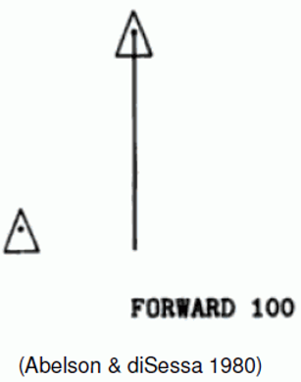
Turtle Geometry
command controlled, local navigation of the Turtle in 2D or 3D space
(Abelson & diSessa 1980; see Programming
language "Logo")
Turtle: drawing or construction device
(virtual)
associated with a state memory
(important for branches)
current state of the Turtle contains e.g., information about current line thickness, step size, color, other properties of the next object to be constructed

Slide 76
Commands (in XL)
http://www.uni-forst.gwdg.de/~wkurth/xl_turtle.pdf
F0 - Forward, construct cylinder, will use current increment (from the turtle state) for the length (the zero stands for "no explicit length definition")
M0 Forward without construction (Move command)
L(x) change the current increment (length) to x
LAdd(x) increments the current step by x
LMul(x) multiplies the current increment by x
D(x), DAdd(x), DMul(x) - analogously for the actual diameter
P(c) sets the color on c (0 - 15)
F(x), F(x, d), F(x, d, c) - constructs a cylinder
x - length, d - diameter, c - color
RU(a) turns to the right (a > 0) or to the left (a < 0) by a given angle in degrees

Slide 77
Turtle Geometry

Slide 78
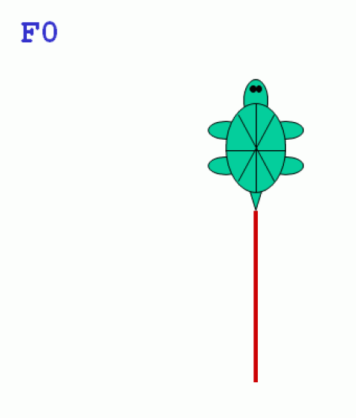

Slide 79
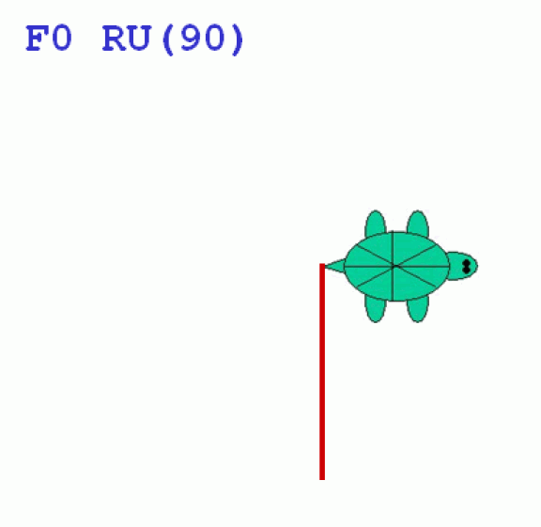

Slide 80
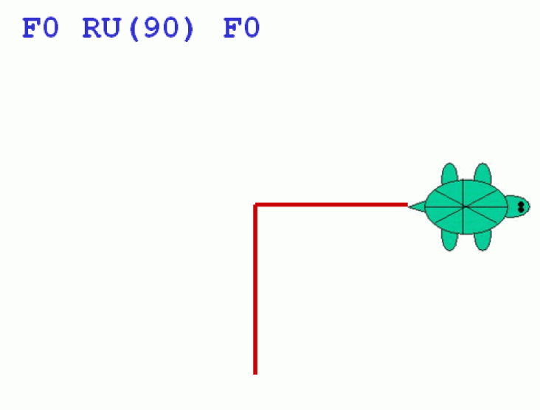

Slide 81
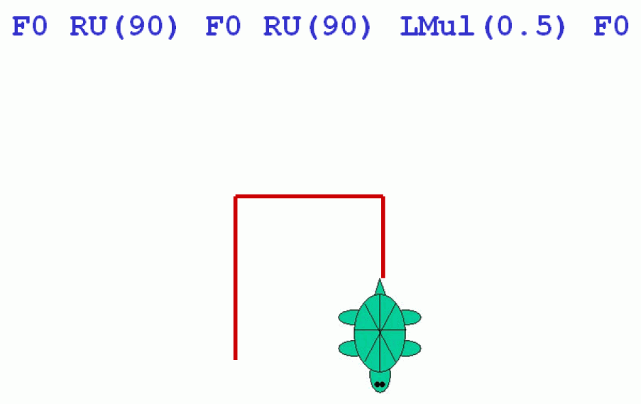

Slide 82
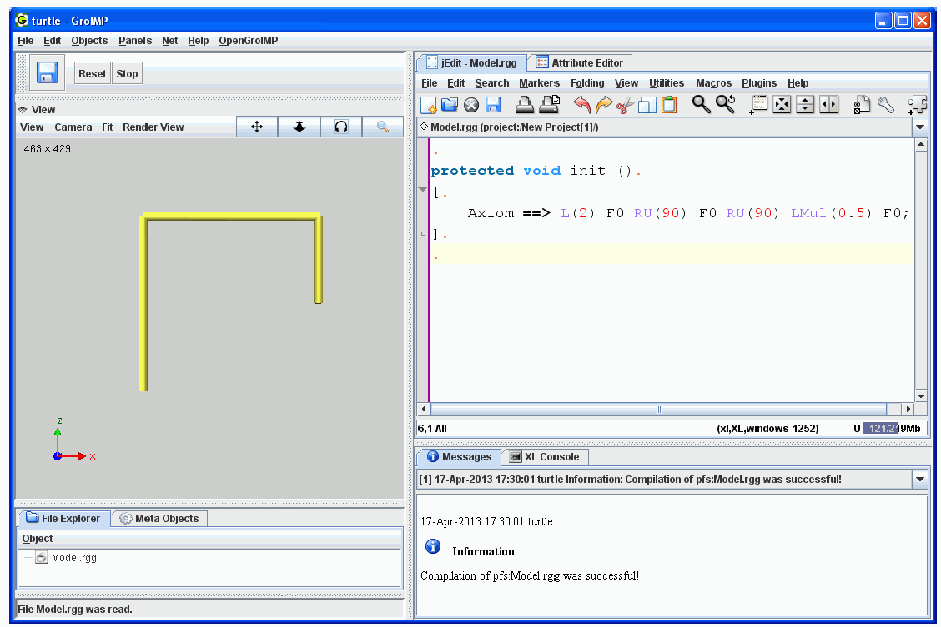
Turtle Geometry in GroIMP

Slide 83
How to execute a Turtle command sequence with GroIMP
write to a GroIMP project file (or to a file with the extension .rgg)
protected void init()
[
Axiom ==> Turtle command sequence
]

Slide 84
Example: Drawing of a triangle
protected void init()
[ Axiom ==> RU(30) F(10) RU(120) F(10) RU(120) F(10) ]
See example code (accessible on homepage): sm09_e01.rgg

Slide 85
Repetition of sections of the string possible with "for“
Example:
for ((1:3)) ( A B C )
Output: A B C A B C A B C

Slide 86
What is the outcome from the following code?
L(10) for ((1:6))
( F0 RU(90) LMul(0.8) )

Slide 87

L(10) for ((1:6))
( F0 RU(90) LMul(0.8) )

Slide 88
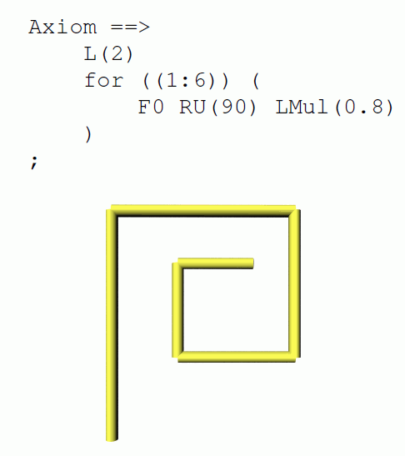

Slide 89
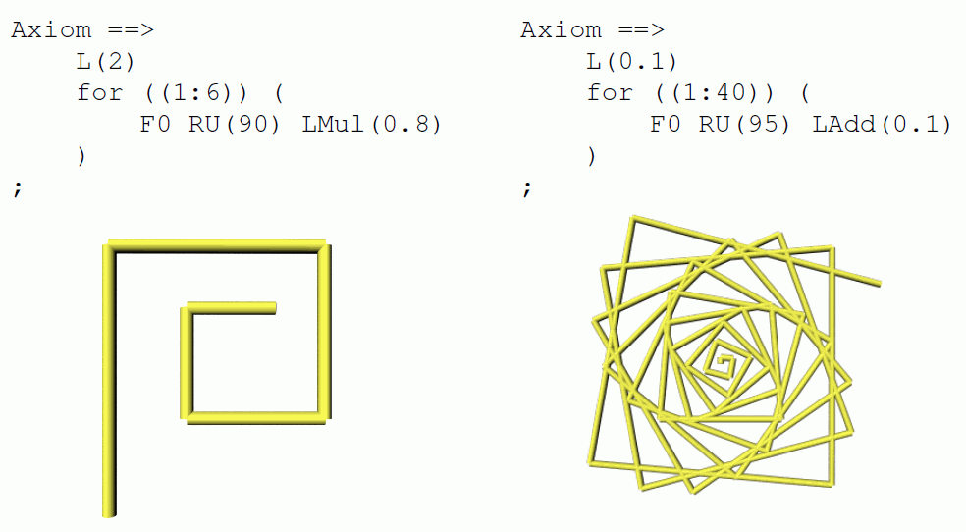

Slide 90
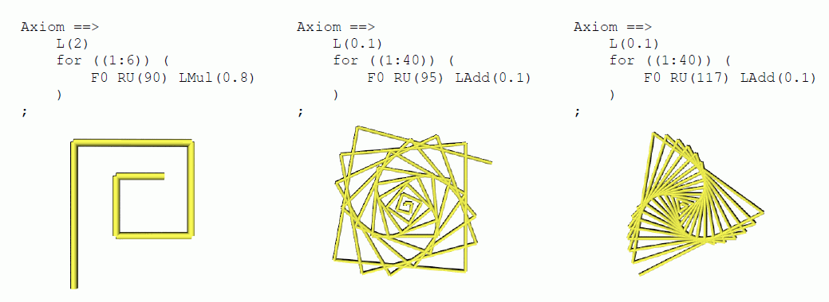

Slide 91
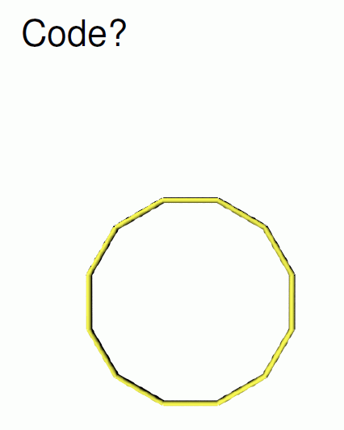

Slide 92
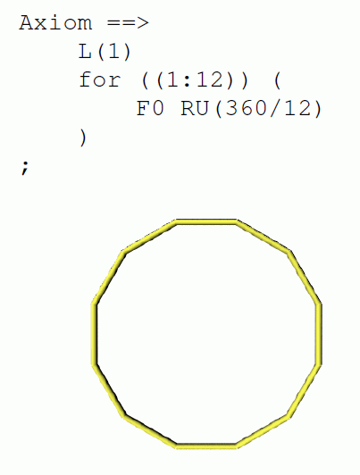

Slide 93
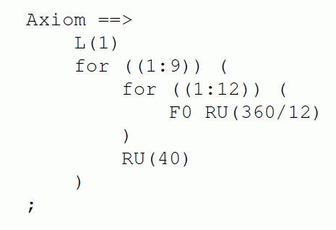

Slide 94
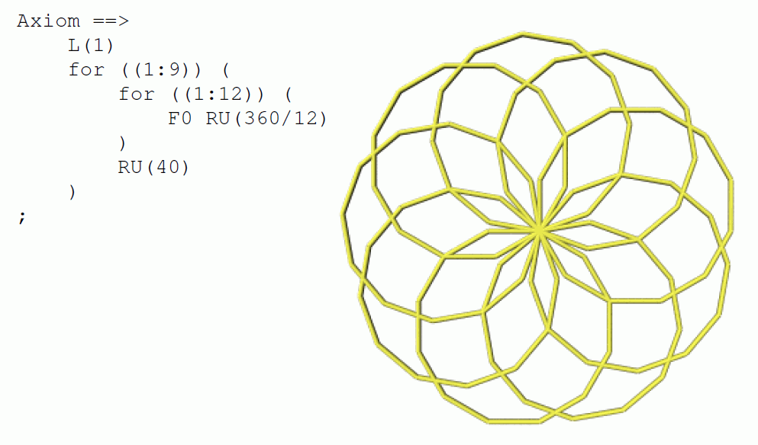

Slide 95
Another example:
for ((1:20)) ( for ((1:36))
( F0 RU(165) F0 RU(165) ) RU(270) )

Slide 96
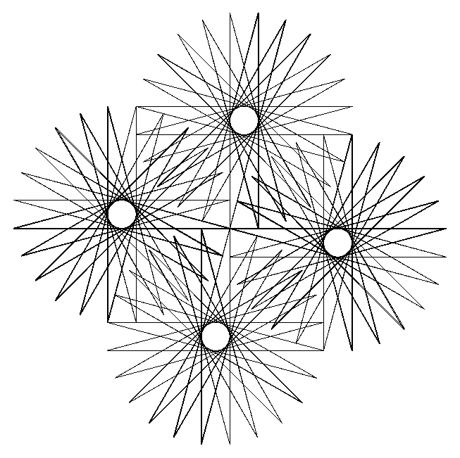
Another example:
for ((1:20)) ( for ((1:36))
( F0 RU(165) F0 RU(165) ) RU(270) )

Slide 97
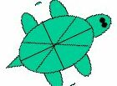
Extension to 3D graphics:
Turtle rotations around 3 axes

Slide 98
Extension to 3D graphics:
Turtle rotations around 3 axes
left
head
up

Slide 99
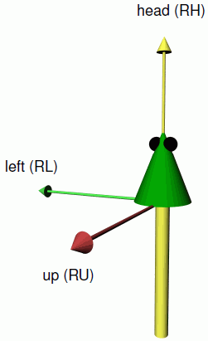
Extension to 3D graphics:
Turtle rotations around 3 axes
left
head
up

Slide 100
Extension to 3D graphics:
Turtle rotations around 3 axes
RL
RH
RU

Slide 101
3D commands
RU(45) Rotate the turtle about the "up" axis by 45°
RL(...), RH(...) analogously around "left" and "head" axis. Up-, left- and head-axis form an orthogonal, spatial coordinate system, which is carried by the turtle
RV(x) Rotation "downwards" with strength given by x
RG Rotation all the way down (direction (0, 0, -1))

Slide 102
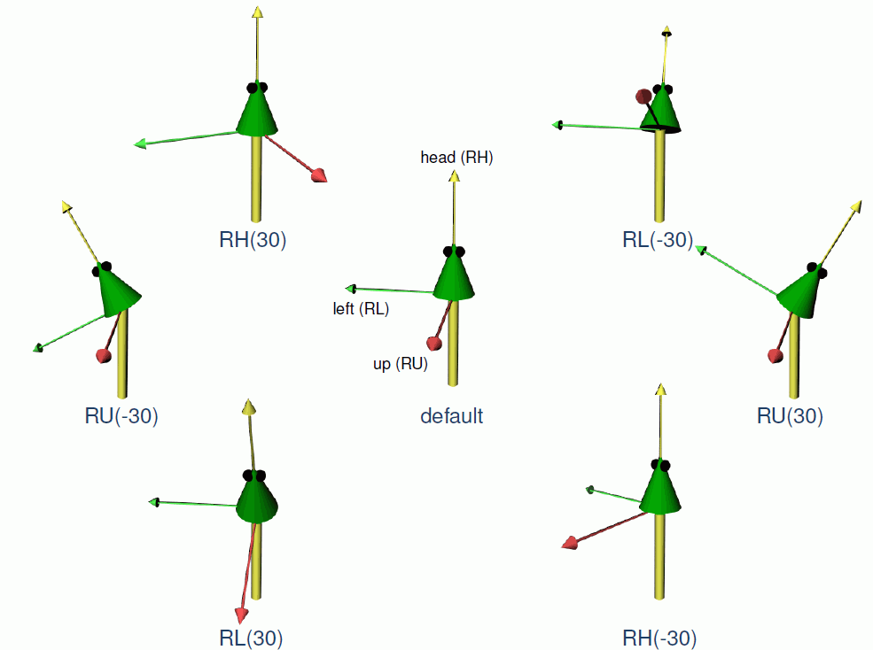

Slide 103
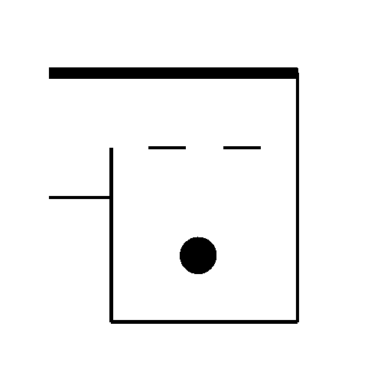
Example
L(100) D(3) RU(-90) F(50) RU(90) M0 RU(90) D(10) F0 F0
D(3) RU(90) F0 F0 RU(90) F(150) RU(90) F(140) RU(90)
M(30) F(30) M(30) F(30) RU(120) M0 Sphere(15)
Output
What is the output for the following code?
L(10) F0 RU(45) F0 RU(45) LMul(0.5) F0 M0 F0

Slide 104
Assignment
Read Chapter 1, Section 1.1 – 1.5 (without 1.4) in the book "The Algorithmic Beauty of Plants“ by P. Prusinkiewicz and A. Lindenmayer (available online, see literature page for the lecture). (= pp. 1-21 without section 1.4).

