Slide 1

Functional-Structural Plant Models
Master studies - FES
Summer semester 2023 -
Winfried Kurth
University of Göttingen
Chair of Computer Graphics and Ecoinformatics
together with Department of Forest Botany and Tree Physiology
Lecture 1: 13 April, 2023

Slide 2
Functional-structural plant models
Workload: 6 ECTS
Lectures + Exercises + Measurements + Self-study
Homepage of the course:
http://www.uni-forst.gwdg.de/~wkurth/sm23_home.htm
here also the slides (using material from Katarína Streit).
Additional material:
http://studip.uni-goettingen.de - Learning modules
Literature:
http://www.uni-forst.gwdg.de/~wkurth/sm09_lit.htm
Software description and download:
http://www.grogra.de

Slide 3
Organizational matters
Parts of the course:
1. Modelling with XL every Thu 14¹⁵ - 15⁵⁰
additionally 12 June, 10¹⁵ - 11⁵⁰ a.m.
2. Lectures on photosynthesis 11 + 25 May, 2023, 10¹⁵ – 11⁵⁰ a.m.
3. Measurements for photosynthesis
4. Morphology measurements
5. Term paper until 15 September:
- Analysis and further development of a model
- Summary of physiological modelling (photosynthesis)
}
2 blocks:
22 + 29 June, 2023,
9⁰⁰ - ca. 12⁰⁰ a.m.
(Greenhouse)

Slide 4
Today:
Model triangle for plant models
pure structural models, motivation
3 levels of structure description
2 types of statistical description
- tabular (dtd format)
- imperative (turtle geometry)
Getting started with the GroIMP software

Slide 5
What are Functional Structural Plant Models?
(FSPM)

Slide 6
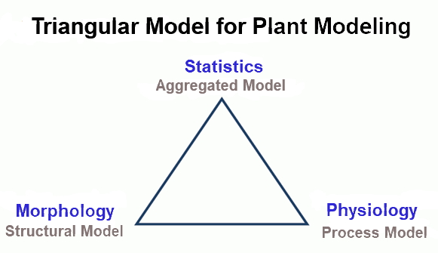

Slide 7
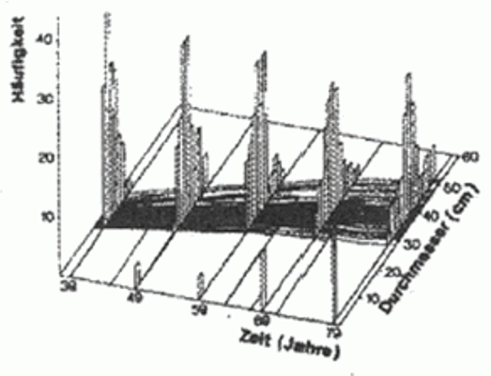

Slide 8
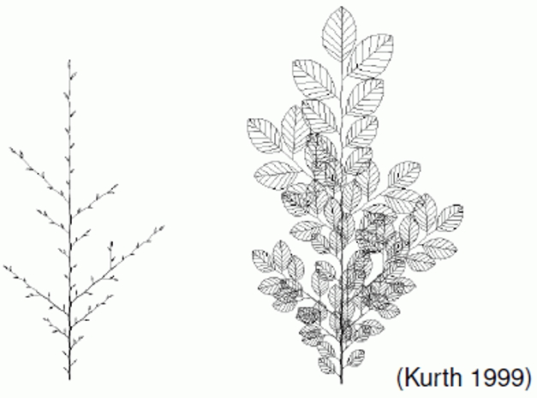

Slide 9
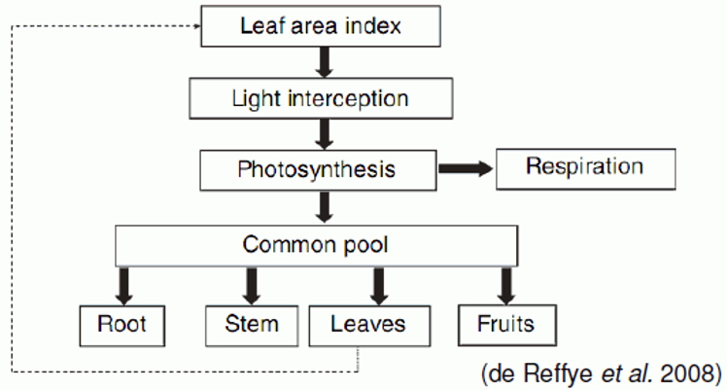

Slide 10
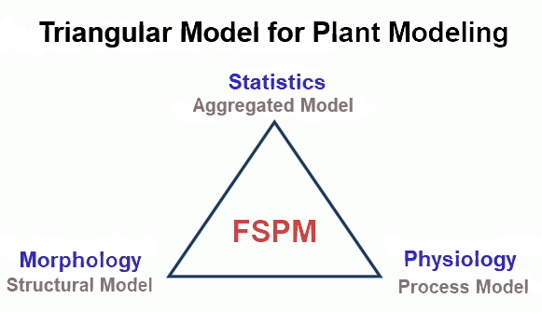
Functional Structural Plant Model

Slide 11
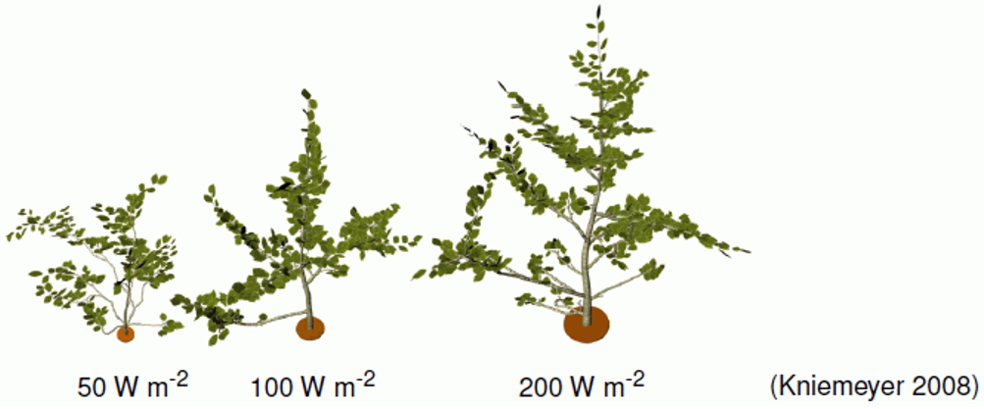
Functional Structural Plant Model

Slide 12
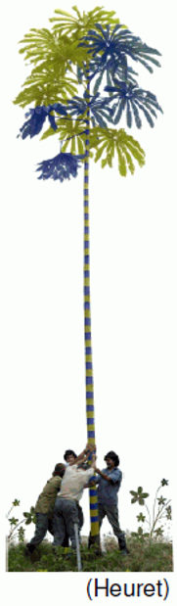
What are functional structural models?
Combination of botanical structures and functions
(e.g. light interception, photosynthesis, water flow) in a
unified model
Structure – arrangement of modules (shoots, leaves, etc.)
The processes are linked to the morphological objects
The processes impact the structure and development
“Functional Structural Plant Models (FSPM), or virtual plant models, are models explicitly describing the development over time of the 3D architecture or structure of plants as governed by physiological processes which, in turn depend, on environmental factors”
(Vos et al. 2010)

Slide 13
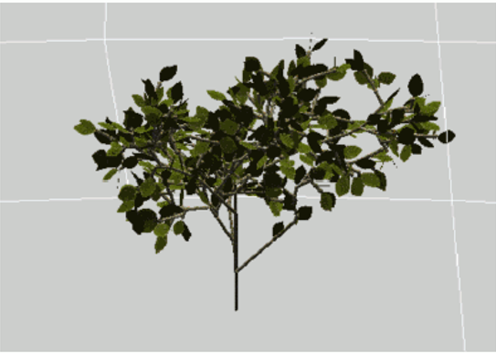
Our Goals
Analyze a functional-structural model
Further development and improvement of the model
Evaluation of measured data (morphology and photosynthesis)
Parameterization of the model with measured data
Sensitivity analysis
Beech model, Y. Ong, 2012

Slide 14
Motivation for FSPMs of trees
Ecosystem Research:
Forests as structurally rich communities
Concrete questions:
Influence of tree architecture
on the carbon balance?
on water balance / drought stress resistance?
Interpretation of crown degradation patterns
Simulation:
Competition, forestry interventions

Slide 15
Motivation for FSPMs of trees
Basic research:
Tree canopy (+ root systems) = complex structures
Information compression?
botanical knowledge base
Bridging the gap:
Forest botanical approach -- Ecosystem models
model coupling
Illustration
- Visualization of future development
Virtual landscapes as planning and decision-support tools

Slide 16
Motivation for FSPMs of trees
Special requirements of the modelling of:
Light in existing buildings
Mechanics
Water flow in the tree
Competition
Bridge between process models and botanical observations
Common basis for various processes in/on the tree (increasing the consistency of different models)

Slide 17
Origins of plant modelling, schools and motivations
French school
(Hallé et al.: botany; CIRAD)
tropical forests
agronomy

Slide 18
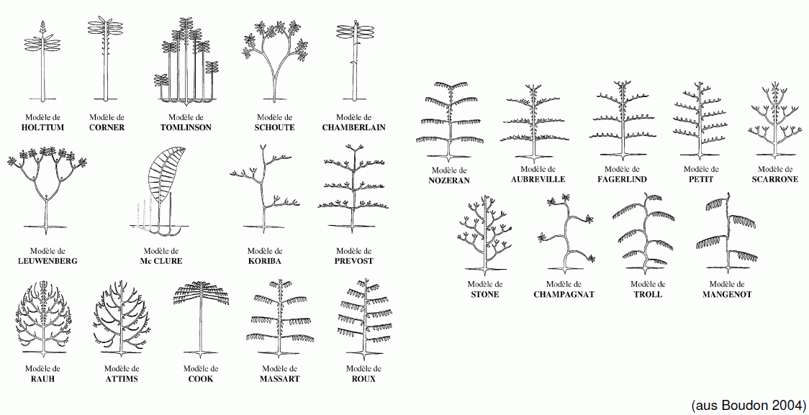
Origins of plant modelling, schools and motivations
French school
(Hallé et al.: Botany; CIRAD)
tropical forests, agronomy
23 architectural models

Slide 19
Origins of plant modelling, schools and motivations
French school
(Hallé et al.: Botany; CIRAD)
tropical forests, agronomy
Theoretical biologists (especially in Great Britain)
Theoretical computer science
  L-Systems: Grammar of shape formation
  Mathematization

Slide 20
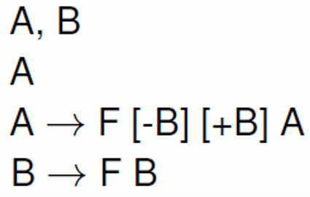
L-Systems (Lindenmayer system)
Specify the development of character strings in discrete time steps, which is achieved by replacing individual characters by others:
alphabet
start word (axiom)
rules

Slide 21
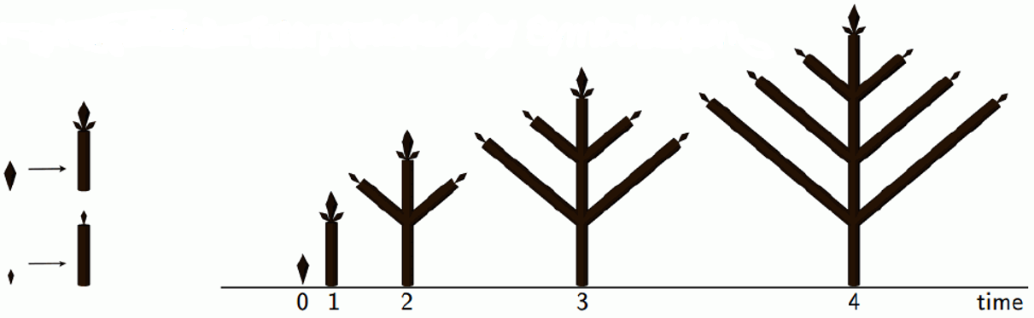
L-Systems (Lindenmayer system)
Specify the development of character strings in discrete time steps, which is achieved by replacing individual characters by others:
  alphabet
  start word (axiom)
  rules
Geometrical interpretation of the symbol chain

Slide 22
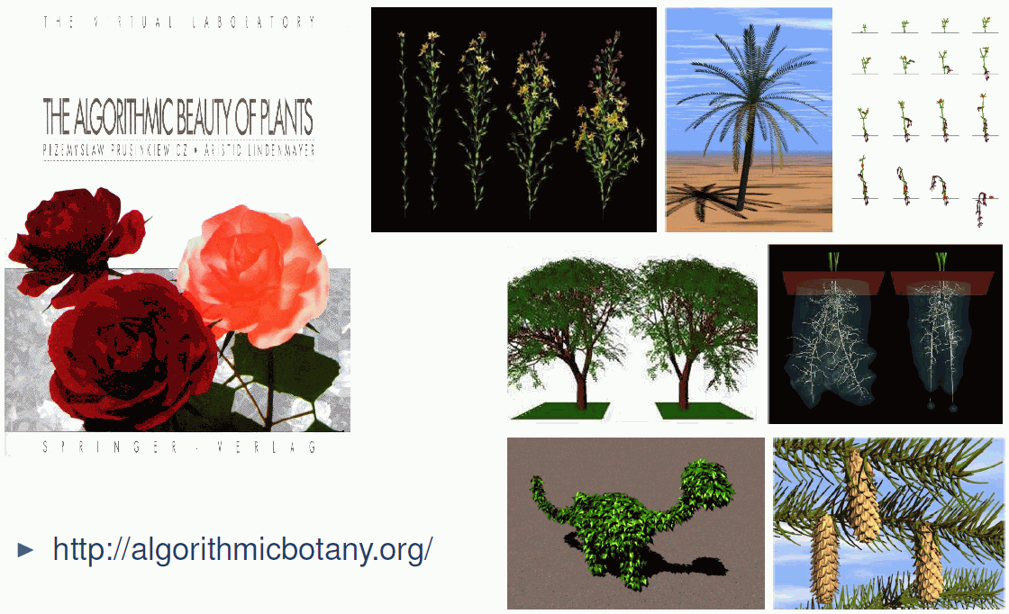
Plant Models from L-Systems

Slide 23
Origins of plant modelling, schools and motivations
French school
(Hallé et al.: Botany; CIRAD)
tropical forests, agronomy
Theoretical biologists (especially in Great Britain)
Theoretical computer science
  L-Systems: Grammar of shape formation
  mathematization
Computer graphics designers
  virtual reality
  efficiency of algorithms

Slide 24
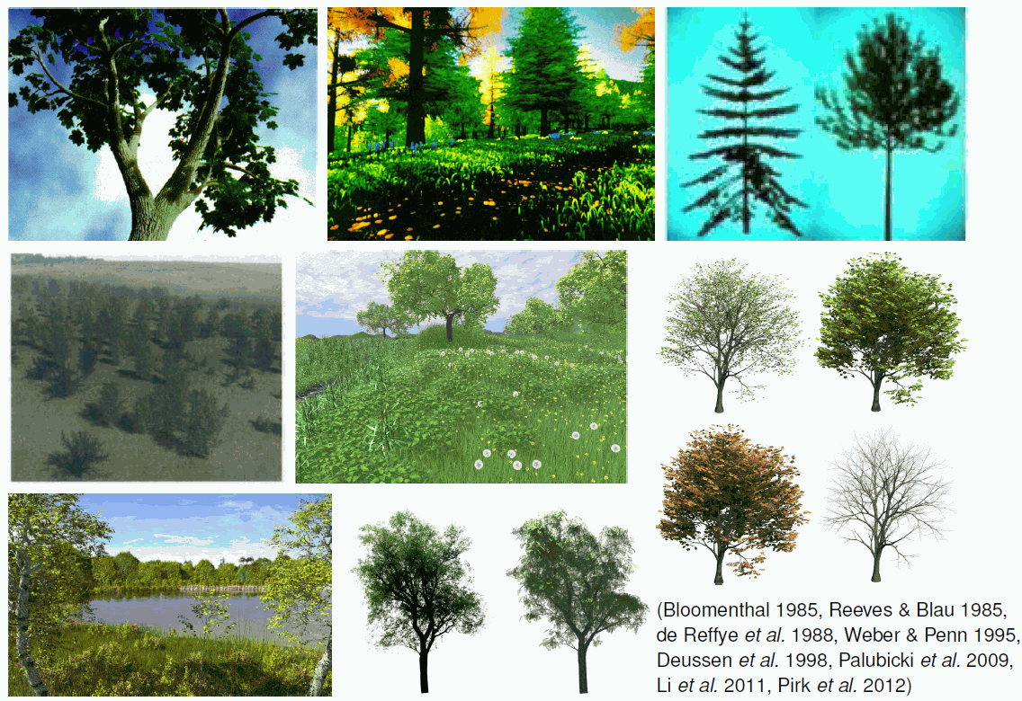
Plant Models from Computer Graphics

Slide 25
Origins of plant modelling, schools and motivations
Forest ecologists and foresters
  growth models oriented towards individual trees
  heterogeneous stands
  Processes ↔ morphological appearance
  ecosystem research
Bioclimatologists and tree physicists
  Heterogeneity: nonlinear light response of photosynthesis.
  Tree mechanics, hydraulics
Entomologists
  Interaction herbivores - plant structure (agronomy)
  CPAI Brisbane

Slide 26
Measurement of 3D structures of plants
Data acquisition by classical means
Combination ruler
Calipers
Protractors
Sketchpad

Slide 27
Semi-automatic / Fully automatic digitization
Combination of digital caliper - digital compass - interface software (Oppelt et al. 2000)
Electromagnetic probe (Polhemus FASTRAK, Sinoquet et al., Clermont-Ferrand)
Ultrasonic probe
Mechanical booms
3D laser scanner
Evaluation of stereoscopic photos

Slide 28

Electromagnetic 3D-Tracking system Polhemus FASTRAK

Slide 29
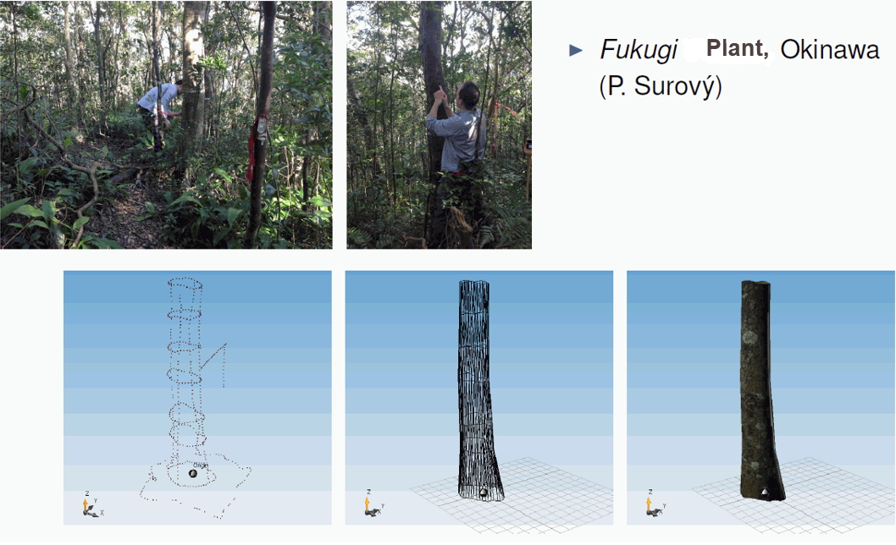

Slide 30
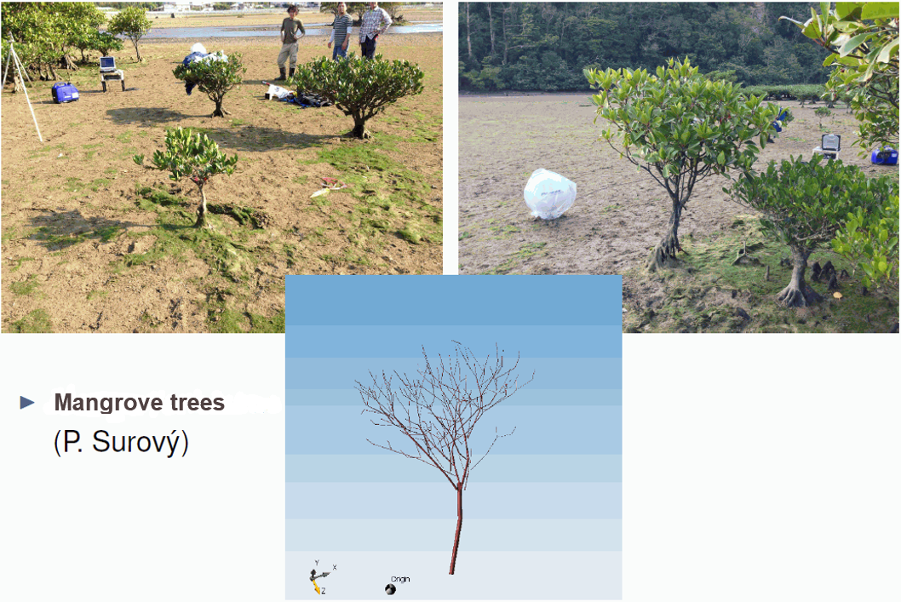

Slide 31
Structural description
3 levels:
Static structure description
- Plant at a fixed time (e.g. on 21 April 2022)
2. Dynamic structure description, non-sensitive
- Description of the development (ontogenesis) of a plant:
Time series of three-dimensional structures
3. Dynamics with consideration of causal influences / conditions (sensitive models)
- different development paths
- logical conditions for the choice of path
- (in the simplest case stochastic)

Slide 32
To #1: Static structure description
2 approaches:
Tabular
- each plant module = one row
- dtd code, "descriptive tree data“
2. Imperative (command controlled)
- "Turtle geometry”
- virtual turtle "constructs" the structure,
the description are the commands which
control it
- turtle geometry: see later

Slide 33
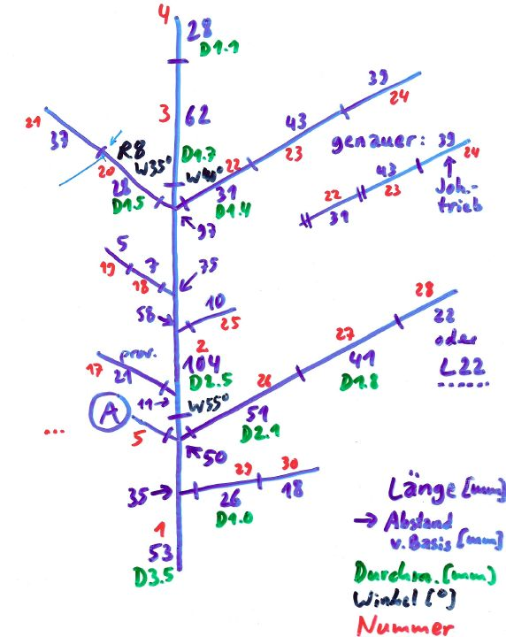
Example of a topological and metric sketch
Length [mm]
→ distance from base [mm]
diameter [mm]
angle [degrees]
identifyer

Slide 34
The dtd Code
(digitized tree data format)
Basic unit: annual shoot (or growth unit)
depending on the resolution of the model also internode possible
One row per growth unit
1st col.: Name (or number of the growth unit)
2nd col.: L Length (in mm)
3rd col.: # name of the mother shoot (for the branching topology)
Additional columns:
A position
R direction angle
W branching angle
D diameter
B number of leaves E number of internodes
C colour index F number of fruits

Slide 35
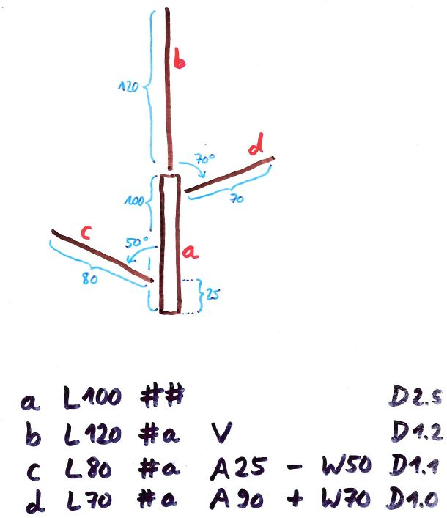
Example:
dtd coding of a branching system
For a description of the dtd code, follow:
http://www.uni-forst.gwdg.de/~wkurth/dtd_code_en.pdf

Slide 36
Consistency check of the dtd file
Optical control
- (pay special attention to the basic shoot, are there at the basis plenty (too many) shoots?)
Control of the age count
- Grogra analysis option F,
5th column of the generated table:
is age 0 (zero) too rare?

Slide 37
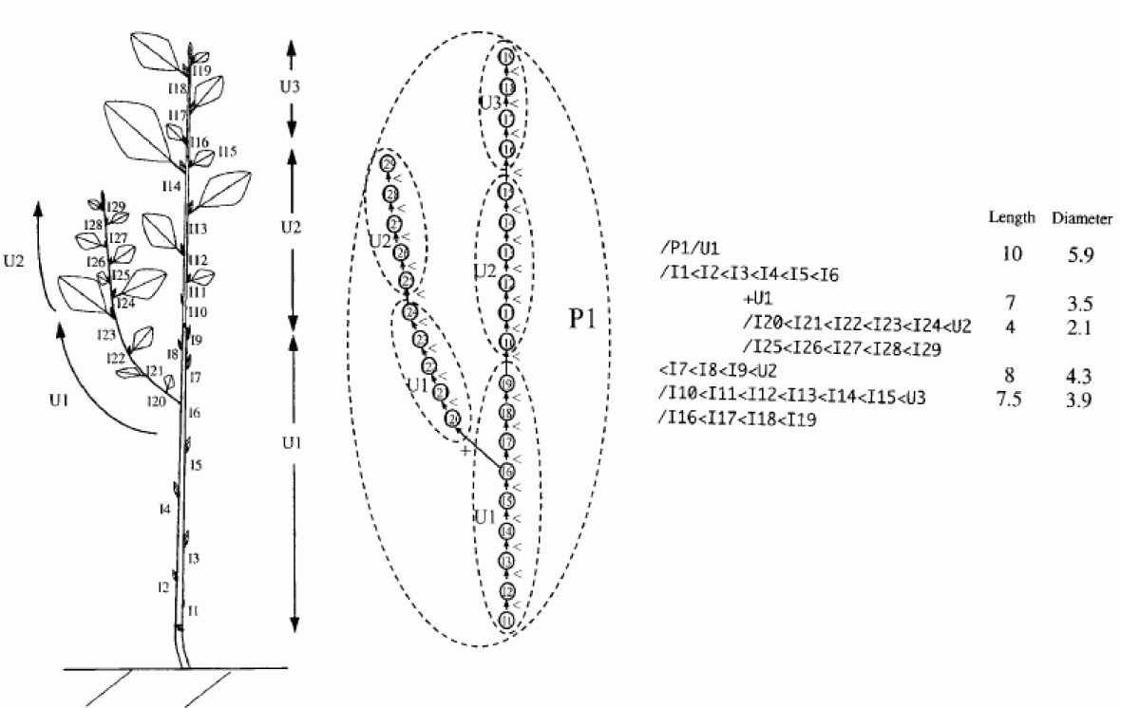
Other (more flexible) data format:
MTG (Multiscale Tree Graph)

Slide 38
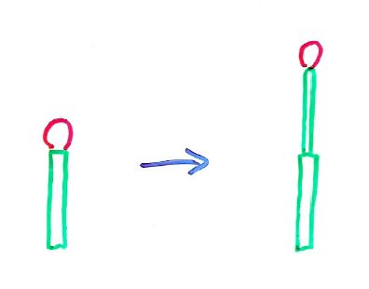
The transition to the 2nd level of structural description
Dynamic description of plant structures
How do plants change in the course of ontogenesis?

Slide 39
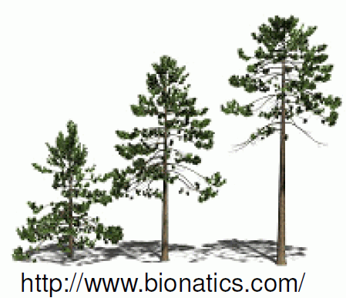
AMAP
Atelier de Modélisation de l‘Architecture des Plantes
Montpellier, Paris, Strasbourg, Nancy, Beijing (LIAMA)

Slide 40
AMAP
Atelier de Modélisation de l‘Architecture des Plantes
Montpellier, Paris, Strasbourg, Nancy, Beijing (LIAMA)
Ph. de Reffye, R. Lecoustre, M. Jaeger, E. Costes,
P. Dinouard, F. Blaise, P.-H. Cournède et al.
(agronomists, computer scientists, botanists, mathematicians)
Modelling the activity of meristems
Shape of the tree = trajectory of its meristems
First AMAP version (basis of today's commercial software REALnat, Bionatics): refers to the 23 "architectural models" by Hallé et al.

Slide 41
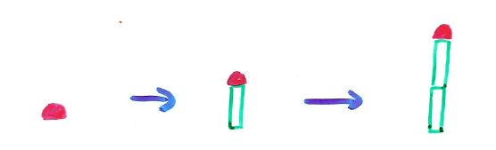

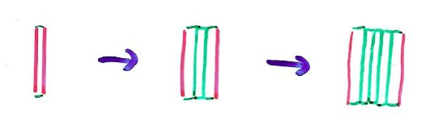
Modelling approach
tree shape = trajectory of the meristems
primary meristem
branching
secondary meristem
(to be added:
mechanical deformations, deformations with physiological causes, injuries, death processes)

Slide 42
Meristem-based modeling approach
Adrian D. Bell 1979
3 basic processes
Formation of a shoot (growth)
Transition to idle state (and reactivation)
Dying
similar: de Reffye 1981
3 meristem states
dormance (dormancy)
croissance (growth)
mortalité (death)
State transitions with probabilities
Binomial distribution, Markov chains

Slide 43
Description Synthesis
Multiscale graph Axis of reference
(AMAPsim, GreenLab)
dtd-Code L-System, Relational
Growth Grammar
(Grogra, GroIMP)
Göttingen Montpellier

Slide 44
Combination 1st + 2nd description level
Morphological Measurements
Branch mapping
Encoding
static
Grogra/GroIMP
Statistical Data Analysis
Growth grammar with parameters
dynamic
Grogra/GroIMP
Time series of three-dimensional structures
Statistical data analysis
Graphics
Other simulation programmes

Slide 45
The GroIMP Software www.grogra.de
"Growth-grammar related Interactive Modelling Platform“
written in Java
download from Sourceforge (free & open source)
rgg files, projects (gsz files)
editor, development environment
3D window
2D (graph) window (hidden!)
attribute view for each object
camera position
navigation
interactive modeling
compiler for the programming language XL

Slide 46
Homework
Install GroIMP on your computer and run some examples from the menu item „Examples“
46

