Slide 1


Functional-Structural Plant Models
Summer semester 2022 -
Winfried Kurth
University of Göttingen
Chair of Computer Graphics and Ecoinformatics
11th Lecture: 21 July, 2022

Slide 2
From our last lecture:
Sequential and parallel derivation mode
Instantiation rules
Simple functional-structural plant model
(first steps)

Slide 3
On our next slides:
Simple functional-structural plant model
(further, more refined versions)
measurement and visualization of shadow
on the ground
photosynthesis model
modelling of transport processes
task of the term paper, evaluation criteria

Slide 4
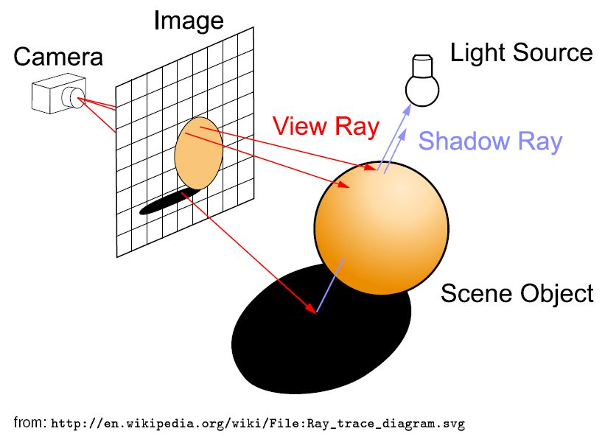
Model approach for light calculation
(physically more accurate than the "shadow cone" approach from last time)
Raytracing - a method from computer graphics
Basic principle:
Additionally the ray can be traced along one or several reflections

Slide 5
we don't want to generate an image, but calculate for all leaves of the virtual plant the amount of intercepted light
→ reversal of the direction of the rays:
the rays run from the light sources to the objects ("photontracing"). An extra shadow test is not necessary.
a large number of rays with random directions is generated: "Monte-Carlo-Raytracing".
accumulation of the intercepted power of radiation (in the unit W = Watt) is possible for each object
Requirement: there has to be a light source in the scene
DirectionalLight, PointLight, SpotLight, Sky

Slide 6
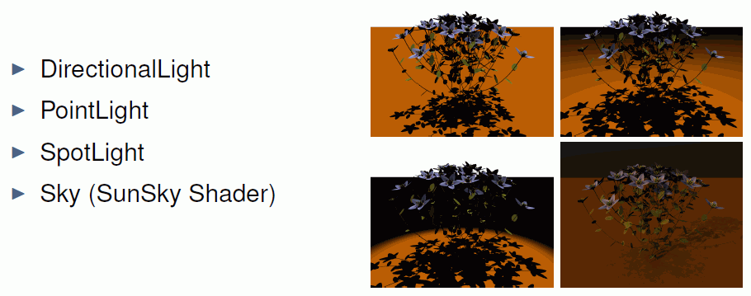
Types of light sources in the scene

Slide 7
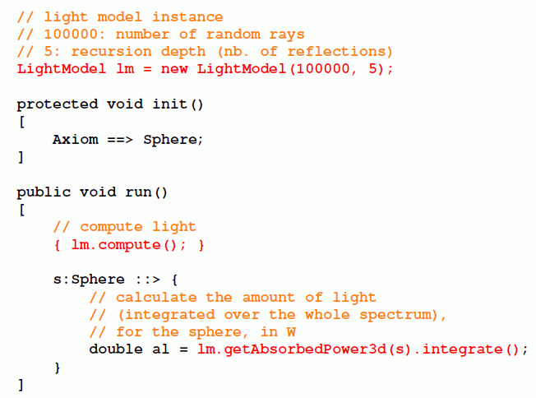
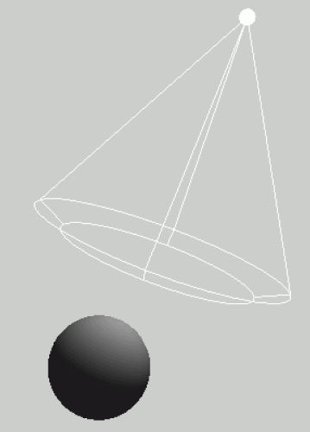
The radiation model of GroIMP

Slide 8
sfspm05.gsz (only new parts of the model are displayed)
Light source inserted into the scene; special feature: AlgorithmSwitchShader
// ..... module definitions .....
/* the leaf collects light and gets a new shader for the radiation model: */
module Leaf(float al) extends Parallelogram(2, 1)
{{ setShader(new AlgorithmSwitchShader(new RGBAShader(0, 1, 0), GREEN)); }};
// ..... further module definitions .....
/* the light source: */
module MyLamp extends SpotLight
{{
setPower(200.0); /* power in W */
setAttenuationDistance(50.0); /* in m */
setAttenuationExponent(0.0);
setInnerAngle(22.5*Math.PI/180.0);
setOuterAngle(30.0*Math.PI/180.0);
}};
module MyLight extends LightNode(1.0, 1.0, 1.0) /* R, G, B */
{{ setLight(new MyLamp()); }};
/* the radiation model is defined */
LightModel lm = new LightModel(100000, 5);
/* 100000: number of random rays, 5: recursion depth (nb. of reflections) */
GUI-Shader Radiation-Shader

Slide 9
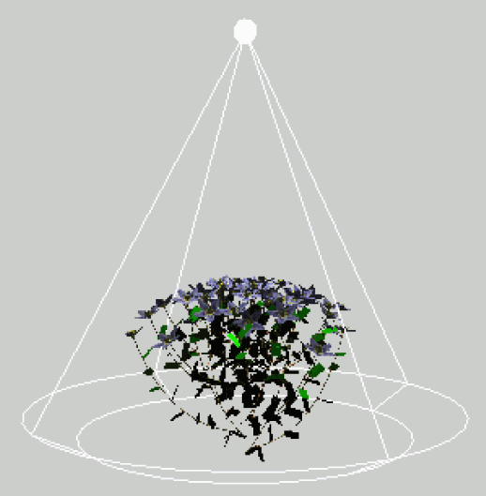
sfspm05.gsz (only new parts of the model are displayed)
protected void init()
[
Axiom ==> Bud(1, PHYLLO, 0);
==> ^ M(50) RU(180) MyLight; /* Light source is placed above the scene */
]
public void grow()
{
run();
lm.compute();
absorb();
}
protected void run()
[
Bud(r, p, o), (p>0) ==> ..........
// further rules....
]
protected void absorb()
[
lf:Leaf ::>
{
lf[al] = lm.getAbsorbedPower3d(lf).integrate();
lf.(setShader(new AlgorithmSwitchShader(
new RGBAShader((float) lf[al]/5.0, (float) lf[al]*2, (float) lf[al]/100.0),
GREEN)));
println(lf[al]);
}
]

Slide 10
sfspm05.gsz (only new parts of the model are displayed)
// ..... module definitions .....
/* the leaf collects light and gets a new shader for the radiation model: */
module Leaf(float al) extends Parallelogram(2, 1)
{{ setShader(new AlgorithmSwitchShader(new RGBAShader(0, 1, 0), GREEN)); }};
// ..... further module definitions .....
/* the light source: */
module MyLamp extends SpotLight
{{
setPower(200.0); /* power in W */
setAttenuationDistance(50.0); /* in m */
setAttenuationExponent(0.0);
setInnerAngle(22.5*Math.PI/180.0);
setOuterAngle(30.0*Math.PI/180.0);
}};
module MyLight extends LightNode(1.0, 1.0, 1.0) /* R, G, B */
{{ setLight(new MyLamp()); }};
/* the radiation model is defined */
LightModel lm = new LightModel(100000, 5);
/* 100000: number of random rays, 5: recursion depth (nb. of reflections) */

Slide 11
sfspm05.gsz (continuation)
protected void init()
[
Axiom ==> Bud(1, PHYLLO, 0);
==> ^ M(50) RU(180) MyLight; /* Light source is placed above the scene */
]
public void grow()
{
run();
lm.compute();
absorb();
}
protected void run()
[
Bud(r, p, o), (p>0) ==> ..........
// further rules....
]
protected void absorb()
[
lf:Leaf ::>
{
lf[al] = lm.getAbsorbedPower3d(lf).integrate();
lf.(setShader(new AlgorithmSwitchShader(
new RGBAShader((float) lf[al]/5.0, (float) lf[al]*2, (float) lf[al]/100.0),
GREEN)));
println(lf[al]);
}
]

Slide 12
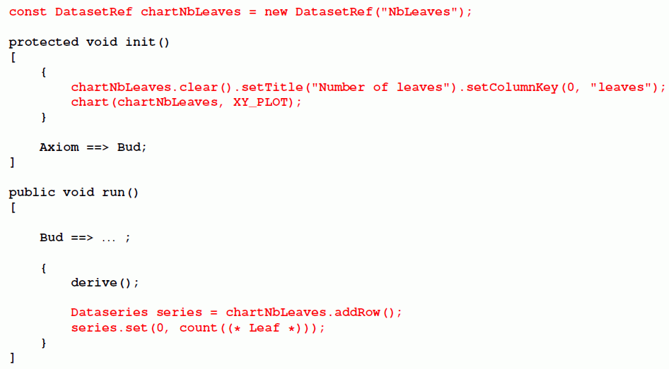
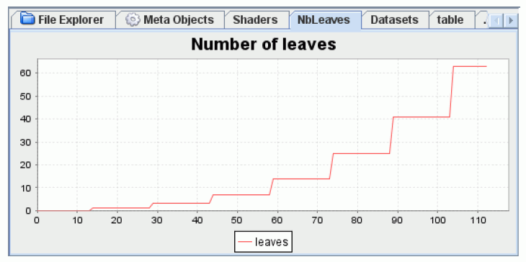
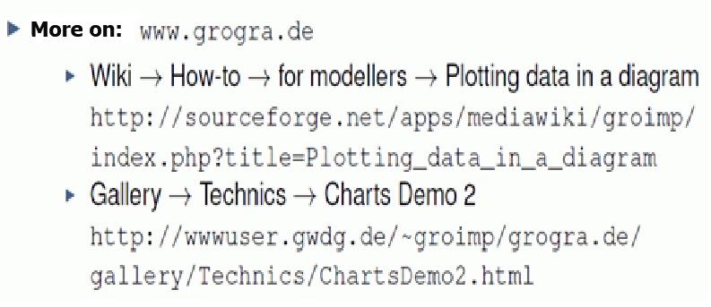
Plotting charts
(repetition, compare dispersal models – examples 23 und 24)

Slide 13
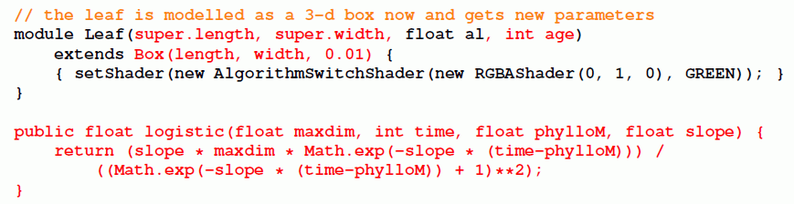
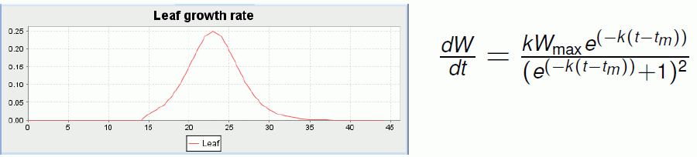
Leaf growth using logistic function

Slide 14
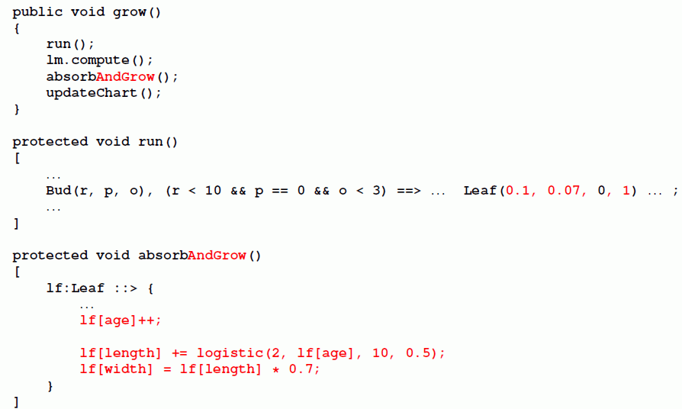
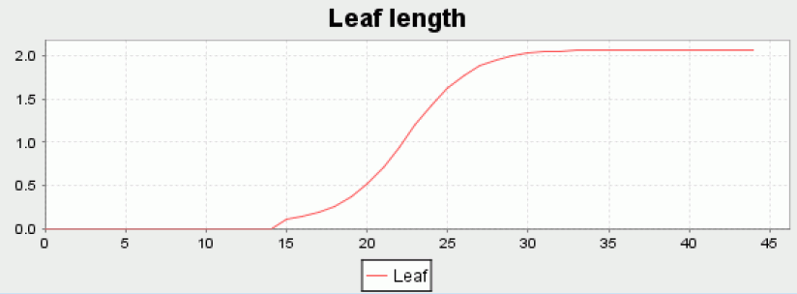
Leaf growth using logistic function (application)

Slide 15
Leaf growth using logistic function
Plotting of absorbed light (only new parts of the model) sfspm06.gsz
/* the leaf is modelled as a 3-d box now and gets new parameters: */
module Leaf(super.length, super.width, float al, int age)
extends Box(length, width, 0.01)
{{ setShader(new AlgorithmSwitchShader(new RGBAShader(0, 1, 0), GREEN)); }};
// ............
/* Introducing leaf growth: */
/* derivative of logistic function */
public float logistic(float maxdim, int time, float phylloM, float slope)
{
return (slope * maxdim * Math.exp(-slope*(time-phylloM))) /
((Math.exp(-slope*(time-phylloM))+1)**2);
}
/* Table for absorbed light values: */
const DatasetRef lightdata = new DatasetRef("Light intercepted by canopy");
protected void init()
[
{
lightdata.clear(); /* the chart is initialized */
chart(lightdata, XY_PLOT);
}
Axiom ==> Bud(1, phyllo, 0);
==> ^ M(50) RU(180) MyLight; /* Light source is placed above the scene */
]

Slide 16
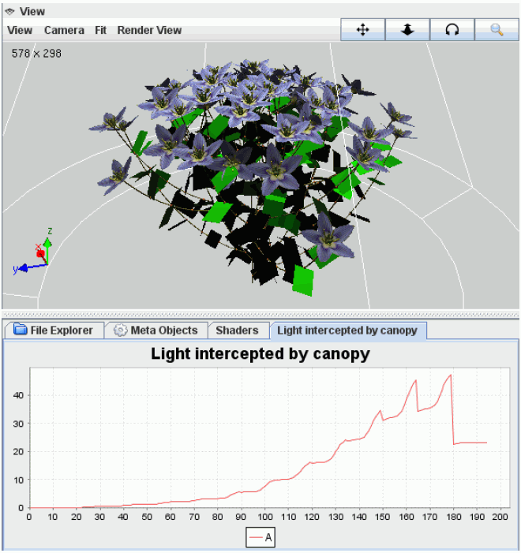
Leaf growth using logistic function
Plotting of absorbed light (only new parts of the model, continued)
sfspm06.gsz:
public void grow()
{
run();
lm.compute();
absorb_and_growleaf();
lightdata.addRow().set(0, sum((* Leaf *)[al]));
}
protected void run()
[
Bud(r, p, o), (p>0) ==> ...........
// further rules....
]
protected void absorb_and_growleaf()
[
lf:Leaf ::>
{
lf[al] = lm.getAbsorbedPower3d(lf).integrate();
lf.(setShader(new AlgorithmSwitchShader(
new RGBAShader((float) lf[al]/5.0, (float) lf[al]*2, (float) lf[al]/100.0),
GREEN)));
println(lf[al]);
lf[age]++; /* the leaf is ageing */
lf[length] += logistic(2, lf[age], 10, 0.5); /* logistic growth */
lf[width] = lf[length]*0.7;
}
]

Slide 17
protected void absorb_and_growleaf()
[
lf:Leaf ::>
{
lf[al] = lm.getAbsorbedPower3d(lf).integrate();
/* without factor 2.25;
this factor would convert from global radiation [W/m2]
into photosynthetically active radiation [umol phot./m2] */
lf.(setShader(new AlgorithmSwitchShader(
new RGBAShader((float) lf[al]/5.0, (float) lf[al]*2,
(float) lf[al]/100.0), GREEN)));
println(lf[al]);
lf[age]++; /* the leaf is ageing */
lf[length] += logistic(2, lf[age], 10, 0.5);
/* logistic growth */
lf[width] = lf[length]*0.7;
}
]

Slide 18
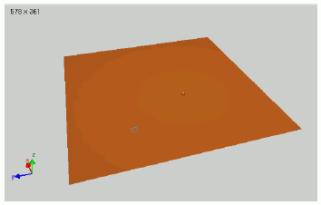
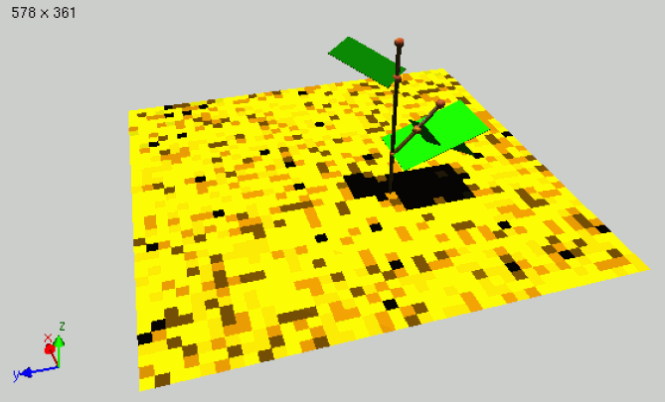
Determination of the light arriving at the soil
sfspm07.gsz: (only new parts of the model)
// .....
/* a single tile (will be positioned on the ground): */
module Tile(float len, float wid) extends Parallelogram(len, wid)
{ float al; };
// .....
protected void init()
[
{
lightdata.clear(); /* the chart is initialized */
chart(lightdata, XY_PLOT);
}
Axiom ==> [ RL(90) M(4) RU(90) M(-4) for ((1:40)) /* paving the ground */
( for ((1:40))
( Tile(0.25, 0.25).(setShader(new RGBAShader(0.6, 0.3, 0.1))) )
M(-10) RU(90) M(0.25) RU(-90)
) ]
Bud(1, phyllo, 0);
==> ^ M(50) RU(180) MyLight; /* Light source is placed above the scene */
]
// .....
protected void absorb_and_grow()
[
lf:Leaf ::> ......
p:Tile ::>
{
p[al] = lm.getAbsorbedPower3d(p).integrate();
println(p[al]);
p.(setShader(new AlgorithmSwitchShader(new RGBAShader(
p[al]*300, p[al]*200, p[al]), new RGBAShader(0.6, 0.3, 0.1))));
}
]

Slide 19
Most simple model of photosynthesis
Assumption of a linear relationship between the absorbed light and the amount of assimilates produced in the leaf
- conversion factor CONV_FACTOR
- Leaf gets new property “as” (produced amount of assimilates)
sfspm08.gsz: use of the linear photosynthesis model
(only new parts of the model)
// .....
const float CONV_FACTOR = 0.2; /* conversion factor light->assimilates */
// .....
protected void absorb_and_grow()
[
lf:Leaf ::>
{
lf[al] = lm.getAbsorbedPower3d(lf).integrate();
// ...................
lf[as] = lf[al] * CONV_FACTOR; /* amount of assimilates */
float lfas = sum((* Leaf *)[as]); /* ... of all leaves */
if (lfas > 0) /* dependency of growth on availability of assimilates */
{
lf[length] += logistic(2, lf[age], 10, 0.5); /* logistic growth */
}
lf[width] = lf[length]*0.7;
}
itn:Internode ::> // ......
]

Slide 20
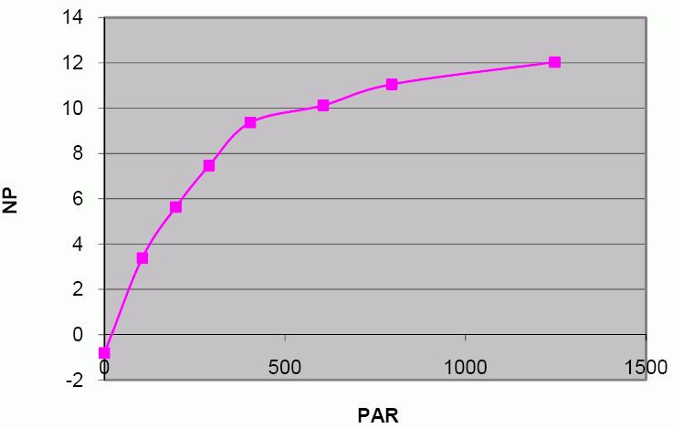
Inclusion of a more realistic (non-linear) model of photosynthesis
(see short script on photosynthesis modelling: photosyn_modell.pdf )
CO₂-exchange rate (carbon dioxide exchange rate, CER) - saturation curve in dependence of photon flux density (ppfd) according to:
mit RD = dark respiration
PE = photosynthetic efficiency
F_{max} = maximal photosynthesis
Units:
CER, ppfd, RD, Fmax : μmol ⋅ m⁻²⋅ s⁻¹ ; PE : dimensionsless
sfspm09.gsz: Photosynthesis in the leaves with improved model (calculation of photosynthesis only)
/* function calculateCER gives the instantaneous CO2 fixation rate
(micromol CO2 m-2 s-1) depending on light intensity (ppfd).
Dependency on temperature is not included. */
float calculateCER(float ppfd)
{
return (float) ( (FMAX+DARK_RESPIRATION_RATE) * PHOTO_EFFICIENCY * ppfd) /
(PHOTO_EFFICIENCY*ppfd + FMAX + DARK_RESPIRATION_RATE) - DARK_RESPIRATION_RATE;
}
CER
ppfd

Slide 21
Conversion of the amount of assimilates in kg for a leaf of certain area and during a given time span
/* function calculatePS gives the assimilate production (in kg) of a leaf,
depending on leaf area a (in m**2), ppfd (in umol/(m**2 s)) and duration
d (in seconds) of light interception.
Dependency on temperature is not included. */
float calculatePS(float a, float ppfd, float d)
{
return
calculateCER(ppfd) * a * d
* 44.01e-6 /* mass of 1 umol CO2 in g */
* (180.162/264.06) /* conversion CO2 -> Glucose */
/ 1000.0; /* conversion g -> kg */
}
Conversion of photon flux from W (power) in μmol ⋅ s⁻¹
const float PPFD_FACTOR = 0.575; /* conversion factor from absorbed
power (W) to photon flux (umol/s);
unit: umol/J; after Kniemeyer 2008 */
// .............
lf:Leaf ::>
{
lf[al] = lm.getAbsorbedPower3d(lf).integrate();
// ................
float area = LEAF_FF * lf[length] * lf[width] / 10000.0;
/* converted from cm**2 to m**2 */
/* calculation of photosynthetic production of the leaf: */
lf[as] += calculatePS(area, PPFD_FACTOR * lf[al] / area, DURATION);
// ................
}

Slide 22
Required for the distribution of the assimilates
Modelling of transport processes
Model assumption: substrate flows from elements with high concentration to elements with low concentration (principle of diffusion)
Example:
sm09_e41.rgg (concentration of a substrate is visualized
by the diameter here)

Slide 23
module Internode(super.diameter) extends F(100, diameter);
protected void init()
[
Axiom ==> P(14) Internode(1) P(2) Internode(1)
P(4) Internode(1) P(15) Internode(60);
]
public void transport()
[
i_oben:Internode < < i_unten:Internode ::>
{
float r = 0.1 * (i_below[diameter] - i_above[diameter]);
i_unten[diameter] :-= r;
i_oben[diameter] :+= r;
}
]
(2 reverse successor edges after the other)

Slide 24
Modelling of transport in sfspm09.gsz
const float DIFF_CONST = 0.01; /* diffusion constant for transport
of assimilates */
// ..........
public void grow()
{
run();
lm.setSeed(irandom(1,100000));
lm.compute();
absorb_and_grow();
for (apply(5)) transport(); /* 5 iterations of transport per step */
// ..........
}
protected void transport()
[
/* transport of assimilates from a leaf to the supporting internode: */
lf:Leaf <-minDescendants- itn:Internode ::>
{
float r = DIFF_CONST * (lf[as] - itn[as]);
lf[as] :-= r;
itn[as] :+= r;
}
/* exchange between successive internodes: */
i_top:Internode <-minDescendants- i_bottom:Internode ::>
{
float r = DIFF_CONST * (i_bottom[as] - i_top[as]);
i_bottom[as] :-= r;
i_top[as] :+= r;
}
]

Slide 25
Questions:
- is this transport mechanism realistic?
- how are the conditions in the very beginning?
- what about buds which do not yet produce assimilates but need some for extension growth?
- for growth and photosynthesis, nitrogen (N) is also needed. This is delivered by the roots. How would a transport model for N differ from that of C?

Slide 26
Further addition
Time counting and integration of phenology (leaf shedding) in sfspm10.gsz
int time; /* global time counter */ /* initialized to 1 in init() */
const int STEPS_OF_YEAR = 100; /* number of time steps of veget. period */
/****************/
public void grow()
{
run();
lm.setSeed(irandom(1,100000));
lm.compute();
absorb_and_grow();
for (apply(5)) transport(); /* 5 iterations of transport per step */
lightdata.addRow().set(0, sum((* Leaf *)[al]));
if (time == STEPS_OF_YEAR) time = 0;
time++;
}
protected void run()
[
Bud(r, p, o), (p>0) ==> Bud(r, p-1, o);
Bud(r, p, o), (r==10 && probability(0.5)) ==>
RV(-0.1) Internode(0.05, 1) Internode(0.05, 1)
NiceFlower(1, irandom(10, 15));
Bud(r, p, o), (p==0 && o<=2) ==> RV(-0.1) Internode(0.1, 1) NiceNode
[ RL(50) Bud(r, PHYLLO, o+1) ] [ RL(70) Leaf(0.1, 0.07, 0, 1, 0) ]
RH(G_ANGLE) RV(-0.1) Internode(1, 1) Bud(r+1, PHYLLO, o);
NiceFlower(t, m), (t < m) ==> NiceFlower(t+1, m); /* ageing of flower */
NiceFlower(t, m), (t >= m) ==> ;
Leaf, (time == STEPS_OF_YEAR) ==>> ;
NiceFlower, (time == STEPS_OF_YEAR) ==>> ;
]

Slide 27
Tasks for the assignment
Functional-structural plant model 2022
(I) Thorough critical analysis of the present model sfspm10.gsz
- please analyze the underlying concept and model structure
- include a description of the modelling of light interception and
photosynthesis
proposals for further conceptual development of an improvement of the model:
- to this end - evaluation of your measured data, statistical analysis, and adaptation of the model
- also, formulate theoretical considerations for improving the modelling, especially for the growth
- you do not need a detailed presentation of the methods for statistical data analysis of the measured data; a presentation of the results is all that is required

Slide 28
Improvement and extension of the model. The following list shows possible subject areas, where you can start. You can also create and develop your own topics (please contact W. Kurth)
Mandatory for all is a parameterization of the model with
measured data (including photosynthesis data, even if the latter has
been determined on other plants)
You can set priorities for further improvements.
(IV) Sensitivity analysis of your model version: How strongly do changes
in parameters / rules, affect the result?
Are the results biologically plausible?
What could be improved further?

Slide 29
Please note:
The model “SFSPM" in its present form is not a complete, fully tested and calibrated version
It may still contain errors!
So far it is designed for plants with terminal flowers. The adaptation of morphology and phenology (e.g. incorporation of dormancy, phases of growth) to woody species would be useful
Finding possible deficiencies and errors is part of this assignment

Slide 30
Possible improvements to the model
Further model adaptation to the measured data photosynthetic parameters, (maximum) organ sizes, angles, growth rates, growth rules
Adaptation of the leaves (flowers/fruits) to the species you have investigated (maple, ash, wild cherry tree)
Equilibrating the mass balance of the plant including assimilate sinks, especially the assimilate requirement for organ growth
Managing growth - light dependence; dependence on existing amount of assimilate; possible density sensitivity...
Control of the formation of new metamers, analogous to the control of growth

Slide 31
Possible improvements to the model (continued)
(6) Consideration of plant dormancy
(7) Inclusion of sylleptic shoot formation / free growth
(8) Branching control (according to assimilate quantity or light)
Improvement of the modeling of growth thickness (e.g. using the pipe model; see also the example "Tree based on pipe model of branch width" in GroIMP)
Improvement of the assimilate allocation model
e.g., change in transport rates for young leaves; inclusion
of a central C stock (starch pool) and a reserve from the
seed at the beginning; inclusion of the root

Slide 32
Evaluation criteria for the assignment
points (giving 7 in total)
Outline, introduction and theory 1
Contents 3
Analysis of the model 0,6
Data analysis, incorporation of the data 0,6
Conceptual improvement (ideas) 0,6
Concrete improvement of the model 0,6
Sensitivity analysis 0,6
Literature 0,5
Accuracy 1
Language 0,5
Originality 1

Slide 33
Deadline for submission of assignment
15 September, 2022, at 12:00
(the date of the digital delivery is noted; please also submit a printed copy)
Note:
Use the consultation opportunities provided by W. Kurth and A. Tavkhelidze), in particular when re-programming the model!

Slide 34
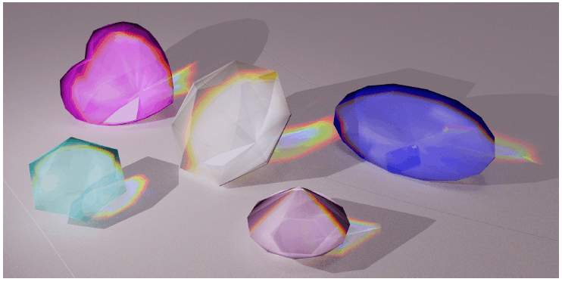
Thank you for your attention!

