Slide 1


Functional-Structural Plant Models
Summer semester 2022 -
Winfried Kurth
University of Göttingen
Chair of Computer Graphics and Ecoinformatics
9th lecture: 7 July, 2022

Slide 2
From our last lecture:
spruce model
another rule type: update rules
notation of graphs in XL
the current graph in GroIMP
derived relations

Slide 3
On the following slides:
The XL language: Overview
Queries in the graph
The GroIMP software: Overview
A first model for shadow

Slide 4
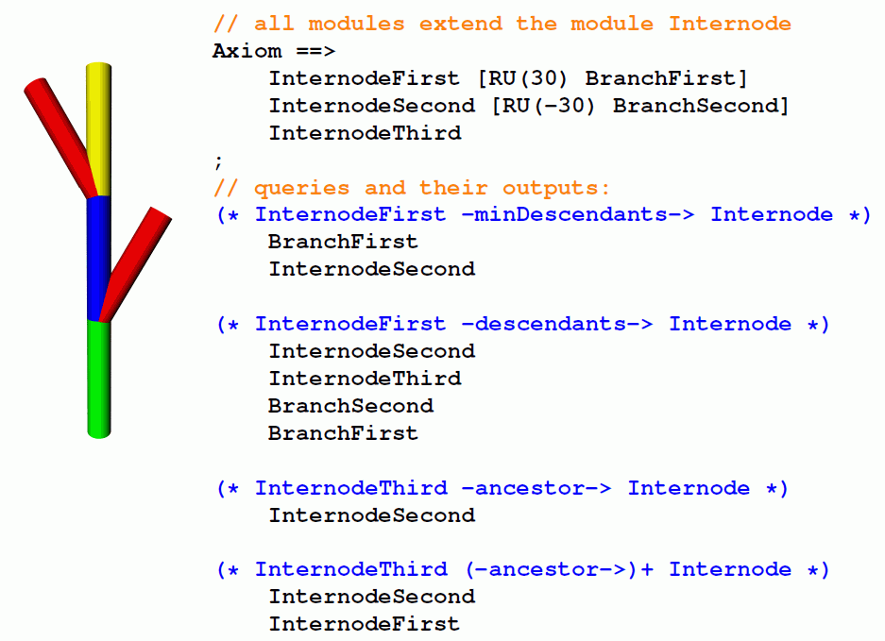
The derived relation –ancestor->

Slide 5
Test the following examples:
sm09_e28.rgg
sm09_e29.rgg
sm09_e30.rgg
Notice that “ancestor” skips nodes of types different from the target type of the query!

Slide 6
Assignment from the last lecture:
How can the following graph be described in XL code?
Bud
>
0
1
X
+
Leaf

Slide 7
The programming language XL
„eXtended L-system language“
A synthesis of three paradigms
Imperative
Object oriented
Rule based
Java
XL

Slide 8
XL
Language specification: Kniemeyer (2008)
Dissertation:
http://nbn-resolving.de/urn/resolver.pl?urn=urn:nbn:de:kobv:co1-opus-5937
extension of Java
allows specification of L-Systems and RGG at the same time (graph grammars) in intuitively understandable standard notation
imperative blocks, similar to Java: { ... }
rule-oriented blocks (RGG part): [ ... ]

Slide 9
Features of the XL language
● nodes of the graphs are Java objects
● also geometry objects

Slide 10
Features of the XL language
● nodes of the graphs are Java objects
● also geometry objects
Example: XL-program for the Koch curve
public void derivation()
[
Axiom ==> RU(90) F(10);
F(x) ==> F(x/3) RU(-60) F(x/3) RU(120)
F(x/3) RU(-60) F(x/3);
]

Slide 11
Features of the XL language
● nodes of the graphs are Java objects
● also geometry objects
Example: XL- Program for the Koch curve
public void derivation()
[
Axiom ==> RU(90) F(10);
F(x) ==> F(x/3) RU(-60) F(x/3) RU(120)
F(x/3) RU(-60) F(x/3);
]
Node of graph Edge (type “successor”)

Slide 12
Features of the XL language
● nodes of the graphs are Java objects
● also geometry objects
Special Nodes:
Geometric objects
Box, Sphere, Cylinder, Cone, Frustum,
Parallelogram...

Slide 13
Features of the XL language
● nodes of the graphs are Java objects
● also geometry objects
Special Nodes:
Geometric objects
Box, Sphere, Cylinder, Cone, Frustum,
Parallelogram...
Access to attributes via the parameter list:
Box(x, y, z) (length, width, height)
or with special functions:
Box(...).(setColor(0x007700)) (color)

Slide 14
Access to node attributes
Example: sm09_e26.rgg
module Bud() extends Sphere(0.1) {{ setShader(RED); }};
module Internode() extends F(1) {{ setShader(GREEN); setScale(1); }};
protected void init()
[ Axiom ==> Internode() Bud();
]
public void run1()
[ i:Internode ::> i[length] = i[length] + 0.1;
]
public void run2()
[ i:Internode ::> i.length = i.length + 0.1;
]
public void run3()
[ i:Internode ::> i[scale] += 0.1;
]
public void run4()
[ i:Internode ::> i.setScale(1);
]

Slide 15
Features of the XL language
● nodes of the graphs are Java objects
● also geometry objects
Special Nodes:
Geometric objects
Box, Sphere, Cylinder, Cone, Frustum,
Parallelogram...
Transformation nodes
Translate(x, y, z), Scale(cx, cy, cz), Scale(c),
Rotate(a, b, c), RU(a), RL(a), RH(a), RV(c), RG, ...

Slide 16
Features of the XL language
● nodes of the graphs are Java objects
● also geometry objects
Special Nodes:
Geometric objects
Box, Sphere, Cylinder, Cone, Frustum,
Parallelogram...
Transformation nodes
Translate(x, y, z), Scale(cx, cy, cz), Scale(c),
Rotate(a, b, c), RU(a), RL(a), RH(a), RV(c), RG, ...
Light sources
PointLight, DirectionalLight, SpotLight, AmbientLight

Slide 17
Features of the XL language
● nodes of the graphs are Java objects, also geometry objects
● rules organized in blocks [...], control of the application through control structures

Slide 18
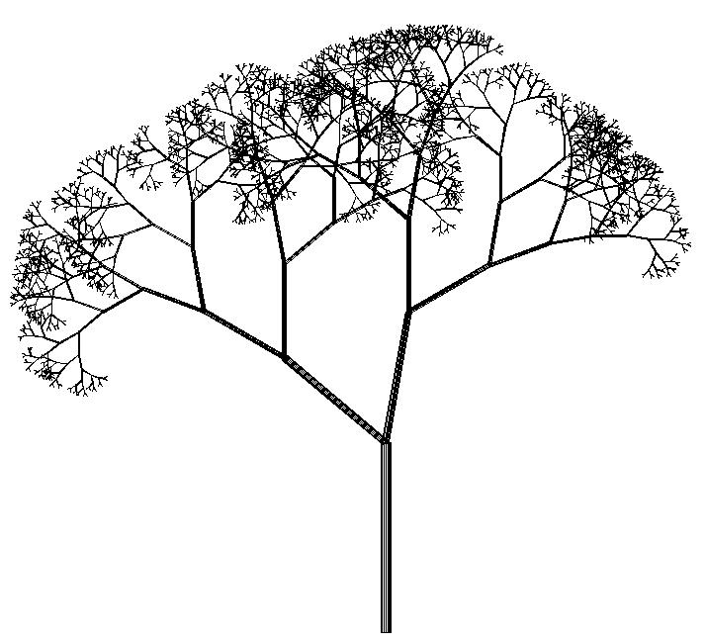
Features of the XL language
● nodes of the graphs are Java objects, also geometry objects
● rules organized in blocks [...], control of the application through control structures
Example: Rules for the stochastic tree
Axiom ==> L(100) D(5) A;
A ==> F0 LMul(0.7) DMul(0.7)
if (probability(0.5))
( [ RU(50) A ] [ RU(-10) A ] )
else
( [ RU(-50) A ] [ RU(10) A ] );

Slide 19
Features of the XL language
● nodes of the graphs are Java objects, also geometry objects
● rules organized in blocks [...], control of the application through control structures
● parallel application of the rules

Slide 20
Features of the XL language
● nodes of the graphs are Java objects, also geometry objects
● rules organized in blocks [...], control of the application through control structures
● parallel application of the rules
(can be modified: sequential mode can be set, more on this later…)

Slide 21
Features of the XL language
● nodes of the graphs are Java objects, also geometry objects
● rules organized in blocks [...], control of the application through control structures
● parallel application of the rules
● parallel execution of assignments possible
Special assignment operator := besides the normal =
Quasi-parallel assignment to the variables x und y:
x := f(x, y);
y := g(x, y);

Slide 22
Features of the XL language
● nodes of the graphs are Java objects, also geometry objects
● rules organized in blocks [...], control of the application through control structures
● parallel application of the rules
● parallel execution of assignments possible
● operator overloading (e.g. "+" for numbers as for vectors)

Slide 23
Features of the XL language
● nodes of the graphs are Java objects, also geometry objects
● rules organized in blocks [...], control of the application through control structures
● parallel application of the rules
● parallel execution of assignments possible
● operator overloading (e.g. "+" for numbers as for vectors)
● set-valued expressions (more precisely: producers instead of sets)

Slide 24
Features of the XL language
● nodes of the graphs are Java objects, also geometry objects
● rules organized in blocks [...], control of the application through control structures
● parallel application of the rules
● parallel execution of assignments possible
● operator overloading (e.g. "+" for numbers as for vectors)
● set-valued expressions (more precisely: producers instead of sets)
● graph queries to analyze the actual structure

Slide 25
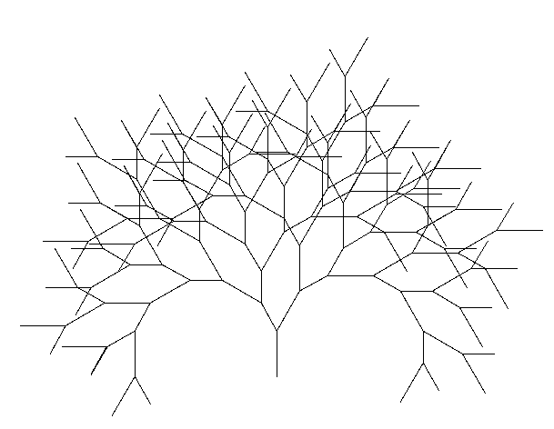
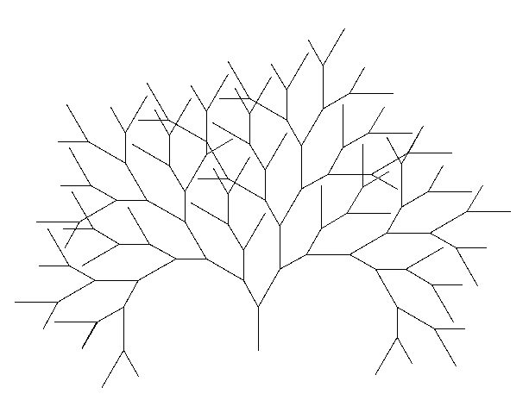
Example for a graph query
Binary tree, growth shall start only if there is enough distance to the other F objects
Axiom ==> F(100) [ RU(-30) A(70) ] RU(30) A(100);
a:A(s) ==> if ( forall(distance(a, (* F *)) > 60) )
( RH(180) F(s) [ RU(-30) A(70) ] RU(30) A(100) )
without the “if” condition with the “if” condition

Slide 26
Features of the XL language
● nodes of the graphs are Java objects, also geometry objects
● rules organized in blocks [...], control of the application through control structures
● parallel application of the rules
● parallel execution of assignments possible
● operator overloading (e.g. "+" for numbers as for vectors)
● set-valued expressions (more precisely: producers instead of sets)
● graph queries to analyze the actual structure
● aggregating operators (e.g., “sum”, “mean”, “empty”, “forall”,
“selectWhereMin”)

Slide 27
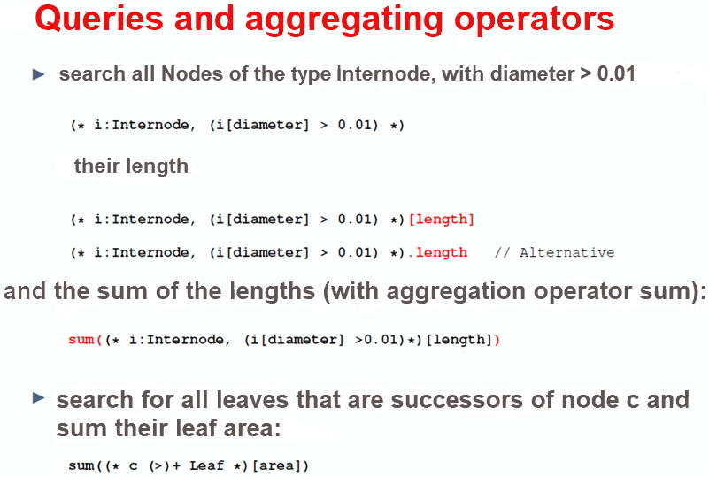

Slide 28
Queries and aggregating operators
provide possibilities to connect structure and function
Example: search for all leaves which are successors of node c and sum up their surface areas
query

Slide 29
Queries and aggregating operators
provide possibilities to connect structure and function
Example: search for all leaves which are successors of node c and sum up their surface areas
query
transitive closure
aggregating operator

Slide 30
Queries and aggregating operators
provide possibilities to connect structure and function
Example: search for all leaves which are successors of node c and sum up their surface areas
query
result can be transferred to an imperative calculation
transitive closure
aggregating operator

Slide 31
Query in a plant / animal model
p:Plant,
(* a:Animal, (distance(a,p) < p[radius]) *)

Slide 32
Query in a plant / animal model
p:Plant,
(* a:Animal, (distance(a,p) < p[radius]) *)
searches all animals within the radius of p

Slide 33
The Software GroIMP
http://www.grogra.de
there also link to the download page
http://sourceforge.net/projects/groimp/
Also a Gallery with examples
See also learning material on GroIMP (author: K. Petersen, M.Sc. Forest., Summer semester 2009, and others).
GroIMP is an Open-Source Project!

Slide 34
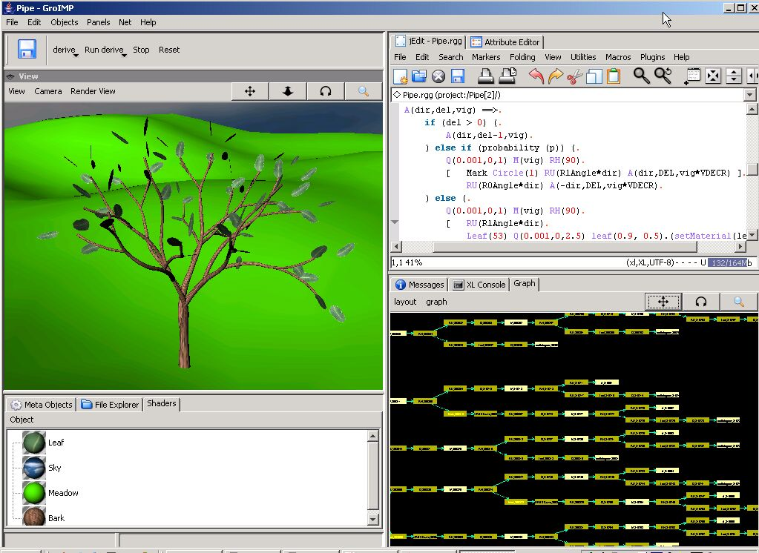
GroIMP (Growth-grammar related Interactive Modelling Platform)

Slide 35
GroIMP is a combination of:
- compiler and interpreter for the language XL
- development environment for XL
- 3-d modeller (interactive)
- 3-d renderer (several variants)
- 2-d graph visualizer
editor for 3-d objects and attributes
tool for generating textures
display for DTD and MTG files
tool for simulating light distribution

Slide 36
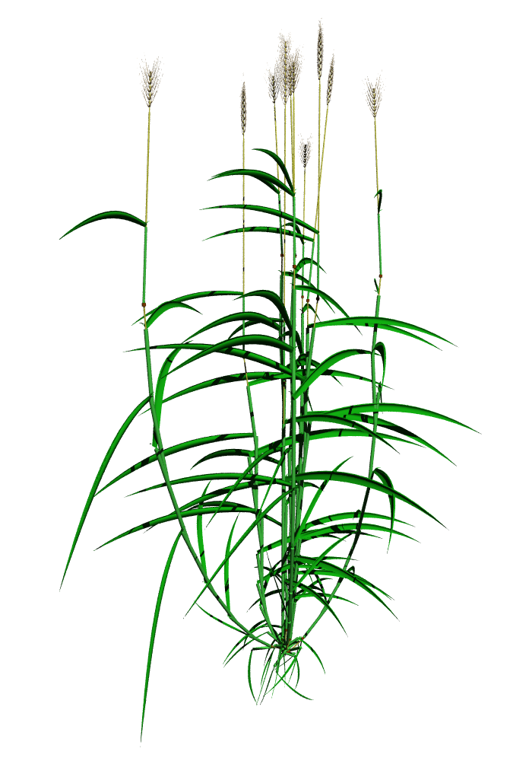
Example of a plant model realized with GroIMP
(barley)

Slide 37
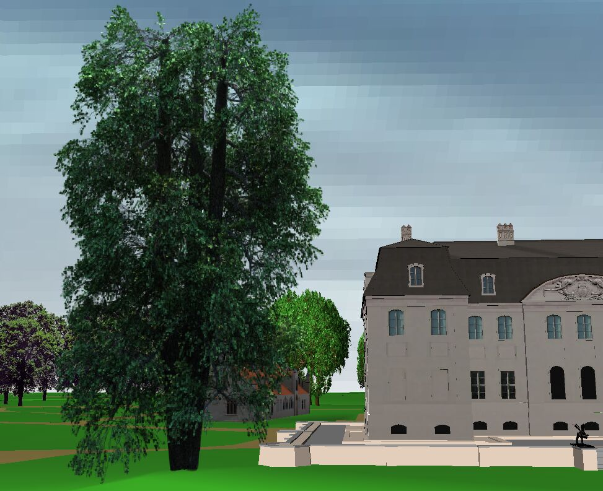
Application example
Modelling of park landscapes (Rogge & Moschner 2007, for Branitzer Park Foundation, Cottbus)
Generated with GroIMP
alder tree in VRML-world

Slide 38
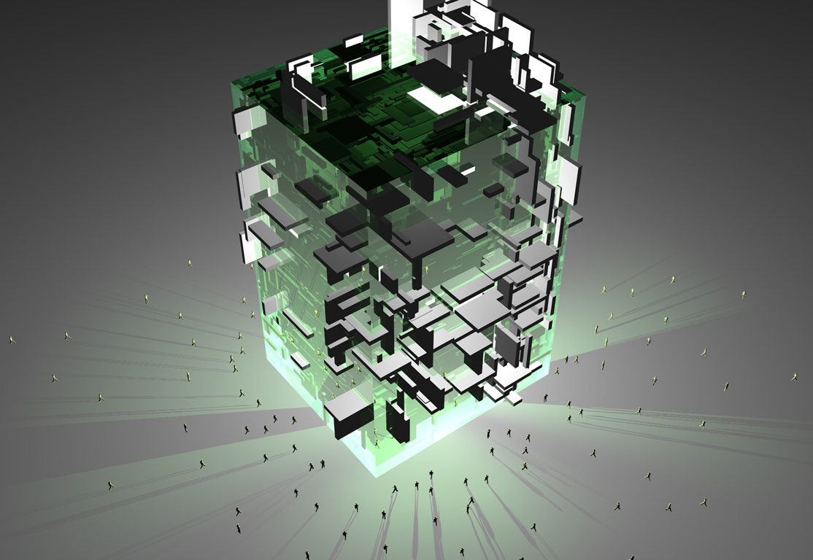
Results from architecture seminar with XL
Liang 2007

Slide 39
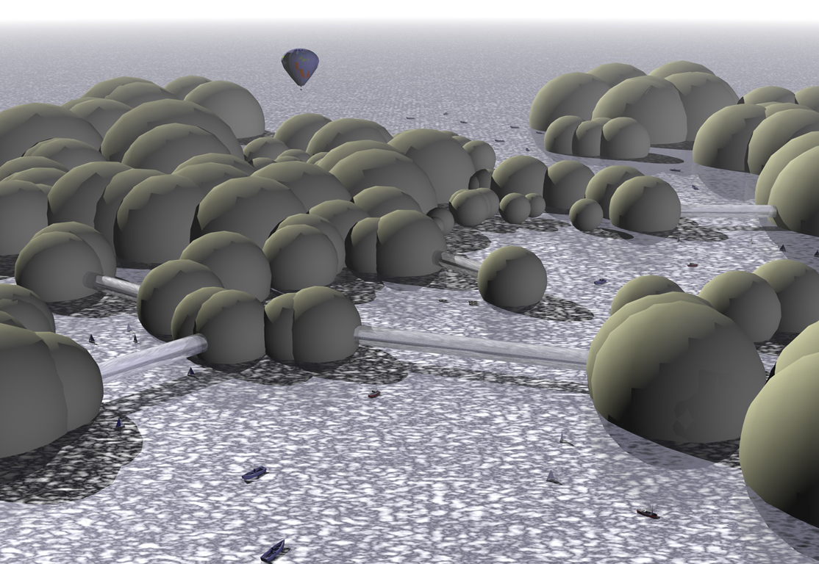
Liang 2007

Slide 40
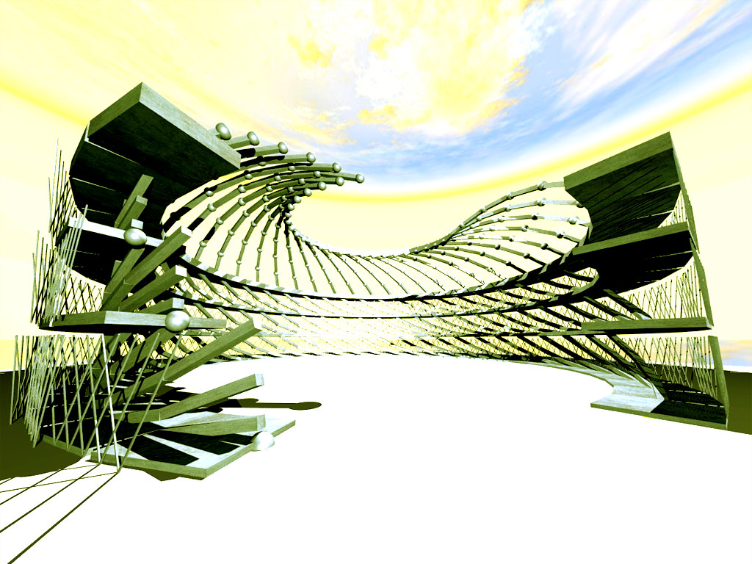
Jarchow 2007

Slide 41
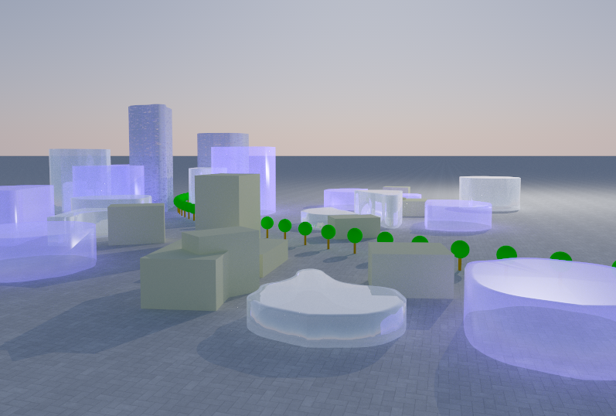
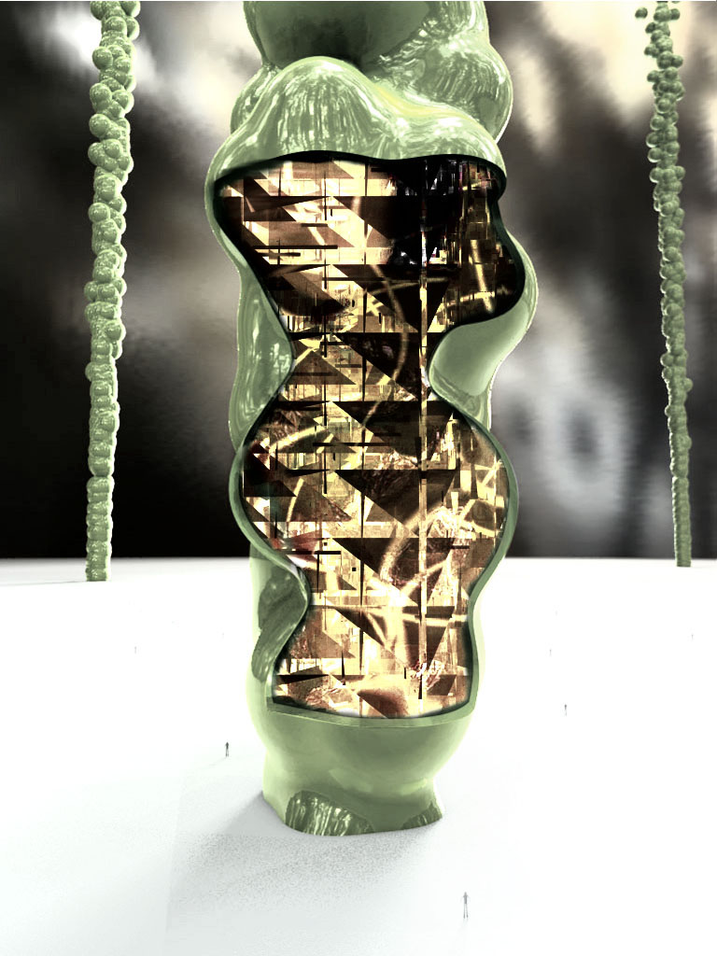
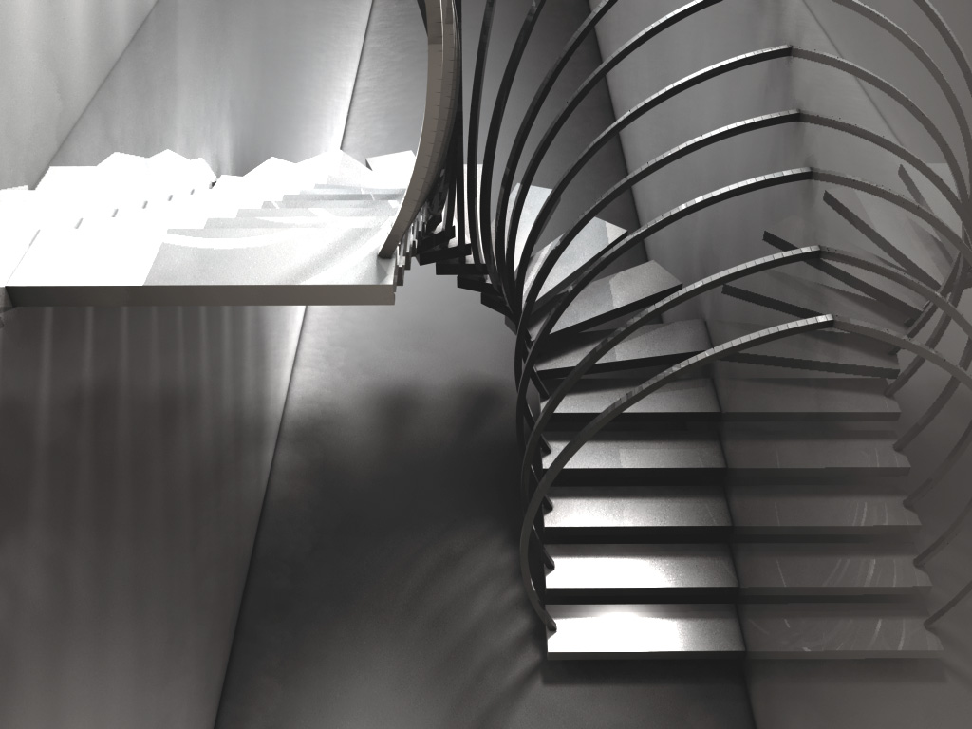

Slide 42
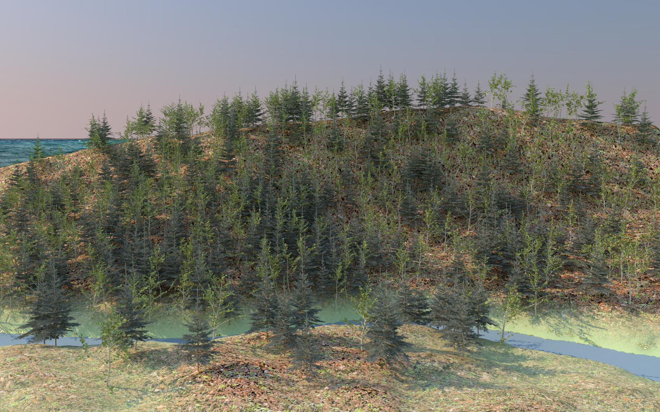
Virtual landscape (with mixed beech and spruce stand)

Slide 43
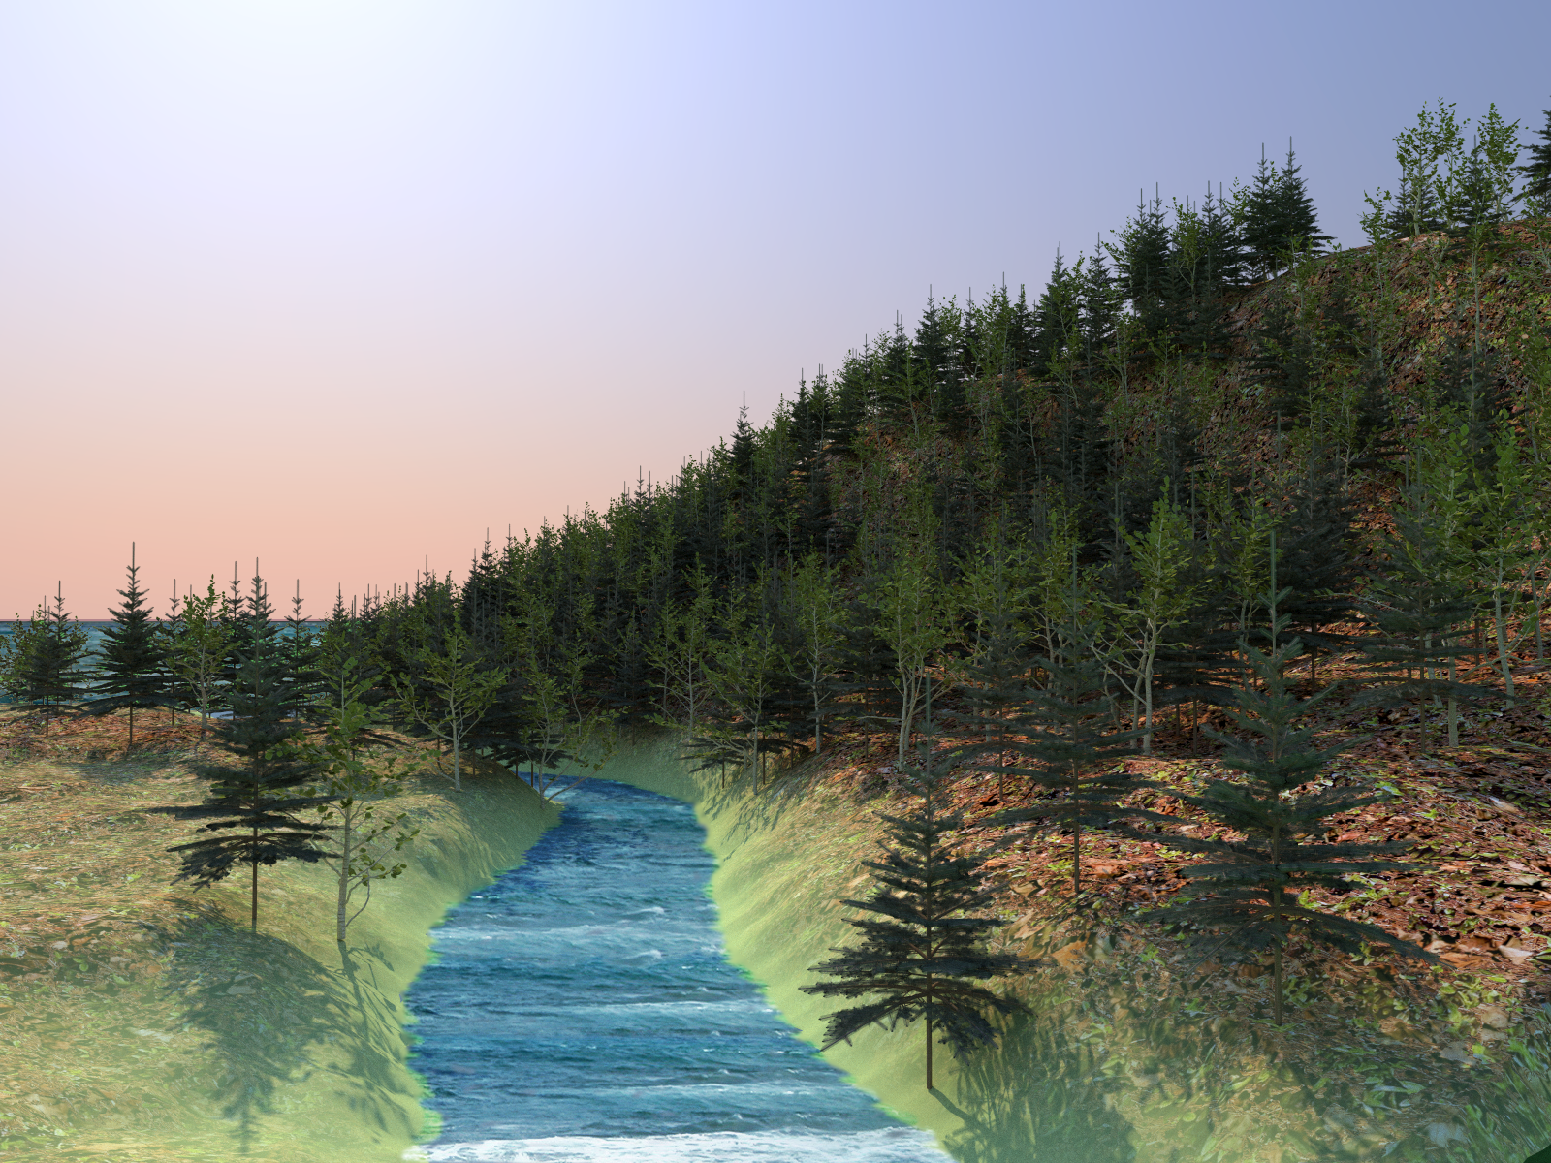

Slide 44
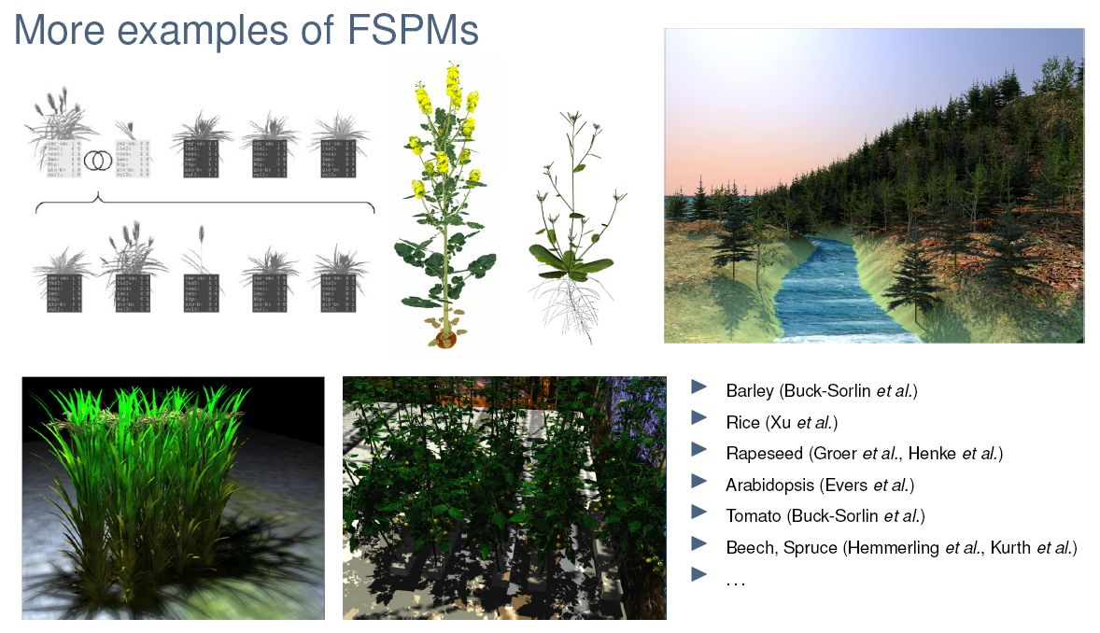
More examples of functional-structural plant models, realized with GroIMP

Slide 45
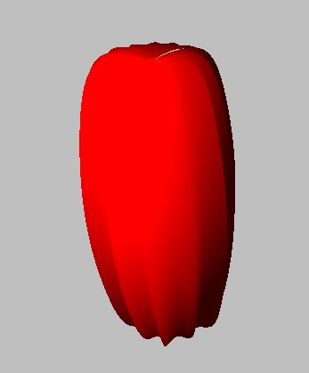
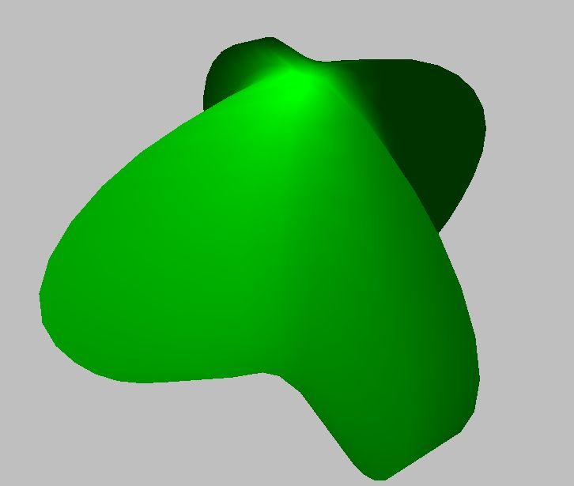
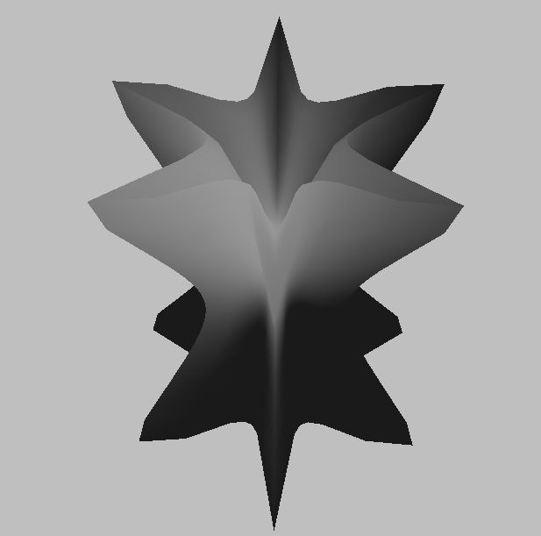
GroIMP - newer extensions
“Supershape” (class of mathematically defined surfaces) as geometrical primitive objects

Slide 46
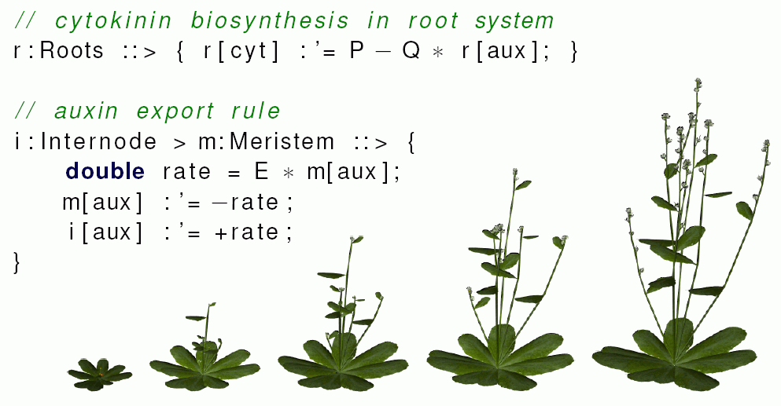
GroIMP - newer extensions
Rate-assignement operator - ability to easily call efficient and numerically stable solution methods for ordinary differential equations in model code
(Hemmerling 2012)
Example:

Slide 47
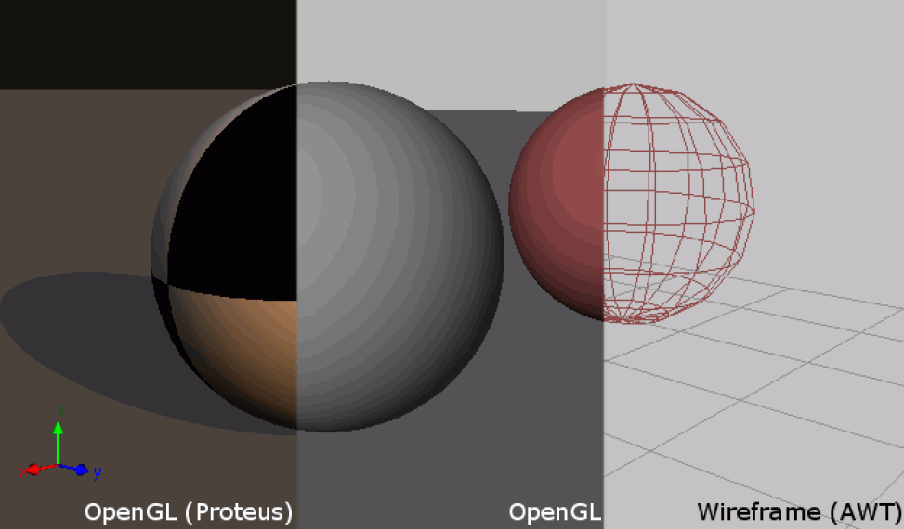
GroIMP - newer extensions
Improved OpenGL-3D-View for visualization
(Hartmann, Hemmerling 2010)

Slide 48
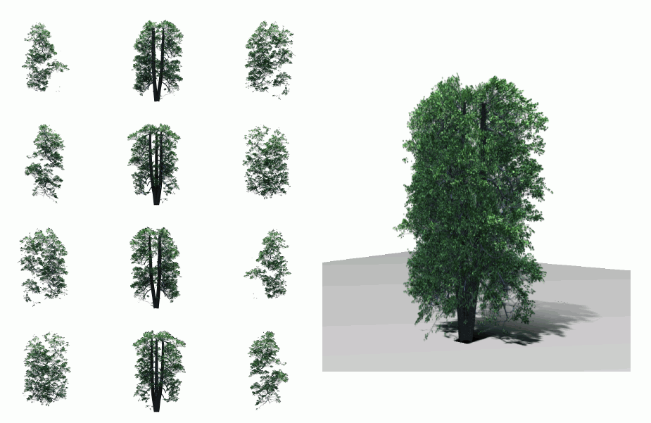
GroIMP - newer extensions
integrated tool for the creation of “billboard objects" for quick vegetation display
(Hemmerling 2010)

Slide 49
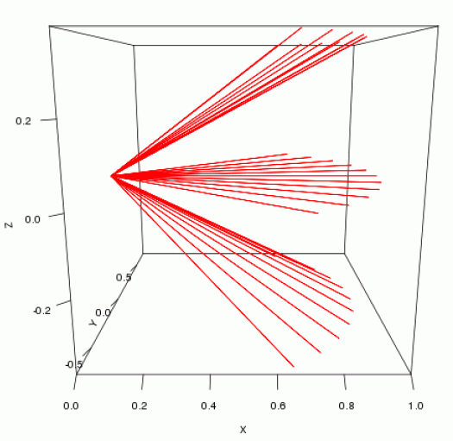
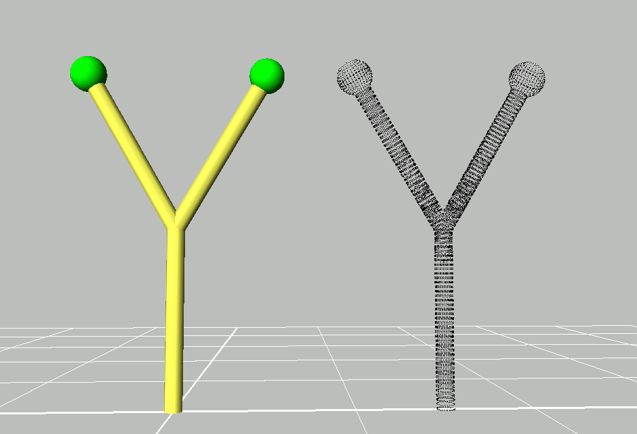
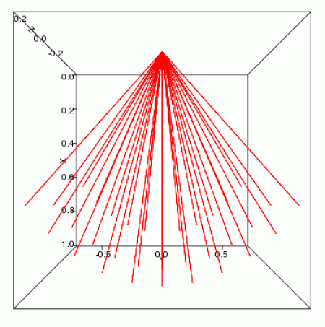
GroIMP - newer extensions
integrated virtual laser scanner (realized with Ecole Centrale Paris, practical work of a student)
(Etard 2011)

Slide 50
Modelling with light / shadow
First model approach (highly simplified)
A shadow is thrown on an object if there are other objects in an imaginary cone with its tip point in the object, opened upwards (z-direction)
Example:
sm09_e42.rgg competition for light by three
2-dimensional plant models

Slide 51
module Segment(int t, int ord) extends F0;
module TBud(int t) extends F(1, 1, 1);
module LBud extends F(0.5, 0.5, 1);
Vector3d z = new Vector3d(0, 0, 1);
protected void init()
[
Axiom ==> P(2) D(5) V(-0.15) [ TBud(-4) ] RU(90) M(600) RU(-90)
[ TBud(0) ] RU(-90) M(1200) RU(90)
[ TBud(-8) ];
]
public void run()
[
TBud(t), (t < 0) ==> TBud(t+1);
x:TBud(t), (t >= 0 && empty( (* s:Segment, (s in cone(x, z, 45)) *) ) ) ==>
L(random(80, 120)) Segment(0, 0)
[ MRel(random(0.5, 0.9)) RU(60) LBud ]
[ MRel(random(0.5, 0.9)) RU(-60) LBud ] TBud(t+1);
y:LBud,
(empty( (* s:Segment, (s in cone(y, z, 45)) *) ) ) ==>
L(random(60, 90) Segment(0, 1) RV0 LBud;
Segment(t, o), (t < 8) ==> Segment(t+1, o);
Segment(t, o), (t >= 8 && o == 1) ==>> ; /* Deletion of branches */
]

