Slide 1
Functional-Structural Plant Models
Summer semester 2022 -
Winfried Kurth
University of Göttingen
Chair of Computer Graphics and Ecoinformatics
8. Lecture: 23rd June, 2022

Slide 2
From our last lecture:
Graph as mathematical basic structure
Graph replacement rules
Two rule types: L-system and SPO rules
Simple spruce model

Slide 3
On our next slides:
Spruce model: discussion of the questions
Notation of graphs in XL
The current graph in GroIMP
derived relations

Slide 4
A spruce model in XL (see last lecture)
/* Spruce model sm09_fichte.rgg W.K. 11.6.2009 */
module T; /* Terminal buds */
module M1; /* Side-branch bud 1st order, medial position */
module S1; /* Side-branch bud 1st order, subapical position */
module M2; /* Side-branch bud 2nd order, medial position */
module S2;
module M3;
module S3;
module GU(float incd, int age) extends F0; /* growth unit */
module BA(int age, super.angle) extends RL(angle);
module GA(int age, super.angle) extends RL(angle);
module HA(int age, super.angle) extends RL(angle);
const int ang = 45;
const int x3 = 50;
const int[] a = { 0, 15, 25, 32, 37, 40 };
const int[] gg = { 0, 0, 4 };
const int[] hh = { 0, 0, 2, 4, 8 };
int n, k;
const float[] prob_n = {0.1, 0.4, 0.3, 0.2};
const int[] n_subap = {5, 6, 7, 8};

Slide 5
protected void init()
[
Axiom ==> P(2) D(1) L(100) T;
]
public void grow()
[
x:T ==> Nl(80*TurtleState.length(x)) GU(2.2, 0)
RH(random(0, 360)) { k = 0; }
for ((1:3)) /* 3 medial side branches 1st order */
( [ MRel(random(0.2, 0.85)) RH(k*120+normal(0, 5.5))
{ k++; } RL(x3+normal(0, 2.2)) BA(0, 0) LMul(0.4) M1 ] )
RH(random(0, 360)) { n = n_subap[distribution(prob_n)]; k = 0; }
for ((1:n)) /* n subapical side branches of 1st order */
( [ MRel(random(0.85, 1)) RH(k*360/n+normal(0, 3.1))
{ k++; } RL(x3+normal(0, 2.2)) BA(0, 0) LMul(0.65) S1 ] )
T;
x:S1 ==> Nl(80*TurtleState.length(x)) GU(1.3, 0)
[ MRel(random(0.85, 1)) RH(15)
RU(ang+normal(0, 2.2)) AdjustLU LMul(0.7) S2 ]
[ MRel(random(0.85, 1)) RH(-15)
RU(-ang+normal(0, 2.2)) AdjustLU LMul(0.7) S2 ] GA(0, 0) S1;
x:M1 ==> Nl(80*TurtleState.length(x)) GU(0.8, 0)
[ MRel(random(0.85, 1)) RH(15)
RU(ang+normal(0, 2.2)) AdjustLU LMul(0.7) M2 ]
[ MRel(random(0.85, 1)) RH(-15)
RU(-ang+normal(0, 2.2)) AdjustLU LMul(0.7) M2 ] HA(0, 0) M1;

Slide 6
x:S2 ==> Nl(80*TurtleState.length(x)) GU(1.3, 0)
[ MRel(random(0.85, 1)) RH(10)
RU(ang) AdjustLU LMul(0.7) S3 ]
[ MRel(random(0.85, 1)) RH(-10)
RU(-ang) AdjustLU LMul(0.7) S3 ] S2;
x:M2 ==> Nl(80*TurtleState.length(x)) GU(0.8, 0)
[ MRel(random(0.85, 1)) RH(10)
RU(ang) AdjustLU LMul(0.7) M3 ]
[ MRel(random(0.85, 1)) RH(-10)
RU(-ang) AdjustLU LMul(0.7) M3 ] M2;
x:S3 ==> Nl(80*TurtleState.length(x)) GU(1.3, 0);
x:M3 ==> Nl(80*TurtleState.length(x)) GU(0.8, 0);
GU(incd, t) ==> DlAdd(incd*(t+1)) GU(incd, t+1);
DlAdd(arg) ==> ;
BA(age, angle) ==> BA(age+1, a[age<5 ? age+1 : 5]);
GA(age, angle) ==> GA(age+1, gg[age<2 ? age+1 : 2]);
HA(age, angle) ==> HA(age+1, hh[age<4 ? age+1 : 4]);
]

Slide 7
Try to answer the following questions:
how to increase the thickness growth
- for all growth units (GU)?
- for the trunk only?
how can a slimmer crown shape be achieved (e.g., by changing the length growth)?
- how can the number of main side branches be reduced?

Slide 8
Repetition: RELATIONAL GROWTH GRAMMARS
RGG: Relational Growth Grammars, parallel graph grammars
Summary: Structure of a rule of a RGG
(* C *), L,(E) ==> R { P };
Context
(Set of graphs)
Left-hand side of rule
(Set of graphs
to be replaced by R)
Condition
(Set of logical expressions, contains parameters related to node labels from L and C)
Right-hand side of rule
(Set of graphs)
Imperative Code
(List of commands)
Graphs: directed with edge-labels and node-labels

Slide 9
Another type of rule
Update rules
Sometimes you don't want to change anything in the graph structure, but only change attributes of a single node (e.g. to calculate the photosynthesis for a leaf). There is a separate rule type for this:
A ::> { imperative Code };
Test the following examples:
sm09_e25.rgg
sm09_e16.rgg
sm09_e18.rgg

Slide 10
Display of graphs in the XL programming
language
● node types must be declared with "module”
● nodes can be all Java objects. In user-made module declarations, methods (functions) and additional variables can be introduced, as in Java
● Notation for nodes in a graph:
Node type, optionally preceded by: label:
Examples: A, Meristem(t), b:Bud
● Notation for edges in a graph:
-edgetype->
<-edgetype-
● Special edge types:
successor edge: -successor->, > or (blank)
branch edge: -branch->, +> or [
refinement or decomposition edge: />

Slide 11
Representation of graphs
Notation for edges in a graph:
-r-> forward
<-r- backward
-r- forward or backward
<-r-> forward and backward
r (edge identifier) = successor, branch, ancestor,
minDescendants, descendants, ... (more later)

Slide 12
User-defined edge types
const int xxx = EDGE_0; // or EDGE_1, ..., EDGE_14
Usage in the graph: -xxx->, <-xxx-, -xxx-

Slide 13
Notations for special edge types (overview)
forward backward forward or backward forward and backward
successor
branch
refinement
arbitrary

Slide 14
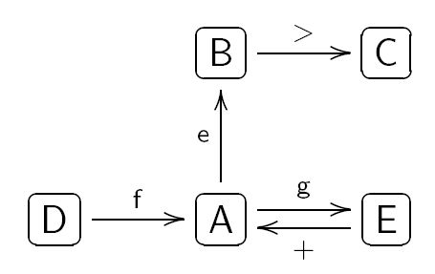
Notation of graphs in XL
Example:
is represented in program code as
(the representation is not unique!)
( >: successor edge, +: branch edge)

Slide 15
How can the following graph be described in XL code?
Bud
>
0
1
X
+
Leaf

Slide 16
The current graph
GroIMP maintains always a graph which contains the complete current structural information. This graph is transformed by application of the rules.
Attention: Not all nodes are visible objects in the 3-D view of the structure!
F0, F(x), Box, Sphere: Yes
RU(30), A, B: normally not (if not derived by “extends“
from visible objects)
The graph can be completely visualized in the 2-D graph view (in GroIMP: Panels - 2D - Graph).

Slide 17
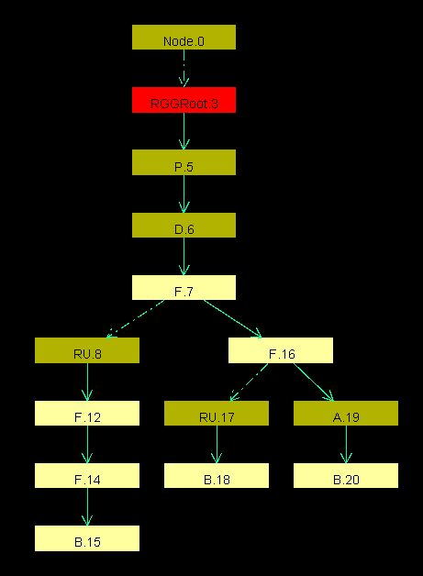
Load an example RGG file in GroIMP
and execute some steps (do not work with a too complex structure).
Open the 2-D graph view, fix the window with the mouse in the GroIMP user interface and test different layouts (Layout - Edit):
Tree
Sugiyama
Square
Circle
Random
SimpleEdgeBased
Fruchterman
Keep track of the changes of the
graph when you apply the rules
(click on “redraw”)

Slide 18
Which parts of the current graph of GroIMP are visible (in the 3-D view)?
all geometry nodes which can be accessed from the root (denoted ^) of the graph by exactly one path which consists only of "successor" and "branch" edges
How to enforce that an object is visible in any case:
==>> ^ Object

Slide 19
Derived Relations
relation between nodes connected by several edges (one after the other) of the same type
“transitive closure” of the original relation (edge type)

Slide 20
Notation for the transitive closure in XL:
(-edgetype->)+
reflexive-transitive closure (“node stands in relation to itself”
is also permitted)
(-edgetype->)*
e.g., for the successor relation: (>)*
Common transitive closure of the special relations
“successor” and “branch”, in reverse direction:
(-ancestor->)*
interpretation: this relation is valid for all “preceding nodes”
in a tree along the path back to the root.

Slide 21
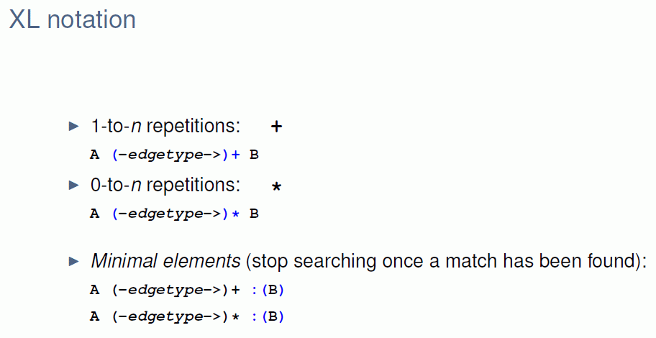
Notation for the transitive closure in XL
(these two relations only extend to the first node of type B)

Slide 22
Query syntax
- possibility of combining structure and function
- a query is enclosed by (* *)
The elements are given in their expected order, e.g.:
(* A A B *) searches for a subgraph which consists of a sequence of nodes of the types A A B, connected by successor edges

Slide 23
Query Examples

Slide 24
Ancestor and Descendants

Slide 25
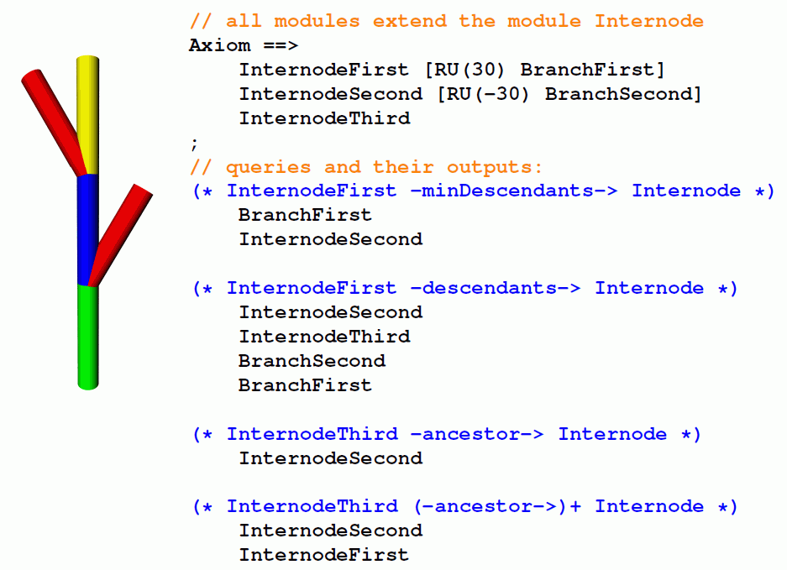

Slide 26
Test the following examples:
sm09_e28.rgg
sm09_e29.rgg
sm09_e30.rgg
Notice at the last two examples that nodes of types different from the target node type are automatically skipped in a search with “-ancestors->” !

