Slide 1


Functional-Structural Plant Models
Summer semester 2022 -
Winfried Kurth
University of Göttingen
Chair of Computer Graphics and Ecoinformatics
7th Lecture: 16 June, 2022

Slide 2
From our last lecture:
stochastic L-Systems
context sensitive L-Systems
interpretation rules
remarks concerning the measurements

Slide 3
On our next slides:
The graph as a basic data structure: Definition
Properties of graphs
Graph replacement rules
How relational growth grammars work
Two rule types: L system rules and SPO rules
Simple model of a young spruce tree

Slide 4
The step to graph grammars
Disadvantage of L-Systems:
• In L-Systems with branches (using Turtle commands) only 2 possible relations between objects:
- "direct successor" and "branch"
Extensions:
Allow further relation types (arbitrarily selected)
Allow cycles
→ Graph-Grammar

Slide 5
A graph: a way to organize data
Definition: a set of nodes (partially) connected by (directed) edges (relations)
S
S
S
I
I
I
Edge types (relational):
- Successor relationship
- Decomposition relationship
Nodes
S
I
(S = Shoot, I = Internode)

Slide 6
A sequence of characters (string):
- a very simple graph
- A string of characters can be interpreted as a 1-dimensional graph with only one type of edge
- Successor edges (successor relation)
A
B
A
C
A
A
B
A
C

Slide 7
Do you find such a structure anywhere in real life?
R
S
S
S
B
S
S
B
B
S
S
B
B
B
B
B
S
B
B
S
B
B
S
B
B
B
B
B
S
B
B
S
B
B
S
B
B
B
B
B
B

Slide 8
How about now?
Bud
Bud
Shoot
Bud
Bud
Bud
Shoot
Bud
Shoot
Shoot
Bud
Bud
Bud
Bud
Bud
Shoot
Bud
Shoot
Bud
Bud
Bud
Bud
Bud
Shoot
Shoot
Bud
Shoot
Shoot
Shoot
Bud
Bud
Bud
Bud
Bud
Shoot
Bud
Root
Shoot
Bud
Bud
Bud

Slide 9
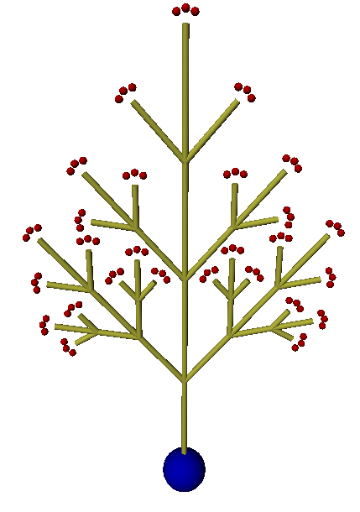
It is a tree
- trees are special graphs
4
3 Node types
  Root compartment
  annual shoots
  Buds
3
2
2 Edge types
  Successor relation (same axis)
  Branching relation (new axis)
1

Slide 10
Topology - underlying field of mathematics
mathematical field, where positional relationships are investigated by omitting metrics (lengths, angles)
Typical topological terms:
  Neighborhood
  Boundary (of a set)
  Connectedness
Two geometric structures are topologically equivalent (isomorphic) if they can be transformed into each other by plastic deformation (without cutting or gluing parts together)

Slide 11
Graph Theory
This has emerged as an independent field from topology and combinatorics
A graph consists of a set of vertices (nodes) and a set of (directional or non-directional) edges (links) each connecting two vertices
Two isomorphic graphs:

Slide 12
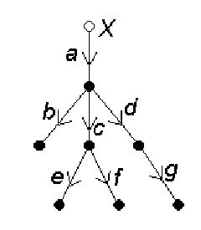
Directed graphs
all edges are provided with a direction (orientation)
A tree is a graph without circles (closed chains of consecutive edges).
A rooted tree is a tree with a specially designed vertex, the base vertex or root.
each rooted tree can be given a "natural orientation" of the edges by orienting all edges "away from the base vertex".

Slide 13
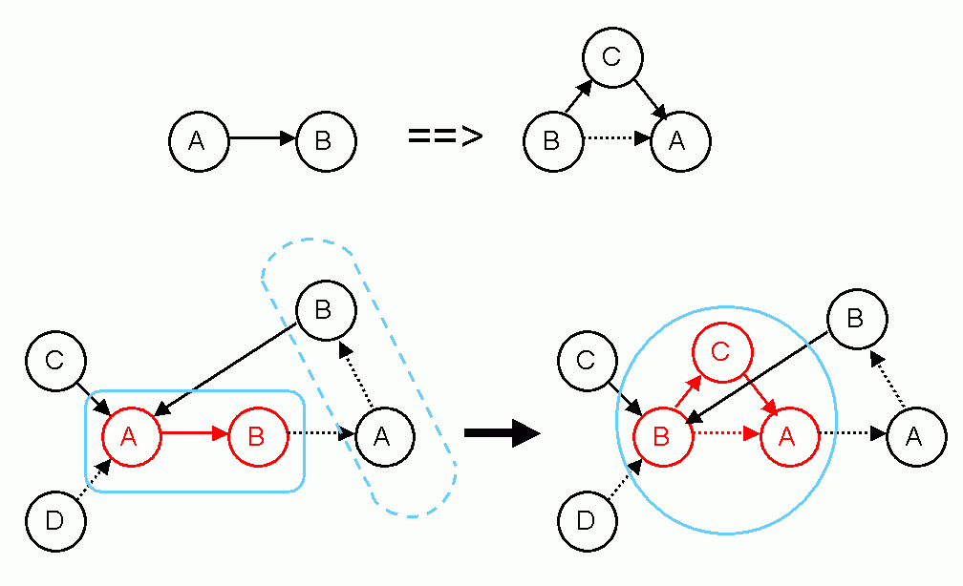
Now we let the graphs change over time!
Graph-grammars (example)
Example rule:

Slide 14
Graph-grammar (example)
Rule:
Application:
not applicable here! (wrong edge type)

Slide 15
A Relational Growth Grammar (RGG)
is a special type of graph grammar
Contains:
an alphabet
- the definition of all allowed
▪ node types
▪ edge types (types of relations)
the axiom
- an initial graph composed of elements of the
alphabet
a set of graph replacement rules

Slide 16
A Relational Growth Grammar contains:
an alphabet
- the definition of all allowed
▪ node types
▪ types of relations
the axiom
- an initial graph composed of elements of the
alphabet
a set of graph replacement rules
Root
Shoot
Bud
Successor Branching
Root
Shoot
Bud

Slide 17
What are these graph replacement rules (RGG rules)?
And how do we apply them?

Slide 18
Graph replacement rules are
rules for the transformation of a graph (subgraph) into another graph
A rule consists essentially of:
left-hand side of rule ==> right-hand side of rule

Slide 19
How an RGG rule is applied
each left-hand side of a rule describes a subgraph (a pattern of nodes and edges which is searched for in the whole graph), which is replaced when the rule is applied
each right-hand side of a rule defines a new subgraph, which is inserted as substitute for the removed subgraph

Slide 20
Simple example with strings
Every occurrence of the subgraph defined in the left-hand side of the rule is replaced!
A
B
C
A
C
A
is replaced by
D
D
B
C
D
C
2 rule applications in the same time step

Slide 21
A complete RGG rule can contain 5 parts
(* context *), left-hand side, ( condition )
==>
right-hand side { imperative XL code }

Slide 22
Context example
(* context *), left-hand side, ( condition )
==>
right-hand side { imperative XL code }
Example:
A
B
C
A
C
A
(*
B
*)
is replaced by
D
D
B
C
A
C

Slide 23
Condition example
(* context *), left-hand side, ( condition )
==>
right-hand side { imperative XL code }
Example:
A
B
C
A
C
a:A
B
( a[length] > 10 )
is replaced by
D
D
C
A
C
2 possible results, depending on the current length parameter of the A node
A
B
C
A
C

Slide 24
RELATIONAL GROWTH GRAMMARS
RGG: Relational Growth Grammars, parallel graph grammars
Summary: Structure of a rule of a RGG
(* C *), L,(E) ==> R { P };
Context
(Set of graphs)
Left-hand side of rule
(Set of graphs
to be replaced by R)
Condition
(Set of logical expressions, contains parameters related to node labels from L and C)
Right-hand side of rule
(Set of graphs)
Imperative Code
(List of commands)
Graphs: directed with edge-labels and node-labels

Slide 25
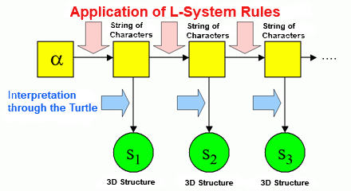
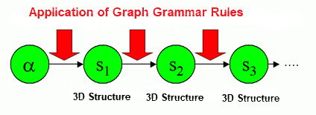
The grammar directly modifies the graph
The workaround via string code is omitted (or is only used for rule input)

Slide 26
RGG as generalizations of L-systems
Character strings correspond to special graphs
In text form we write in general (user-defined) edges as
-edgetype->
Edges of the special type "successor" are usually written as a blank
(instead of -successor->)
Also possible: >

Slide 27
For general graphs:
Problem of embedding the right-hand side of the rule
Rule:
Application:

Slide 28
Two types of rules for graph replacement in XL
● L-System-Rule, symbol: ==>
embeds the right-hand side into the graph (i.e. incoming and outgoing edges are retained)
● SPO-Rule, symbol: ==>>
incoming and outgoing edges are deleted (unless their retention is explicitly specified in the rule)
“SPO” means “single pushout” - a notion from universal algebra

Slide 29
Example
a:A ==>> a C (SPO-rule)
B ==> D E (L-System rules)
C ==> A
Start graph:
A
B
C

Slide 30
Example
a:A ==>> a C (SPO-rule)
B ==> D E (L-System rules)
C ==> A
A
B
C
D
E
A

Slide 31
Example
a:A ==>> a C (SPO-rule)
B ==> D E (L-System rules)
C ==> A
A
B
C
a:
D
E
A

Slide 32
Example
a:A ==>> a C (SPO-rule)
B ==> D E (L-System rules)
C ==> A
A
D
E
A
a:
= final result
C

Slide 33
Test the example sm09_e27.rgg
module A extends Sphere(3);
protected void init()
[ Axiom ==> F(20, 4) A; ]
public void runL()
[
A ==> RU(20) F(20, 4) A;
]
public void runSPO()
[
A ==>> ^ RU(20) F(20, 4, 5) A;
]
(^ denotes the root node in the current graph)

Slide 34
Example sm09_e27.rgg
module A extends Sphere(3);
protected void init()
[ Axiom ==> F(20, 4) A; ]
public void runL()
[
A ==> RU(20) F(20, 4) A;
]
public void runSPO()
[
A ==>> ^ RU(20) F(20, 4, 5) A;
]
Also view the result in the (2D) graph panel!

Slide 35
A Spruce Model in XL
/* Spruce model sm09_fichte.rgg */
module T; /* Terminal buds */
module M1; /* Side-branch bud 1st order, medial position */
module S1; /* Side-branch bud 1st order, subapical position */
module M2; /* Side-branch bud 2nd order, medial position */
module S2;
module M3;
module S3;
module GU(float incd, int age) extends F0; /* growth unit */
module BA(int age, super.angle) extends RL(angle);
module GA(int age, super.angle) extends RL(angle);
module HA(int age, super.angle) extends RL(angle);
const int ang = 45;
const int x3 = 50;
const int[] a = { 0, 15, 25, 32, 37, 40 };
const int[] gg = { 0, 0, 4 };
const int[] hh = { 0, 0, 2, 4, 8 };
int n, k;
const float[] prob_n = {0.1, 0.4, 0.3, 0.2};
const int[] n_subap = {5, 6, 7, 8};

Slide 36
protected void init()
[
Axiom ==> P(2) D(1) L(100) T;
]
public void grow()
[
x:T ==> Nl(80*TurtleState.length(x)) GU(2.2, 0)
RH(random(0, 360)) { k = 0; }
for ((1:3)) /* 3 medial side branches of 1st order */
( [ MRel(random(0.2, 0.85)) RH(k*120+normal(0, 5.5))
{ k++; } RL(x3+normal(0, 2.2)) BA(0, 0) LMul(0.4) M1 ] )
RH(random(0, 360)) { n = n_subap[distribution(prob_n)]; k = 0; }
for ((1:n)) /* n subapical side branches of 1st order */
( [ MRel(random(0.85, 1)) RH(k*360/n+normal(0, 3.1))
{ k++; } RL(x3+normal(0, 2.2)) BA(0, 0) LMul(0.65) S1 ] )
T;
x:S1 ==> Nl(80*TurtleState.length(x)) GU(1.3, 0)
[ MRel(random(0.85, 1)) RH(15)
RU(ang+normal(0, 2.2)) AdjustLU LMul(0.7) S2 ]
[ MRel(random(0.85, 1)) RH(-15)
RU(-ang+normal(0, 2.2)) AdjustLU LMul(0.7) S2 ] GA(0, 0) S1;
x:M1 ==> Nl(80*TurtleState.length(x)) GU(0.8, 0)
[ MRel(random(0.85, 1)) RH(15)
RU(ang+normal(0, 2.2)) AdjustLU LMul(0.7) M2 ]
[ MRel(random(0.85, 1)) RH(-15)
RU(-ang+normal(0, 2.2)) AdjustLU LMul(0.7) M2 ] HA(0, 0) M1;

Slide 37
x:S2 ==> Nl(80*TurtleState.length(x)) GU(1.3, 0)
[ MRel(random(0.85, 1)) RH(10)
RU(ang) AdjustLU LMul(0.7) S3 ]
[ MRel(random(0.85, 1)) RH(-10)
RU(-ang) AdjustLU LMul(0.7) S3 ] S2;
x:M2 ==> Nl(80*TurtleState.length(x)) GU(0.8, 0)
[ MRel(random(0.85, 1)) RH(10)
RU(ang) AdjustLU LMul(0.7) M3 ]
[ MRel(random(0.85, 1)) RH(-10)
RU(-ang) AdjustLU LMul(0.7) M3 ] M2;
x:S3 ==> Nl(80*TurtleState.length(x)) GU(1.3, 0);
x:M3 ==> Nl(80*TurtleState.length(x)) GU(0.8, 0);
GU(incd, t) ==> DlAdd(incd*(t+1)) GU(incd, t+1);
DlAdd(arg) ==> ;
BA(age, angle) ==> BA(age+1, a[age<5 ? age+1 : 5]);
GA(age, angle) ==> GA(age+1, gg[age<2 ? age+1 : 2]);
HA(age, angle) ==> HA(age+1, hh[age<4 ? age+1 : 4]);
]
New node types and commands that occur here: see the following slides

Slide 38
Function TurtleState.length(x) (for one node x):
returns the step length of the turtle at node x
Turtle-Command (Node) AdjustLU :
rotates the Turtle around the H-axis so that the U-vector points upwards
Turtle-Command (Node) N :
controls leaf mass (analogous to L and D)

Slide 39
Operator with 3 arguments for case distinctions:
Condition ? Expression 1 : Expression 2
- Returns the value of Expression1 if the condition is met, otherwise the value of Expression2.
x = Condition ? Expression1 : Expression2 is equivalent to
if (Condition)
x = Expression1;
else
x = Expression2;
(this operator is also available in C, C++ and Java)

Slide 40
Assignment
Analyze the XL-Code of the model sm09_fichte.rgg.
Test the model with GroIMP, and analyze again the code for the second time.
Take note of everything that might be unclear to you.
Try to answer the following questions:
how to increase the thickness growth
- for all growth units (GU)?
- for the trunk only?
how can a slimmer crown shape be achieved (e.g., by changing the length growth)?
- how can the number of main side branches be reduced?

