Slide 1
Functional-Structural Plant Models
Summer semester 2022 -
Winfried Kurth
University of Göttingen
Chair of Computer Graphics and Ecoinformatics
6th Lecture: 2 June, 2022

Slide 2
From our last lecture:
Using imperative code in XL programs
Loops and arrays in branch constructions
Adding textures to plant models

Slide 3
Today:
stochastic L-systems
context sensitive L-systems
a new rule type: interpretation rules
preparation for the morphological measurements which will be done on June 10 and 17, 2022 in the greenhouse

Slide 4
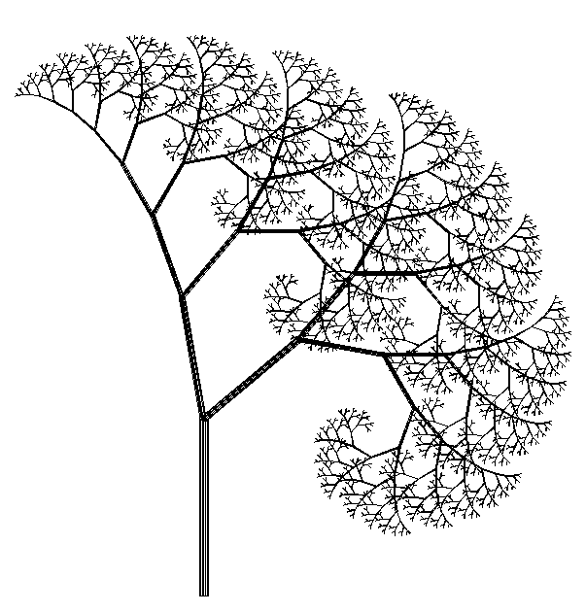
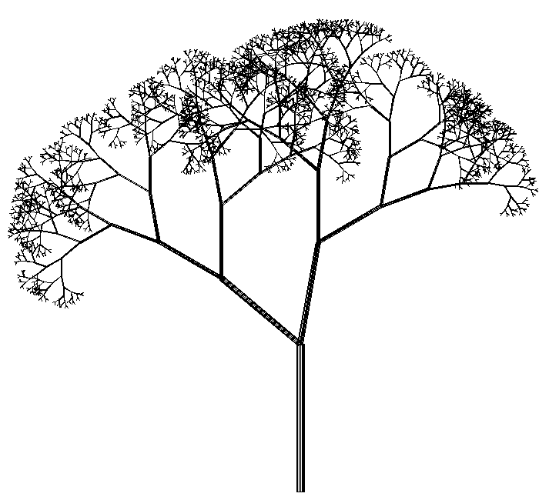
Stochastic L-Systems
Use of pseudo-random numbers
Example:
deterministic stochastic
Axiom ==> L(100) D(5) A;
A ==> F0 LMul(0.7) DMul(0.7)
[ RU(50) A ] [ RU(-10) A ];
Axiom ==> L(100) D(5) A;
A ==> F0 LMul(0.7) DMul(0.7)
if (probability(0.5))
( [ RU(50) A ] [ RU(-10) A ] )
else
( [ RU(-50) A ] [ RU(10) A ] );

Slide 5
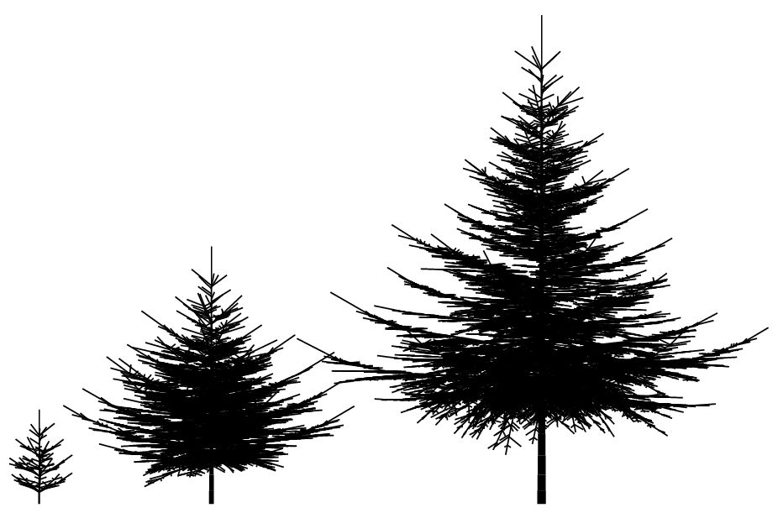
Example:
Spruce model in 3D
generated with L-system

Slide 6
XL functions for pseudo-random numbers
probability (x)
returns 1 with probability x, 0 with probability 1-x
random (a, b)
generates evenly distributed floating point random numbers between a and b
irandom (a, b)
generates evenly distributed integer random numbers between a and b
normal (m, s)
generates normally distributed floating-point random numbers with mean m and standard deviation s
setSeed (n)
sets a starting value for the random number generator (to generate identical sequences of pseudo-random numbers)
Math.random ()
Generates evenly distributed floating-point random numbers between 0 and 1
distribution (v) with vector v
returns whole integer random numbers with probability v[0] for 0, v[1] for 1, ...

Slide 7
Try the example
sm09_e19.rgg
Stochastic L-System
(different variants of the use of random variables)

Slide 8
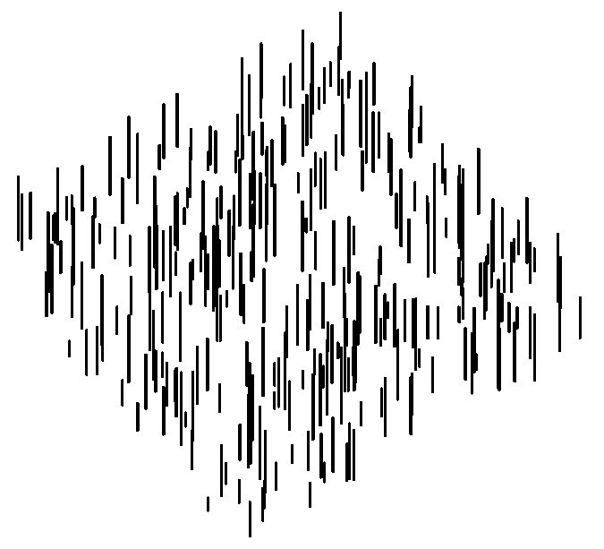
Generation of a random distribution in a plane
Axiom ==> D(0.5) for ((1:300))
( [ Translate(random(0, 100), random(0, 100), 0)
F(random(5, 30)) ] );
View from above Diagonally from the side

Slide 9
Try the examples
sm09_e23.rgg Dispersal model (1 species)
sm09_e24.rgg Dispersal model (2 species)
In these examples the competition is not yet taken into account
It is also shown how population densities can be plotted during the simulation runtime, in charts

Slide 10
Context-sensitive L-systems
Query a context that must exist for a rule to be applicable
in XL: context specification in (* .... *)

Slide 11
Context-sensitive L-systems
Example of using left-sided context:
another example of left context:
sm09_e14.rgg

Slide 12
Context-sensitive L-systems
Example of using right-sided context:
another example of right context:
sm09_e15.rgg

Slide 13
Right context
installation in a model for signal-controlled triggering of lateral shoot formation
module A(int age);
module B(super.length, super.color) extends F(length, 3, color);
Axiom ==> A(0);
A(t), (t < 5) ==> B(10, 2) A(t+1); // 2 = green
A(t), (t == 5) ==> B(10, 4); // 4 = red
B(s, 2) (* B(r, 4) *) ==> B(s, 4);
B(s, 4) ==> B(s, 3) [ RH(random(0, 360)) RU(30) F(30, 1, 14) ]; // 3 = blue

Slide 14
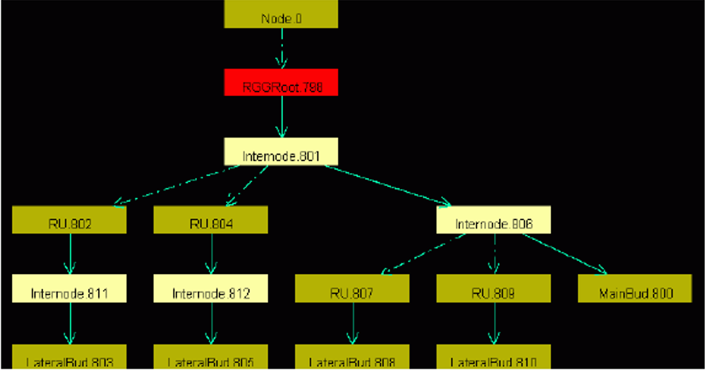
Insertion:
Graph View
GroIMP always carries a graph with it, which contains all the current structure information.
this is transformed by applying the rules
the graph can be displayed completely in the 2D graph view
GroIMP: Panels > 2D > Graph
(the 2D graph view can be anchored with
the mouse in the GroIMP user interface)
Graph > Layout
Graph > View > Redraw

Slide 15
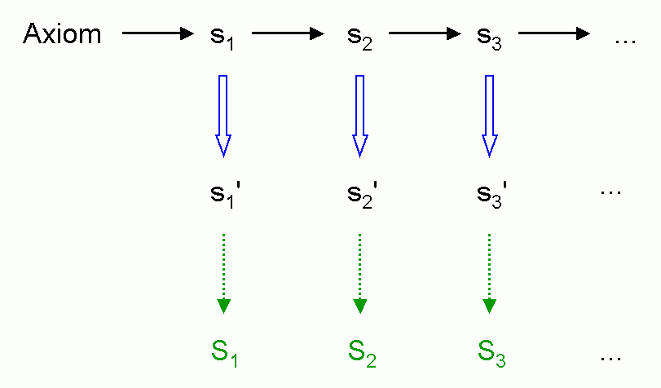
Interpretation rules
Installation of a further rule application immediately before graphic interpretation (without effect on the next generation)
Interpretation rule application
Turtle - interpretation

Slide 16
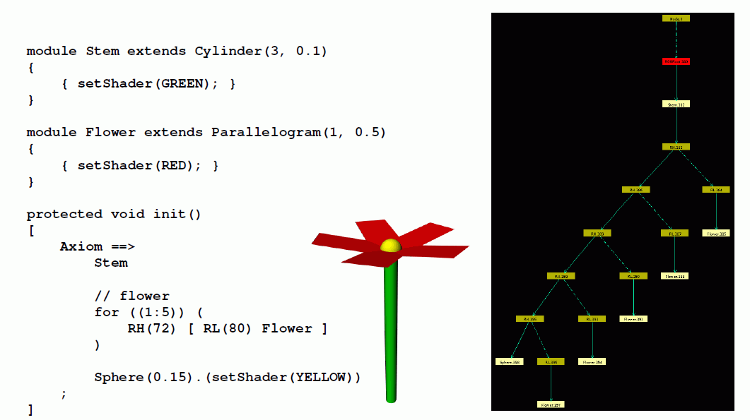
Ordinary geometric interpretation (without interpretation rules)

Slide 17
With the use of interpretation rules

Slide 18
Another example
module MainBud(int x) extends Sphere(3) {{setShader(GREEN);}};
module LBud extends Sphere(2) {{setShader(RED);}};
module LMeris;
module AMeris;
module Flower;
const float d = 30;
const float crit_dist = 21;
protected void init()
[ Axiom ==> MainBud(10); ]
public void run()
{ [
MainBud(x) ==> F(20, 2, 15) if (x > 0)
( RH(180) [ LMeris ] MainBud(x-1) )
else
( AMeris );
LMeris ==> RU(random(50, 70)) F(random(15, 18), 2, 14) LBud;
LBud ==> RL(90) [ Flower ];
AMeris ==> Scale(1.5) RL(90) Flower; /* Flower: here only a symbol */
]
applyInterpretation(); /* Call for the execution of interpretation rules
(in imperative section { ... } !) */
}
protected void interpret() /* Block with interpretation rules */
[
Flower ==> RH(30) for ((1:5))
( RH(72) [ RL(80) F(8, 1, 9) ] );
]

Slide 19
Yet another example
public void run()
{
[
Axiom ==> A;
A ==> Scale(0.3333) for (int i:(-1:1))
for (int j:(-1:1))
if ((i+1)*(j+1) != 1)
( [ Translate(i, j, 0) A ] );
]
applyInterpretation();
}
public void interpret()
[
A ==> Box;
]
creates the so-called "Menger Sponge" (a fractal)

Slide 20
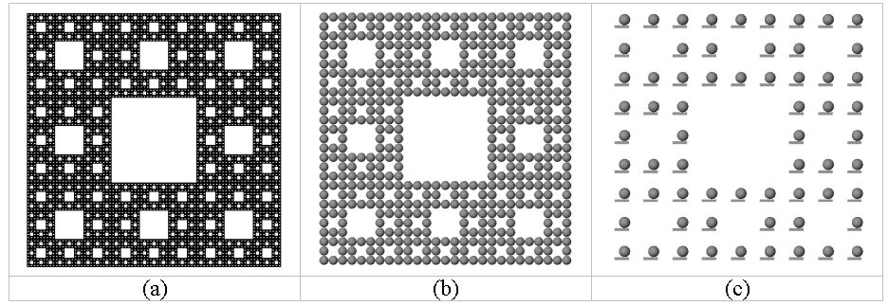
public void run()
{ [
Axiom ==> A;
A ==> Scale(0.3333) for (int i:(-1:1))
for (int j:(-1:1))
if ((i+1)*(j+1) != 1)
( [ Translate(i, j, 0) A ] );
]
applyInterpretation();
}
public void interpret()
[
A ==> Box;
]
(a)
(b)
(c)
A ==> Box(0.1, 0.5, 0.1)
Translate(0.1, 0.25, 0) Sphere(0.2);
A ==> Sphere(0.5);

Slide 21
What does this example create?
public void run()
{
[
Axiom ==> [ A(0, 0.5) D(0.7) F(60) ] A(0, 6) F(100);
A(t, speed) ==> A(t+1, speed);
]
applyInterpretation();
}
public void interpret()
[
A(t, speed) ==> RU(speed*t);
]

Slide 22
Morphological measurements, 10 and 17 June, 2022 (Greenhouse of the Forest Botany Department)
Please bring the following:
Smartphone or camera
Coloured pencils
Ruler, protractor (if available)
Small adhesive labels (if available), alternatively “Tesafilm”
Notebook / Tablet to enter data in dtd format
3 Groups will work simultaneously
gas exchange / manual morphology / FASTRAK digitizer

Slide 23
Objects of investigation:
Young plants Beech / Hornbeam / Maple / Sweet Cherry, the same as for the photosynthesis measurements
Before the detailed measurements:
Give the tree an ID name (name tag!)
Check for special features
Define reference direction (in pot)
Photograph the tree from several sides (with reference direction and name tag)
record measured variables related to the entire tree

Slide 24
Measurement quantities related to the entire tree:
Height
Diameter at the base
Number of leaves
Number of side branches 1st order
Date of measurement
Units of measurement:
for lengths and diameters: mm
for angle: degrees
for masses: g (but in GroIMP, as a rule, SI unit: kg)

Slide 25
Preparation of the topological and geometrical detail survey of the tree:
Finding the annual shoot limits (shoot base scars), as far as possible!
Numbering of the internodes of the main axis (trunk) from bottom to top (with consideration of the annual shoot arrangement); correspondingly also for the side branches; if necessary short shoots and leaves.
For side branches: number further within each side branch
Topological sketch of the entire tree with all leaves on a large drawing sheet (use several sheets if necessary - provide enough space for length and angle information!)

Slide 26
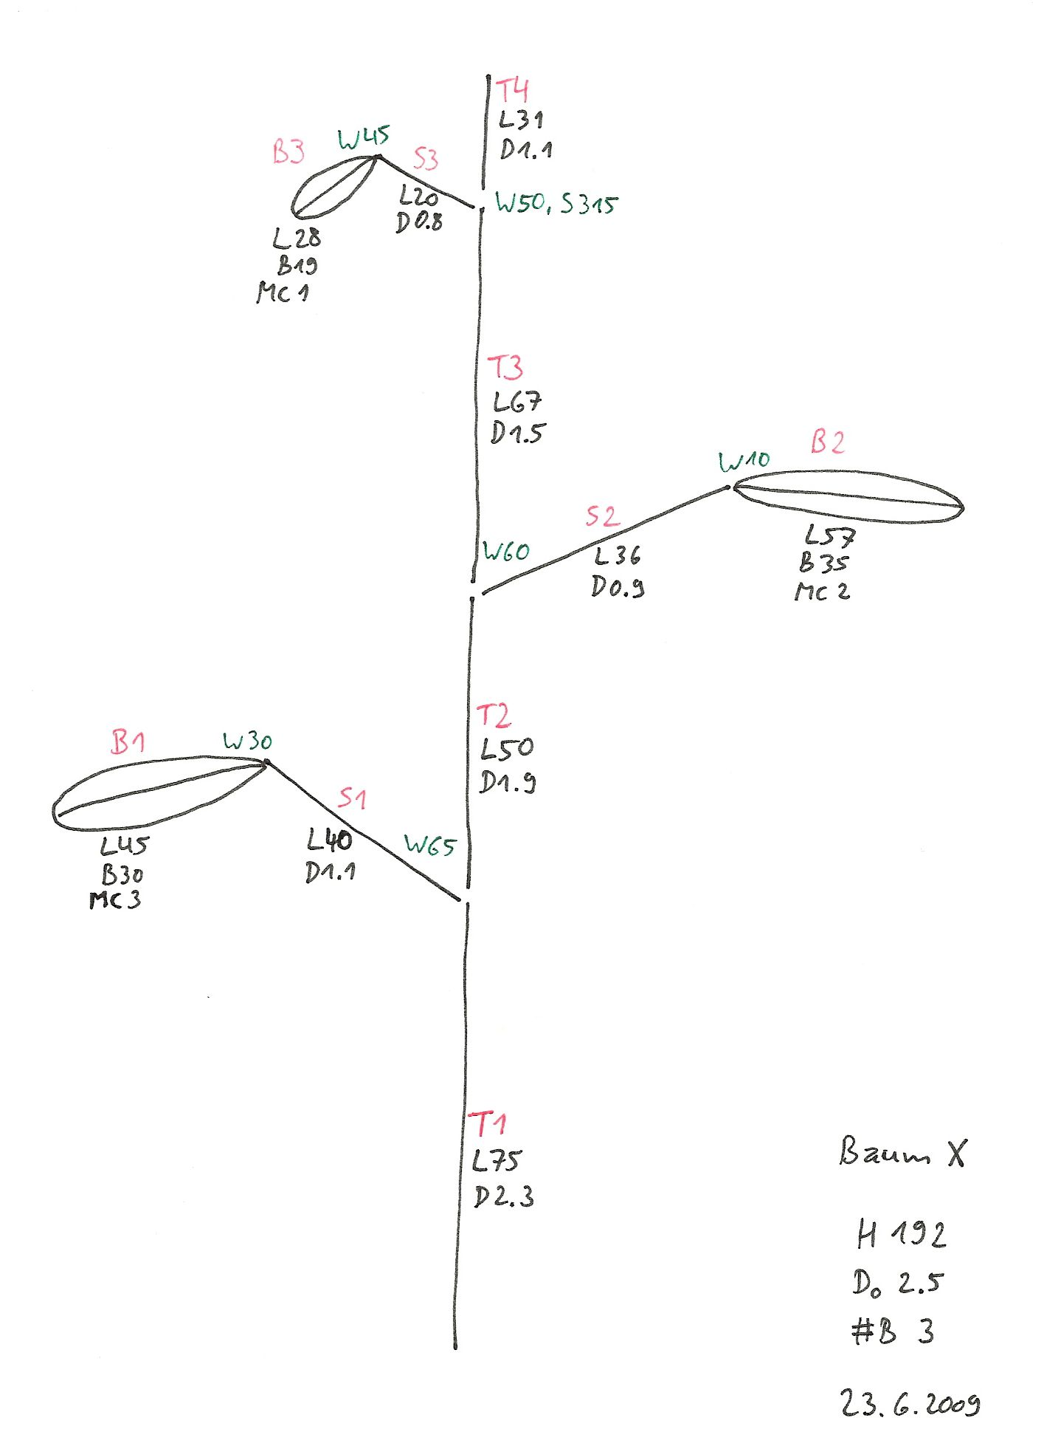
Red: Names of internodes, petioles and leaf blades
Black: Length (L), Diameter (D), Width (of leaf blade; B)
Green: Angle specifications. Angle of divergence (deviation from the growth direction of the main axis): W (in degrees), azimuth angle (relative to the reference direction on the ground): S (in degrees); note: no negative angles possible.
optional: angle between two consecutive internodes (W-indicator)

Slide 27
Corresponding dtd file:
T1 L75 ## O0 D2.3
T2 L50 #T1 V D1.9
T3 L67 #T2 V D1.5
T4 L31 #T3 V D1.1
S1 L40 #T1 - W65 D1.1
S2 L36 #T2 + W60 D0.9
S3 L20 #T3 S315 W50 D0.8
B1 L45 #S1 V R5 W30 C4 < B30 >
B2 L57 #S2 V R5 W10 C4 < B35 >
B3 L28 #S3 V R5 W45 C4 < B19 >
# Name of the parent segment
V stands for "extension" (of the axis)
+ for S90 (growth direction right)
– for S270 (growth direction left)
R5 for downward direction (= S180)
C4 for red colour marking (arbitrary)
The B-specifications for the leaf blades are written in comment brackets (currently no automatic processing by GroIMP)

Slide 28
Short shoot chains:
summary information possible through Qn instead of the length Lx
stands for short shoot chain consisting of n short shoots (no length specification provided)

Slide 29
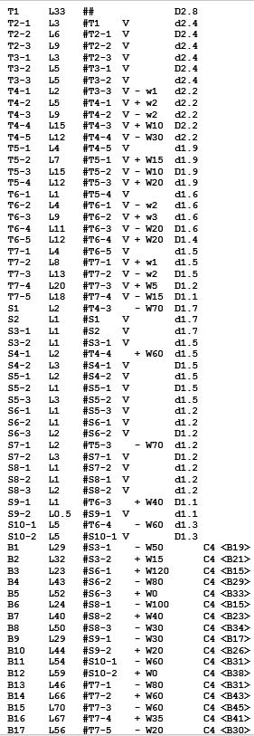
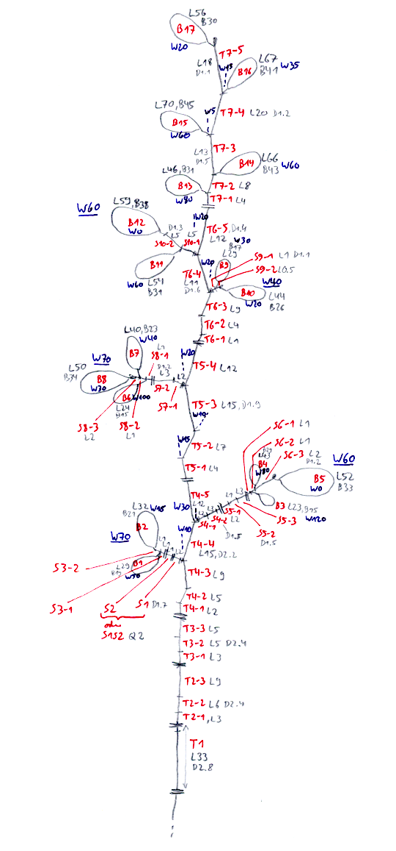
Example for small Beech
dtd-Data

Slide 30
Geometric detail measurements:
Length of internodes and petioles: accurate to mm
Diameter of internodes (annual growth at least 1 time per year) : accurate to 1/10 mm; measured in the middle
Length of a leaf: measured from the beginning of the leaf stalk to the blade tip, accurate to mm
Width of leaf: measured at the widest point
Leaf area (only by destructive measurement): possible with a special leaf measuring instrument after the dismemberment of the tree
Angle: accurate to 5° (azimuth angle: 10°); measurement between internode and midrib of leaf blade
Mass:
Internodes and Leaves: dry mass for entire tree

Slide 31
To analyze the measured data
dtd-Data:
upload in GroIMP - check for visual plausibility
Representation of leaves with width and area currently not possible (transfer leaf data to extra table)
First analyses: Creation of tables with GroIMP (elementary analysis; lengths and angles); also possible with queries from the GroIMP console
Statistical evaluation of tables (R or Statistica) (see description on Grogra-CD, to be adapted)
Targets: Progression of morphological quantities along the axes and during branching; correlation and regression analysis of the quantities among each other; mean values and standard deviations; non-linear adaptation of a light response curve to the photosynthesis data

Slide 32
How to upload dtd-Data in GroIMP
File / Open > choose dtd-Data > Open
Branching structure appears in the 3D view
Change camera settings if necessary
Modify the file and save
modification becomes visible on the display

Slide 33
Checking for consistency of the dtd file:
Optical control
- pay special attention to the base shoot, are there
more (too many) shoots at the base?
- Checking the age count:
- Grogra analysis option F
- 5th column of the generated table: is age 0 too rare?

Slide 34
Simple analyses
some features were taken from the predecessor software GROGRA
Panels > RGG Panels > GROGRA functions > Analysis
There you can find:
- list of all shoots (generates complete list)
- elementary analysis
- basic tree parameters
- topological analysis (more on this later)

Slide 35
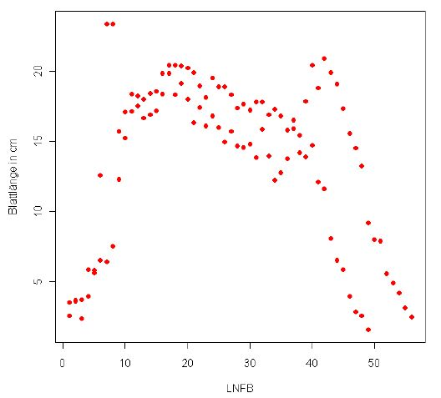
Example for statistical analysis
Trend for leaf length along the main tree trunk for Poplar
(assignment results from René Degenhard, 2008)

Slide 36
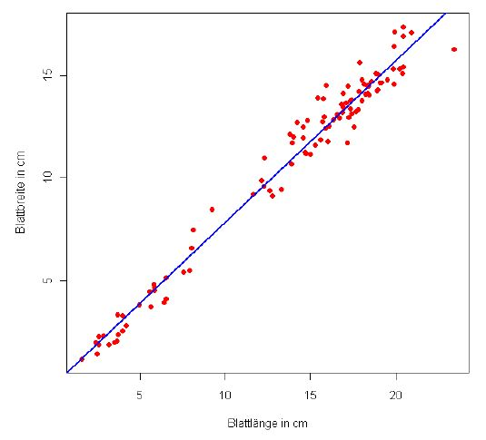
Correlation between leaf length and width for Poplar
(assignment results from René Degenhard, 2008)
The analysis of the data will be part of the assignment (term paper) and will not be elaborated here any further.

Slide 37
Assignments
1. Work through lessons 11 - 13 in the ILIAS learning module "GroIMP XL" (available via StudIP).
2. Read Chapter 1, Section 1.8 of the book "The Algorithmic Beauty of Plants" by P. Prusinkiewicz and A. Lindenmayer (pp. 30-35)
(Note the different notation for context-sensitive rules)

