Slide 1
Functional-Structural Plant Models
Summer semester 2022 -
Winfried Kurth
University of Göttingen
Chair of Computer Graphics and Ecoinformatics
5th Lecture: 19 May, 2022

Slide 2
From our last lecture:
simple branching patterns modelled with L-systems
more L-system examples
imperative code in XL (introduction)

Slide 3
Today:
two additional examples
using imperative code in XL programs (continued)
use of loops and arrays for branch constructions
conditional rule application (examples)
incorporation of textures into plant models
creating a project in GroIMP

Slide 4
Examples:
sm09_e08.rgg - define your own modules in order
to simplify the code
sm09_e21.rgg - 3 variants how to position lateral
branches at another place than at
the end of an object

Slide 5
Simple data types in Java and XL:
int - integers
float - floating point numbers
double - floating point numbers, double precision
char - characters
void - empty type (for functions that return nothing)

Slide 6
Simple data types in Java and XL:
int - integers
float - floating point numbers
double - floating point numbers, double precision
char - characters
void - empty type (for functions that return nothing)
Exact definition:
or
characters
till
till
till
till

Slide 7
Mathematical constants:
Math.PI π
Math.E e
Logical operators:
&& AND
|| OR
! NOT

Slide 8
Mathematical Functions:
Math.abs absolute value Math.sqrt square root
Math.acos arccosine Math.tan tangent
Math.asin arcsine Math.toDegrees
Math.atan arctangent Math.toRadians
Math.cos cosine
Math.exp exponential function e^{x}
Math.log natural logarithm
Math.max maximum of two numbers
Math.min minimum of two numbers
Math.round rounding function
Math.sin sine
Conversion
degree ↔ radian measurement

Slide 9
sm_progbsp01.rgg
A simple imperative program:
the numbers from 1 to 10 are output to the GroIMP console
protected void init()
{
int i;
for (i=1; i<= 10; i++)
println(i);
println("End.");
}

Slide 10
sm_progbsp02.rgg
a simple imperative program:
the odd square numbers from 1 to 81 are output to the GroIMP console
protected void init()
{
int a, b;
for (a = 1; a <= 10; a++)
{
b = a*a;
if (b % 2 != 0) println(b);
}
println("end.");
}

Slide 11
sm_progbsp03.rgg
a simple imperative program
the first 20 Fibonacci numbers are written into an array
and then output to the GroIMP console
protected void init()
{
int i;
int[] fibo = new int[20]; /* Array declaration
and initialization */
fibo[0] = fibo[1] = 1;
for (i=2; i <= 19; i++)
fibo[i] = fibo[i-1] + fibo[i-2];
for (i=0; i <= 19; i++)
println(fibo[i]);
println("end.");
}

Slide 12
sm_progbsp04.rgg: using a function
/* a simple imperative program:
A self-written function calculates x² + 1;
this is evaluated for x from 0 to 1 in 0.1 steps.
Pay attention to rounding errors and to the correct upper limit for x. */
public float function(float x)
{
return x*x + 1;
}
protected void init()
{
float a = 0.0; /* floating-point number */
while (a <= 1.00001)
{
println(function(a)); /* evaluate function, and print */
a += 0.1; /* increment a */
}
println("end.");
}

Slide 13
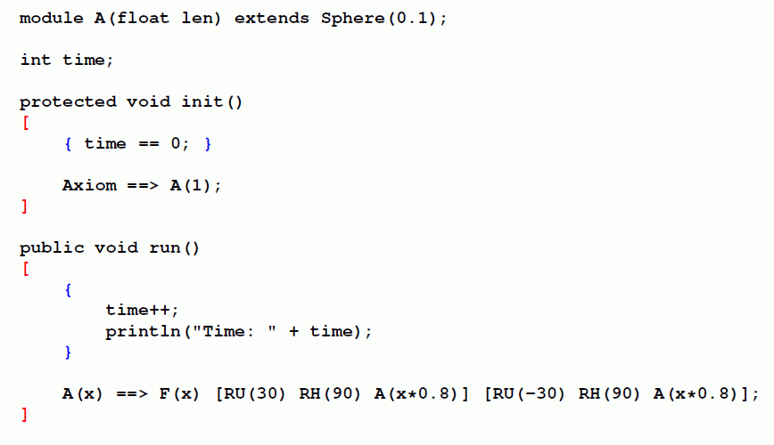
Nesting of rule-based and imperative code in XL
Rule-oriented block: [ … ]
Imperative block (similar to Java): { … }
=

Slide 14
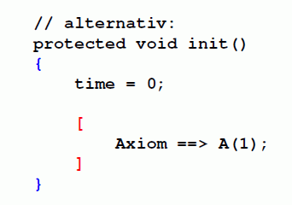
Nesting of rule-based and imperative code in XL
Rule-oriented block: [ … ]
Imperative block (similar to Java): { … }
alternatively:
=

Slide 15
Note the different syntax of control structures in the imperative and rule-based parts of XL:
imperative:
{
// ...
for (int i = 1; i <= 42; i++)
{
x[i] = 3*i + 1;
}
}
rule-based:
[
A(x) ==> for (int i = 1; i <= 7; i++)
(
RU(15) F(x)
);
]
(also with if ( ... ) )

Slide 16
Example of a for-loop:
the automatic generation of several lateral branches
sm09_e22.rgg
protected void init()
[ Axiom ==> F(10); ]
public void sideBranch()
[
F(x) ==> F(x) L(x)
for (int i=1; i<=5; i++)
(
[ MRel(0.1*i+0.2) RU((-1**i)*30) F(x*0.2) ]
);
]

Slide 17
Example of using arrays
difference between functions and arrays
sm09_e20.rgg
const float[] length = { 1, 1, 0.5, 0.2};
const float[] angle = {40, 50, 80 , 100 };
public void run1()
[
a:A, (a[order] < 4) ==> F(length[a[order]])
[ RU( angle[a[order]]) RH(90) A(a[order]+1) ]
[ RU(-angle[a[order]]) RH(90) A(a[order]+1) ];
]

Slide 18
Additional Examples
sm09_e07.rgg
(Colored Koch curve) - insert simple imperative XL code directly into a rule
sm09_e07a.rgg
Transfer of information (here: color) to successor objects

Slide 19
Conditional L-system rule in XL
left side of rule, (condition) ==> right side of rule
Examples:
sm09_e11.rgg - how to make the application of a rule depend on a condition
sm09_e12.rgg - how to keep the branching order as a parameter and how to get access to its value in a condition
sm09_e13.rgg - how to connect two conditions logically

Slide 20
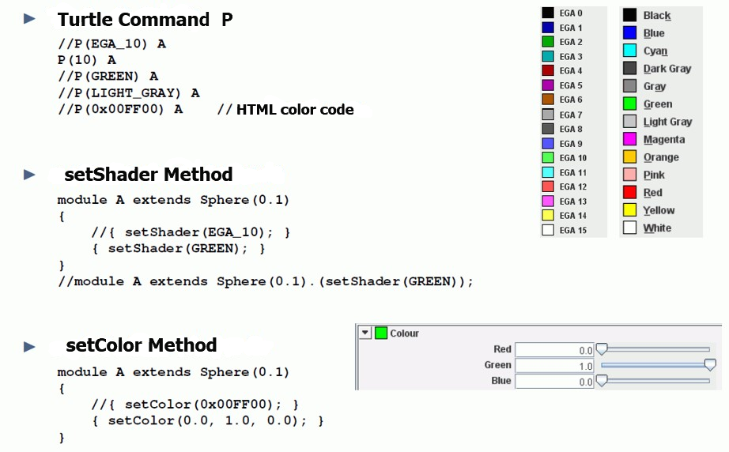
Setting colors in XL (summary)

Slide 21
Texture
Textures are 2-dimensional patterns that are applied to surfaces instead of colors to give a more realistic impression of the appearance of object surfaces.
Sources for textures: photos, scans of objects, image databases on the Internet, artificially generated patterns...

Slide 22
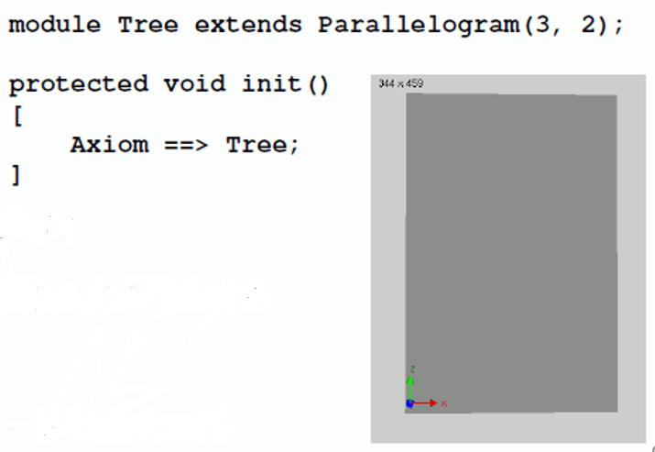
GroIMP project with textures
Our default program: see the box
Panels > Explorers > 3D > Shaders
The shader window to be anchored in the user interface
In the shader window: Object > New > Lambert
Name “Lambert” click twice (with pause) or tip F2 and rename (e.g., tree)
Double click on the Sphere icon > the Attribute Editor should open
In Attribute Editor: Diffuse color > Surface Maps > Image
Then click on: Image > From File
Choose your photo data and add to the project by using “Add File”

Slide 23
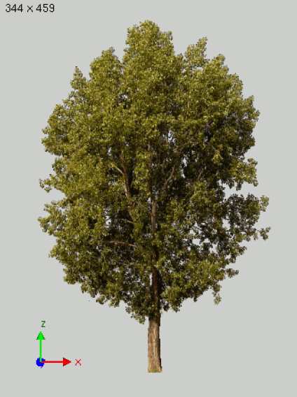
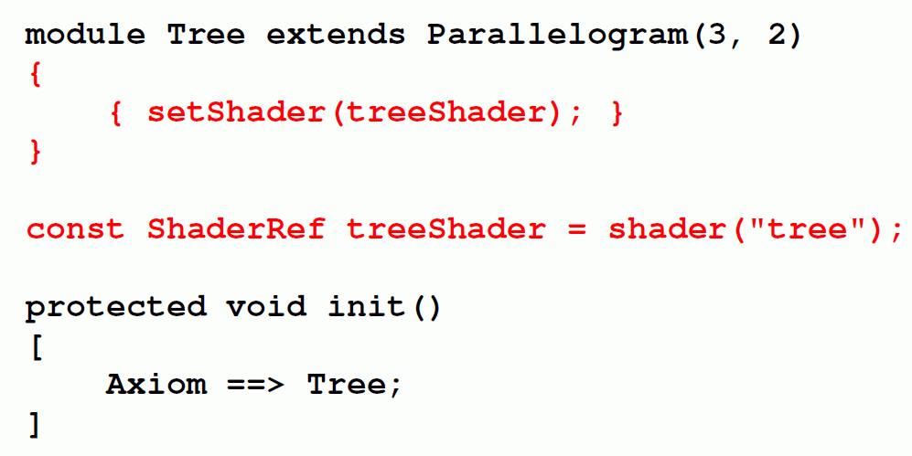
Example with tree photo as texture for the rectangle:

Slide 24
To be taken into account when creating the project:
after selecting the image file, the editor content needs to be saved / compiled once again
- textured objects are now displayed with texture
Saving the entire project :
File → Save, give name of the Project (does not have to match the name of the RGG program). Photo data will be saved.
Project data will have a name ending with .gsz (readable with a data compression program, e.g., WinZIP)
Example:
sm09_e10.gsz Use of a leaf texture

Slide 25
Assignment for our next lecture:
(1) Work in the ILIAS learning module “GroIMP – Module XL“ (available through StudIP):
- Lessons 1 - 10
(2) Read Chapter 1, Sections 1.6 – 1.7 and 1.10 / 1.10.1 in the book “The Algorithmic Beauty of Plants“ by P. Prusinkiewicz and A. Lindenmayer (available online, see literature site for the course). (= pp. 21-30 and 40-43).

