Slide 1
Functional-Structural Plant Models
Summer semester 2021
Winfried Kurth
University of Göttingen
Chair of Computer Graphics and Ecoinformatics
10th Lecture: 8 July, 2021

Slide 2
From our last lecture:
Notations for derived relations in graphs
Overview of XL and GroIMP
Graph queries in XL
Cone-based shadow model

Slide 3
On the following slides:
Cone-based shadow model (again)
Sequential and parallel derivation modes
Instantiation rules
First steps towards a simple FSPM

Slide 4
Cone-based shadow model
sm09_e42.rgg
module Segment(int t, int ord) extends F0;
module TBud(int t) extends F(1, 1, 1);
module LBud extends F(0.5, 0.5, 1);
Vector3d z = new Vector3d(0, 0, 1);
protected void init()
[
Axiom ==> P(2) D(5) V(-0.15) [ TBud(-4) ] RU(90) M(600) RU(-90)
[ TBud(0) ] RU(-90) M(1200) RU(90)
[ TBud(-8) ];
]
public void run()
[
TBud(t), (t < 0) ==> TBud(t+1);
x:TBud(t), (t >= 0 && empty( (* s:Segment, (s in cone(x, z, 45)) *) ) ) ==>
L(random(80, 120)) Segment(0, 0)
[ MRel(random(0.5, 0.9)) RU(60) LBud ]
[ MRel(random(0.5, 0.9)) RU(-60) LBud ] TBud(t+1);
y:LBud,
(empty( (* s:Segment, (s in cone(y, z, 45)) *) ) ) ==>
L(random(60, 90) Segment(0, 1) RV0 LBud;
Segment(t, o), (t < 8) ==> Segment(t+1, o);
Segment(t, o), (t >= 8 && o == 1) ==>> ; /* Deletion of branches */
]

Slide 5
Derivation modes in XL
- Default: parallel application of rules (like in L-systems)
- To switch into sequential mode (then in each step at most one rule is applied to one match):
setDerivationMode(SEQUENTIAL_MODE)
- To switch back to parallel mode use:
setDerivationMode(PARALLEL_MODE)
Test the following example:
sm09_e32.rgg

Slide 6
Modelling diameter growth in plants
Frequently used approaches:
Regression diameter ~ length for new growth units
- Diameter increment dependent from age, branch order, etc.
e.g., use rule with fixed annual growth
Shoot(l, d) ==> Shoot(l, d+delta_d);
Interpretive rule for shoot: Shoot(l, d) ==> F(l, d);
or: “pipe-model” assumption

Slide 7
“pipe model”
(Shinozaki et al. 1964)
Parallel “unit pipes”
Cross section area
~ leaf mass
~ fine root mass

Slide 8
Conclusion
“Leonardo rule” (da Vinci, about 1500)
d_{i}
In each branching node we have
d² = Σ d_{i}²
(invariance of cross section area)
↔
↔
d

Slide 9
Realization in an XL-Model
See examples: sm09_e33.rgg, sm09_e34.rgg
In those examples, first the structural and length growth is simulated, then in separate steps the diameter growth, calculated top-down
(also, a more realistic combination is possible)
A₁
A = A₁ + A₂
d ² = d₁² + d₂²
A
A₂

Slide 10
Yet another rule type in XL
Instantiation rules
Purpose: replacement of individual modules with more complicated structures, for display only (as with interpretive rules)
But, less is saved (saving storage space)
unlike interpretive rules, no turtle commands are used with effect on other nodes
Further possibility: "replicator node" for copying and repositioning of entire structures

Slide 11
Instantiation rules - syntax
no new rule arrow
specifying the instantiation rule directly in the module declaration
module A ==> B C D;
replaces (instantiates) everywhere A by B C D
Example:
sm09_e43.rgg

Slide 12
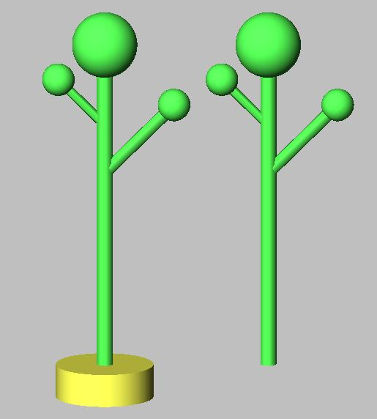
const int multiply = EDGE_0; /* self-defined edge type */
module Tree ==> F(20, 1)
[ M(-8) RU(45) F(6, 0.8) Sphere(1) ]
[ M(-5) RU(-45) F(4, 0.6) Sphere(1) ] Sphere(2);
module Replicator ==> [ getFirst(multiply) ] Translate(10, 0, 0)
[ getFirst(multiply) ];
public void run1()
[
Axiom ==> F(2, 6) P(10) Tree;
]
public void run2()
[
Axiom ==> F(2, 6) P(10) Replicator -multiply-> Tree;
]
Tree is instantiated with the red structure
it will be inserted what is hanging at the "multiply" edge

Slide 13
Another example of an application of a multiplier node with instantiation rule
(Henke 2006)

Slide 14
Simple functional-structural plant model (FSPM) in 10 steps
no real plant species, rather a general basic shape and development
(cf. Goethe: “Urpflanze")
mimics an annual plant
modification / adaptation of the model will be part of the assignment
functional part will be: light interception, photosynthesis, transport of assimilates in the plant
in the first versions, purely structural model of a plant

Slide 15
First version (sfspm01.rgg):
/* Steps towards a simple FSPM. sfspm01.rgg:
A simple plant with leaves and branching
is generated.
Original version by G. Buck-Sorlin; modified. */
module Bud extends Sphere(0.1)
{{ setShader(RED); }};
module Node extends Sphere(0.07)
{{ setShader(GREEN); }};
module Internode extends F;
/* leaves are rectangles: */
module Leaf extends Parallelogram(2, 1);
const float G_ANGLE = 137.5; /* golden angle */

Slide 16
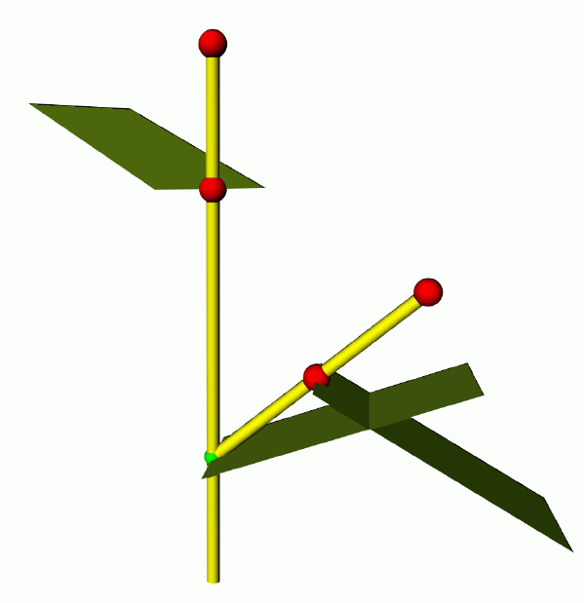
/* simple plant, with leaves and branches: */
protected void init()
[
Axiom ==> Bud;
]
public void run()
[
Bud ==> Internode Node [ RL(50) Bud ] [ RL(70) Leaf ]
RH(G_ANGLE) Internode Bud;
]
(an “Internode” is here basically half of an internode)

Slide 17
Second version (sfspm02.rgg)
Restriction of the branching order
module Bud(int order) extends Sphere(0.0001)
{{ setShader(RED); setRadius(0.2); }};
module Node extends Sphere(0.07)
{{ setShader(GREEN); }};
module Internode extends F;
module Leaf extends Parallelogram(2, 1);
const float G_ANGLE = 137.5; /* golden angle */
/* simple plant, with leaves and branches: */
protected void init()
[
Axiom ==> Bud(0);
]
public void run()
[
Bud(o), (o < 3) ==> Internode Node [ RL(50) Bud(o+1) ]
[ RL(70) Leaf] RH(G_ANGLE) Internode Bud(o);
]

Slide 18
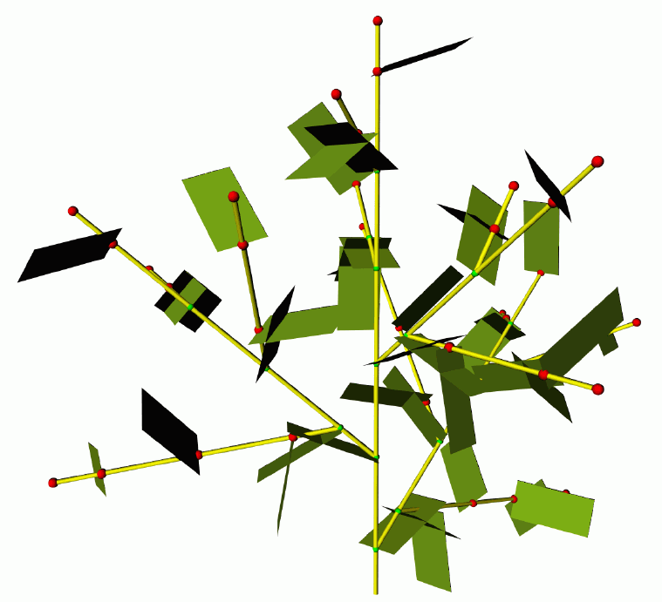
restricted branching order

Slide 19
Third version:
- more precise timing for appearance of new metamers (internode, node, leaf)
- Phyllochron = time span between the appearances of new metamers in apical position at the same shoot axis
- (often used as synonym: plastochron, but this means in its proper sense the time span between two initiations of new metamers)
- (Phyllochron: notion does not depend on growth being preformed or neoformed)
Time count in the model in discrete steps
(1 step = 1 parallel application of rules)
finer time steps!

Slide 20
sfspm03.rgg
module Bud (int ph, int order) extends Sphere(0.1)
{{ setShader(RED); }};
module Node extends Sphere(0.07)
{{ setShader(GREEN); }};
module Internode extends F;
module Leaf extends Parallelogram(2, 1);
const float G_ANGLE = 137.5; /* golden angle */
/* introducing a phyllochron */
const int PHYLLO = 25;
protected void init()
[
Axiom ==> Bud(PHYLLO, 0);
]
public void run()
[
Bud(p, o), (p > 0) ==> Bud(p-1, o); /* first parameter
counted down until...*/
Bud(p, o), (p == 0 && o <= 1) ==> Internode Node
[ RL(50) Bud(PHYLLO, o+1) ] [RL(70) Leaf]
RH(G_ANGLE) Internode Bud(PHYLLO, o);
/* (order restricted to 1 ... for efficiency) */
]

Slide 21
sfspm04.gsz: with flowers and textured organs
const ShaderRef leafmat = new ShaderRef("Leafmat");
const ShaderRef petalmat = new ShaderRef("Petalmat");
const ShaderRef internodemat = new ShaderRef("Internodemat");
const ShaderRef nodemat = new ShaderRef("Nodemat");
module Bud(int time, int ph, int order) extends Sphere(0.1)
{{ setShader(nodemat); }};
module Node extends Sphere(0.07)
{{ setShader(GREEN); }};
module NiceNode extends Sphere(0.07)
{{ setShader(nodemat); }};
module Internode extends F(1, 0.1, 7);
module NiceInternode extends Cylinder(1, 0.08)
{{ setShader(internodemat); }};
module Leaf extends Parallelogram(2, 1)
{{ setColor(0x82B417); }};
module NiceLeaf extends Parallelogram(2,2)
{{ setShader(leafmat); }};
module Flower ==> /* Instanzierungsregel */
RU(180) Cone(0.3, 0.3).(setColor(0x82B417)) M(-0.25) RL(90)
[ for (int i=1; i<=5; i++) ( [ RU(i*360/5) RL(20)
Parallelogram(2, 1).(setColor(0xFF00FF)) ] ) ] RU(45)
[ for (int i=1; i<=5; i++) ( [ RU(i*360/5) RL(40) F(0.3, 0.1, 14) RV(-0.3)
F(0.3, 0.1, 14) RV(-0.3) F(0.3, 0.1, 14) ] ) ] RU(-45)
[ for (int i=1; i<=5; i++) ( [ RU(i*360/5) RL(70)
Frustum(0.7, 0.2, 0.05).(setColor(0x8DAF58)) ] )
module NiceFlower ==>
RU(180) Cone(0.3, 0.3).(setShader(internodemat)) M(-0.25) RL(90)
[ for (int i=1; i<=5; i++) ( [ RU(i*360/5) RL(20)
Parallelogram(2, 1).(setShader(petalmat)) ] ) ] RU(45)
[ for (int i=1; i<=2; i++) ( [ RU(i*360/3) RL(40) F(0.3, 0.1, 14) RV(-0.3)
F(0.3, 0.1, 14) RV(-0.3) F(0.3, 0.1, 14) ] ) ] RU(-45)
[ for (int i=1; i<=5; i++) ( [ RU(i*360/5) RL(70)
Frustum(0.7, 0.2, 0.05).(setColor(0x8DAF58)) ] ) ];

Slide 22
// sfspm04.gsz, continuation
const float G_ANGLE = 137.5; /* golden angle */
const int PHYLLO = 25;
protected void init()
[
Axiom ==> Bud(1, PHYLLO, 0);
]
public void run()
[
Bud(r, p, o), (p > 0) ==> Bud(r, p-1, o);
Bud(r, p, o), (r<10 && p==0 && o<=2) ==> RV(-0.1) NiceInternode NiceNode
[ RL(50) Bud(r, PHYLLO, o+1) ] [ RL(70) NiceLeaf ] RH(G_ANGLE) RV(-0.1)
NiceInternode Bud(r+1, PHYLLO, o);
Bud(r, p, o), (r == 10) ==> RV(-0.1) NiceInternode RV(-0.1)
NiceInternode NiceFlower;
]
Additionally there are image files for the used textures, which are connected manually in GroIMP with the shader names "Leafmat", "Petalmat" etc. (see Lecture on textures)

Slide 23
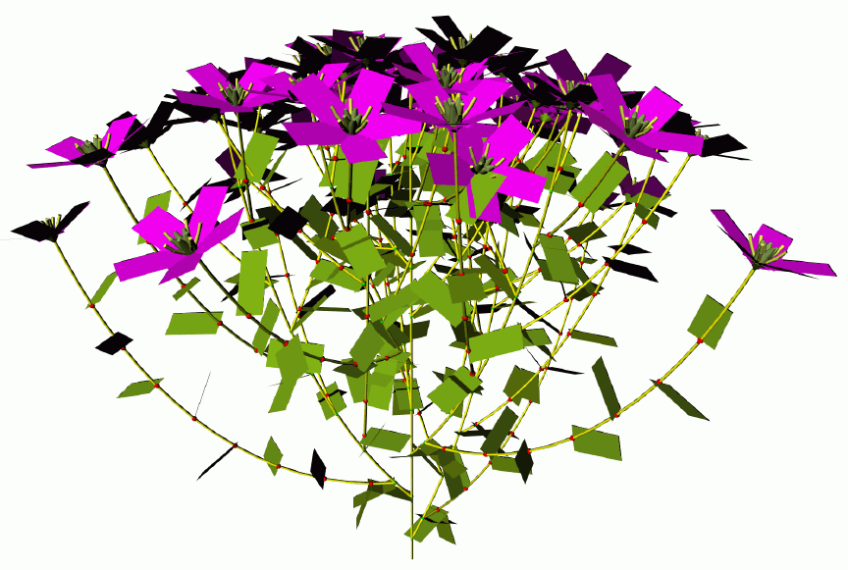
A variant with simpler “Flower” instead of the texturized “NiceFlower”

Slide 24
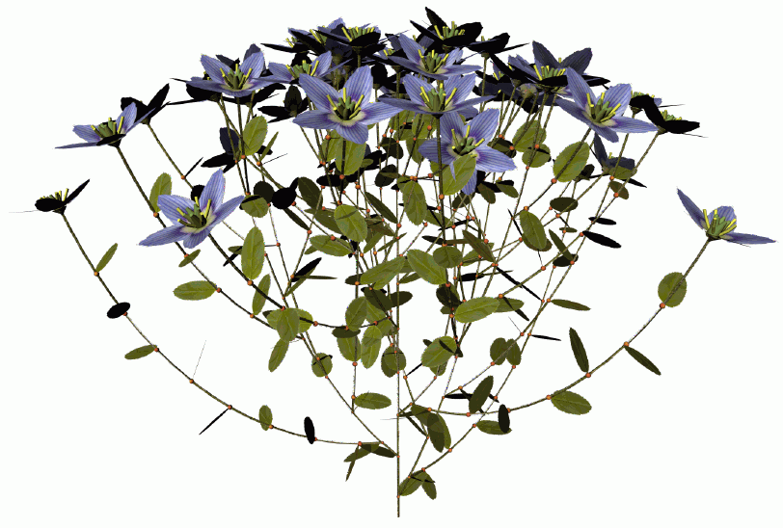
A variant with “NiceFlower” and “NiceLeaf”

