Slide 1


Functional-Structural Plant Models
Summer semester 2021
Winfried Kurth
University of Göttingen
Chair of Computer Graphics and Ecoinformatics
9th lecture: 1st July, 2021

Slide 2
From our last lecture:
another rule type: update rules
notation of graphs in XL
the current graph in GroIMP
about the measurements

Slide 3
On the following slides:
Derived relations, particularly the transitive closure
The XL language: Overview
Queries in the graph
The GroIMP software: Overview
A first model for shadow

Slide 4
Derived Relations
relation between nodes connected by several edges (one after the other) of the same type
“transitive closure” of the original relation (edge type)

Slide 5
Notation for the transitive closure in XL:
(-edgetype->)+
reflexive-transitive closure (“node stands in relation to itself”
is also permitted)
(-edgetype->)*
e.g., for the successor relation: (>)*
Common transitive closure of the special relations
“successor” and “branch”, in reverse direction:
(-ancestor->)*
interpretation: this relation is valid for all “preceding nodes”
in a tree along the path back to the root.

Slide 6
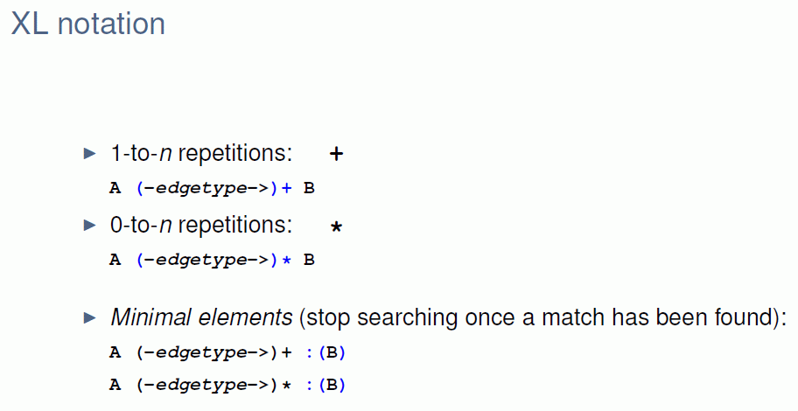
Notation for the transitive closure in XL
(these two relations only extend to the first node of type B)

Slide 7
Query syntax
- possibility of combining structure and function
- a query is enclosed by (* *)
The elements are given in their expected order, e.g.:
(* A A B *) searches for a subgraph which consists of a sequence of nodes of the types A A B, connected by successor edges

Slide 8
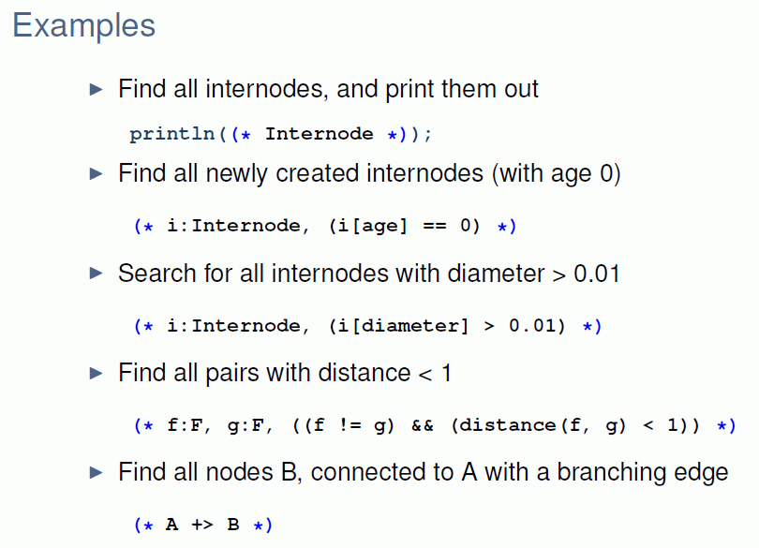
Query Examples

Slide 9
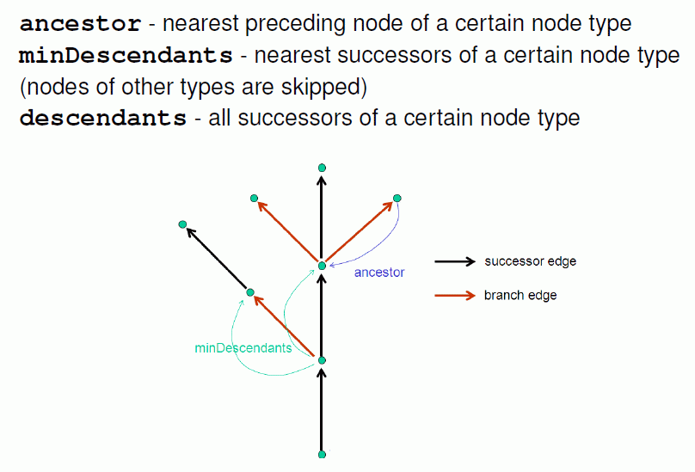
Ancestor and Descendants

Slide 10
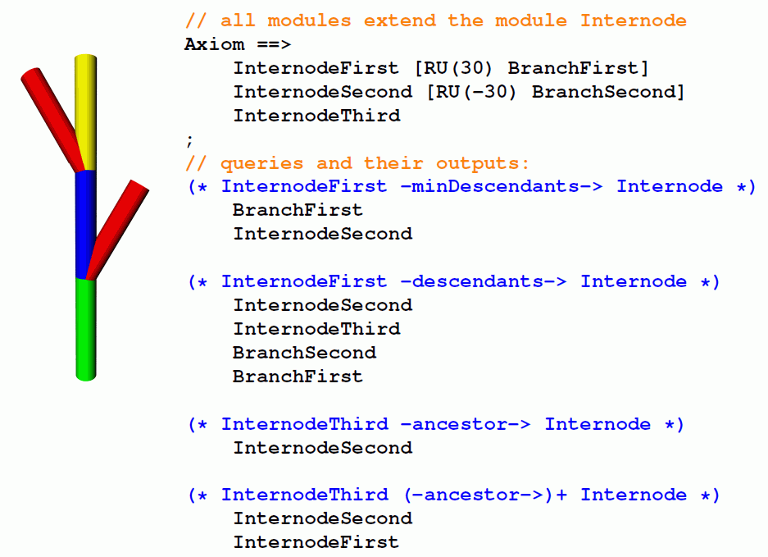

Slide 11
Test the following examples:
sm09_e28.rgg
sm09_e29.rgg
sm09_e30.rgg

Slide 12
The programming language XL
„eXtended L-system language“
A synthesis of three paradigms
Imperative
Object oriented
Rule based
Java
XL

Slide 13
XL
Language specification: Kniemeyer (2008)
Dissertation:
http://nbn-resolving.de/urn/resolver.pl?urn=urn:nbn:de:kobv:co1-opus-5937
extension of Java
allows specification of L-Systems and RGG at the same time (graph grammars) in intuitively understandable standard notation
imperative blocks, similar to Java: { ... }
rule-oriented blocks (RGG part): [ ... ]

Slide 14
Features of the XL language
● nodes of the graphs are Java objects
● also geometry objects

Slide 15
Features of the XL language
● nodes of the graphs are Java objects
● also geometry objects
Example: XL-program for the Koch curve
public void derivation()
[
Axiom ==> RU(90) F(10);
F(x) ==> F(x/3) RU(-60) F(x/3) RU(120)
F(x/3) RU(-60) F(x/3);
]

Slide 16
Features of the XL language
● nodes of the graphs are Java objects
● also geometry objects
Example: XL- Program for the Koch curve
public void derivation()
[
Axiom ==> RU(90) F(10);
F(x) ==> F(x/3) RU(-60) F(x/3) RU(120)
F(x/3) RU(-60) F(x/3);
]
Node of graph Edge (type “successor”)

Slide 17
Features of the XL language
● nodes of the graphs are Java objects
● also geometry objects
Special Nodes:
Geometric objects
Box, Sphere, Cylinder, Cone, Frustum,
Parallelogram...

Slide 18
Features of the XL language
● nodes of the graphs are Java objects
● also geometry objects
Special Nodes:
Geometric objects
Box, Sphere, Cylinder, Cone, Frustum,
Parallelogram...
Access to attributes via the parameter list:
Box(x, y, z) (length, width, height)
or with special functions:
Box(...).(setColor(0x007700)) (color)

Slide 19
Access to node attributes
Example: sm09_e26.rgg
module Bud() extends Sphere(0.1) {{ setShader(RED); }};
module Internode() extends F(1) {{ setShader(GREEN); setScale(1); }};
protected void init()
[ Axiom ==> Internode() Bud();
]
public void run1()
[ i:Internode ::> i[length] = i[length] + 0.1;
]
public void run2()
[ i:Internode ::> i.length = i.length + 0.1;
]
public void run3()
[ i:Internode ::> i[scale] += 0.1;
]
public void run4()
[ i:Internode ::> i.setScale(1);
]

Slide 20
Features of the XL language
● nodes of the graphs are Java objects
● also geometry objects
Special Nodes:
Geometric objects
Box, Sphere, Cylinder, Cone, Frustum,
Parallelogram...
Transformation nodes
Translate(x, y, z), Scale(cx, cy, cz), Scale(c),
Rotate(a, b, c), RU(a), RL(a), RH(a), RV(c), RG, ...

Slide 21
Features of the XL language
● nodes of the graphs are Java objects
● also geometry objects
Special Nodes:
Geometric objects
Box, Sphere, Cylinder, Cone, Frustum,
Parallelogram...
Transformation nodes
Translate(x, y, z), Scale(cx, cy, cz), Scale(c),
Rotate(a, b, c), RU(a), RL(a), RH(a), RV(c), RG, ...
Light sources
PointLight, DirectionalLight, SpotLight, AmbientLight

Slide 22
Features of the XL language
● nodes of the graphs are Java objects, also geometry objects
● rules organized in blocks [...], control of the application through control structures

Slide 23
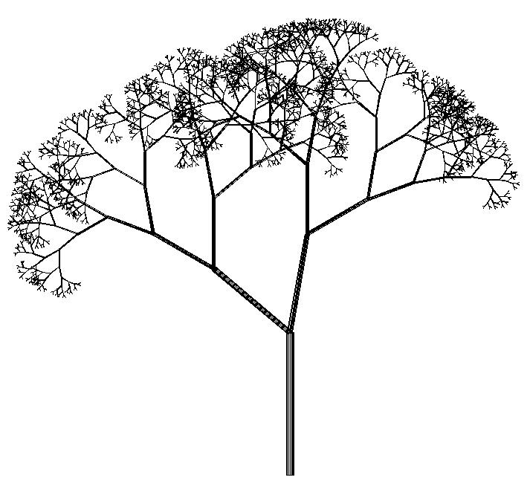
Features of the XL language
● nodes of the graphs are Java objects, also geometry objects
● rules organized in blocks [...], control of the application through control structures
Example: Rules for the stochastic tree
Axiom ==> L(100) D(5) A;
A ==> F0 LMul(0.7) DMul(0.7)
if (probability(0.5))
( [ RU(50) A ] [ RU(-10) A ] )
else
( [ RU(-50) A ] [ RU(10) A ] );

Slide 24
Features of the XL language
● nodes of the graphs are Java objects, also geometry objects
● rules organized in blocks [...], control of the application through control structures
● parallel application of the rules

Slide 25
Features of the XL language
● nodes of the graphs are Java objects, also geometry objects
● rules organized in blocks [...], control of the application through control structures
● parallel application of the rules
(can be modified: sequential mode can be set, more on this later…)

Slide 26
Features of the XL language
● nodes of the graphs are Java objects, also geometry objects
● rules organized in blocks [...], control of the application through control structures
● parallel application of the rules
● parallel execution of assignments possible
Special assignment operator := besides the normal =
Quasi-parallel assignment to the variables x und y:
x := f(x, y);
y := g(x, y);

Slide 27
Features of the XL language
● nodes of the graphs are Java objects, also geometry objects
● rules organized in blocks [...], control of the application through control structures
● parallel application of the rules
● parallel execution of assignments possible
● operator overloading (e.g. "+" for numbers as for vectors)

Slide 28
Features of the XL language
● nodes of the graphs are Java objects, also geometry objects
● rules organized in blocks [...], control of the application through control structures
● parallel application of the rules
● parallel execution of assignments possible
● operator overloading (e.g. "+" for numbers as for vectors)
● set-valued expressions (more precisely: producers instead of sets)

Slide 29
Features of the XL language
● nodes of the graphs are Java objects, also geometry objects
● rules organized in blocks [...], control of the application through control structures
● parallel application of the rules
● parallel execution of assignments possible
● operator overloading (e.g. "+" for numbers as for vectors)
● set-valued expressions (more precisely: producers instead of sets)
● graph queries to analyze the actual structure

Slide 30
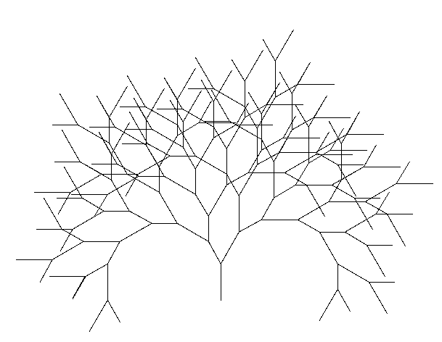
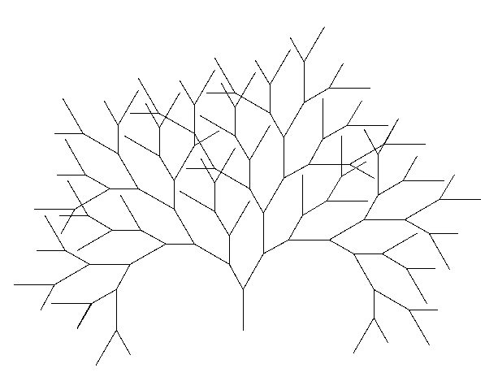
Example for a graph query
Binary tree, growth shall start only if there is enough distance to the other F objects
Axiom ==> F(100) [ RU(-30) A(70) ] RU(30) A(100);
a:A(s) ==> if ( forall(distance(a, (* F *)) > 60) )
( RH(180) F(s) [ RU(-30) A(70) ] RU(30) A(100) )
without the “if” condition with the “if” condition

Slide 31
Features of the XL language
● nodes of the graphs are Java objects, also geometry objects
● rules organized in blocks [...], control of the application through control structures
● parallel application of the rules
● parallel execution of assignments possible
● operator overloading (e.g. "+" for numbers as for vectors)
● set-valued expressions (more precisely: producers instead of sets)
● graph queries to analyze the actual structure
● aggregating operators (e.g., “sum”, “mean”, “empty”, “forall”,
“selectWhereMin”)

Slide 32
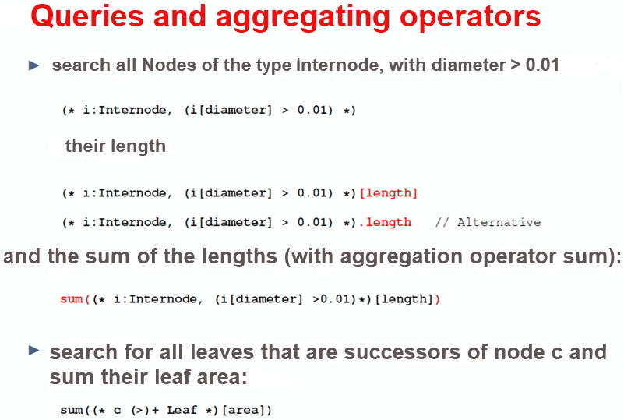

Slide 33
Queries and aggregating operators
provide possibilities to connect structure and function
Example: search for all leaves which are successors of node c and sum up their surface areas
query

Slide 34
Queries and aggregating operators
provide possibilities to connect structure and function
Example: search for all leaves which are successors of node c and sum up their surface areas
query
transitive closure
aggregating operator

Slide 35
Queries and aggregating operators
provide possibilities to connect structure and function
Example: search for all leaves which are successors of node c and sum up their surface areas
query
result can be transferred to an imperative calculation
transitive closure
aggregating operator

Slide 36
Query in a plant / animal model
p:Plant,
(* a:Animal, (distance(a,p) < p[radius]) *)

Slide 37
Query in a plant / animal model
p:Plant,
(* a:Animal, (distance(a,p) < p[radius]) *)
searches all animals within the radius of p

Slide 38
The Software GroIMP
http://www.grogra.de
there also link to the download page
http://sourceforge.net/projects/groimp/
Also a Gallery with examples
See also learning material on GroIMP (author: K. Petersen, M.Sc. Forest., Summer semester 2009, and others).
GroIMP is an Open-Source Project!

Slide 39
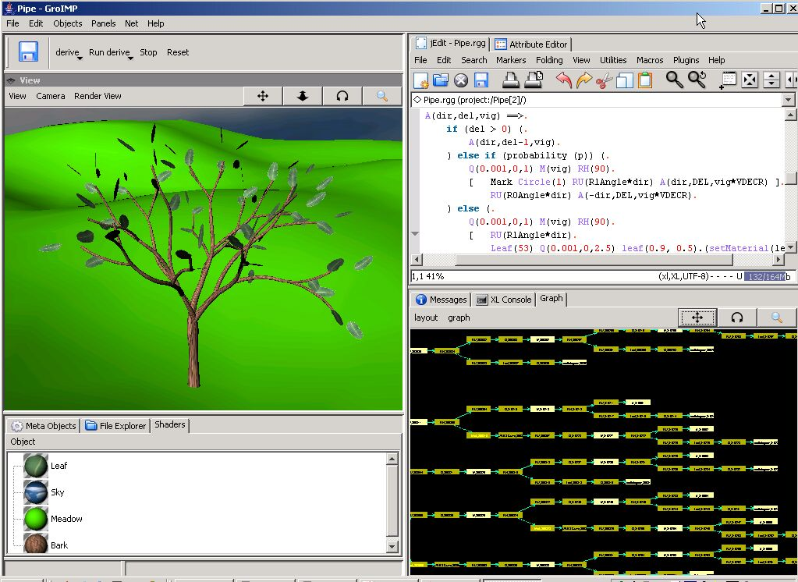
GroIMP (Growth-grammar related Interactive Modelling Platform)

Slide 40
GroIMP is a combination of:
- compiler and interpreter for the language XL
- development environment for XL
- 3-d modeller (interactive)
- 3-d renderer (several variants)
- 2-d graph visualizer
editor for 3-d objects and attributes
tool for generating textures
display for DTD and MTG files
tool for simulating light distribution

Slide 41
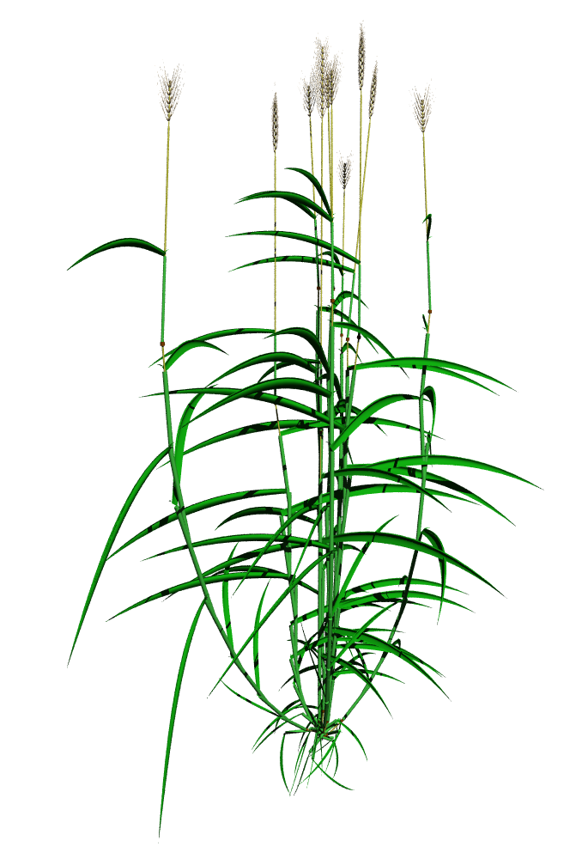
Example of a plant model realized with GroIMP
(barley)

Slide 42
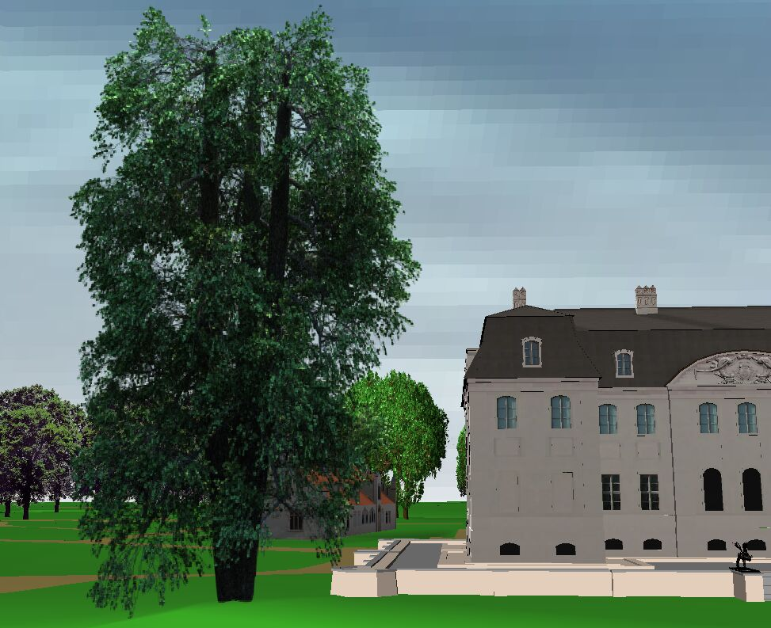
Application example
Modelling of park landscapes (Rogge & Moschner 2007, for Branitzer Park Foundation, Cottbus)
Generated with GroIMP
alder tree in VRML-world

Slide 43

Results from architecture seminar with XL
Liang 2007

Slide 44
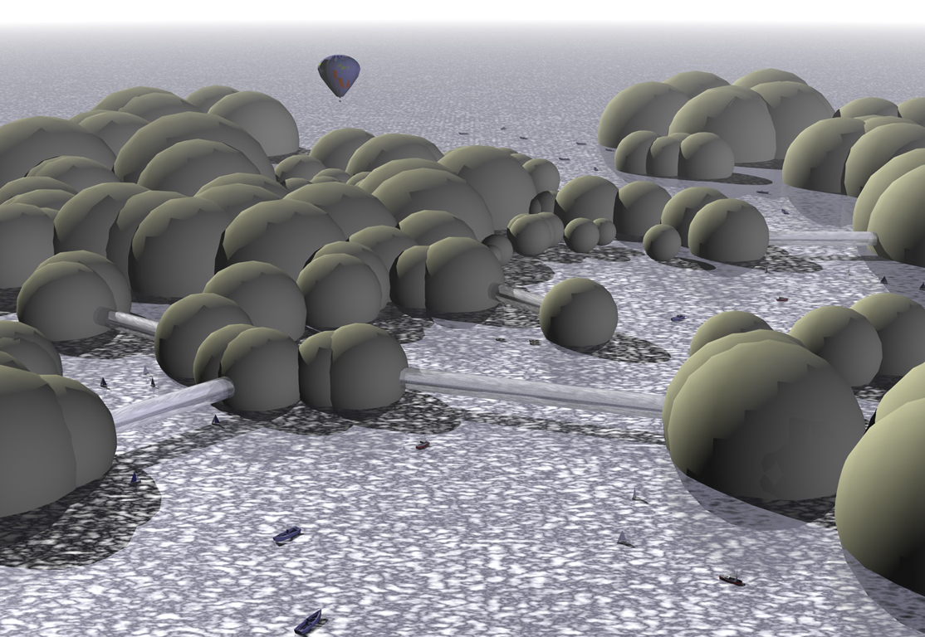
Liang 2007

Slide 45
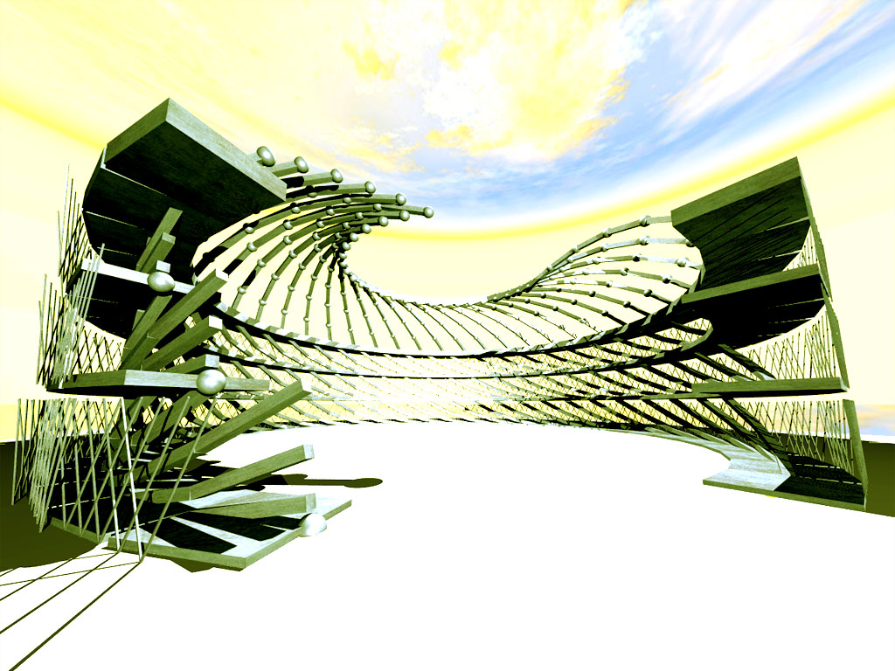
Jarchow 2007

Slide 46
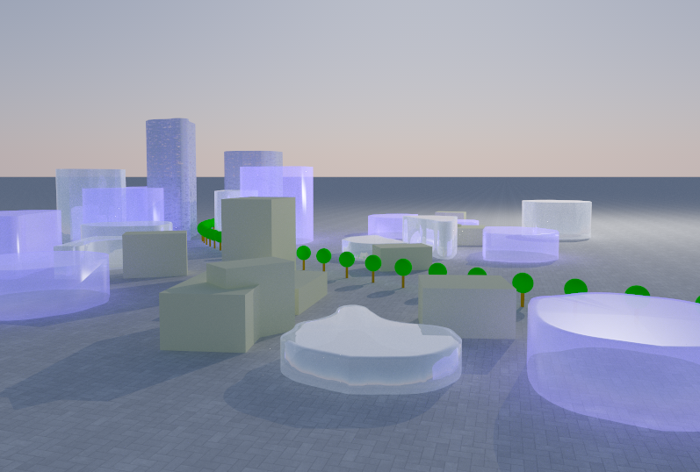
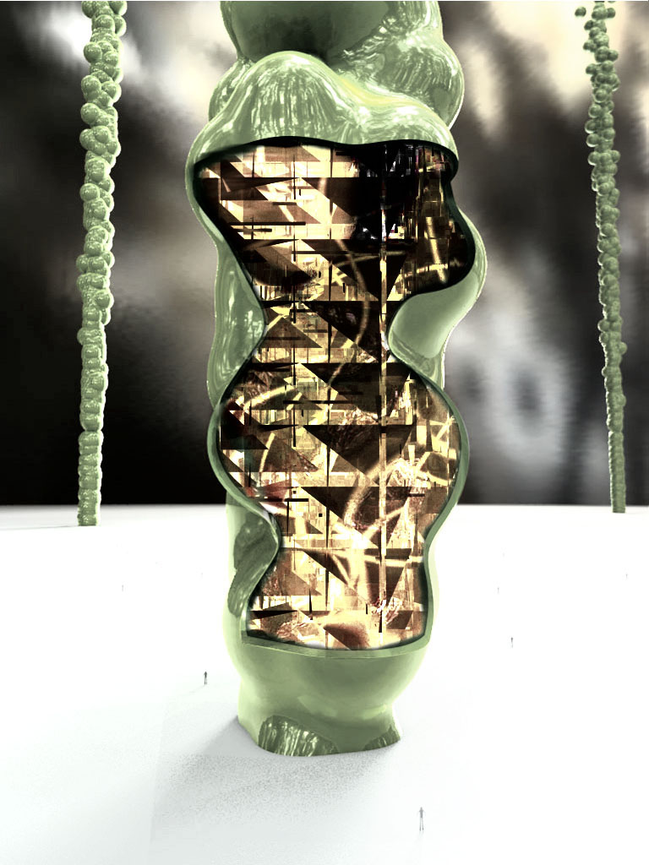
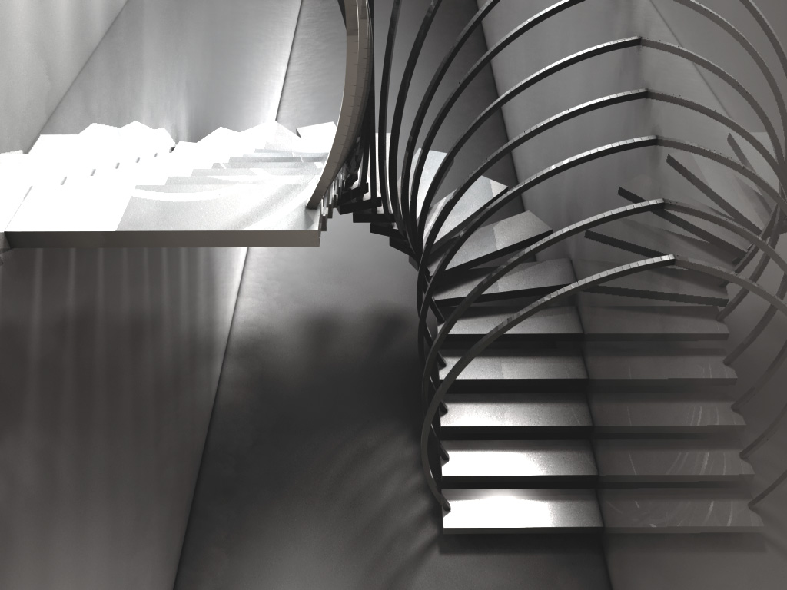

Slide 47
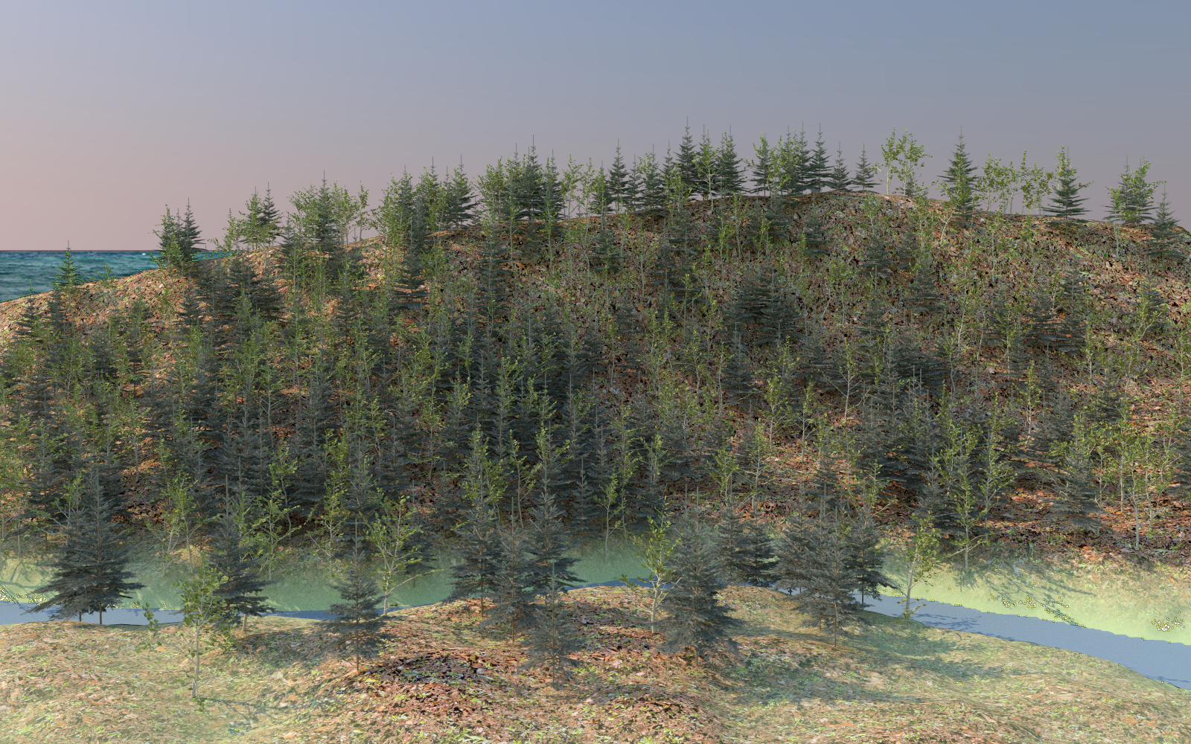
Virtual landscape (with mixed beech and spruce stand)

Slide 48
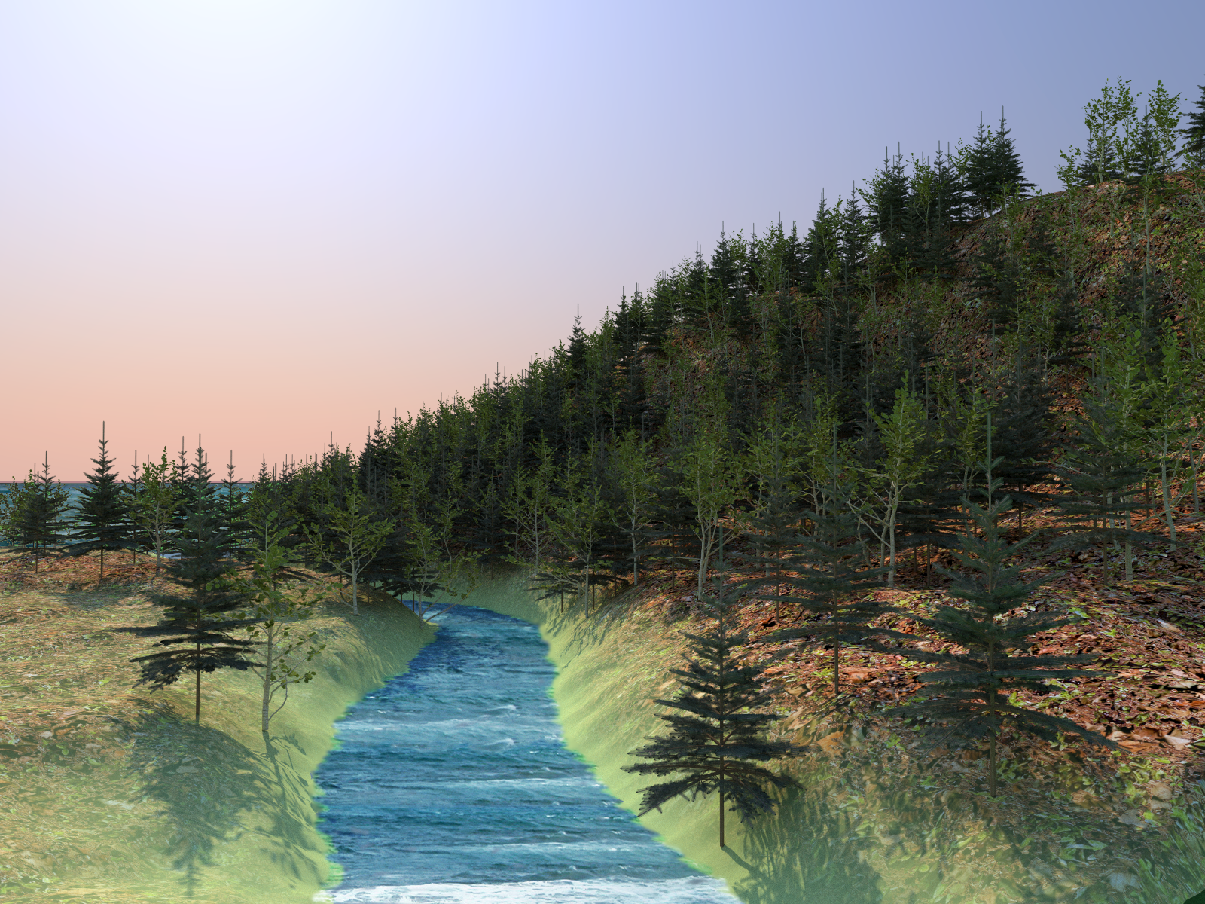

Slide 49
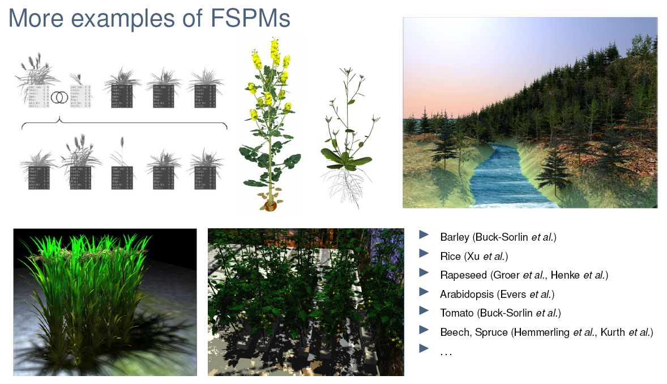
More examples of functional-structural plant models, realized with GroIMP

Slide 50
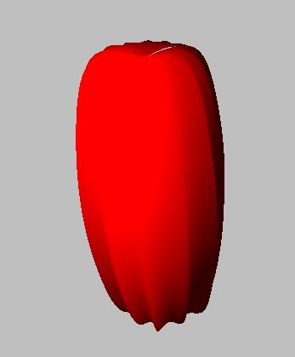
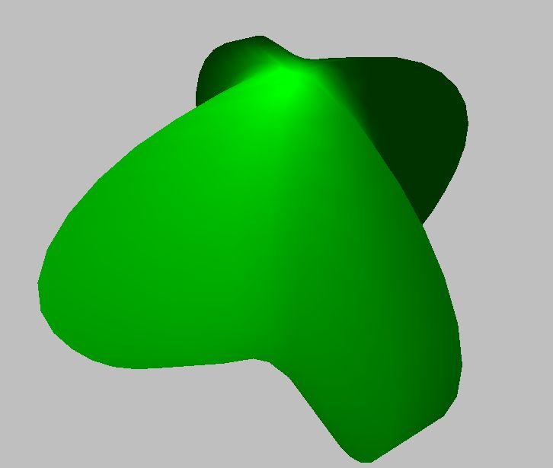
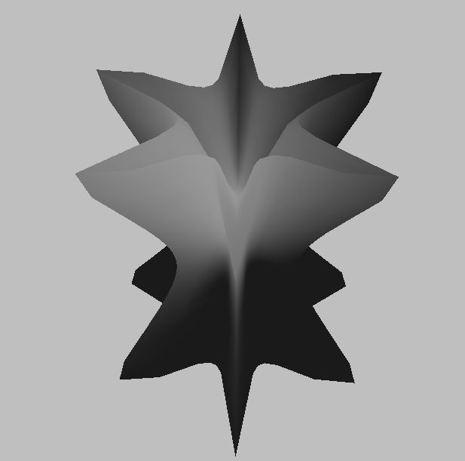
GroIMP - newer extensions
“Supershape” (class of mathematically defined surfaces) as geometrical primitive objects

Slide 51
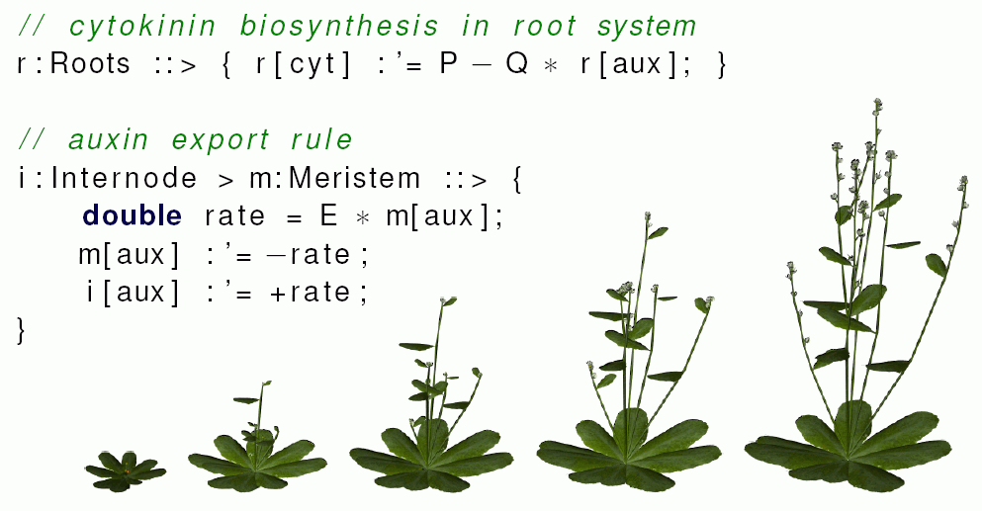
GroIMP - newer extensions
Rate-assignement operator - ability to easily call efficient and numerically stable solution methods for ordinary differential equations in model code
(Hemmerling 2012)
Example:

Slide 52
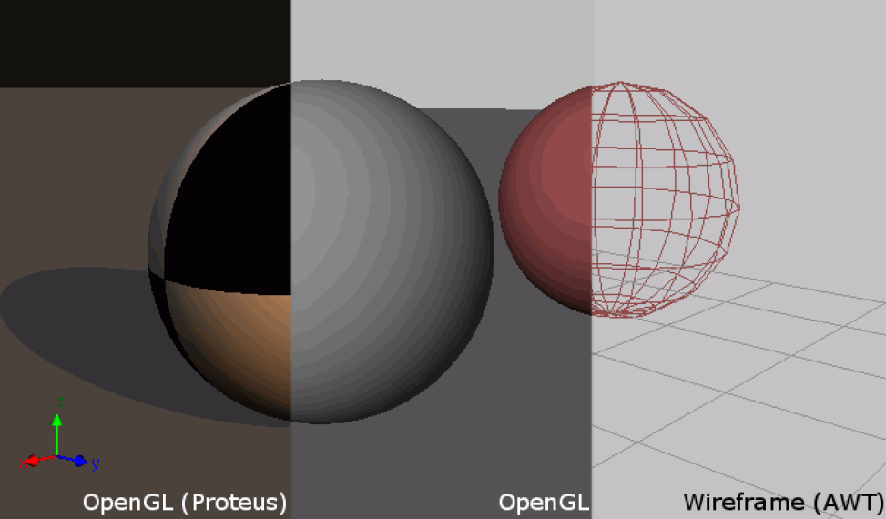
GroIMP - newer extensions
Improved OpenGL-3D-View for visualization
(Hartmann, Hemmerling 2010)

Slide 53
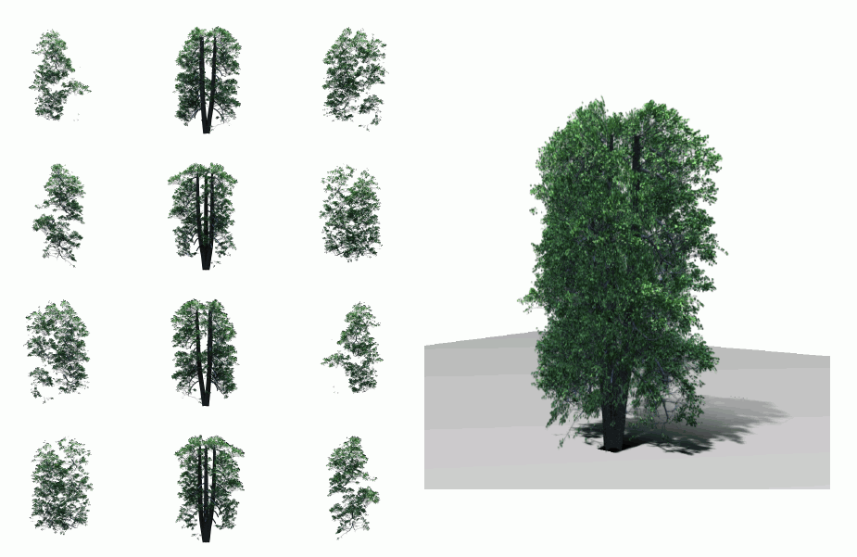
GroIMP - newer extensions
integrated tool for the creation of “billboard objects" for quick vegetation display
(Hemmerling 2010)

Slide 54
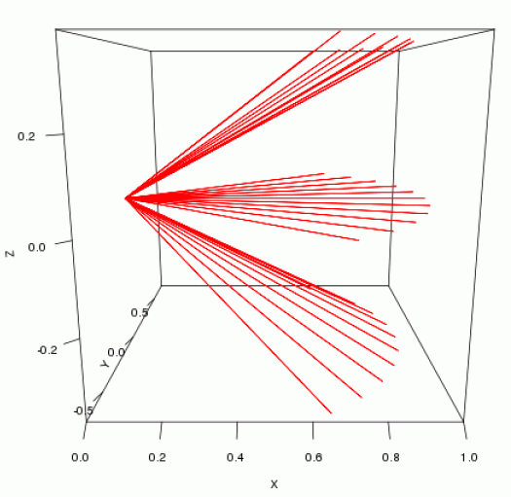
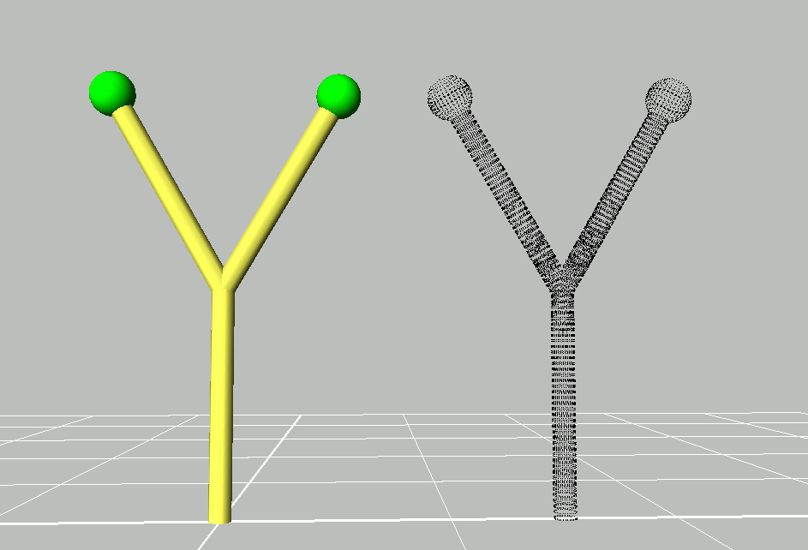
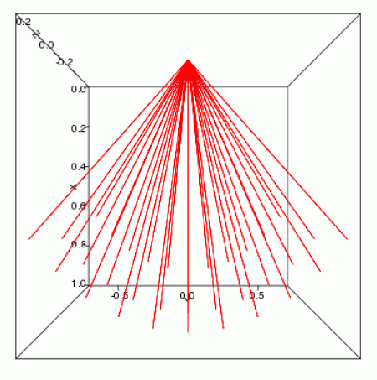
GroIMP - newer extensions
integrated virtual laser scanner (realized with Ecole Centrale Paris, practical work of a student)
(Etard 2011)

Slide 55
Modeling with light / shadow
First model approach (highly simplified)
A shadow is thrown on an object if there are other objects in an imaginary cone with its tip point in the object, opened upwards (z-direction)
Example:
sm09_e42.rgg competition for light by three
2-dimensional plant models

Slide 56
module Segment(int t, int ord) extends F0;
module TBud(int t) extends F(1, 1, 1);
module LBud extends F(0.5, 0.5, 1);
Vector3d z = new Vector3d(0, 0, 1);
protected void init()
[
Axiom ==> P(2) D(5) V(-0.15) [ TBud(-4) ] RU(90) M(600) RU(-90)
[ TBud(0) ] RU(-90) M(1200) RU(90)
[ TBud(-8) ];
]
public void run()
[
TBud(t), (t < 0) ==> TBud(t+1);
x:TBud(t), (t >= 0 && empty( (* s:Segment, (s in cone(x, z, 45)) *) ) ) ==>
L(random(80, 120)) Segment(0, 0)
[ MRel(random(0.5, 0.9)) RU(60) LBud ]
[ MRel(random(0.5, 0.9)) RU(-60) LBud ] TBud(t+1);
y:LBud,
(empty( (* s:Segment, (s in cone(y, z, 45)) *) ) ) ==>
L(random(60, 90) Segment(0, 1) RV0 LBud;
Segment(t, o), (t < 8) ==> Segment(t+1, o);
Segment(t, o), (t >= 8 && o == 1) ==>> ; /* Deletion of branches */
]

