Slide 1


Functional-Structural Plant Models
Summer semester 2021
Winfried Kurth
University of Göttingen
Chair of Computer Graphics and Ecoinformatics
6th Lecture: 3 June, 2021

Slide 2
From our last lecture:
Using imperative code in XL programs
Loops and arrays in branch constructions
Adding textures to plant models

Slide 3
Today:
stochastic L-systems
context sensitive L-systems
a new rule type: interpretation rules
a simple spruce model in XL

Slide 4
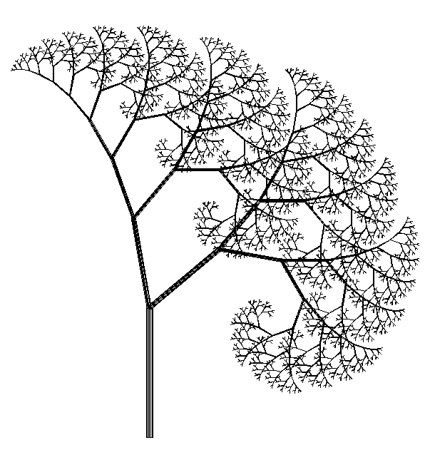
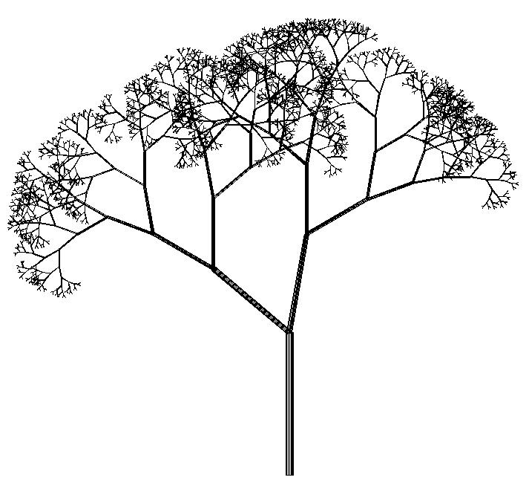
Stochastic L-Systems
Use of pseudo-random numbers
Example:
deterministic stochastic
Axiom ==> L(100) D(5) A;
A ==> F0 LMul(0.7) DMul(0.7)
[ RU(50) A ] [ RU(-10) A ];
Axiom ==> L(100) D(5) A;
A ==> F0 LMul(0.7) DMul(0.7)
if (probability(0.5))
( [ RU(50) A ] [ RU(-10) A ] )
else
( [ RU(-50) A ] [ RU(10) A ] );

Slide 5
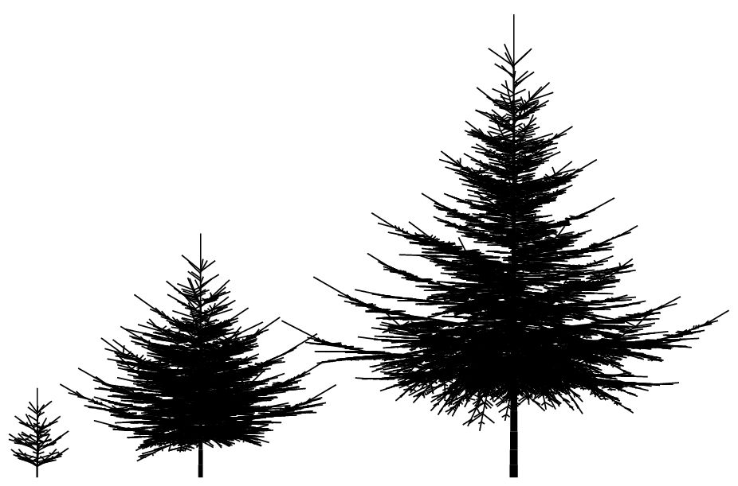
Example:
Spruce model in 3D
generated with L-system

Slide 6
XL functions for pseudo-random numbers
probability (x)
returns 1 with probability x, 0 with probability 1-x
random (a, b)
generates evenly distributed floating point random numbers between a and b
irandom (a, b)
generates evenly distributed integer random numbers between a and b
normal (m, s)
generates normally distributed floating-point random numbers with mean m and standard deviation s
setSeed (n)
sets a starting value for the random number generator (to generate identical sequences of pseudo-random numbers)
Math.random ()
Generates evenly distributed floating-point random numbers between 0 and 1
distribution (v) with vector v
returns whole integer random numbers with probability v[0] for 0, v[1] for 1, ...

Slide 7
Try the example
sm09_e19.rgg
Stochastic L-System
(different variants of the use of random variables)

Slide 8
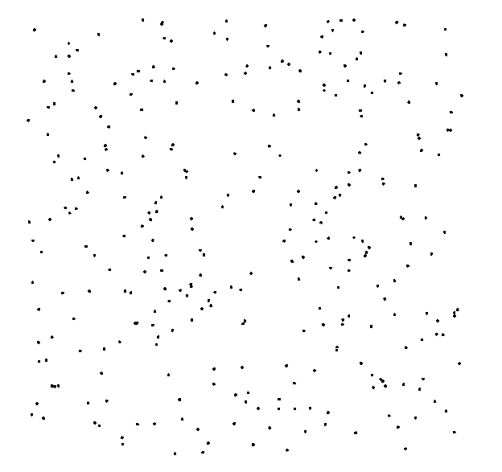
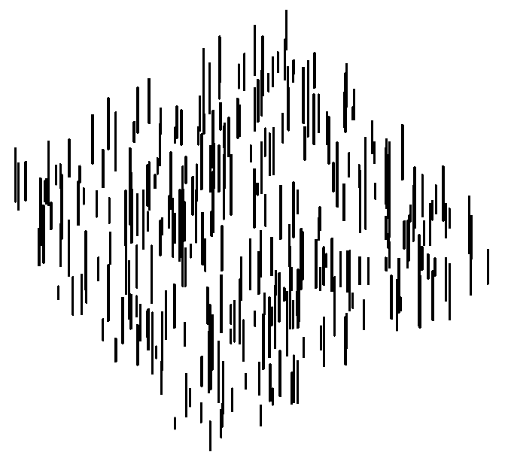
Generation of a random distribution in a plane
Axiom ==> D(0.5) for ((1:300))
( [ Translate(random(0, 100), random(0, 100), 0)
F(random(5, 30)) ] );
View from above Diagonally from the side

Slide 9
Try the examples
sm09_e23.rgg Dispersal model (1 species)
sm09_e24.rgg Dispersal model (2 species)
In these examples the competition is not yet taken into account
It is also shown how population densities can be plotted during the simulation runtime, in charts

Slide 10
Context-sensitive L-systems
Query a context that must exist for a rule to be applicable
in XL: context specification in (* .... *)

Slide 11
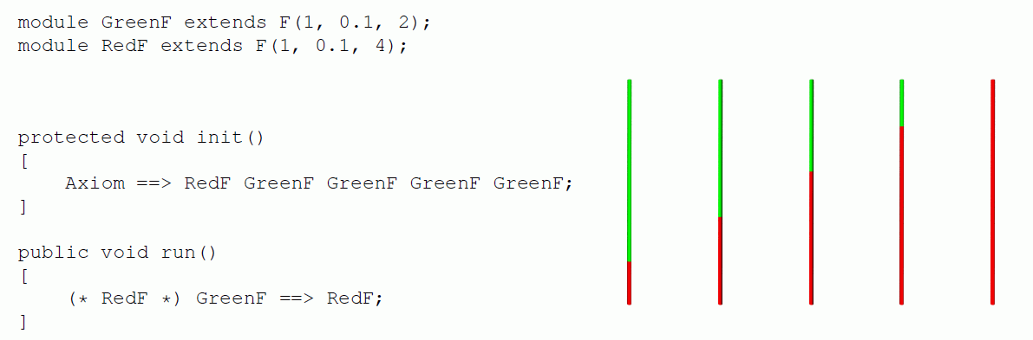
Context-sensitive L-systems
Example of using left-sided context:
another example of left context:
sm09_e14.rgg

Slide 12
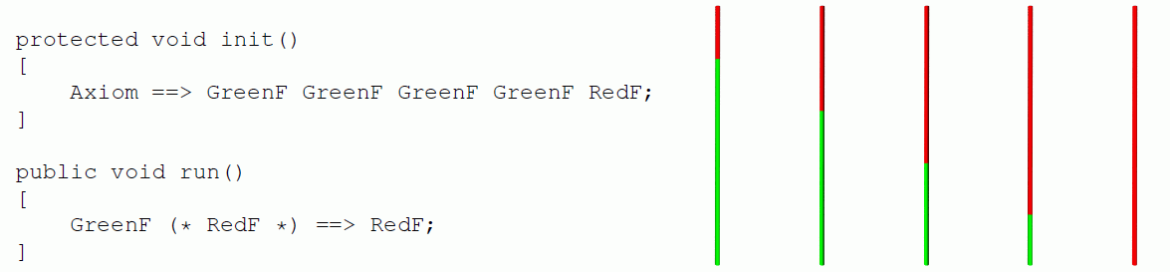
Context-sensitive L-systems
Example of using right-sided context:
another example of right context:
sm09_e15.rgg

Slide 13
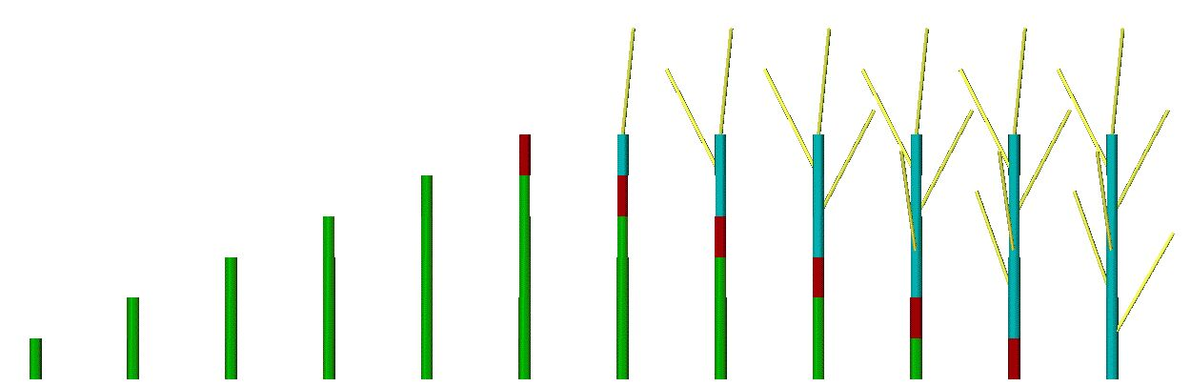
Right context
installation in a model for signal-controlled triggering of lateral shoot formation
module A(int age);
module B(super.length, super.color) extends F(length, 3, color);
Axiom ==> A(0);
A(t), (t < 5) ==> B(10, 2) A(t+1); // 2 = green
A(t), (t == 5) ==> B(10, 4); // 4 = red
B(s, 2) (* B(r, 4) *) ==> B(s, 4);
B(s, 4) ==> B(s, 3) [ RH(random(0, 360)) RU(30) F(30, 1, 14) ]; // 3 = blue

Slide 14
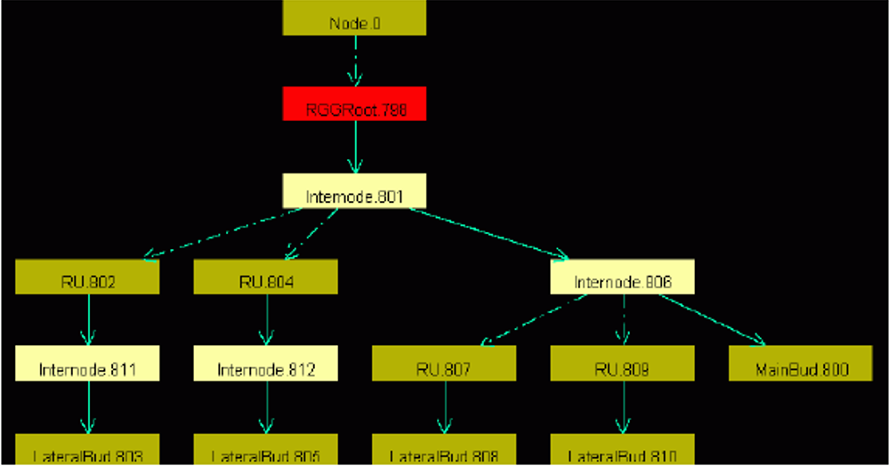
Insertion:
Graph View
GroIMP always carries a graph with it, which contains all the current structure information.
this is transformed by applying the rules
the graph can be displayed completely in the 2D graph view
GroIMP: Panels > 2D > Graph
(the 2D graph view can be anchored with
the mouse in the GroIMP user interface)
Graph > Layout
Graph > View > Redraw

Slide 15
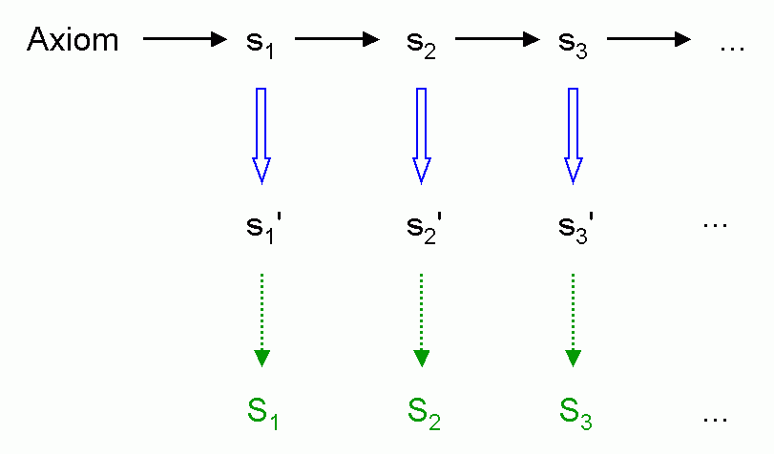
Interpretation rules
Installation of a further rule application immediately before graphic interpretation (without effect on the next generation)
Interpretation rule application
Turtle - interpretation

Slide 16
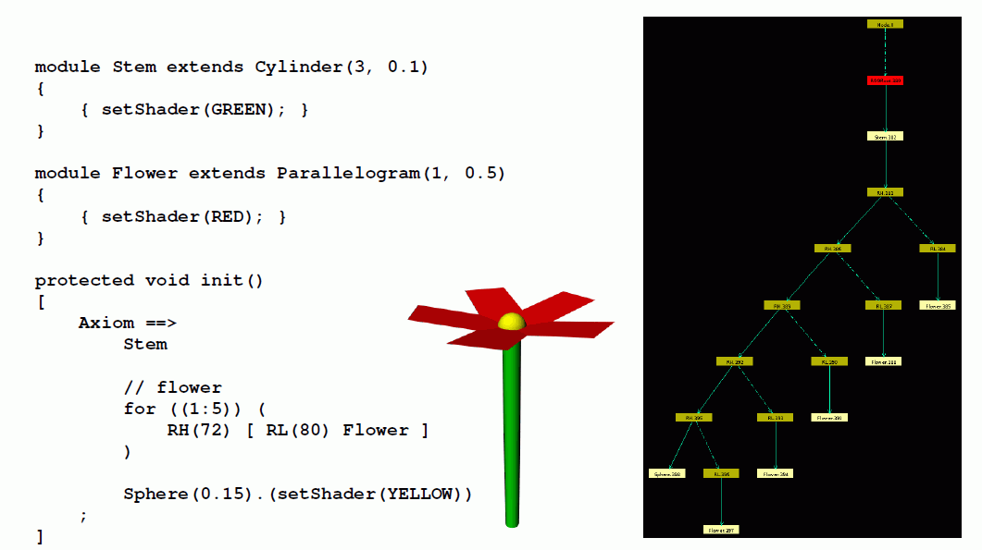
Ordinary geometric interpretation (without interpretation rules)

Slide 17
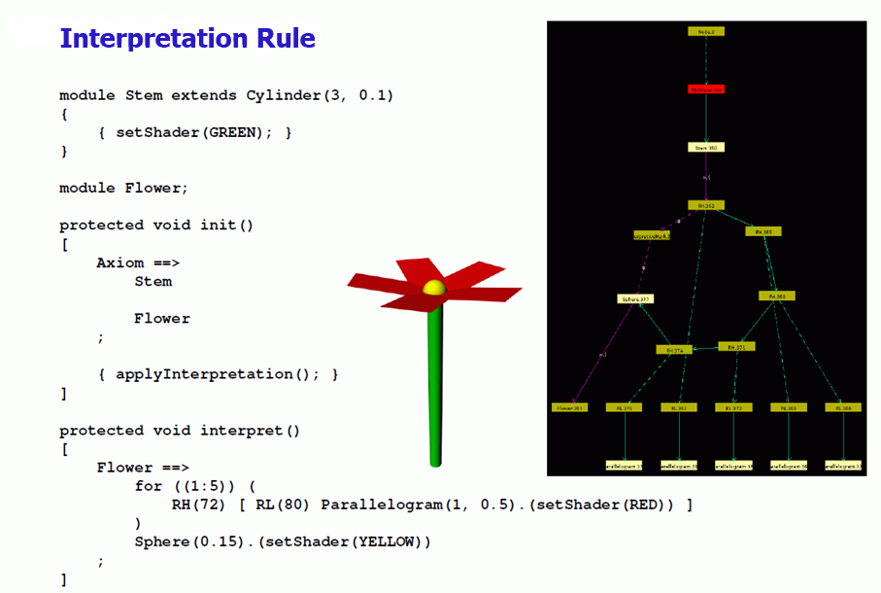
With the use of interpretation rules

Slide 18
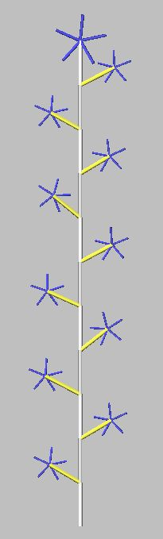
Another example
module MainBud(int x) extends Sphere(3) {{setShader(GREEN);}};
module LBud extends Sphere(2) {{setShader(RED);}};
module LMeris;
module AMeris;
module Flower;
const float d = 30;
const float crit_dist = 21;
protected void init()
[ Axiom ==> MainBud(10); ]
public void run()
{ [
MainBud(x) ==> F(20, 2, 15) if (x > 0)
( RH(180) [ LMeris ] MainBud(x-1) )
else
( AMeris );
LMeris ==> RU(random(50, 70)) F(random(15, 18), 2, 14) LBud;
LBud ==> RL(90) [ Flower ];
AMeris ==> Scale(1.5) RL(90) Flower; /* Flower: here only a symbol */
]
applyInterpretation(); /* Call for the execution of interpretation rules
(in imperative section { ... } !) */
}
protected void interpret() /* Block with interpretation rules */
[
Flower ==> RH(30) for ((1:5))
( RH(72) [ RL(80) F(8, 1, 9) ] );
]

Slide 19
Yet another example
public void run()
{
[
Axiom ==> A;
A ==> Scale(0.3333) for (int i:(-1:1))
for (int j:(-1:1))
if ((i+1)*(j+1) != 1)
( [ Translate(i, j, 0) A ] );
]
applyInterpretation();
}
public void interpret()
[
A ==> Box;
]
creates the so-called "Menger Sponge" (a fractal)

Slide 20
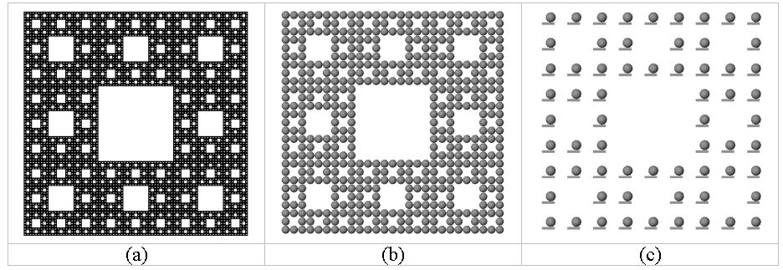
public void run()
{ [
Axiom ==> A;
A ==> Scale(0.3333) for (int i:(-1:1))
for (int j:(-1:1))
if ((i+1)*(j+1) != 1)
( [ Translate(i, j, 0) A ] );
]
applyInterpretation();
}
public void interpret()
[
A ==> Box;
]
(a)
(b)
(c)
A ==> Box(0.1, 0.5, 0.1)
Translate(0.1, 0.25, 0) Sphere(0.2);
A ==> Sphere(0.5);

Slide 21
What does this example create?
public void run()
{
[
Axiom ==> [ A(0, 0.5) D(0.7) F(60) ] A(0, 6) F(100);
A(t, speed) ==> A(t+1, speed);
]
applyInterpretation();
}
public void interpret()
[
A(t, speed) ==> RU(speed*t);
]

Slide 22
A Spruce Model in XL
/* Spruce model sm09_fichte.rgg */
module T; /* Terminal buds */
module M1; /* Side-branch bud 1st order, middle position */
module S1; /* Side-branch bud 1st order, subapical position */
module M2; /* Side-branch bud 2nd order, middle position */
module S2;
module M3;
module S3;
module GU(float incd, int age) extends F0; /* growth unit */
module BA(int age, super.angle) extends RL(angle);
module GA(int age, super.angle) extends RL(angle);
module HA(int age, super.angle) extends RL(angle);
const int ang = 45;
const int x3 = 50;
const int[] a = { 0, 15, 25, 32, 37, 40 };
const int[] gg = { 0, 0, 4 };
const int[] hh = { 0, 0, 2, 4, 8 };
int n, k;
const float[] prob_n = {0.1, 0.4, 0.3, 0.2};
const int[] n_subap = {5, 6, 7, 8};

Slide 23
protected void init()
[
Axiom ==> P(2) D(1) L(100) T;
]
public void grow()
[
x:T ==> Nl(80*TurtleState.length(x)) GU(2.2, 0)
RH(random(0, 360)) { k = 0; }
for ((1:3)) /* 3 middle side branches 1st order */
( [ MRel(random(0.2, 0.85)) RH(k*120+normal(0, 5.5))
{ k++; } RL(x3+normal(0, 2.2)) BA(0, 0) LMul(0.4) M1 ] )
RH(random(0, 360)) { n = n_subap[distribution(prob_n)]; k = 0; }
for ((1:n)) /* n subapical side branches of 1st order */
( [ MRel(random(0.85, 1)) RH(k*360/n+normal(0, 3.1))
{ k++; } RL(x3+normal(0, 2.2)) BA(0, 0) LMul(0.65) S1 ] )
T;
x:S1 ==> Nl(80*TurtleState.length(x)) GU(1.3, 0)
[ MRel(random(0.85, 1)) RH(15)
RU(ang+normal(0, 2.2)) AdjustLU LMul(0.7) S2 ]
[ MRel(random(0.85, 1)) RH(-15)
RU(-ang+normal(0, 2.2)) AdjustLU LMul(0.7) S2 ] GA(0, 0) S1;
x:M1 ==> Nl(80*TurtleState.length(x)) GU(0.8, 0)
[ MRel(random(0.85, 1)) RH(15)
RU(ang+normal(0, 2.2)) AdjustLU LMul(0.7) M2 ]
[ MRel(random(0.85, 1)) RH(-15)
RU(-ang+normal(0, 2.2)) AdjustLU LMul(0.7) M2 ] HA(0, 0) M1;

Slide 24
x:S2 ==> Nl(80*TurtleState.length(x)) GU(1.3, 0)
[ MRel(random(0.85, 1)) RH(10)
RU(ang) AdjustLU LMul(0.7) S3 ]
[ MRel(random(0.85, 1)) RH(-10)
RU(-ang) AdjustLU LMul(0.7) S3 ] S2;
x:M2 ==> Nl(80*TurtleState.length(x)) GU(0.8, 0)
[ MRel(random(0.85, 1)) RH(10)
RU(ang) AdjustLU LMul(0.7) M3 ]
[ MRel(random(0.85, 1)) RH(-10)
RU(-ang) AdjustLU LMul(0.7) M3 ] M2;
x:S3 ==> Nl(80*TurtleState.length(x)) GU(1.3, 0);
x:M3 ==> Nl(80*TurtleState.length(x)) GU(0.8, 0);
GU(incd, t) ==> DlAdd(incd*(t+1)) GU(incd, t+1);
DlAdd(arg) ==> ;
BA(age, angle) ==> BA(age+1, a[age<5 ? age+1 : 5]);
GA(age, angle) ==> GA(age+1, gg[age<2 ? age+1 : 2]);
HA(age, angle) ==> HA(age+1, hh[age<4 ? age+1 : 4]);
]
New node types and new commands occurring herein:
see the following slides

Slide 25
Function TurtleState.length(x) (for one node x):
returns the step length of the turtle at node x
Turtle command (Node) AdjustLU :
rotates the turtle around the H axis so that the U vector points upwards
Turtle-Command (Node) N :
controls leaf mass (analogous to L und D)

Slide 26
Operator with 3 arguments for case distinctions:
Condition ? Expression 1 : Expression 2
- Returns the value of Expression1 if the condition is met, otherwise the value of Expression2.
x = Condition ? Expression1 : Expression2 is equivalent to
if (Condition)
x = Expression1;
else
x = Expression2;
(this operator is also available in C, C++ and Java)

Slide 27
Assignments
1. Analyze the XL code of the model sm09_fichte.rgg.
Test the Model with GroIMP, and analyze again the code for the second time.
Take note of everything that might be unclear to you.
Try to answer the following questions:
how to increase the thickness growth
- for all growth units (GU)?
- for the trunk only?
how can a slimmer crown shape be achieved (e.g., by changing the length growth)?
- how can the number of main side branches be reduced?

Slide 28
Assignments (continued)
2. Work through lessons 13 - 16 and 20 - 22 in the ILIAS learning module "Introduction to GroIMP" (available via StudIP).
3. Read Chapter 1, Section 1.8 of the book "The Algorithmic Beauty of Plants" by P. Prusinkiewicz and A. Lindenmayer (pp. 30-35)
(Note the different notation for context-sensitive rules)

