Slide 1
Functional-Structural Plant Models
Summer semester 2021
Winfried Kurth
University of Göttingen
Chair of Computer Graphics and Ecoinformatics
4th Lecture: 6 May, 2021

Slide 2
From our last lecture:
generating branches with turtle geometry
simple L-systems (string substitution systems)
their execution with GroIMP
simple branching patterns modeled with L-systems

Slide 3
which geometrical structure is generated by
Axiom ==> F(10) A ;
A ==> [ RU(-60) F(6) RH(180) A Sphere(3) ]
[ RU(40) F(10) RH(180) A Sphere(3) ];
Sphere ==> Z; ?

Slide 4
On our next slides:
parametric L-systems, further L-system examples
imperative code in XL (Introduction)

Slide 5
Extension of the symbol concept
Allow numerical parameters not only for turtle commands such as "RU(45)" and "F(3)", but for all characters as well
parameterized L-Systems
Any long, finite parameter lists are allowed!
Parameters are assigned values during rule matching
Example:
Rule A(x, y) ==> F(7*x+10) B(y/2)
present character, example: A(2, 6)
After rule application: F(24) B(3)
Conditions for the parameters can be checked (in logical conditions with Java syntax):
A(x, y) (x >= 17 && y != 0) ==> ....

Slide 6
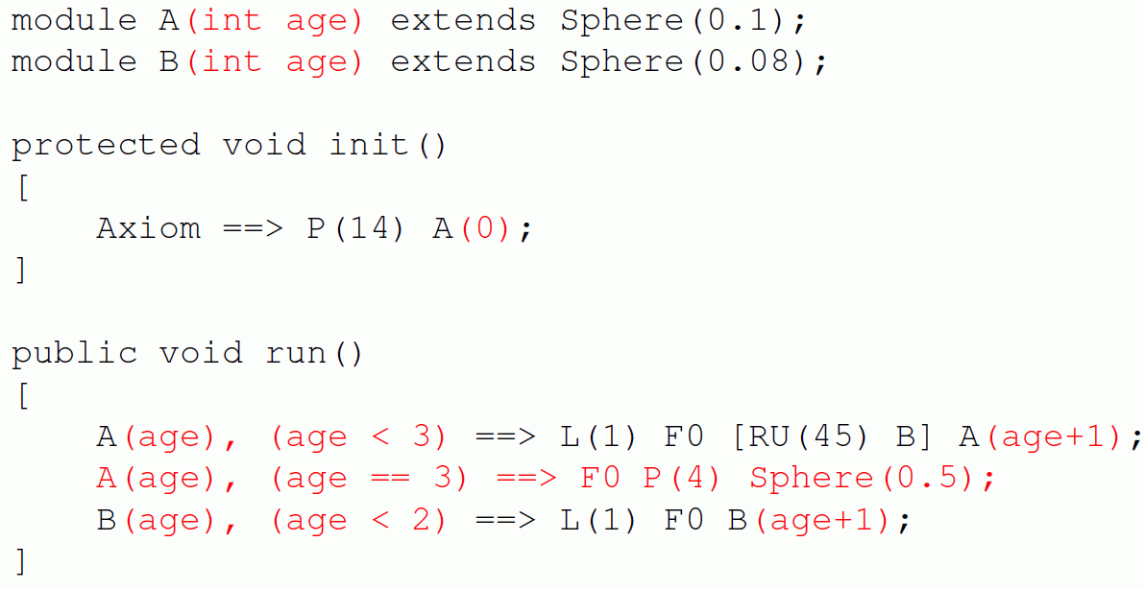
Example:

Slide 7
What structure is generated by the following L-System?
Axiom ==> [ RU(90) M(1) RU(90) A(1) ] A(1);
A(n) ==> F(n) RU(90) A(n+1);

Slide 8
What structure is generated by the following L-System?
Axiom ==> [ RU(90) M(1) RU(90) A(1) ] A(1);
A(n) ==> F(n) RU(90) A(n+1);
Alternative:
in the second rule replace "RU(90)" for instance,
by "RU(92)"

Slide 9
Examples:
sm09_e04.rgg - two rule blocks
sm09_e05.rgg - alternating positioning of lateral
branches
sm09_e06.rgg - shoot growth with opposite
branching (in 3d)
sm09_e07.rgg - insert simple imperative XL code
directly into a rule
sm09_e08.rgg - define your own modules in order
to simplify the code
sm09_e21.rgg - 3 variants how to position lateral
branches at another place than at
the end of an object

Slide 10
Using Imperative Code in XL Programs
Commands such as assignments of values to variables, additions, function statements, output (print commands), etc., are specified with the same notation as in the Java programming language and are enclosed in curly brackets { ... }
Examples:
int i; // Declaration of an integer variable with the name i
float a = 0.0; // Declaration and initialization
// of a floating point variable
int[] x = new int[20]; // Declaration of an array (data field) with
// length 20; with access: x[0], ..., x[19]
float[] y = { 0.1, 0.2, 0.7, -1.4 }; // Declaration and
// initialization of an array
i = 25; // assignment

Slide 11
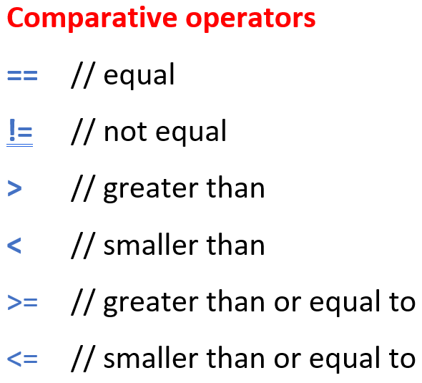
Use of imperative code (continued)
i++; // i will be increased by 1
i--; // i will be decreased by 1
i += 5; // i will be increased by 5
i -= 5; // i will be decreased by 5
i *= 2; // i will be doubled
i /= 3; // i will be divided by 3
n = m % a; // n becomes the remainder of m after integer
// division by a
x = Math.sqrt(2); // x is the square root of 2 by assignment
if (x != 0) { y = 1/x; } // conditional assignment of 1/x to y
while (i <= 10) { i++; } // Loop: as long as i ≤ 10,
// i is increased by 1
for (i = 0; i < 100; i++) { x[i] = 2*i; } // imperative
// for-loop
if (i == 0) { ... } // test for equality ( “=“ would be assignment!)

Slide 12
Simple Data Types:
int - integers
float - floating point numbers
double - floating point numbers, double precision
char - characters
void - empty type (for functions that return nothing)

Slide 13
Simple Data Types:
int - integers
float - floating point numbers
double - floating point numbers, double precision
char - characters
void - empty type (for functions that return nothing)
Exact definition:
or
characters
till
till
till
till

Slide 14
Mathematical constants:
Math.PI π
Math.E e
Logical operators:
&& AND
|| OR
! NOT

Slide 15
Mathematical Functions:
Math.abs absolute value Math.sqrt square root
Math.acos arccosine Math.tan tangent
Math.asin arcsine Math.toDegrees
Math.atan arctangent Math.toRadians
Math.cos cosine
Math.exp exponential function e^{x}
Math.log natural logarithm
Math.max maximum of two numbers
Math.min minimum of two numbers
Math.round rounding function
Math.sin sine
Conversion –
degree ↔ radian measurement

Slide 16
sm_progbsp01.rgg
A simple imperative program:
the numbers from 1 to 10 are output to the GroIMP console
protected void init()
{
int i;
for (i=1; i<= 10; i++)
println(i);
println("End.");
}

Slide 17
Assignment for our next lecture:
(1) Work in the ILIAS learning module “Introduction to GroIMP“ (available through StudIP):
- Introduction
- Lessons 1 - 4
(2) Read Chapter 1, Sections 1.6 – 1.7 and 1.10 / 1.10.1 in the book “The Algorithmic Beauty of Plants“ by P. Prusinkiewicz and A. Lindenmayer (available online, see literature site for the course). (= pp. 21-30 and 40-43).

