Slide 1
Functional-Structural Plant Models
- Summer Semester 2021 -
Winfried Kurth
University of Göttingen
Chair of Computer Graphics and Ecoinformatics
2nd Lecture: 22 April, 2021

Slide 2
From our last lecture
Model triangle for plant models
Pure structural models, motivation
3 levels of structure description
2 types of static description
tabular (dtd format)
imperative (Turtle geometry - not yet discussed)

Slide 3
On our next slides
Meristem-based modelling approach
GroIMP
Programming paradigms
Turtle geometry
Execution of Turtle geometry command sequences using GroIMP

Slide 4
Modelling approach
tree shape = trajectory of the meristems
primary meristem
branching
secondary meristem
(to be added:
mechanical deformations, deformations with physiological causes, injuries, death processes)

Slide 5
Meristem-based modeling approach
Adrian D. Bell 1979
3 basic processes
Formation of a shoot (growth)
Transition to idle state (and reactivation)
Dying
Similar to de Reffye 1981:
3 meristem states
dormance (dormancy)
croissance (growth)
mortalité (death)
State transitions with probabilities
Binomial distribution, Markov chains

Slide 6
Description Synthesis
Multiscale graph Axis of reference
(AMAPsim, GreenLab)
dtd-Code L-System, Relational
Growth Grammar
(Grogra, GroIMP)
Göttingen Montpellier

Slide 7
Combination 1. + 2. description level
Morphological Measurements
Branch mapping
Encoding
static
Grogra/GroIMP
Statistical Data Analysis
Growth grammar with parameters
dynamic
Grogra/GroIMP
Time series of three-dimensional structures
Statistical data analysis
Graphics
Other simulation programmes

Slide 8
The GroIMP Software
"Growth-grammar related Interactive Modelling Platform“
Written in Java
Download from Sourceforge (free & open source)
rgg files, projects (gsz files)
Editor, development environment
3D window
2D (graph) window (hidden!)
Attribute view for each object
Camera position
Navigation
Interactive modeling
Compiler for the programming language XL

Slide 9
Paradigms of programming
The term "programming paradigm”
Paradigm:
fundamental way of thinking, concept guided by examples

Slide 10
Paradigm:
"Describes a lot of theories, standards and methods, which jointly represent a way to organize knowledge”
Thomas Kuhn 1970: The Structure of Scientific Revolutions

Slide 11
Paradigm:
"Describes a lot of theories, standards and methods, which jointly represent a way to organize knowledge”
Thomas Kuhn 1970: The Structure of Scientific Revolutions
Paradigm shift: difficult.
A revolution in the way of thinking!

Slide 12
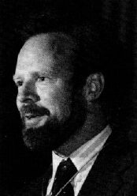
This was picked up by Robert Floyd in 1978:
Turing Award Lecture
- "The Paradigms of Programming”
Robert W. Floyd (1936-2001)

Slide 13
Which paradigms are suggested through problems such as......
… the simulation of natural objects?
… computer graphics representation?

Slide 14
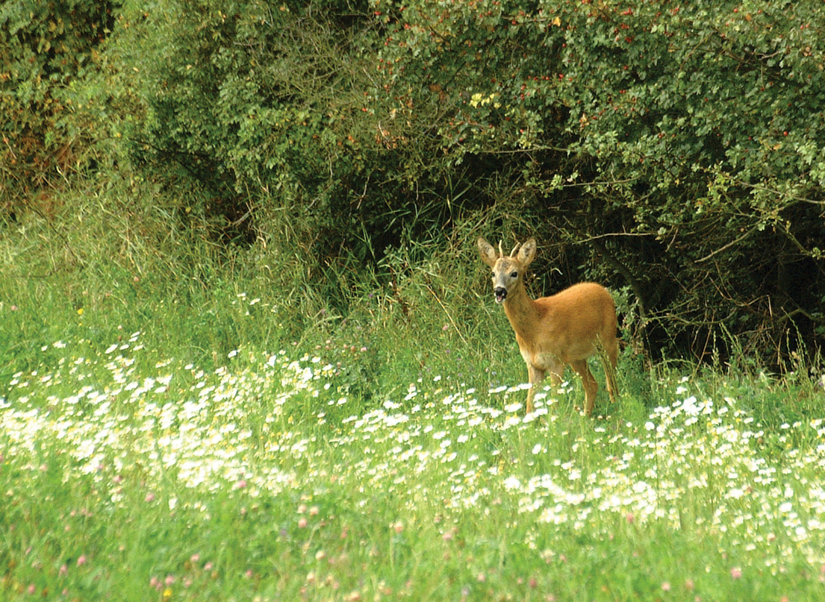
Ecology

Slide 15
Ecology
Organisms

Slide 16
Ecology
Organisms
Describing the structure

Slide 17
Ecology
Behavior (under certain conditions)
Organisms
Describing the structure

Slide 18
Ecology
Behavior (under certain conditions)
Organisms
Describing the structure
General principles
(rules) determine

Slide 19
Ecology
Behavior (under certain conditions)
Organisms
Describing the structure
Processes
General principles
(rules) determine

Slide 20
Ecology
Behavior (under certain conditions)
Organisms
Describing the structure
Processes
General principles
(rules) determine
Calculated dynamics

Slide 21
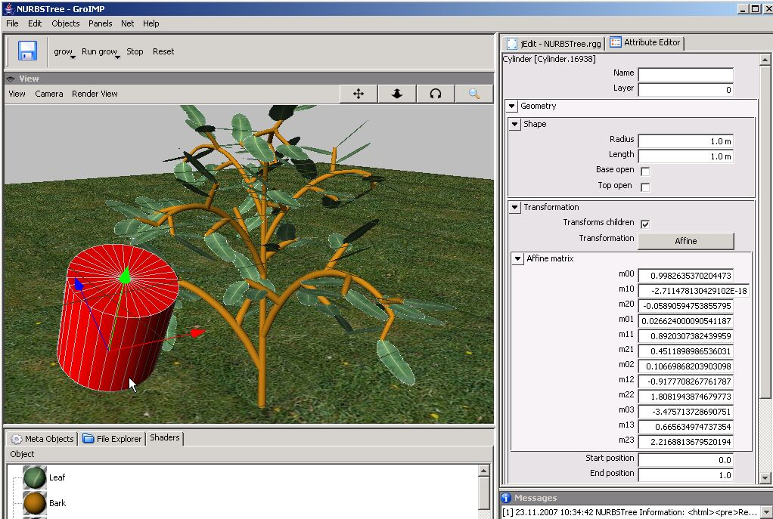
Graphical system

Slide 22
Graphical system
Object

Slide 23
Graphical system
Object
(with attributes)

Slide 24
Graphical system
Object
(with attributes)
Regular
structures

Slide 25
Graphical system
Object
(with attributes)
Regular
structures
Processes

Slide 26
Programming paradigms
for numerical simulation of processes:
imperative paradigm

Slide 27
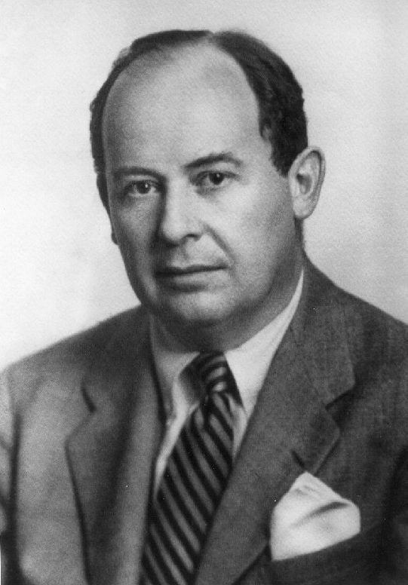
Programming paradigms
for numerical simulation of processes:
imperative paradigm
(also: Von-Neumann paradigm,
control-flow paradigm)
John von Neumann (1903-1957)

Slide 28
Imperative:
„Programming by commands“
Computer = ?

Slide 29
Imperative programming
Computer = machine for changing values
of variables

Slide 30
Imperative programming
Computer = machine for changing values
of variables
(these changes can have side effects)

Slide 31
Imperative programming
Computer = machine for changing values
of variables
(these changes can have side effects)
- Programme = ?

Slide 32
Imperative programming
Computer = machine for changing values
of variables
(these changes can have side effects)
Programme = plan for the calculation process
with indication of the commands
and the control flow (e.g., loops)

Slide 33
Imperative programming
Computer = machine for changing values
of variables
(these changes can have side effects)
Programme = plan for the calculation process
with indication of the commands
and the control flow (e.g., loops)
- Programme development: ?

Slide 34
Imperative programming
Computer = machine for changing values
of variables
(these changes can have side effects)
Programme = plan for the calculation process
with indication of the commands
and the control flow (e.g., loops)
Programme development: find elementary
single steps and put them in a suitable,
flexible order

Slide 35
Imperative programming
Computer = machine for changing values of variables (these changes can have side effects)
Programme = plan for the calculation process with indication of the commands and the control flow (e.g., loops)
Programme development: find elementary single steps and put them in a suitable, flexible order
Programming languages that support this
paradigm:
- Fortran, Pascal, C, ..., parts of Java, ...

Slide 36
Example
x = 0;
while (x < 100)
x = x + 1;
Content of the variable x is changed
Loop defines control flow

Slide 37
Example
x = 0;
while (x < 100)
x = x + 1;
Content of the variable x is changed
Loop defines control flow
Note: "=" does not stand for the common math equality, but for assignment (a process)!

Slide 38
Disadvantage of the imperative paradigm
simultaneous, parallel assignment is not supported

Slide 39
Disadvantage of the imperative paradigm
simultaneous, parallel assignment is not supported
Example (Floyd 1978):
Predator-Prey-System, described by two equations:
R_{neu} = f(R, B),
B_{neu} = g(R, B)
Beginner's programming error:
for (i = ... ) {
R = f(R, B);
B = g(R, B);
}

Slide 40
Disadvantage of the imperative paradigm
simultaneous, parallel assignment is not supported
Example (Floyd 1978):
Predator-Prey-System, described by two equations:
R_{neu} = f(R, B),
B_{neu} = g(R, B)
Beginner's programming error:
for (i = ... ) {
R = f(R, B);
B = g(R, B);
}

Slide 41
Programming languages that support this paradigm
- Fortran, Pascal, C, ..., parts of Java, ...
Command language of Turtle geometry

Slide 42
Turtle
A drawing turtle, which listens to commands

Slide 43
Turtle
A drawing turtle, which listens to commands

Slide 44
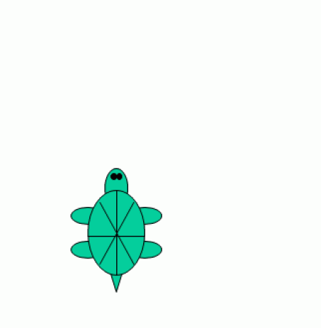
F0

Slide 45
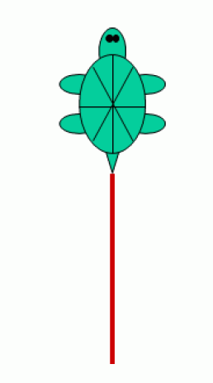
F0

Slide 46
F0 RU(90)

Slide 47
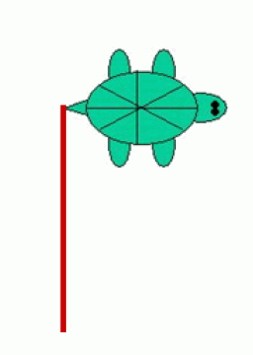
F0 RU(90)

Slide 48
F0 RU(90) F0

Slide 49
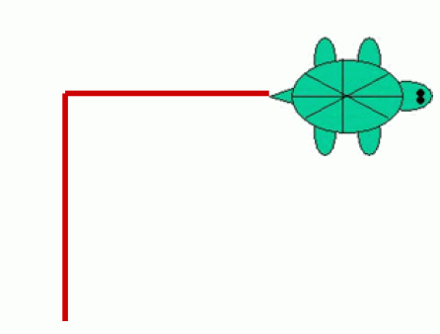
F0 RU(90) F0

Slide 50
F0 RU(90) F0 RU(90) LMul(0.5) F0

Slide 51
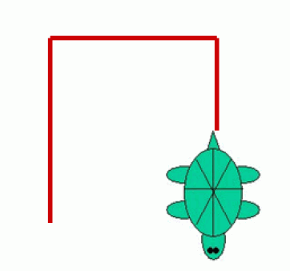
F0 RU(90) F0 RU(90) LMul(0.5) F0
(more for later)

Slide 52
Back to previous example
Object
(with attributes)

Slide 53
Object-oriented paradigm
Computer = environment for virtual objects
Programme = List of (object) classes, i.e. general specifications of objects that can be created and destroyed (several times) at runtime and communicate with each other.
Programme development: Specification of the classes (data and methods) that define the object structure and behavior.
Programming languages: Smalltalk, Simula, C++, Java, ...

Slide 54
Example
public class Car extends Vehicle
{
public String brand;
public int places;
public void show()
{
System.out.println("The Car is a " + brand);
System.out.println("It has " + places + "Seats.");
}
}
Typical:
Classes (Car) with data (brand, places) and methods (show)

Slide 55
Inheritance of attributes and methods from superclass to subclass
Example
public class Car extends Vehicle
{
public String brand;
public int places;
public void show()
{
System.out.println("The Car is a " + brand);
System.out.println("It has " + places + "Seats.");
}
}
Typical:
Classes (Car) with data (brand, places) and methods (show)

Slide 56
Object hierarchies also make sense in biology
Example:
Organ
Leaf
Flower
Internode
Root Segment
Deciduous leaf
Needle
Coarse-RS
Fine-RS

Slide 57
Regular
Structures

Slide 58
Rule-based paradigm
Computer = transformational machine for structures
There is a current structure that is transformed as long as it is possible

Slide 59
Rule-based paradigm
Computer = transformational machine for structures
There is a current structure that is transformed as long as it is possible
Work process: search and application process
matching: search for a suitable rule
rewriting: application of the rule to rewrite the structure.

Slide 60
Rule-based paradigm
Computer = transformational machine for structures
There is a current structure that is transformed as long as it is possible
Work process: search and application process.
matching: search for a suitable rule
rewriting: application of the rule to rewrite the structure.
Programme = set of transformation rules

Slide 61
Rule-based paradigm
Computer = transformational machine for structures
There is a current structure that is transformed as long as it is possible
Work process: search and application process.
matching: search for a suitable rule
rewriting: application of the rule to rewrite the structure.
Programme = set of transformation rules
Programme development: specification of rules

Slide 62
Rule-based paradigm
Computer = transformational machine for structures
There is a current structure that is transformed as long as it is possible
Work process: search and application process.
matching: search for a suitable rule
rewriting: application of the rule to rewrite the structure.
Programme = set of transformation rules
Programme development: specification of rules
Programming languages: L-System languages, AI languages, Prolog, ...

Slide 63
Example
L-Systems (Lindenmayer Systems)
Control systems for the replacement of character strings
(more coming soon)

Slide 64
Similar rule-based mechanism:
Graph grammars

Slide 65
Similar rule-based mechanism:
Graph grammars
Rule:

Slide 66
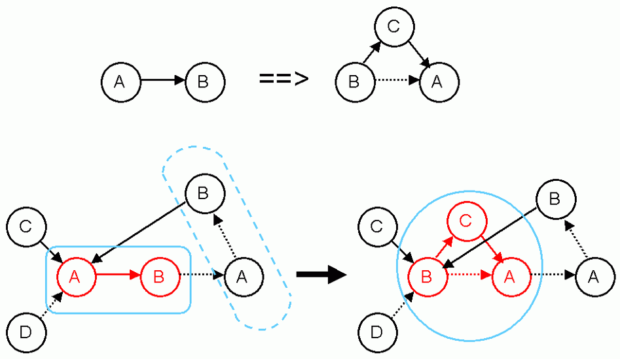
Similar rule-based mechanism:
Graph grammars
Rule:
Application:

Slide 67
Conclusion:
Programming paradigms

Slide 68
Conclusion:
Programming paradigms
Imperative

Slide 69
Conclusion:
Programming paradigms
Imperative
Change in variables
Turtle geometry as an example

Slide 70
Conclusion:
Programming paradigms
Imperative
Change in variables
Turtle geometry as an example
Object-oriented

Slide 71
Conclusion:
Programming paradigms
Imperative
Change in variables
Turtle geometry as an example
Object-oriented
Rule-based

Slide 72
Conclusion:
Programming paradigms
Imperative
Change in variables
Turtle geometry as an example
Object-oriented
Rule-based
L-Systems
Graph grammars

Slide 73
Conclusion:
Programming paradigms
Imperative
Change in variables
Turtle geometry as an example
Object-oriented
Rule-based
L-Systems
Graph grammars
Other: functional; concurrent; chemical…

Slide 74
Application focus
Imperative:
- numerics
- e.g., solving systems of equations
- e.g., photosynthesis; tree water flow
(Darcy law = differential equation, discretized, numerical
solution method)
Rule-based:
- development of branched structures (locally 1-D)
- e.g., plants
- logical dependencies
- e.g., knowledge-based systems
Object-oriented:
- sets of interacting objects
- e.g., individual animals

Slide 75
Synthesis: The Language XL
- "eXtended L-system language“
- programming language that makes parallel graph grammars (RGG) easily available

Slide 76
Imperative
Object-oriented
Rule-based
Java
XL

Slide 77
Turtle-Geometry
F0 RU(90) F0 RU(90) LMul(0.5) F0

Slide 78
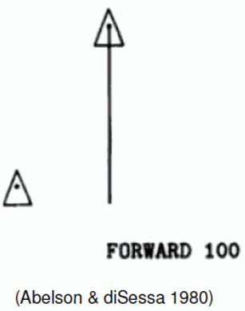
Turtle Geometry
command controlled, local navigation of the Turtle in 2D or 3D space
(Abelson & diSessa 1980; see Programming
language "Logo")
Turtle: drawing or construction device
(virtual)
associated with a state memory
(important for branches)
current state of the Turtle contains e.g., information about current line thickness, step size, color, other properties of the next object to be constructed

Slide 79
Commands (in XL)
http://www.uni-forst.gwdg.de/~wkurth/xl_turtle.pdf
F0 - Forward, construct cylinder, will use current increment (from the turtle state) for the length (the zero stands for "no explicit length definition")
M0 Forward without construction (Move command)
L(x) change the current increment (length) to x
LAdd(x) increments the current step by x
LMul(x) multiplies the current increment by x
D(x), DAdd(x), DMul(x) - analogously for the actual diameter
P(c) sets the color on c (0 - 15)
F(x), F(x, d), F(x, d, c) - constructs a cylinder
x - length, d - diameter, c - color
RU(a) turns to the right (a > 0) or to the left (a < 0) by a given angle in degrees

Slide 80
Turtle Geometry

Slide 81
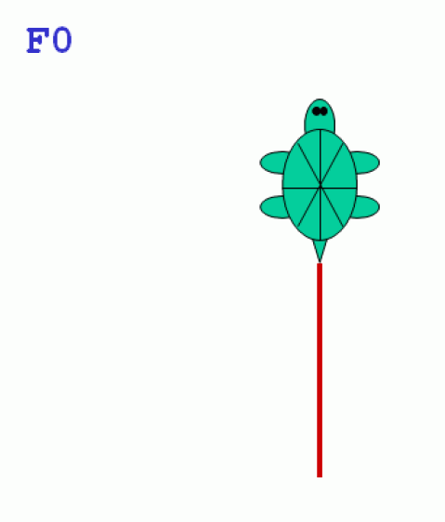

Slide 82
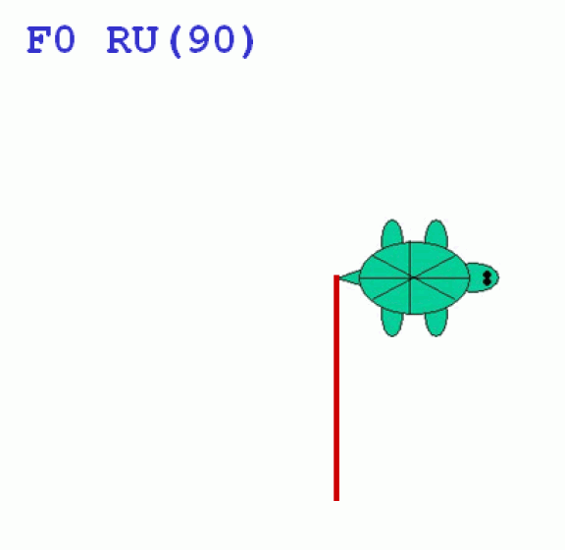

Slide 83
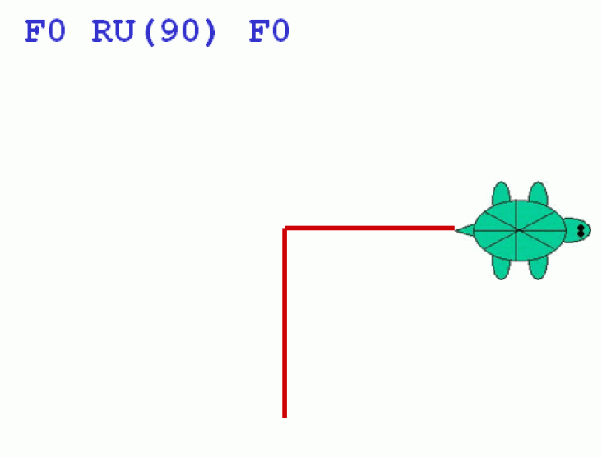

Slide 84
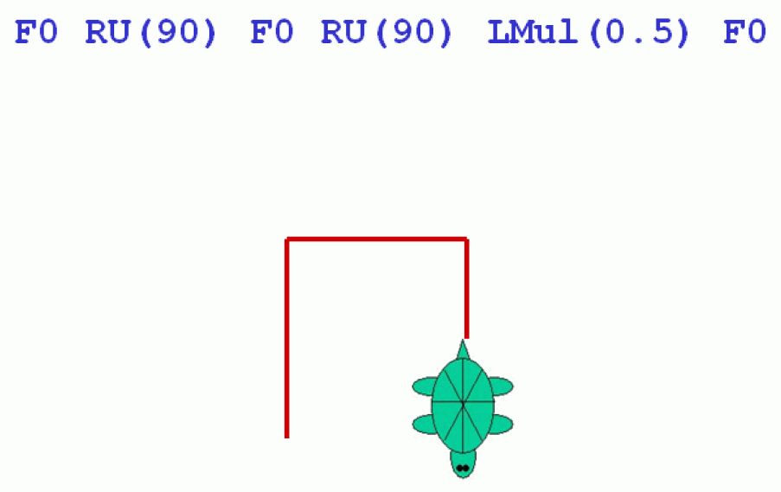

Slide 85
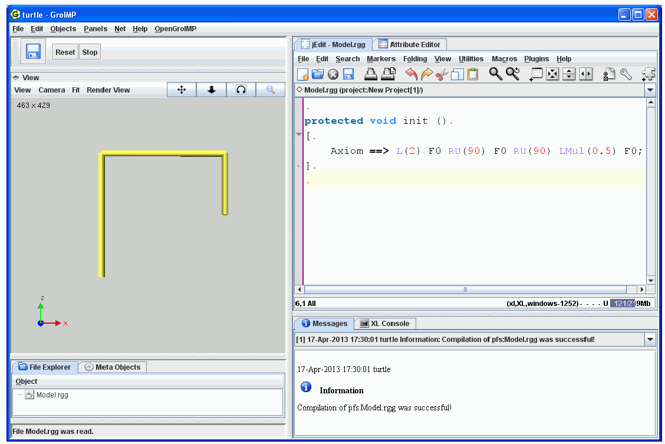
Turtle Geometry in GroIMP

Slide 86
How to execute a Turtle command sequence with GroIMP
write to a GroIMP project file (or to a file with the extension .rgg)
protected void init()
[
Axiom ==> Turtle command sequence
]

Slide 87
Example: Drawing of a triangle
protected void init()
[ Axiom ==> RU(30) F(10) RU(120) F(10) RU(120) F(10) ]
See example code (accessible on homepage): sm09_e01.rgg

Slide 88
Repetition of sections of the string possible with "for“
Example:
for ((1:3)) ( A B C )
Output: A B C A B C A B C

Slide 89
What is the outcome from the following code?
L(10) for ((1:6))
( F0 RU(90) LMul(0.8) )

Slide 90
L(10) for ((1:6))
( F0 RU(90) LMul(0.8) )

Slide 91
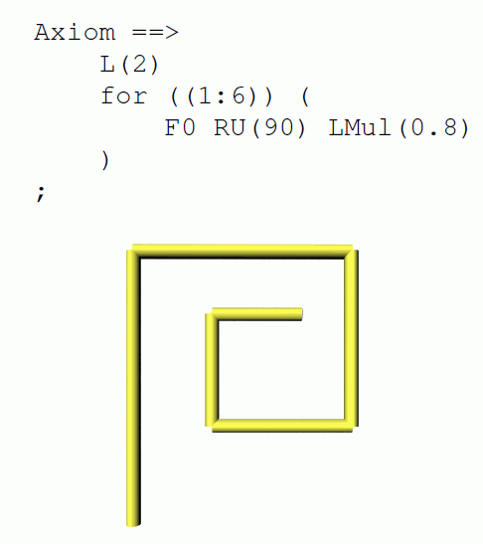

Slide 92
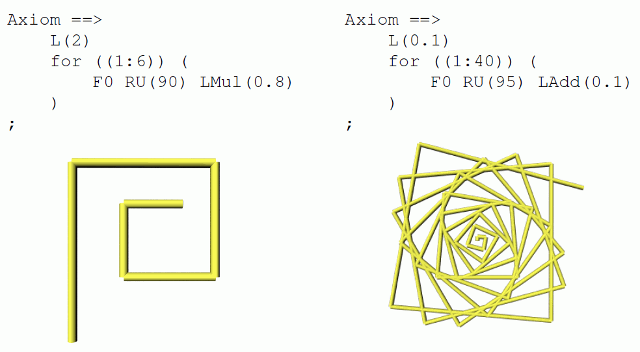

Slide 93
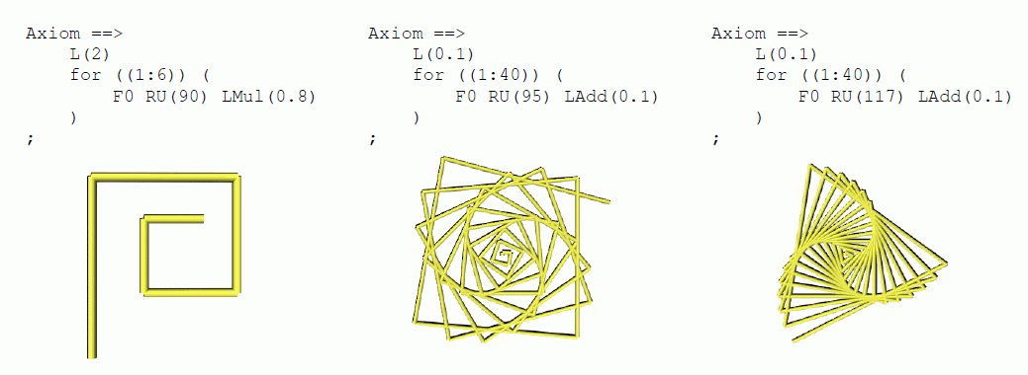

Slide 94
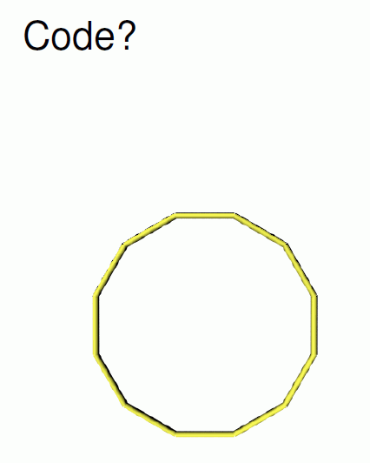

Slide 95
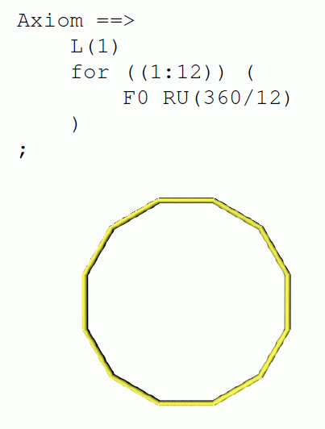

Slide 96
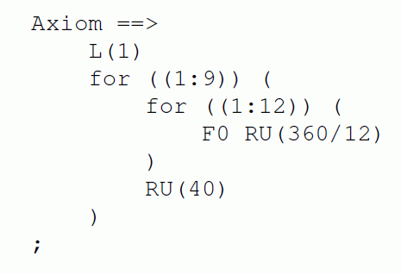

Slide 97
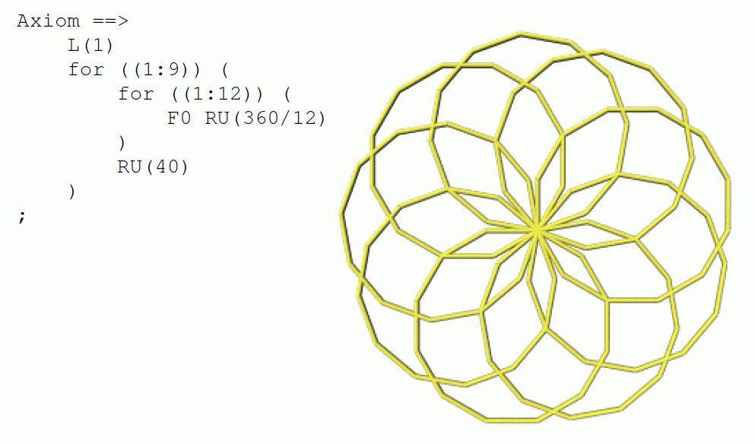

Slide 98
Another example:
for ((1:20)) ( for ((1:36))
( F0 RU(165) F0 RU(165) ) RU(270) )

Slide 99
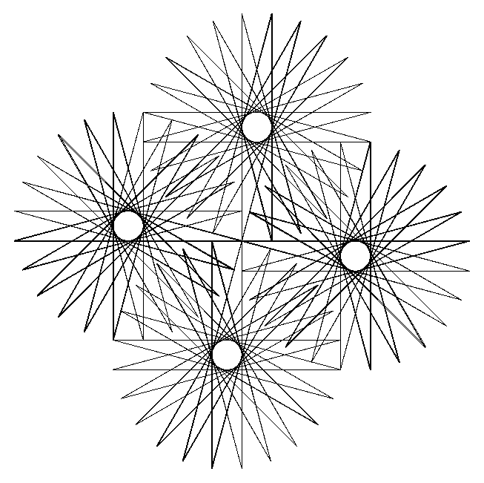
Another example:
for ((1:20)) ( for ((1:36))
( F0 RU(165) F0 RU(165) ) RU(270) )

Slide 100
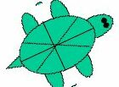
Extension to 3D graphics:
Turtle rotations around 3 axes

Slide 101
Extension to 3D graphics:
Turtle rotations around 3 axes
left
head
up

Slide 102
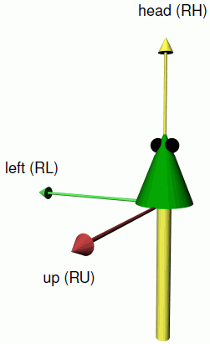
Extension to 3D graphics:
Turtle rotations around 3 axes
left
head
up

Slide 103
Extension to 3D graphics:
Turtle rotations around 3 axes
RL
RH
RU

Slide 104
3D commands
RU(45) Rotate the turtle about the "up" axis by 45°
RL(...), RH(...) analogously around "left" and "head" axis. Up-, left- and head-axis form an orthogonal, spatial coordinate system, which is carried by the turtle
RV(x) Rotation "downwards" with strength given by x
RG Rotation all the way down (direction (0, 0, -1))

Slide 105
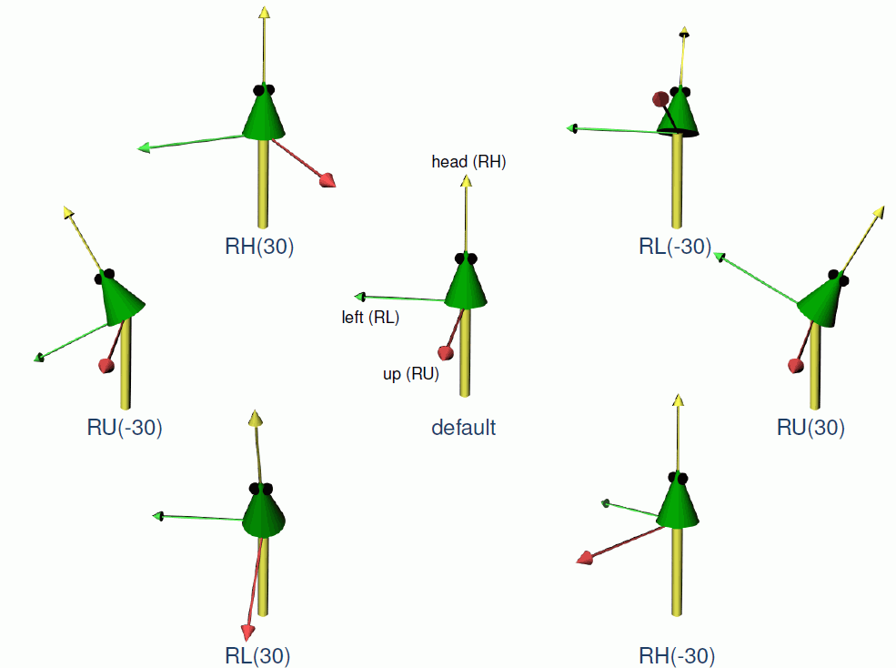

Slide 106
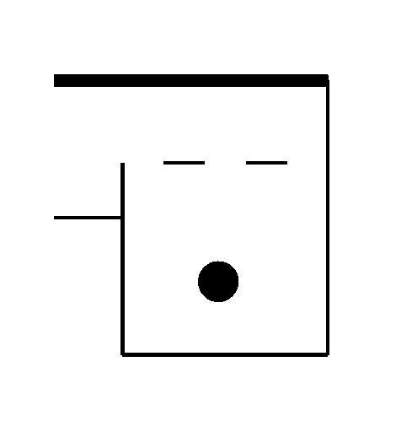
Example
L(100) D(3) RU(-90) F(50) RU(90) M0 RU(90) D(10) F0 F0
D(3) RU(90) F0 F0 RU(90) F(150) RU(90) F(140) RU(90)
M(30) F(30) M(30) F(30) RU(120) M0 Sphere(15)
Output
What is the output for the following code?
L(10) F0 RU(45) F0 RU(45) LMul(0.5) F0 M0 F0

Slide 107
Assignment
Read Chapter 1, Section 1.1 – 1.5 (without 1.4) in the book "The Algorithmic Beauty of Plants“ by P. Prusinkiewicz and A. Lindenmayer (available online, see literature page for the lecture). (= pp. 1-21 without section 1.4).

