Slide 1
Scalable Real-time Volumetric Surface Reconstruction
Jiawen Chen Dennis Bautembach Shahram Izadi
Microsoft Research, Cambridge, UK
Computer Graphics
Mian Athar Naqash
21570550

Slide 2
Introduction - Reconstruction
Takes 2D image as input
Gives 3D model of 2D image as output
Depth cameras are used to find depth.
Structure from motion (SfM) is a range imaging technique
Notes:
Structure from motion (SfM) is a range imaging technique for estimating three-dimensional structures from two-dimensional image sequences that may be coupled with local motion signals

Slide 3
Volumetric method
Simple fusion method and gives high quality output results
It doesn’t make any assumption about the surface topology
Uses the redundancy of overlapping depth samples.
Captures the uncertainty of depth estimates
Fill small holes but leaves unobserved regions empty.
Notes:
Volumetric method – well-known reconstruction method.

Slide 4
Volumetric method (cont)
Augmented reality:
Here the need is to combine the real world geometry with the virtual actions of user.
Autonomous Guidance:
Where a robot is supposed to reconstruct,
Environment get some data
Respond back to the physical environment.
Notes:
Consumer depth cameras have made real-time depth sensing useful.
Autonomous Guidance provide instantaneous feedback to users as they scan an object or scene.

Slide 5
Objectives of this research
A fast and compact hierarchical GPU data structure
Capable of dynamic update
This increases
The physical size and resolution of reconstruction volume
By using an order of magnitude less memory than a regular grid
Notes:
GPU = graphical processing unit

Slide 6
Problems in other approaches
No information about the underlying acquisition process
Disregard the uncertainty in measurements.
Important in triangulation based methods
These method are not so bad
Can fail in high curvature regions.
Notes:
triangulation based methods = used in the calculation of point on surface with geometrical methods

Slide 7
Volumetric fusion
Use volumetric data structures such as occupancy- storing simple state
Generate binary grids from multiple range images
Samples of continuous function
Surface is represented, based on signed distance fields(SDF)
Hilton et al, proposed the depth map fusion.
Curless and levoy dealt with the direction of sensor in a noisy achievement.
Wheeler worked is to get surfaces from the voxels to increase robustness to outliers.
Notes:
These methods typically use volumetric data structures either storing simple state information such as occupancy
Occupancy typically generate binary occupancy grids from multiple range images, and share similarities with voxel carving methods based on image silhouettes.
In computer graphics, implicit surface representations based on signed distance fields are common for rendering and physical simulation.
An outlier is an observation that appears to deviate markedl y from other observations in the sample. To decrease the possibility of wrong data.

Slide 8
Reconstruction from 2D images
Reconstruct the large outdoor scenes
Most of reconstruction is carried out by the use of 2D cameras
MVS (Multi View Stereo) or SFM (Structure from motion) techniques are used.
Estimation can give a result having non-systematic noise
Regularize depth maps
Testing photo-consistency, visibility, and shape priors of image.
Curless and levoy method, Pollefeys re-casted the problem
It gave impressive results but with the loss of memory and speed.
Notes:
MVS = Multi-View Stereo – Creation of 3D object from images(different perspectives ) of an object
SFM = structure from motion - is a range imaging technique for estimating three-dimensional structures from two-dimensional image sequences.
Unlike active sensors, depth estimation can result in non-systematic noise and outliers, particularly if frame rate is critical.
Recasting the problem as a global optimization (finding out a best solution),

Slide 9
Real-Time reconstruction using active sensor
Some researchers left scale completely
Reconstruction of smaller scenes and objects by the use of active sensors.
Handheld object are scanned by structure light sensor.
Using variant of (iterative closest point), the algorithm first align point cloud, create voxel grid from samples and rendering.
By implementation of curless and levoy algorithm a high quality surface reconstruction can be achieved
Kinectfusion showed a modified version of curless and levoy to fuse noisy kinect depth maps.
Notes:
The tradeoffs between scale, quality and speed have led some researchers to forgo scale completely.
Iterative Closest Point (ICP) is an algorithm employed to minimize the difference between two clouds of points.
KinectFusion provides 3D object scanning and model creation using a Kinect for Windows sensor.
kinect is motion sensing device.

Slide 10
Extending kinect fusion
Kinectfusion provides 3D object scanning and model creation using
Stream:
The graphics memory is streamed and cleaned but the volume of the camera position should be maintained.
Motion volume:
Camera moves with the sensors around the camera
So this approach transform the distance field into active region
No real time dynamic update for fusion and surface extension
approaches are impractical
Notes:
Because of having no real time dynamic update for fusion and surface extension therefore these approaches are impractical

Slide 11
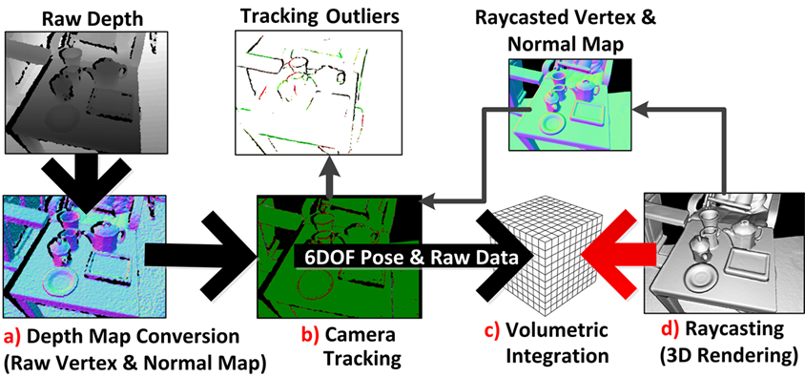
3D reconstruction pipeline
The pipeline that we are using is based on KinectFusion system.
We want to combine both the noisy depth maps and the memory efficient volumetric data structure
Source : https://www.researchgate.net/figure/220877151_fig7_Figure-11-Overview-of-tracking-and-reconstruction-pipeline-from-raw-depth-map-to
Notes:
The first stage is depth map conversion.
The second stage calculates the global/world camera pose (its location and orientation)
The third stage is fusing (or “integration”) of the depth data from the known sensor pose into a single volumetric representation
The reconstruction volume can be raycast from a sensor pose and render visible image of the 3D reconstruction volume

Slide 12
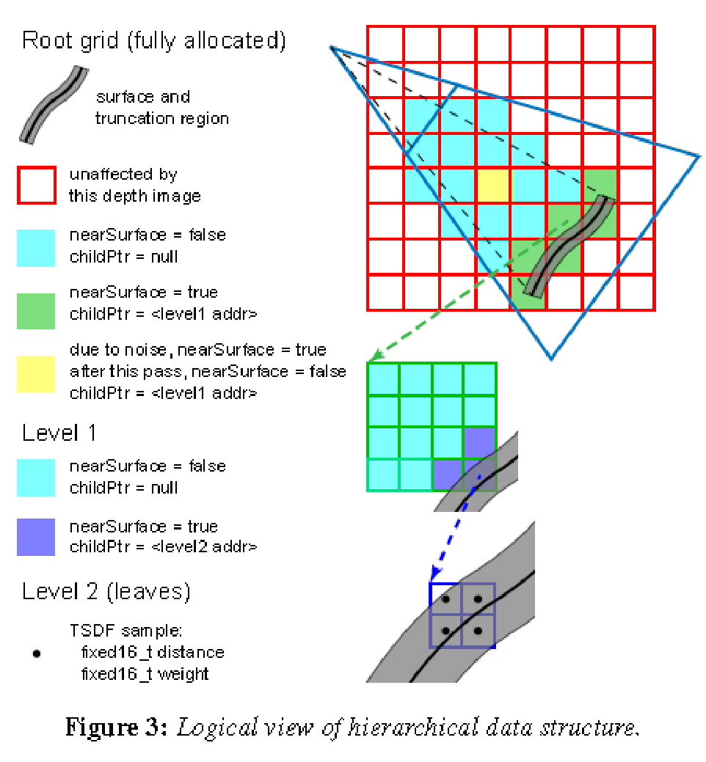
Data Structure Design
The design consist of 3 level
The root(red) is a fully allocated grid and provides a rough subdivision of the physical volume.
Truncation region i.e. in grey needs to be refined.
Refinement is repeated again and again until we reached to the leaf level i.e. in blue each node is small regular grid in this area.
Majority of root voxel are free space (cyan).
Yellow – previously refined but is free space.
Source : Scalable Real-time Volumetric Surface Reconstruction
Jiawen Chen Dennis Bautembach Shahram Izadi
Microsoft Research, Cambridge, UK
Notes:
According to our noise model [Nguyen et al. 2012], the surface lies within the truncation region (in gray),and any intersecting voxels will need to be refined.
majoritz of root voxel are free space (cyan) and dont require refinement.
A common scenario that occurs due to noise or moving objects is that a previously refined voxel (in yellow) is subsequently observed as free space. Our strategy for dealing with these cases is to store metadata at interior nodes, similar to a hierarchical z-buffer [Greeneet al. 1993].

Slide 13
GPU Implementation
The grid is stored in GPU memory
Dense 3D array griddesc initialized as null
Root level grid is always allocated - stored as 3D array griddesc
For each level hierarchy - fixed size pool is allocated
Free list and backing store
The backing, store is an array of n fixed blocks
The free list, is a queue of block indices
When a grid is allocated during integration
A free block is de-queued from free list,
Assigned to poolindex field and marked as dirty
Garbage collection, enqueued again to free list
Notes:
The backing store is an array of n fixed-sized blocks, where each block has size equal to an entire grid at that level.

Slide 14
GPU Implementation (cont)
Integration
The footprint of the depth maps are rasterize into finer voxel grids by the atomic queues
Root voxels are rasterized by threads and are projected to large hexagon within depth map
Both the interior levels and the root algorithm are nearly same.
Careful rasterization is necessary for a hole free result.
Notes:
To ensure that raycasting skips large portions of free space away from geometry, we retain the job queues from
integration to perform summarization in parallel.
signed distance field
atomic queues a crash friendly queue that persists queue state and can restart. uses a worker pool and has configurable concurrency.

Slide 15
GPU Implementation (cont)
Raycasting
Is a rendering technique to create a 3d perspective in a 2d map.
Is fast, because only a calculation has to be done for every vertical line of the screen.
DDA algorithm is used to raycast the data.
DDA - digital differential analyzer, used for rasterization of lines.
Variant of DDA is used to raycast our datastructure on GPU.

Slide 16
GPU Implementation (cont)
Summarization
Perform summarization in parallel - to insure the exclusion of free spaces.
Also a parallel reduction is used to find minimum weight in the leaf.
interior surface SDF != near Surface then skip else nearSurface is set
Notes:
signed distance fields(SDF)

Slide 17
Limitation and future work
The main problem solved here is the data structure.
Issue of camera drift can be a work done in future
One issue is the re-localization in case of camera fail
Camera fail -> ICP fail -> history
Re-localization, loop closure and handling drift are some of the main problems

Slide 18
Summery
The competence of the real-time volumetric reconstruction are discussed
Curless and levoy ‘s work is further extended to the large and fine scale reconstruction
3D reconstruction method
Fast and volumetric data structure design which enables the making of good quality, scale and speed reconstruction

Slide 19
Thank you
Questions?

