Slide 1
Comparison of pruning regimes for Stone pine (Pinus pinea L.) using a Functional-Structural Plant Model
Peter Surovy

Slide 2
Presentation outline
- 3d measurement of plant architecture with topology (data)
Forestry models and FSPM models : philosophy, advantages, disadvantages
Stone pine model – important modules and code parts (model)
Optimization possibilities using 3d model

Slide 3
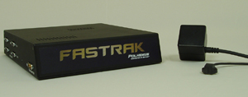
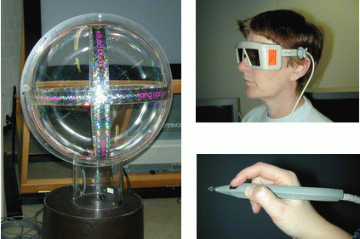
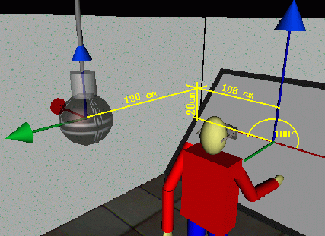
3d measurement of plant architecture with topology
Magnetic motion tracker + cheap (relatively)
+ offers directly relative coordinates
+ magnetic field passes “through” material
- no metalic object
- weather
- small amount of works (communication+math)

Slide 4
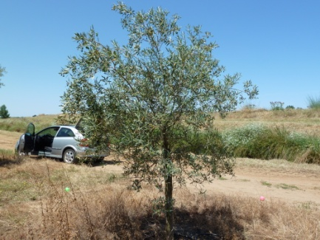
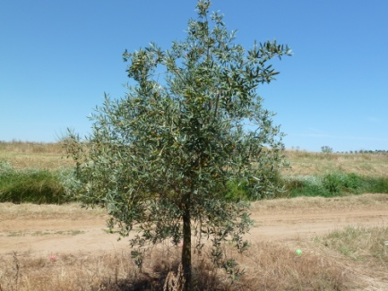
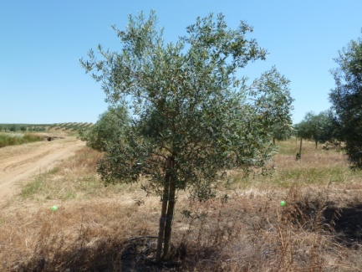
3d measurement of plant architecture with topology

Slide 5
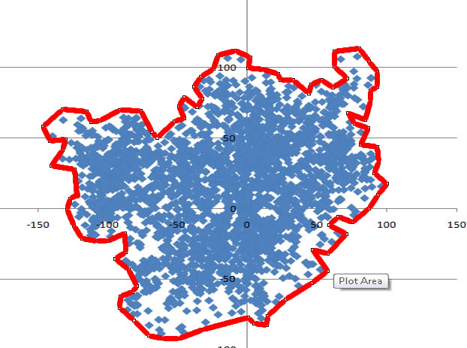
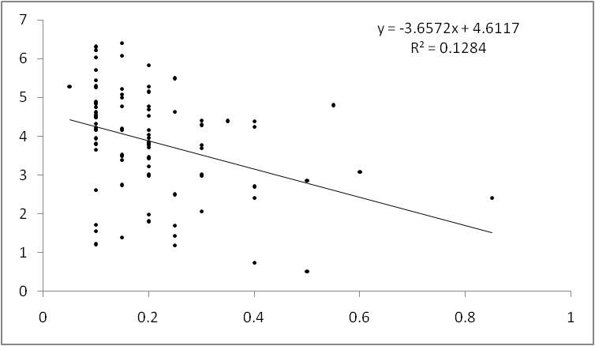
3d measurement of plant architecture with topology
Not destructive measurements of Leaf Area Index
LAI = LA / CA = 2.33

Slide 6
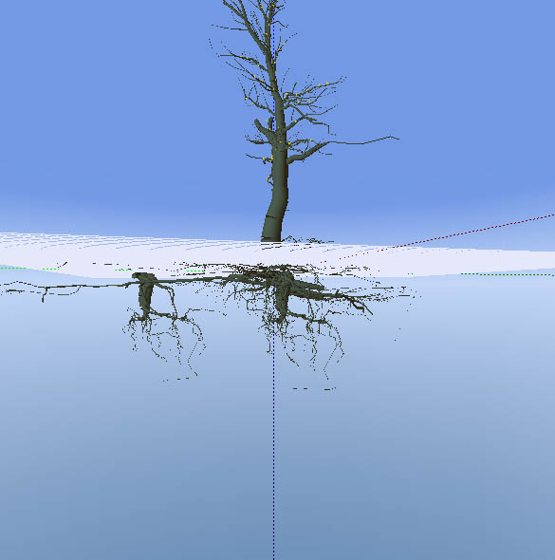
3d measurement of plant architecture with topology
Measurement of
Above and bellow
Plant architecture

Slide 7
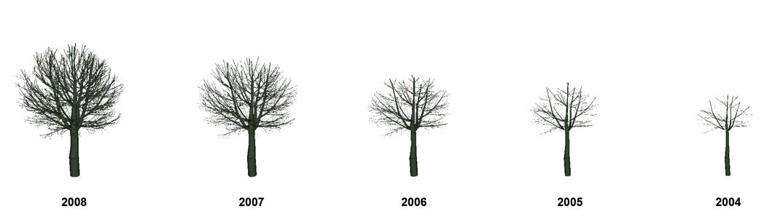
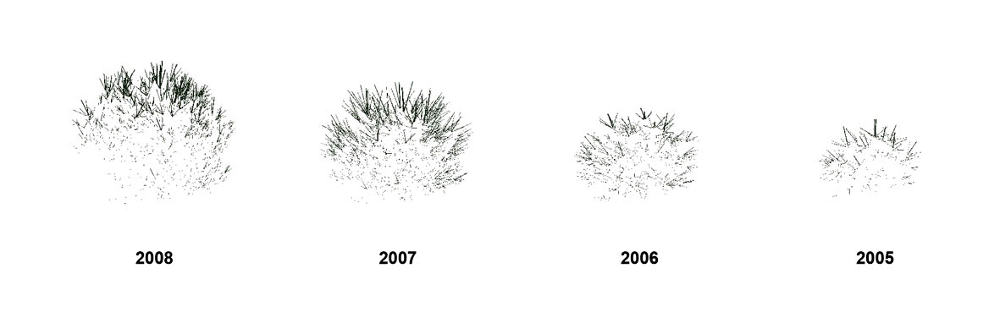
Data dynamics

Slide 8
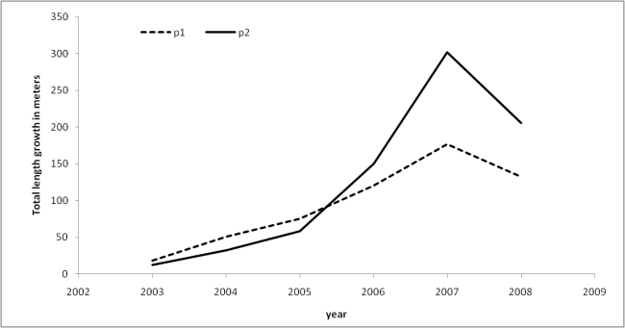
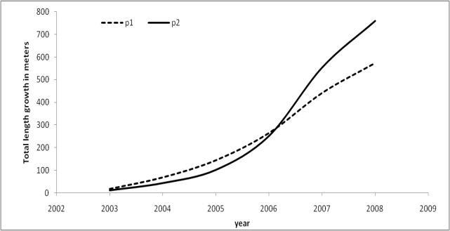
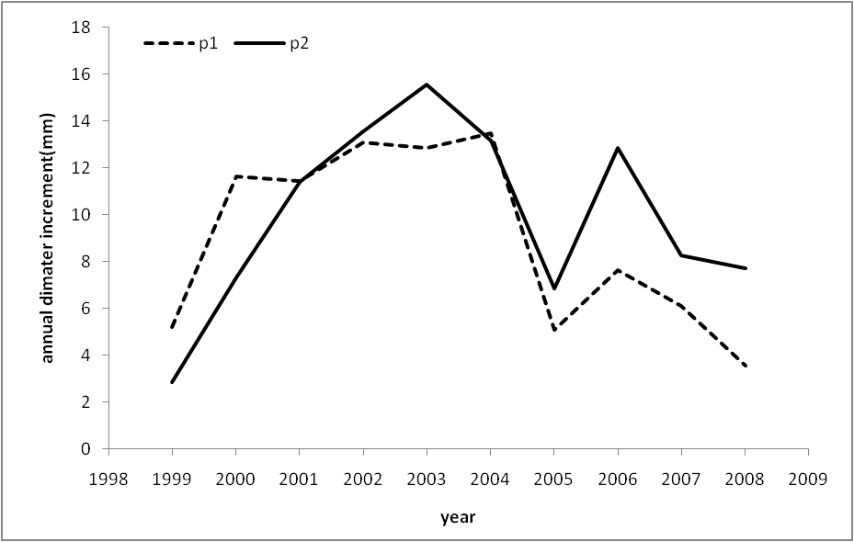
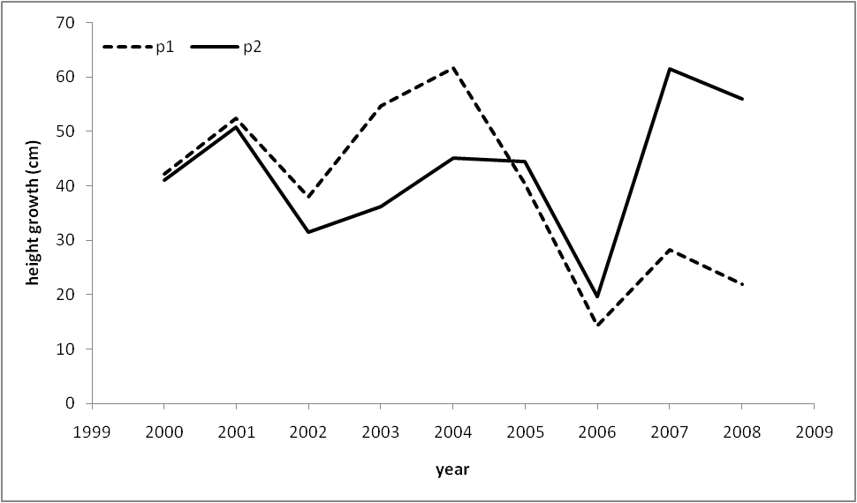
Results from measurements
 | Number of shoots | Total shoots length (m) | Height (m) | d_{1.3} (cm) | Number of competitors
Tree 1 | 4377 | 574.96 | 3.81 | 16.0 (16.3) | 8
Tree 2 | 4363 | 759.68 | 4.16 | 15.6 (16.0) | 5
+3d growth

Slide 9
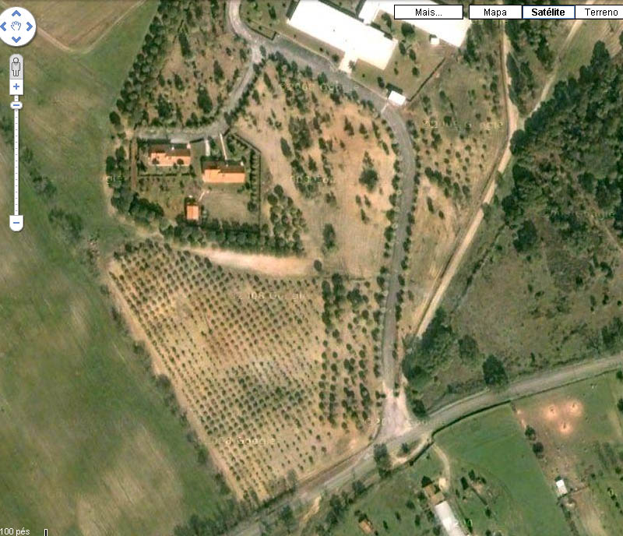
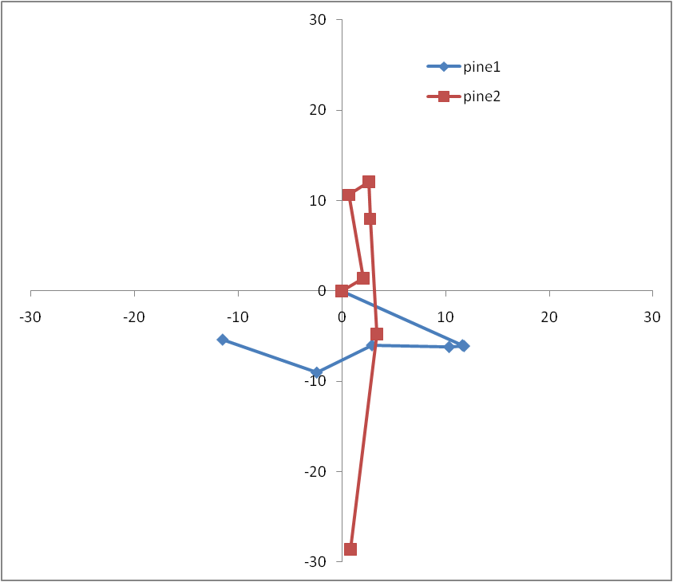
Where is forestry?
Orientation towards north
Plot +-

Slide 10
Data for individual tree increment
Correlation between diameter and length of shoots

Slide 11
Data for individual tree increment
The dependence between branch order and length (left), and between branch distance from 0,0 point and length (right)

Slide 12
Message
There are data from 3d space
(possibility to study, important is to understand the source of the data, as it can be also a source of variability)
This data may be interpreted as continuous or discrete
(continuous increment of size, discrete steps in structure change)
We can model!!!
But how??

Slide 13
Presentation outline
- 3d measurement of plant architecture with topology (data)
Forestry models and FSPM models : philosophy, advantages, disadvantages
Stone pine model – important modules and code parts (model)
Optimization possibilities using 3d model

Slide 14
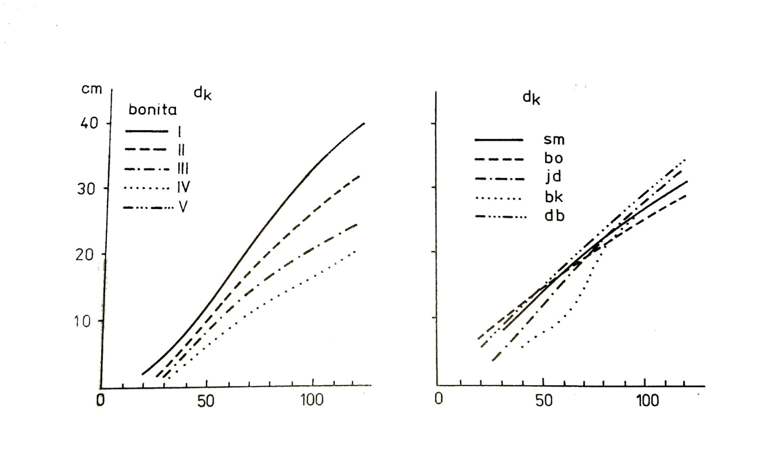
Modeling in forestry
What is a model??
An abstract model (or conceptual model) is a theoretical construct that represents something, with a set of variables and a set of logical and quantitative relationships between them.
Forestry models??

Slide 15
Models classification
Dynamics (causality problem)
statistics
functional-structural
models
structural models
morphology
process models
physiology
Causality (scaling problem)

Slide 16
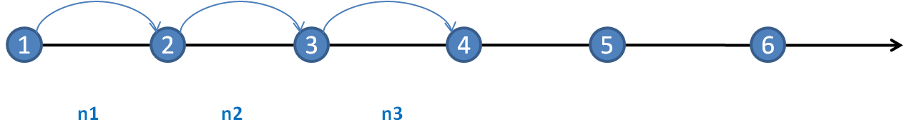
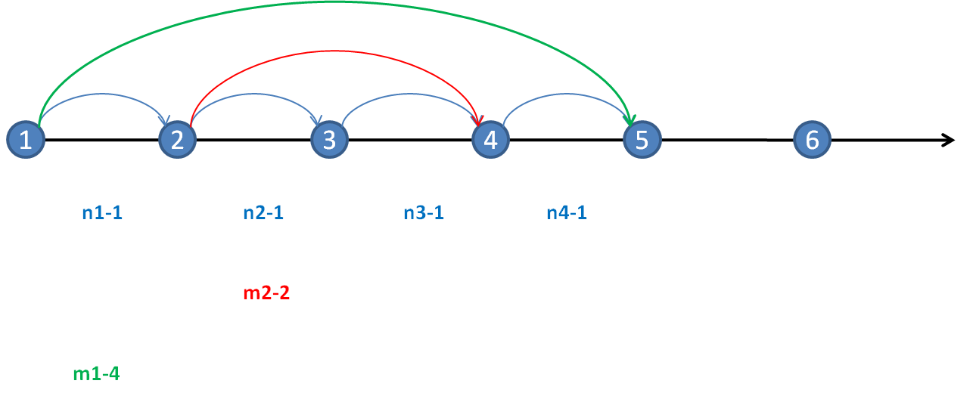
Optimization
Modeling leads to decision support (impact of decision)
The ultimate decision support is: to find the best solution (using model)
very good to test model feasibility
stochasticity and randomness are not acceptible
extreme cases may become optimal solutions (incorrectly)
PATH
MS - PATH

Slide 17
Optimization
Objective – maximize cork production, keep crown cover limits (what should I do?)
Case Study 1 (101) | No constraint | Constraint 70% | Constraint 50%
Year | tree ha⁻¹(kg ha⁻¹)
10 | 0 (1000.47) | 0 (1000.47) | 0 (1000.47)
20 | 320 (1550.42) | 320 (1550.45) | 200 (1548.415)
30 | 320 (1449.51) | 320 (1449.58) | 180 (1447.55)
40 | 320 (8421.99) | 320 (8421.99) | 140 (4722.22)
Case Study 2 (317) | No constraint | Constraint 70% | Constraint 50%
10 | 0 (1958.348) | 0 (1958.348) | 0 (1958.348)
20 | 320 (2764.25) | 160 (2758.88) | 0 (2757.85)
30 | 320 (3167.17) | 100 (3161.62) | 0 (3161.43)
40 | 320 (9959.97) | 60 (4611.55) | 0 (3379.54)
Ribeiro, NA, Surovy, P, Yoshimoto, A (2012) Optimal regeneration regime under continuous crown cover requirements in cork oak woodlands, FORMATH 2011

Slide 18
Presentation outline
- 3d measurement of plant architecture with topology (data)
Forestry models and FSPM models : philosophy, advantages, disadvantages
Stone pine model – important modules and code parts (model)
Optimization possibilities using 3d model

Slide 19
Stone pine model – important modules
First version of pine model:
Structure:
stem cylinder : dynamic in time
branch cylinder : time + order + dist
leaves (after 1 year change to bud)
bud
Functions:
Bud mortality
Second version of pine model:
Structure:
Branch cylinder (order)
leaves (light measure needed)
Bud
Bending (rotation)
Functions:
Bud mortality
Bending

Slide 20
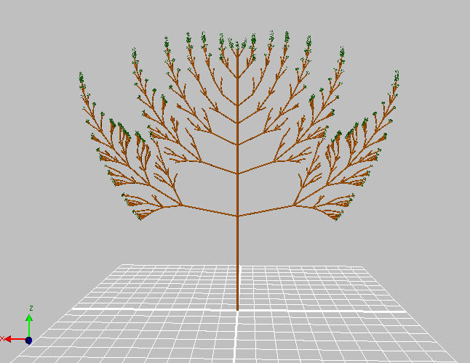
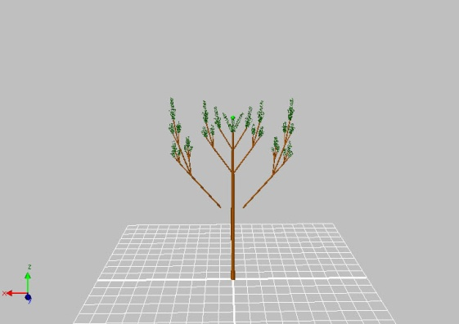
Stone pine model – important modules and code parts
Branch rotation (order, distance)

Slide 21
Presentation outline
- 3d measurement of plant architecture with topology (data)
Forestry models and FSPM models : philosophy, advantages, disadvantages
Stone pine model – important modules and code parts (model)
Optimization possibilities using 3d model

Slide 22

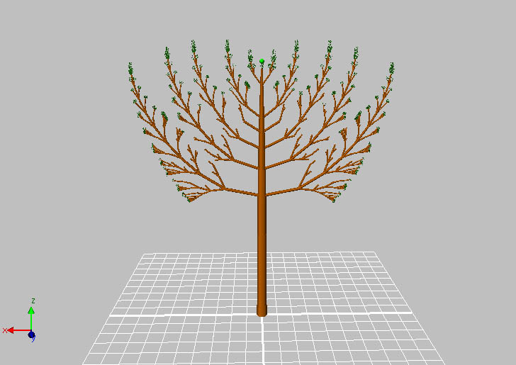
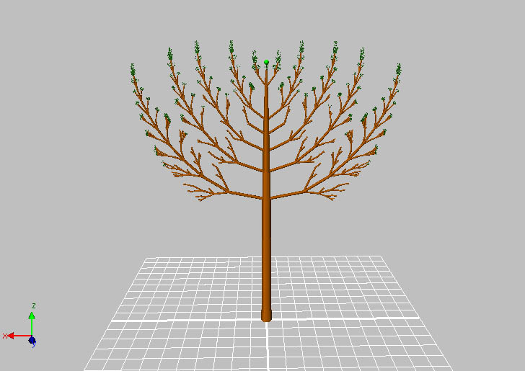
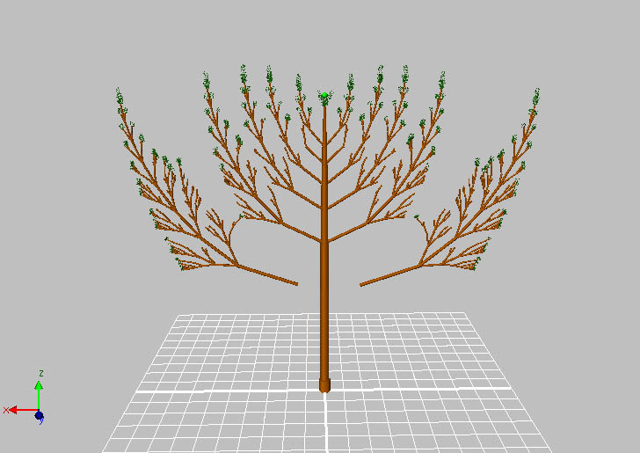
Optimalization possibilities
5
Find the best year to remove the most bottom branch
10

Slide 23
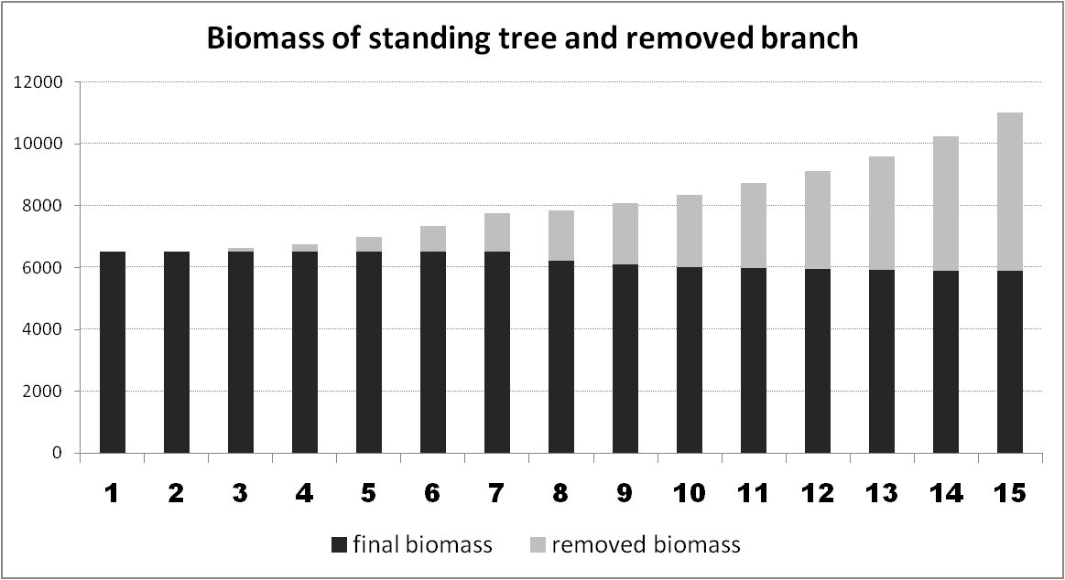
X axis shows the year of removal of branch (Y shows the total biomass)

Slide 24
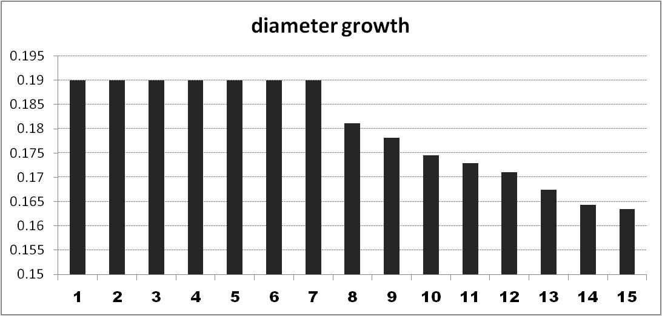
Only green to brown branches ratio

Slide 25
Message :
At this stage the most important is to continue the model development with simultaneous testing of it in optimization processes (Let there be light…)
In this work optimization is focused on the branching – pruning planning
The same model however can be used for initial stand density optimization as well as for thinning optimization (parallel optimization testing is important)

Slide 26
Very important part:
Sensitivity analysis: (what to measure, where to focus)
The branch elongation makes important difference
The total biomass of crown and the bottom branch is different
The mortality based on Cone’s angle makes important difference
  Again the total biomass is influenced and also the look
Though: the BranchRotation is the most decisive element
Smaller change in branch bending makes the survival rates of buds far different

Slide 27
Conclusions :
3d measurement and modeling may bring some new insight into our knowledge on tree growth and structure development .
The functional structural plant models (computer research) allows combination of various necessary components (rules, mathematical functions, external environment simulation)
It is possible with correct model construction the use these models also in optimization work.
Thank you for your attention…

